Slide 1
Lab 6: Binary Search Tree 二分查找树
Dec, 2023

Slide 2
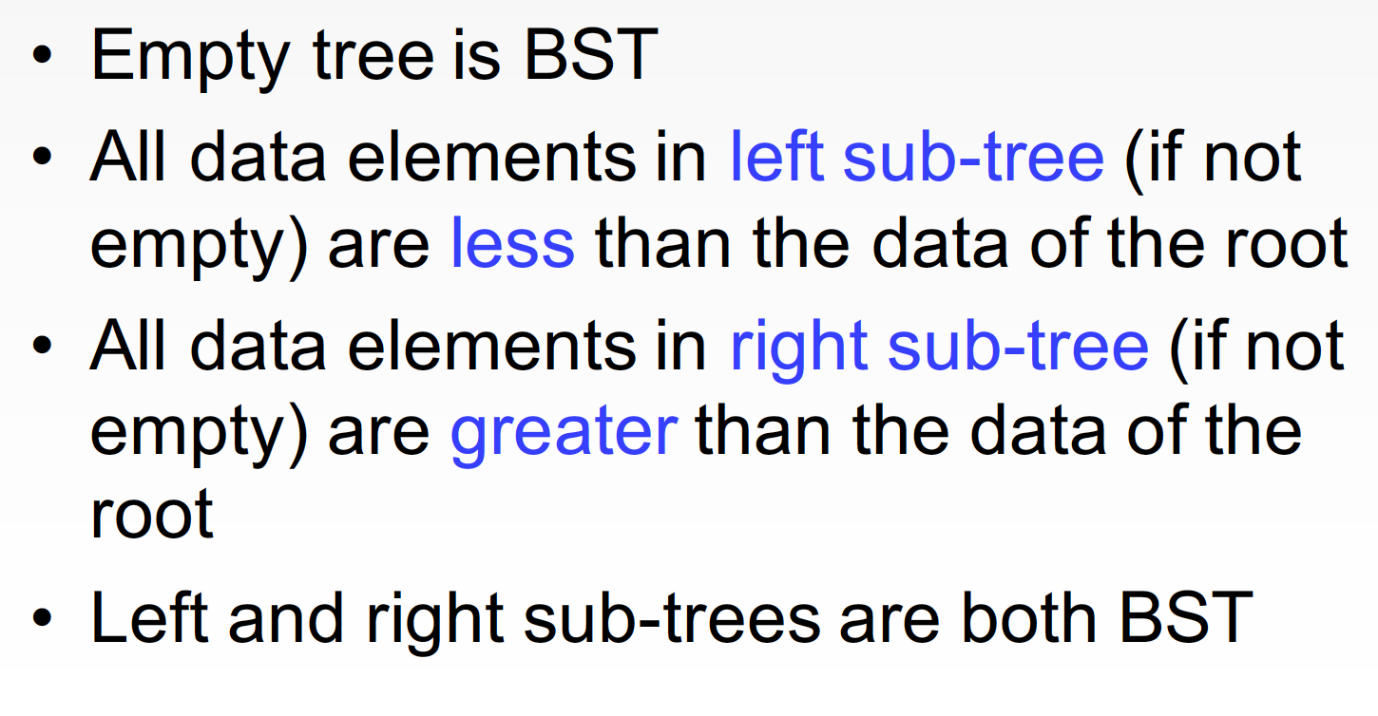
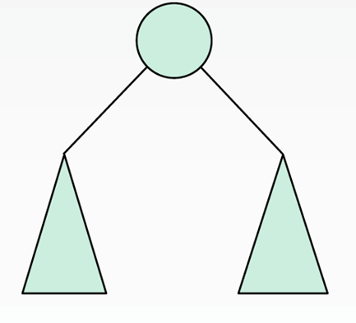
Binary Search Tree (BST)

Slide 3
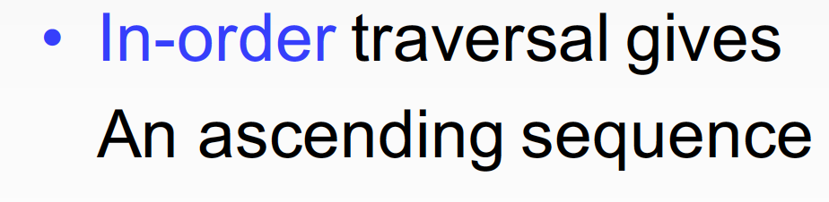
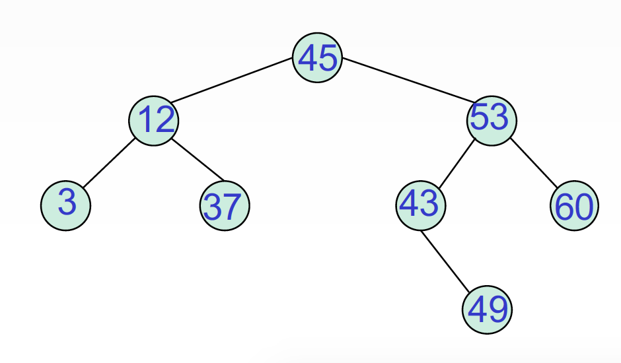
Property（性质）

Slide 4
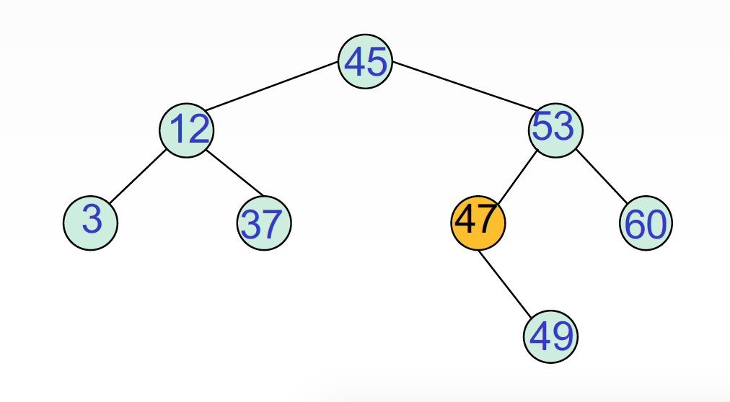
Property（性质）

Slide 5
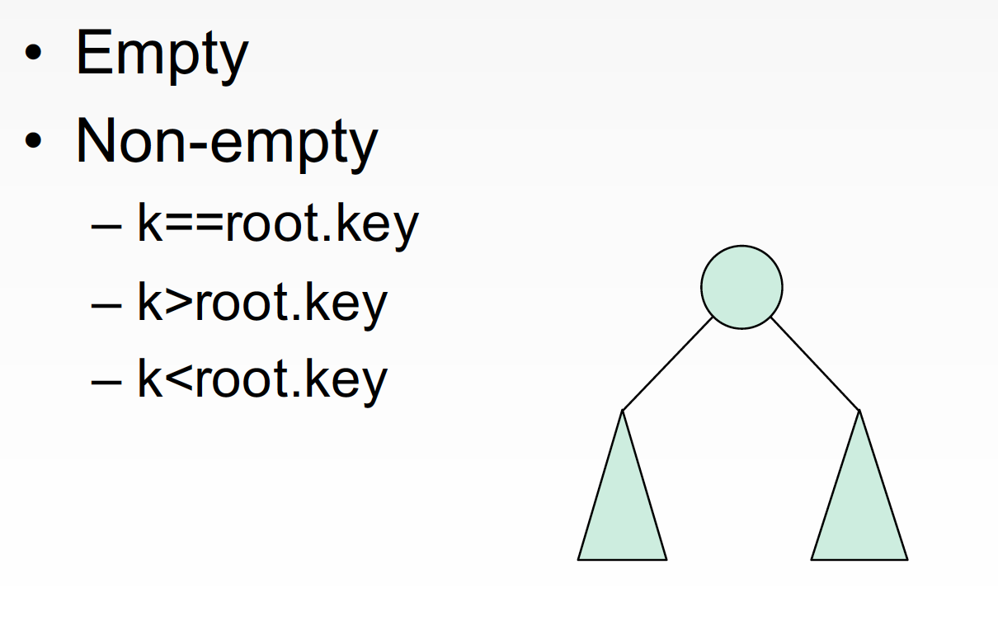
Insertion

Slide 6
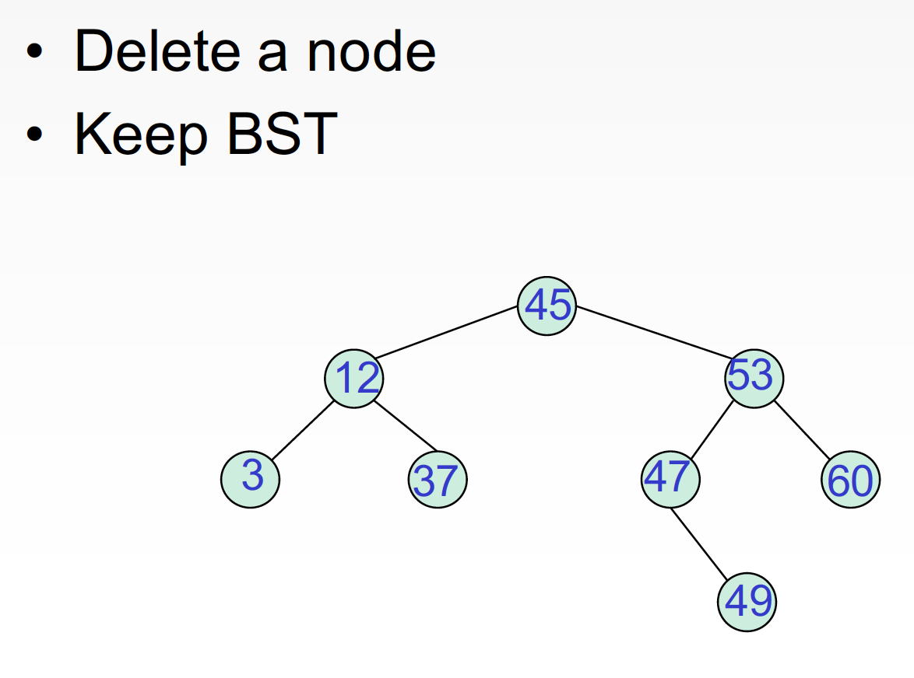
Deletion

Slide 7
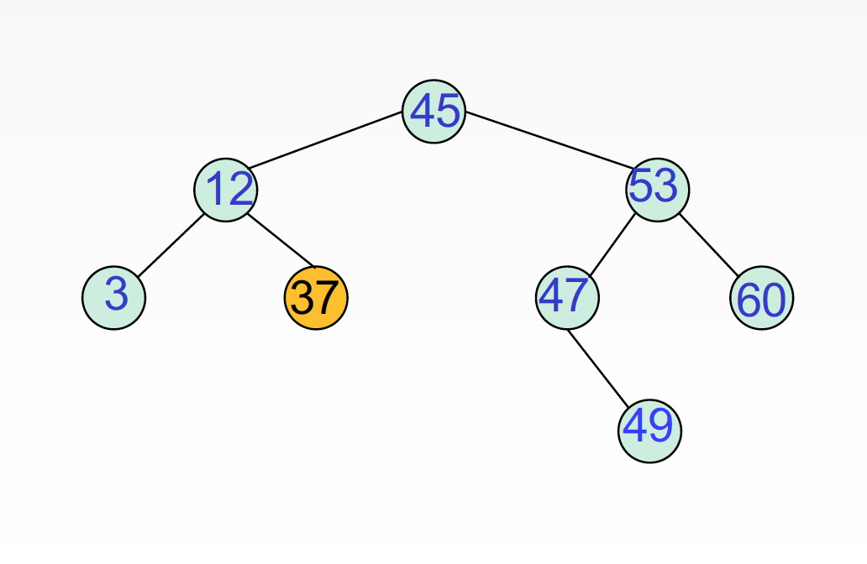
Delete A Leaf

Slide 8
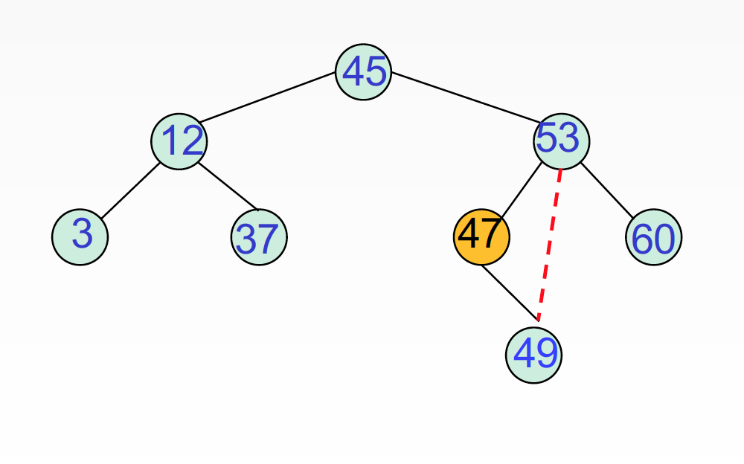
Delete 1-Branch Node

Slide 9
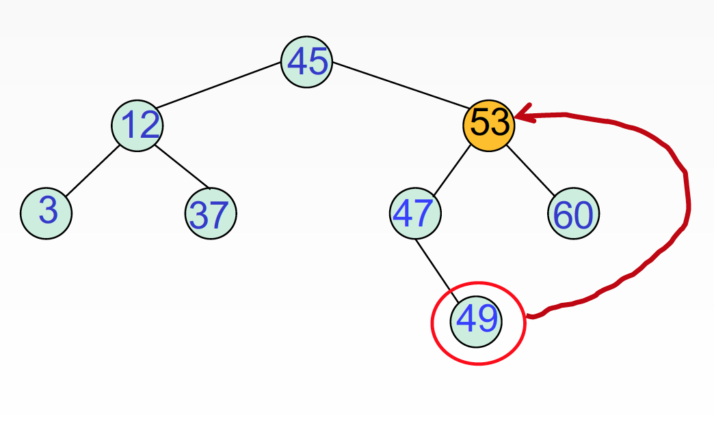
Delete 2-Branch Node

Slide 10
Height of BST（树高）
3
2
1
0
空树？？？

Slide 11
Recursive Def（递归定义）

Slide 12
Thank you!
Questions?

