Slide 1
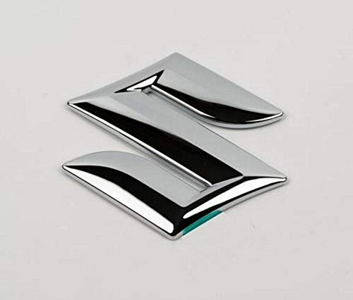
Maruti Suzuki IND ltd
Here is where our presentation begins
Team members – D Gayathri T Lahari G Jyoshna L Poojitha

Slide 2
INTRODUCTION
Maruti Suzuki India Limited (MSIL), a subsidiary of Suzuki Motor Corporation, Japan, is India's largest passenger car maker. Maruti Suzuki is credited with having ushered in the automobile revolution in the country.
The Government of India partially departed the business in 2003 and then sold all of its remaining shares to Suzuki Motor Corporation in 2007.
The Government of India established Maruti Udyog Limited in February 1981 as a joint venture with Suzuki Motor Corporation as a small partner.
The Company is engaged in the business of manufacturing and sale of passenger vehicles in India.

Slide 3
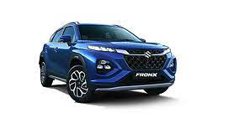
The four millionth Maruti vehicle was built and they entered into a partnership with the State Bank of India. Maruti Udyog Ltd.

Slide 4
About Digital Marketing
Digital marketing refers to the use of digital channels, platforms, and technologies to promote and advertise products, services, or brands to a target audience. It encompasses a wide range of online activities and strategies that businesses and organizations employ to connect with potential customers and drive engagement, sales, and brand awareness. Here are some key aspects of digital marketing.

Slide 5
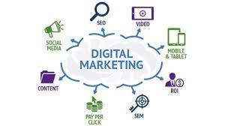
Key components of digital marketing: Website marketing \ Social media marketing Email marketing Search engine marketing Content marketing Affiliate marketing Video marketing Display advertising

Slide 6
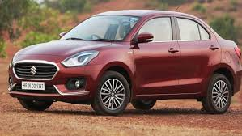
About Company brand Maruti Suzuki has two manufacturing facilities in Haryana (Gurugram and Manesar), and one manufacturing complex in Gujarat wholly owned by parent company Suzuki which supplies its entire production to Maruti Suzuki. All manufacturing facilities have a combined production capacity of 2,250,000 vehicles annually (1.5 million from Maruti Suzuki's two plants and 750,000 from Suzuki Motor.

Slide 7
Brand study, competitor analysis and buyers persona
Research brand -
Maruti Suzuki is a well-known automotive manufacturer based in India. It is a subsidiary of the Japanese automaker Suzuki Motor Corporation and is known for producing a wide range of popular car models. Maruti Suzuki itself is a brand, and they produce and sell cars under the Maruti Suzuki brand name
Mission / Values -
Customer Satisfaction
innovation and Technology
Sustainability
Corporate Social Responsibility (CSR)

Slide 8
USP -
Affordability
Fuel Efficiency
Reliability
Extensive Service Network
SMART GOALS –
Sales and Market Share
Customer Satisfaction
Corporate Social Responsibility
Sustainability
Operational Efficiency
KPI ‘s -
Return on average equity - 5 year average11.62
Net Income/employee - trailing 12 month57,48,148.00
Revenue/employee - most recent fiscal year7,09,67,160.00
Return on investment - most recent fiscal year13.45
Return on average assets - most recent fiscal year10.31

Slide 9
Competitor Analysis
HONDA CARS IND LTD ESTD - 1995 CEO – KATSUSHI INOUE Fully own subsidiary ( Honda motor co.ltd, JAPAN ) Plant 1 – Greater Nodia (UP) 1.20 lac cars PA Plant 2 – Tapukara (Rajasthan) 1.20lac Cars PA R and D centre – GREATER NODIA (UP) | HYUNDAI MOTOR IND LTD ESTD – 1996 CEO – BO SHIN SEO Fully own subsidiary ( Hyundai motor co. SOUTH KOREA ) Plant 1 – KANCHIPURAM ( TAMIL NADU 3.30 lac cars PA ) Plant 2 - KANCHIPURAM ( TAMIL NADU 3.30 lac cars PA ) R and D centre – Hyderabad (AP)

Slide 10
Buyers persona
Budget-Conscious Buyer: This persona is typically price-sensitive and seeks affordable transportation options. They are looking for vehicles that offer good value for their money, are fuel-efficient, and have low maintenance costs.
Family-Oriented Buyer: This persona is looking for spacious and safe vehicles suitable for families. They may prioritize features like ample seating, safety features, and comfort.
Urban Commuter: The urban commuter seeks a compact and fuel-efficient vehicle for daily city commuting. They prioritize factors such as compact size, easy maneuverability, and fuel economy.
Eco-Conscious Buyer: This persona is concerned about the environment and seeks vehicles with low emissions and high fuel efficiency, such as hybrid or electric models.

Slide 11
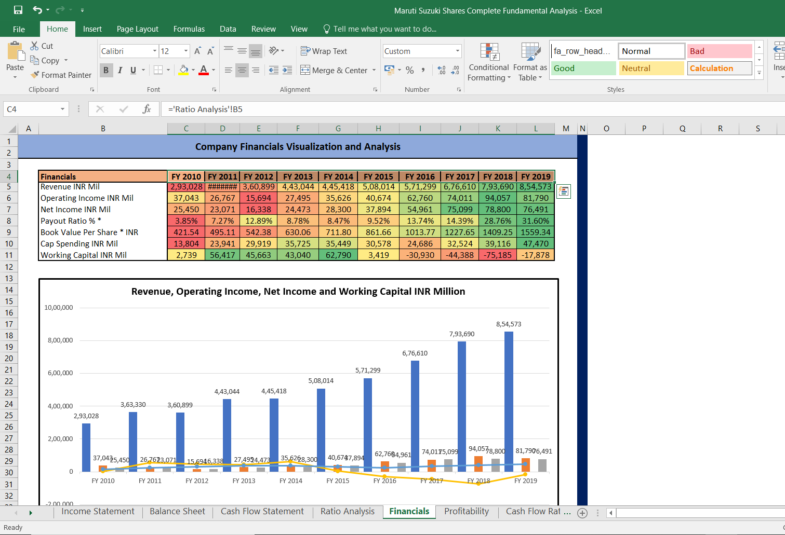
SEO and KEYWORD Research -
SEO Audit -

Slide 12
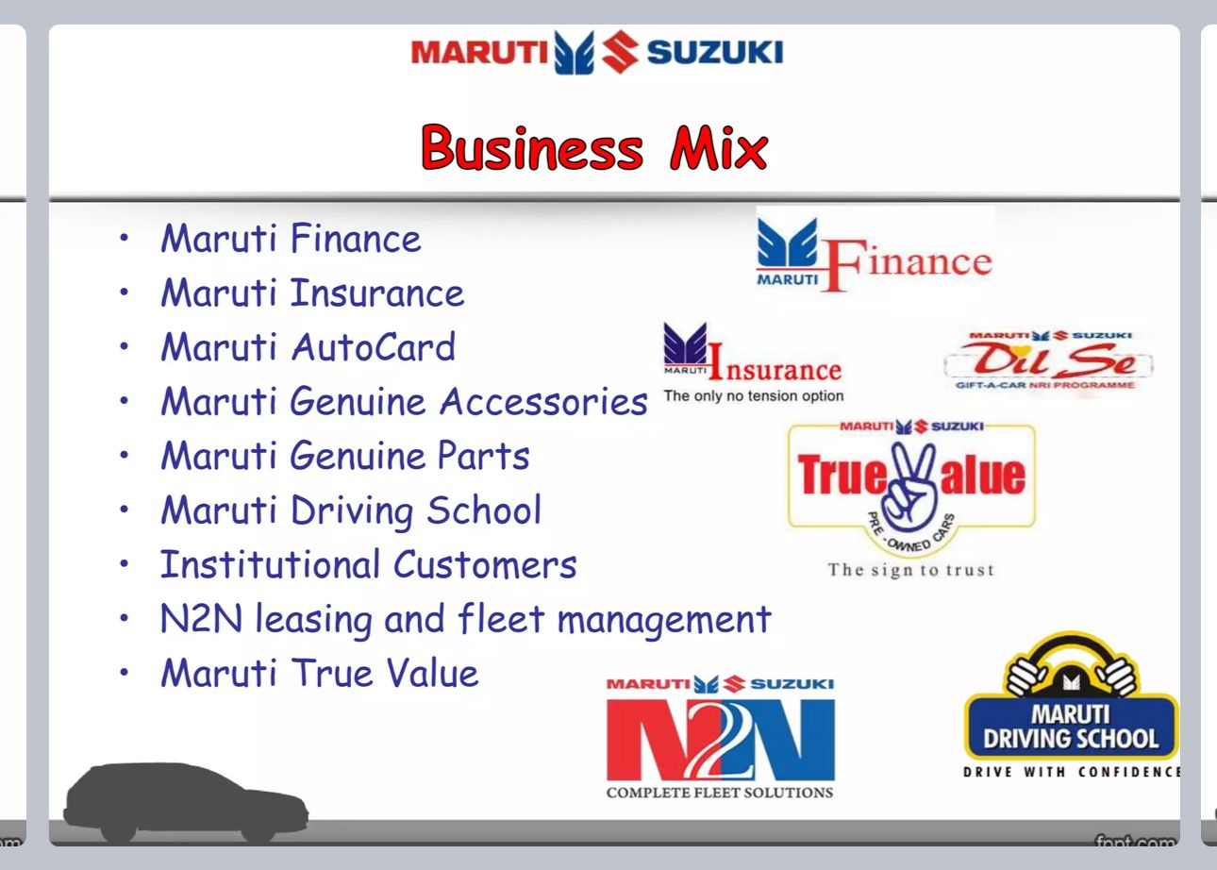
KEY WORD Research -

Slide 13
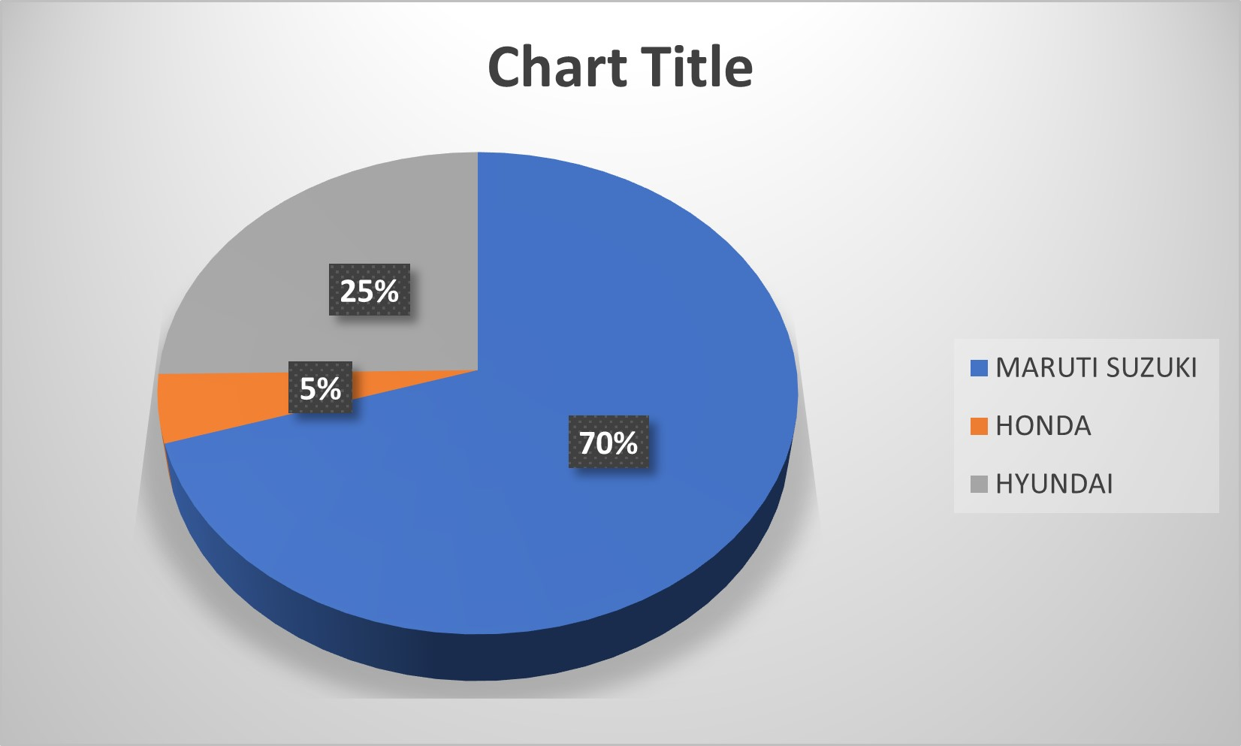
Market Share
MARUTI SUZUKI - 41.39% HONDA - 2.7% HYUNDAI - 14.9%

Slide 14
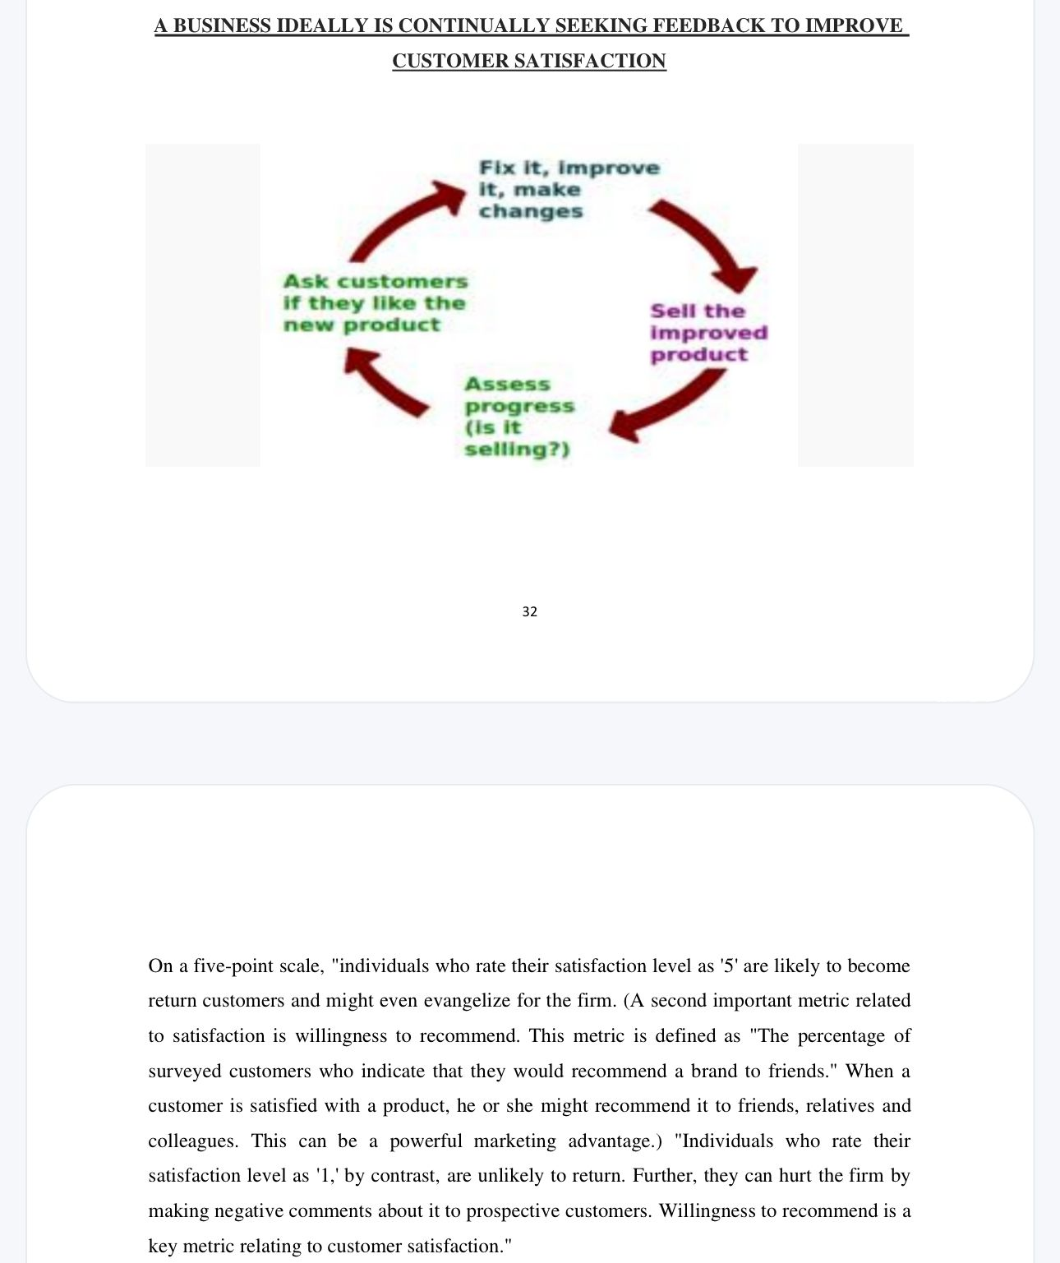
Content ideas and marketing strategies -

Slide 15
Digital promotion strategies:
Content blogs:
Educational Content: Create a blog with articles about motor insurance, and related topics to educate customers.
Website:
User-Friendly Design: Ensure a responsive and easy-to-navigate website.
Digital platform:
Social Media: Maintain active profiles on platforms like Facebook, Twitter, and LinkedIn for customer engagement and updates.
Digital promotion strategies:
Analytics: Continuously monitor and analyze digital marketing efforts for optimization.

Slide 16
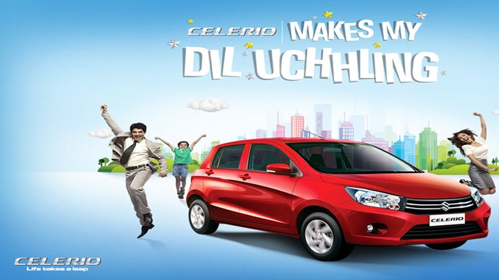
Poster design

Slide 17
Content creation
Creating and curating content for Maruti Suzuki, or any automotive brand, requires a combination of creativity, industry knowledge, and an understanding of the target audience. Here are some guidelines and ideas for content creation and Curation for Maruti Suzuki .
SWOT analysis –
SWOT is an acronym for strengths, weaknesses, opportunities and threats, and represents the key categories for a particular type of business analysis. Car dealerships use it to determine how they fare versus competitors in their local markets.

Slide 18
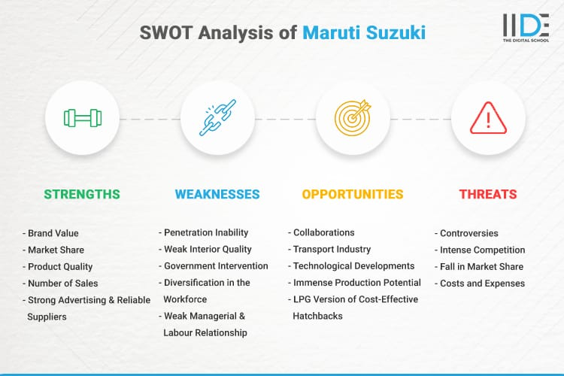

Slide 19
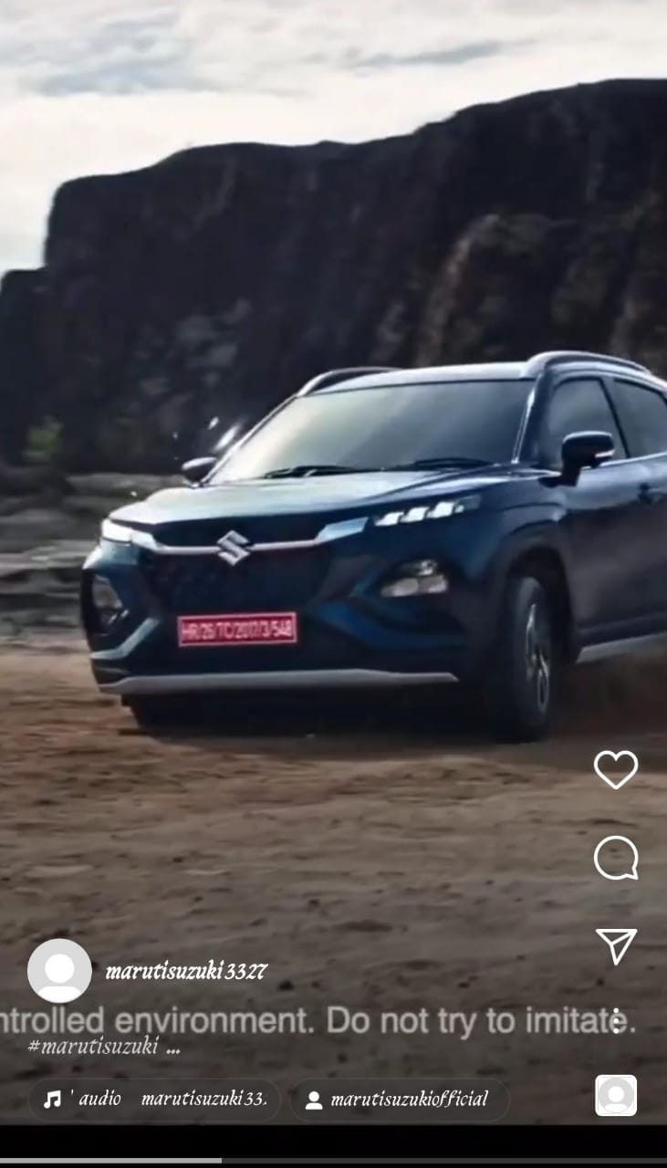
Content Curation -
https://www.instagram.com/reel/CyVbuipvaa6/?igshid=MTc4MmM1YmI2Ng==

Slide 20
Team contribution on presentation
I am very grateful to my team’s active participation in this presentation.
Every person can contributed in some way.\
We worked together to create visually appealing slides with graphs, pie charts and images.
TEAM LEADER: D.Gayathri has contributed :
1.Introduction
2.About digital marketing
3.Key components of digital marketing
4.About company brand
TEAM MEMBER 1 ( T. Lahari ) :
1.Brand study, competitor analysis and buyers persona
2. Competitor analysis
3. Buyers persona
4.SEO and Keyword research

Slide 21
TEAM MEMBER 2 ( G. Jyoshna ) :
1. Market share
2. Digital promotion strategies
3. Poster design
TEAM MEMBER 3 ( L. Poojitha ) :
1. Content creation
2. SWOT analysis of Maruti suzuki
3. Content curation

Slide 22
THANK YOU

