Slide 1
WallBreaker
Kalcsevszki Regina
Kiss Dorottya
Márton Adrienn

Slide 2
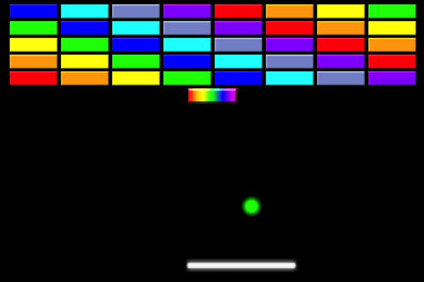
What we wanted

Slide 3
How we wanted: MVC
Controller
Model
View

Slide 4
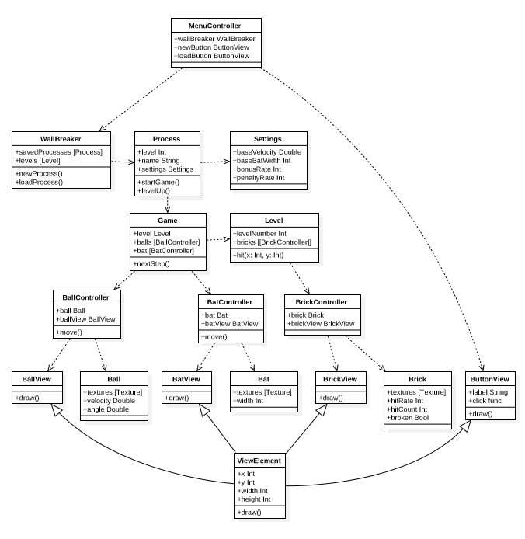
How we wanted: UML

Slide 5



How it’s made

Slide 6
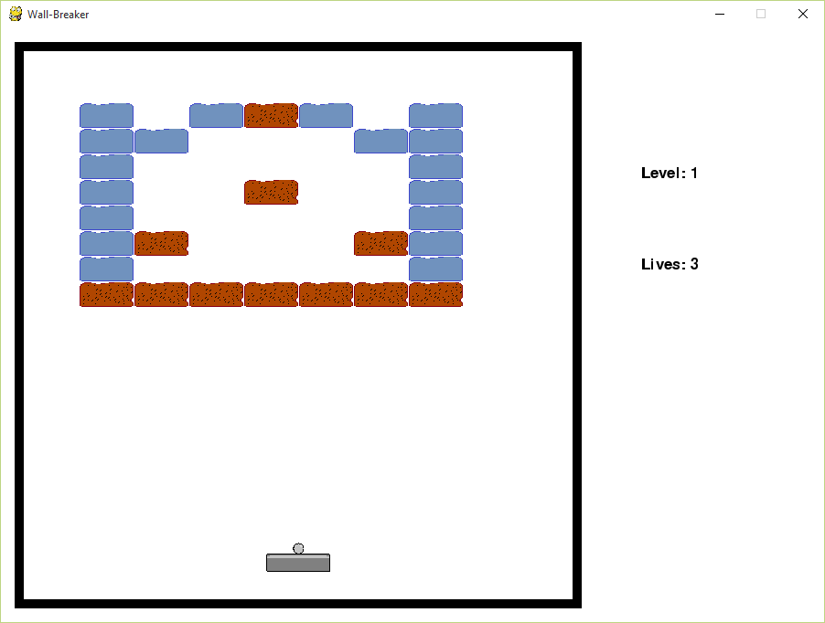
What we made

Slide 7
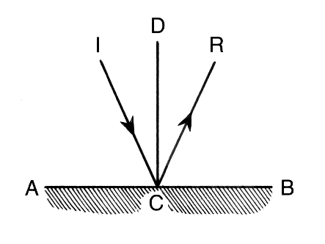
What made trouble
Ball movement
Sprite collides
Lagging

