Slide 1



Mars Real Deal
January 2022 Forecast for Production
By: Zhongyang Hu (Zon-Jan Hu)
Email: zhongyang.hu.rs@gmail.com
11-06-2026 @ Veghel
Notes:
Calculation notes: no calculation on the cover slide.
All forecast figures in the deck are shown in thousand cases ('000).
Source workbook: Business Case - Forecast Analyst.xlsx.

Slide 2
FORECAST DECISION
Agenda
Inquiry about key additional information
Non-firmed production forecast for January P01 (W1-W4)
Review of assumptions
Present to sales
Get sales on board to sign them off
Follow-up
Non-firmed Production Forecast
856,407 cases
January 2022 total for P01
Weekly split: 212 / 254 / 214 / 176k
Notes:
Calculation notes: the headline 856k is the January P01 factory baseline.
Equation: Base P01 = W1 + W2 + W3 + W4.
Base P01 = 211.826 + 254.083 + 214.366 + 176.132 = 856.407, rounded to 856k.
Weekly split rounds to 212 / 254 / 214 / 176k.

Slide 3
Inquiry about key additional information
What is the key additional information you would like to have?
Given the sales team want to take the success into January by pushing for a promotion
January promotion details: customer, timing, mechanic, depth of promotion, and whether it is comparable to Customer 1 and/or Customer 2 promotions in 2021.
Current stock and lost-sales position: especially because P12 / weeks 44–48 show a significant service-level drop, meaning actuals may understate true demand.
January factory capacity and supply feasibility: to understand whether a promotional uplift can actually be produced and delivered.
Customer/order commitments: confirmed orders, retailer agreements, display commitments, and any agreed customer volumes by week.
Evidence for the expected uplift: historical uplift from comparable promotions, whether it was incremental or forward-buying, and whether past data was affected by supply constraints.
Post-promotion impact: whether January demand will be incremental or partly borrowed from February.

Slide 4
Non-firmed production forecast for January P01 (W1-W4)
What forecast would you provide for January?
Non-firmed Production Forecast
1,144k
856k
856,407 cases
Signed two-week promotion scenario - not the factory forecast without sign-off
Clean P13 demand after casefill adjustment
January 2022 total for P01
Base forecast reflects the latest clean four-week demand signal and avoids reacting to shipment noise.
Promotion upside stays transparent as a scenario until Sales confirms mechanics, customers, timing and funding.
Supply Chain separately confirms feasibility: capacity, inventory, allocation rules and recovery plan.
Weekly split: 212 / 254 / 214 / 176k
Notes:
Calculation notes: this slide separates the signed factory forecast from conditional promotion upside.
Base forecast equation: clean P13 ordered demand = 211.826 + 254.083 + 214.366 + 176.132 = 856.407k, rounded to 856k.
Signed promo equation: W1 base + Customer 1 median promo demand in W2 and W3 + W4 base.
Signed promo = 211.826 + 377.856 + 377.856 + 176.132 = 1,143.671k, rounded to 1,144k.
Upside sensitivity = 211.826 + 429.254 + 429.254 + 176.132 = 1,246.466k, rounded to 1,246k.

Slide 5
Non-firmed production forecast for January P01 (W1-W4)
What forecast would you provide for January?
Weekly baseline forecast
JANUARY P01 TOTAL
856,407
254
cases before rounding
All figures in the deck are shown in thousand cases.
212
214
176
Forecast equation
Base P01 = W1 + W2 + W3 + W4
= 211.826 + 254.083 + 214.366 + 176.132
= 856.407k
W1
W2
W3
W4
Notes:
Calculation notes: the 856k no-promotion forecast uses the latest clean P13 weekly demand.
Equation: Base_w = estimated ordered demand for the matching P13 week of period, where no promotion and casefill >= 95%.
Base total = 211.826 + 254.083 + 214.366 + 176.132 = 856.407k, rounded to 856k.

Slide 6
Why shipments alone are not enough
What forecast would you provide for January?
Demand signal hierarchy
1
Clean recent demand
Use latest non-promo, normal-casefill demand as base rate.
2
Casefill-adjusted demand
Rebuild true demand when shipments are constrained.
3
Promo scenarios
Hold upside separate until commercial assumptions are signed.
January baseline chosen at 856k: aligned with clean P13 demand, not raw shipment noise or uncommitted promotion upside.
Key risk: using raw late-December shipments would under-call factory demand and create service pressure in January.
Notes:
Calculation notes: shipments are corrected for casefill before being interpreted as demand.
Equation: Estimated ordered demand_t = delivered actual_t / casefill_t.
Equation: Service loss_t = estimated ordered demand_t - delivered actual_t.
Clean base filter: no promotion and casefill >= 95%.

Slide 7
Assumptions
What assumptions do you make?
1
Base-rate demand is best represented by the latest clean four weeks.
Demand formula
Estimated ordered demand
= Actual delivered cases / Casefill
2
January has no confirmed promotion in the signed factory forecast.
3
Late December was supply constrained; actual shipments are not true demand.
Eligible base weeks
4
Historic January gives a floor, but recent demand momentum is more relevant.
Promo week = Customer 1 promo OR Customer 2 promo
Non-promo week = no promo flag
Clean week = non-promo AND casefill >= 95%
5
Any promotion uplift must be capacity-tested before moving into the factory plan.
Fallback: recent clean week-of-period medians if P13 were incomplete.
Notes:
Calculation notes: assumptions define which data is eligible for the base forecast.
Recent clean demand filter = period number >= 10, no promotion, and casefill >= 95%.
P13 is used because it is the latest clean four-week period; fallback would use recent clean week-of-period medians if P13 were incomplete.

Slide 8

How to present the case to Sales
How would you present your case to sales?
1
Start with agreement
“The product has momentum; the question is how much demand we can safely signal to the factory.”
2
Show the evidence
Use casefill-adjusted demand and the clean four-week run rate to explain 856k.
3
Give Sales a path
Document the 1,144k scenario and show exactly what confirms it.
4
Close with governance
Ask for a one-page signed assumptions log and Supply Chain feasibility sign-off.
Shared goal: sell the upside without putting an unverified number into the factory signal.
Notes:
Calculation notes: Sales discussion should use the same scenario math as the forecast deck.
Base = 856k; signed two-week promo = 1,144k; upside sensitivity = 1,246k.
Do not average scenarios: a promotion either has signed mechanics and volume commitment, or it remains a risk scenario.

Slide 9
Sign-off and follow-up plan
How would you get sales on board to sign them off?
Ask Sales to sign
Expected Sales response
Weekly tracking
One base forecast: 856k cases
Sales will likely push for the higher scenario in the official forecast.
Orders
against signed forecast
Promotion scenario assumptions
Shipments
against factory plan
Response: keep the scenario visible, but require evidence and commitment before factory conversion.
Decision deadline for any update
Casefill
to separate demand from supply
Service-risk acceptance if supply is tight
Stock-outs
customer service risk
Do not turn commercial ambition into a production signal without capacity confirmation.
Variance
update only if material and confirmed
Final recommendation: sign 856k now; only upgrade when the promo scenario is operationally and commercially committed.
Notes:
Calculation notes: sign-off anchors on one factory number plus conditional gates.
Factory sign-off now = 856k.
Conditional update = 1,144k only if Sales signs customer, mechanic, dates, weekly phasing, committed orders, and Supply Chain confirms feasibility.

Slide 10
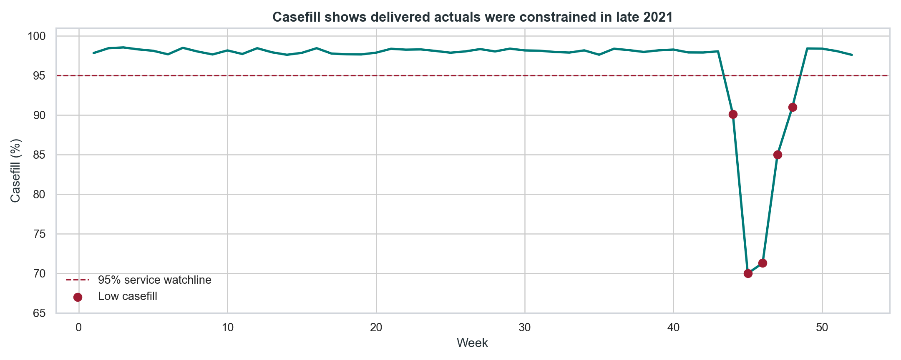
SERVICE CONTEXT
Delivered actuals need casefill context before they become demand.
Implication for the discussion
Casefill below 95% in 5 weeks
Estimated lost / delayed demand: 235k
P12 actuals alone are not a clean baseline
Supply Chain should challenge any January uplift that is justified only by recent delivered actuals. The clean forecast discussion is ordered demand, not shipments in a constrained week.
Notes:
Calculation notes: service context is calculated from casefill.
Service-affected weeks = count(week where casefill < 95%) = 5.
Estimated service loss = sum(actual_t / casefill_t - actual_t) for service-affected weeks = 234.896, rounded to 235k.

Slide 11
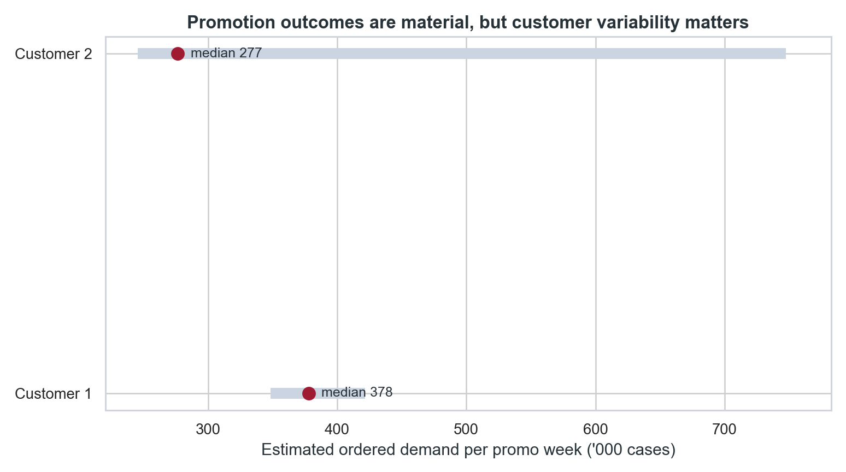
PROMOTION EVIDENCE
Promotions support upside, but customer variability is the risk.
How I would position it
Customer 1 median promo week: 378k
Customer 2 median promo week: 277k
Customer 2 range includes extreme spikes
A promotion is not one universal uplift. I would ask Sales which customer, which mechanic, and which support plan they are asking the factory to believe.
Notes:
Calculation notes: promotion evidence uses estimated ordered demand, not delivered shipments.
Customer 1 median promo week = median(estimated ordered demand where Customer 1 promo) = 377.856k, rounded to 378k.
Customer 2 median promo week = median(estimated ordered demand where Customer 2 promo) = 276.629k, rounded to 277k.
Upside promo week = Q75(estimated ordered demand across all promo weeks) = 429.254k, rounded to 429k.

Slide 12
BASE FORECAST
The clean base is the latest normal run-rate, not the constrained dip.
Base read
Volume
Why it matters
P01 2021 ordered demand
710k
Direct January analogy, but a year old.
P13 2021 ordered demand
856k
Latest clean 4-week period; normal service and no promotion.
Recent clean median x 4
847k
Robust cross-check against P13.
Recent clean mean x 4
870k
Shows P13 is not an aggressive outlier.
Recommended no-promo phasing
Forecast position: 856k cases is defensible because it is close to multiple clean base reads and avoids loading an uncommitted promotion into the factory plan.
W1
W2
W3
W4
212k
254k
214k
176k
Notes:
Calculation notes: base forecast is triangulated against multiple clean demand reads.
P01 2021 ordered demand = sum(estimated ordered demand where period = P01) = 710.232k, rounded to 710k.
P13 2021 ordered demand = sum(estimated ordered demand where period = P13) = 856.407k, rounded to 856k.
Recent clean median x4 = 211.826 x 4 = 847.304k, rounded to 847k.
Recent clean mean x4 = 217.622 x 4 = 870.488k, rounded to 870k.

Slide 13
SIGNED PROMO GATE
If the event is signed, W2-W3 become the capacity constraint.
Scenario
W1
W2
W3
W4
Total
Operational gate
Base operational forecast
212
254
214
176
856
Before loading 1,144k, require Sales to sign: customer, mechanic, W2-W3 phasing, committed orders, and contingency if casefill risk returns.
Signed two-week promo
212
378
378
176
1,144
Sales upside sensitivity
212
429
429
176
1,246
What I would not do: accept a January promotion uplift just because recent promotional weeks were exciting. The factory plan needs a signed event, not a story.
Total volume by scenario
Base
856k
Signed promo
1,144k
Upside
1,246k
Notes:
Calculation notes: scenario table formulas.
Base = 211.826 + 254.083 + 214.366 + 176.132 = 856.407k, rounded to 856k.
Signed promo = 211.826 + 377.856 + 377.856 + 176.132 = 1,143.671k, rounded to 1,144k.
Upside = 211.826 + 429.254 + 429.254 + 176.132 = 1,246.466k, rounded to 1,246k.
Promotion uplift versus base = (promo week value - base W2) + (promo week value - base W3).

