Slide 1
FORECAST DECISION
Hold January at 856k until promotion mechanics are signed.
Sales can carry the upside in its financial view, but the factory signal should only load customer-backed, supply-feasible demand.
January scenarios
Factory baseline
Signed promo gate
Service-risk read
856k
1,144k
235k
Base
856k
Clean P13 run-rate
Two-week Customer 1-like event
Late-year constrained demand
Use for factory sign-off now.
Signed promo
1.144k
Load only after Sales signs assumptions.
Upside
1.246k
Capacity risk, not default forecast.
Source: Business Case - Forecast Analyst.xlsx; cases in '000.

Slide 2
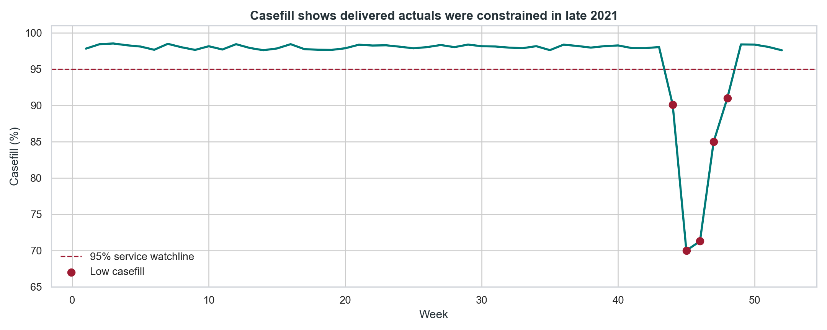
SERVICE CONTEXT
Delivered actuals need casefill context before they become demand.
Implication for the discussion
Casefill below 95% in 5 weeks
Estimated lost / delayed demand: 235k
P12 actuals alone are not a clean baseline
Supply Chain should challenge any January uplift that is justified only by recent delivered actuals. The clean forecast discussion is ordered demand, not shipments in a constrained week.
Source: Business Case - Forecast Analyst.xlsx; cases in '000.
02

Slide 3
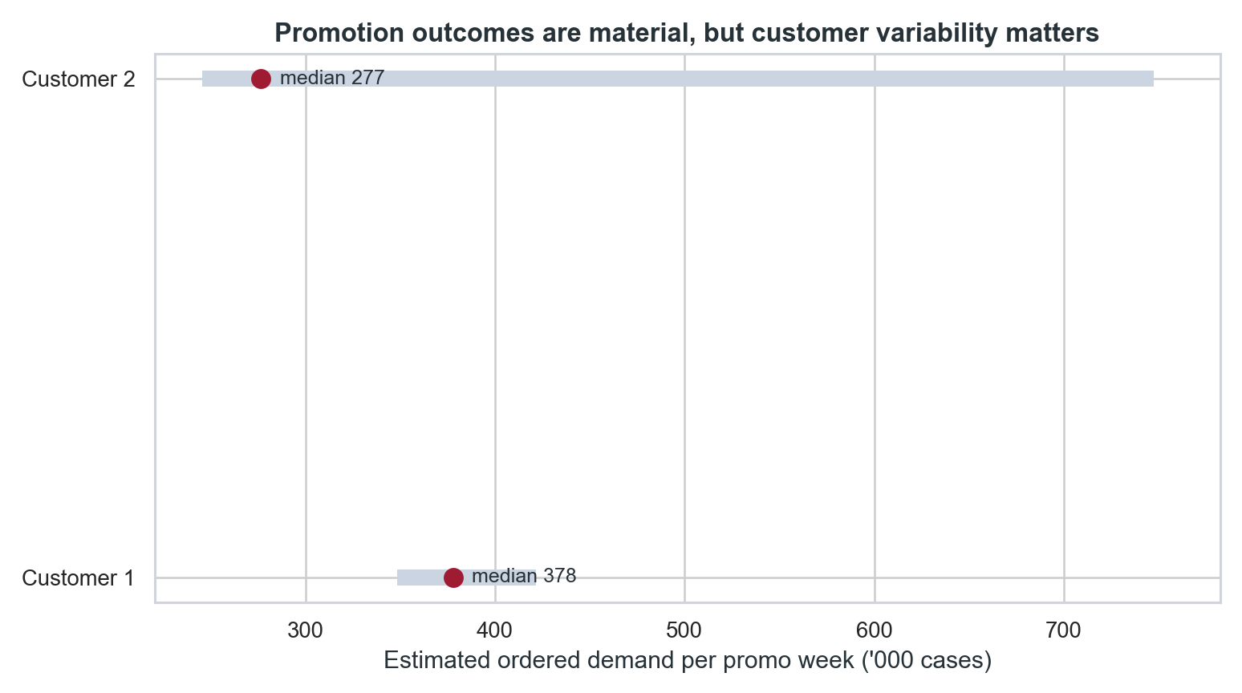
PROMOTION EVIDENCE
Promotions support upside, but customer variability is the risk.
How I would position it
Customer 1 median promo week: 378k
Customer 2 median promo week: 277k
Customer 2 range includes extreme spikes
A promotion is not one universal uplift. I would ask Sales which customer, which mechanic, and which support plan they are asking the factory to believe.
Source: Business Case - Forecast Analyst.xlsx; cases in '000.
03

Slide 4
BASE FORECAST
The clean base is the latest normal run-rate, not the constrained dip.
Base read
Volume
Why it matters
P01 2021 ordered demand
710k
Direct January analogy, but a year old.
P13 2021 ordered demand
856k
Latest clean 4-week period; normal service and no promotion.
Recent clean median x 4
847k
Robust cross-check against P13.
Recent clean mean x 4
870k
Shows P13 is not an aggressive outlier.
Recommended no-promo phasing
Forecast position: 856k cases is defensible because it is close to multiple clean base reads and avoids loading an uncommitted promotion into the factory plan.
W1
W2
W3
W4
212k
254k
214k
176k
Source: Business Case - Forecast Analyst.xlsx; cases in '000.
04

Slide 5
SIGNED PROMO GATE
If the event is signed, W2-W3 become the capacity constraint.
Scenario
W1
W2
W3
W4
Total
Operational gate
Base operational forecast
212
254
214
176
856
Before loading 1,144k, require Sales to sign: customer, mechanic, W2-W3 phasing, committed orders, and contingency if casefill risk returns.
Signed two-week promo
212
378
378
176
1,144
Sales upside sensitivity
212
429
429
176
1,246
What I would not do: accept a January promotion uplift just because recent promotional weeks were exciting. The factory plan needs a signed event, not a story.
Total volume by scenario
Base
856k
Signed promo
1.144k
Upside
1.246k
Source: Business Case - Forecast Analyst.xlsx; cases in '000.
05

Slide 6
SALES SIGN-OFF
Turn Sales ambition into accountable assumptions and weekly follow-up.
Ask before sign-off
How to get Sales on board
Which customer and exact January weeks?
Show base and promo upside as two decisions.
What discount, display, and feature support?
Let Sales own the customer-backed uplift.
What committed orders and weekly phasing?
Agree the factory plan changes only with evidence.
What cannibalization or forward-buy risk?
Review orders, shipments, and casefill weekly.
What supply contingency if casefill drops?
Document assumptions after the meeting.
Expected follow-up: Sales will push for upside. I would keep the upside visible, but only convert it into the operational forecast when customer evidence and supply feasibility are locked.
Source: Assignment brief and forecast scenario outputs.
06

