Slide 1
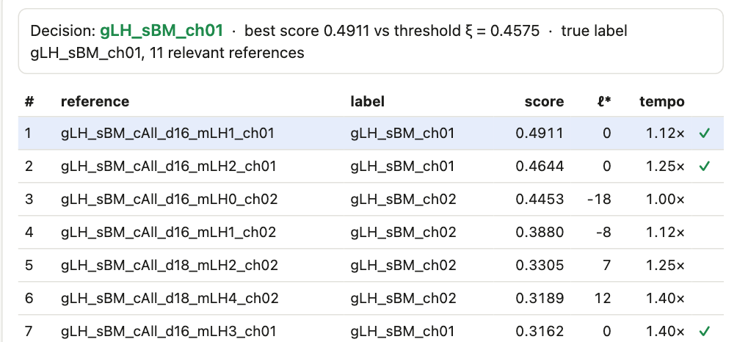
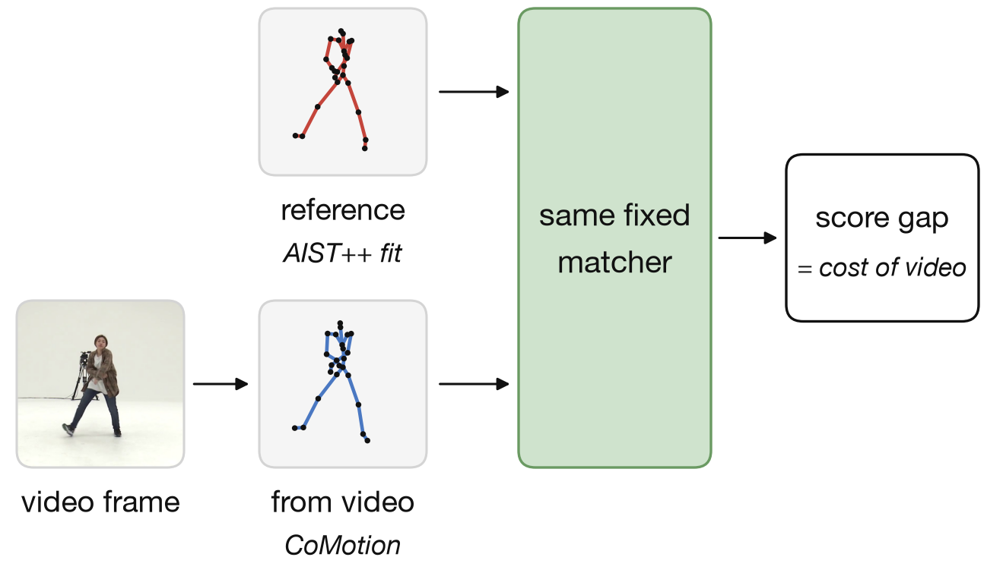
CV801 · progress report
What we fingerprint, and the two questions we ask
THE TASK · RANK THE DATABASE
QUESTION 1 · IS THE SKELETON FROM VIDEO GOOD ENOUGH?
Our web interface: the same choreography (✓) should rank first
QUESTION 2 · CAN WE TELL THAT A VIDEO IS AI-GENERATED?
LEVEL 1
LEVEL 2
No library of real clips: judge the motion alone
With a library of real clips: does the video copy one?
Arina Kharlamova · Advanced Computer Vision, MBZUAI · Mentor: Mohammed Irfan K · 14 October 2026
CV801 · progress report
1
Notes:
The task: given a query clip, rank a database so that clips of the same choreography come first. Same choreography does not mean the same performer, camera or room; the metric is how high the same choreography ranks (AP and mAP, written on the tablet). Question 1: a video is first turned into a skeleton; is that skeleton good enough? We run the same fixed matcher on the reference skeleton and on the skeleton estimated from video; the score gap is the cost of the video step. Question 2: can we tell that a video is AI-generated, first with no library of real clips, then with one? Target: any motion.

Slide 2
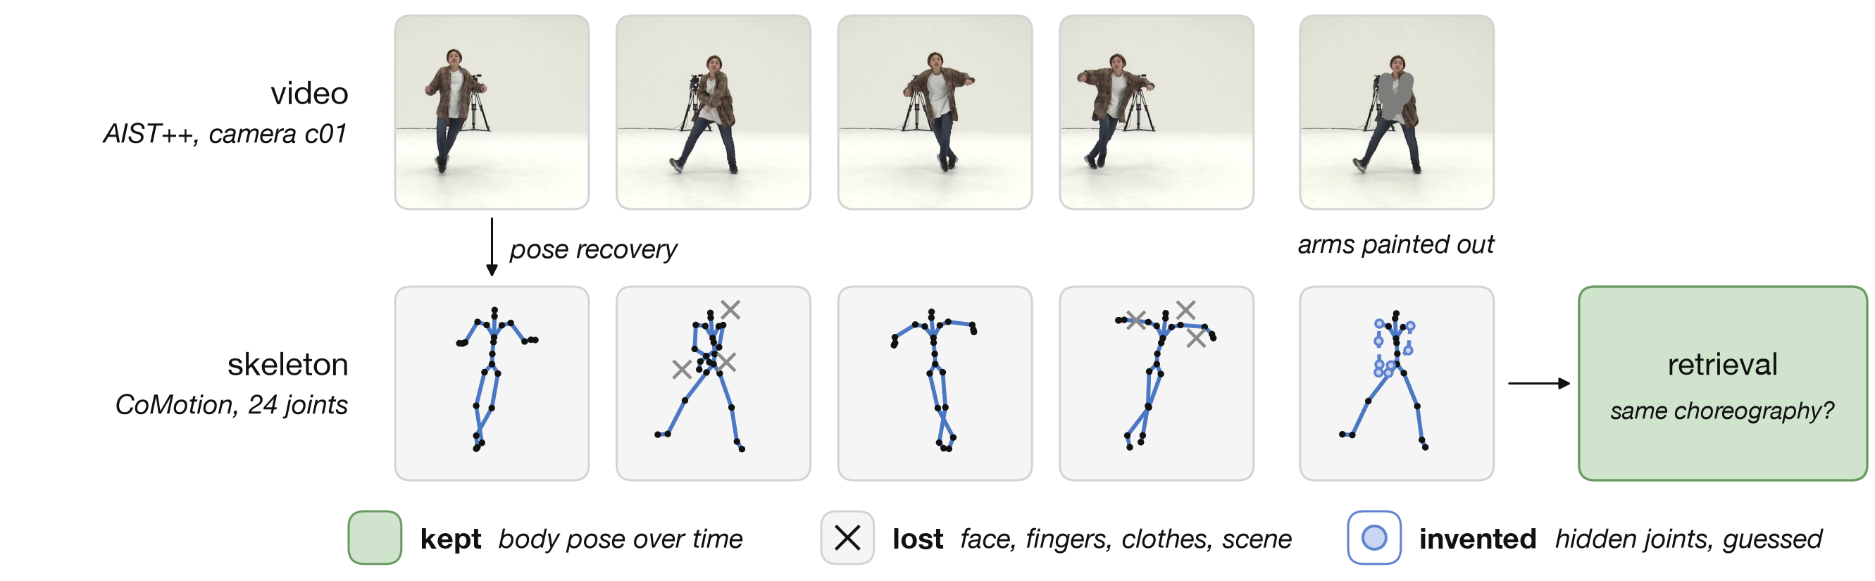
FROM PROFESSOR · the pose-recovery literature was missing
A skeleton keeps pose over time, loses hands and face, and invents hidden joints
POSE RECOVERY
RETRIEVAL
GENERATION
HMR · 4DHumans · WHAM · GVHMR · CoMotion
Choreo · TMR · MotionBERT · Pr-VIPE · DTW · ST-GCN
Animate Anyone · MimicMotion · Wan-Animate
CV801 · progress report
2
Notes:
The pipeline is video, pose recovery, skeleton, retrieval. Whatever the pose model drops or invents cannot be recovered later. The professor pointed out that the review lacked this direction, so we added the pose-recovery and skeleton literature. Literature: pose recovery HMR, 4DHumans, WHAM, GVHMR, CoMotion; retrieval Choreo, TMR, MotionBERT, Pr-VIPE, DTW, ST-GCN; generation Animate Anyone, MimicMotion, Wan-Animate.

Slide 3
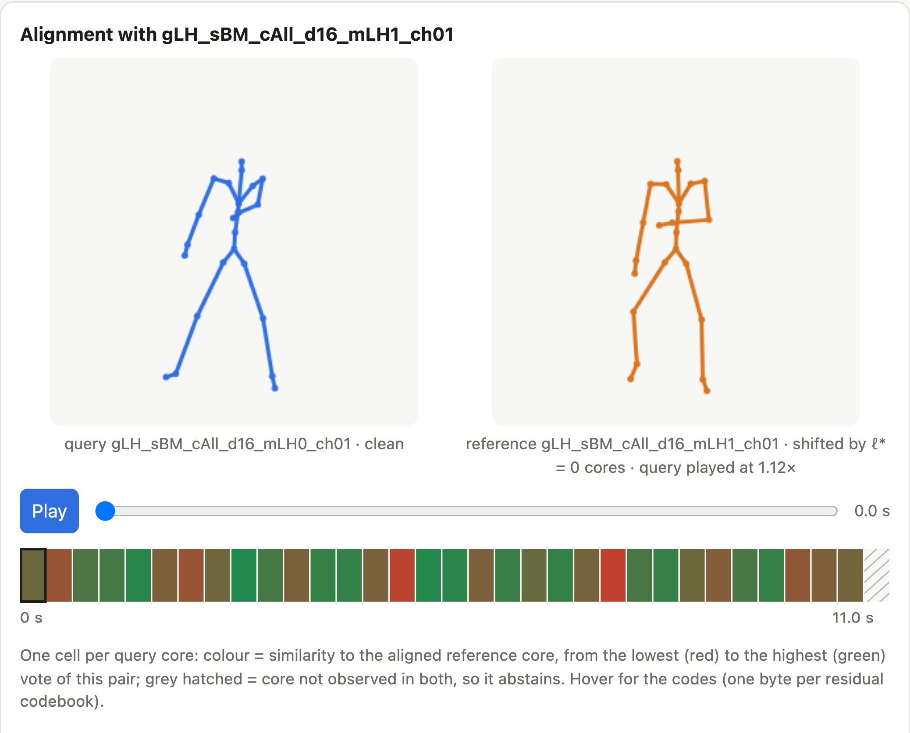
SETUP · what we use
Data and models used
DATA
AIST++ choreography, 9 cameras, reference skeletons
NTU RGB+D everyday actions
Cross-camera videos ~164; animation corpus 230
Social media dataset real performances and copies
Generated Wan-Animate copies (36), text-to-video (24), MimicMotion
MODELS
CoMotion frozen: video → skeleton + 2D confidence
AIST++ fits geometry supervision
kNN, DTW fixed matchers
ChoreoMatch our reproduction of Choreo
Ours refiner + part encoder + visibility, InfoNCE
Generators Wan-Animate, MimicMotion
Our web interface: query (blue), best match (orange), agreement per time slice
CV801 · progress report
3
Notes:
All datasets and models we use. AIST++ is the main benchmark with reference skeletons. CoMotion is frozen and gives a skeleton and a 2D confidence per part. Fixed matchers are kNN and DTW. ChoreoMatch is our reproduction of the Choreo model. Our own model adds a refiner, a part encoder and visibility. Generators produce the copies. Metrics: mAP, Hit@1, margin, AUC, false-alarm rate, 3 training seeds.

Slide 4
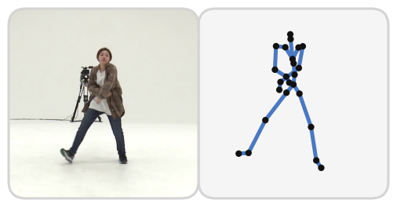
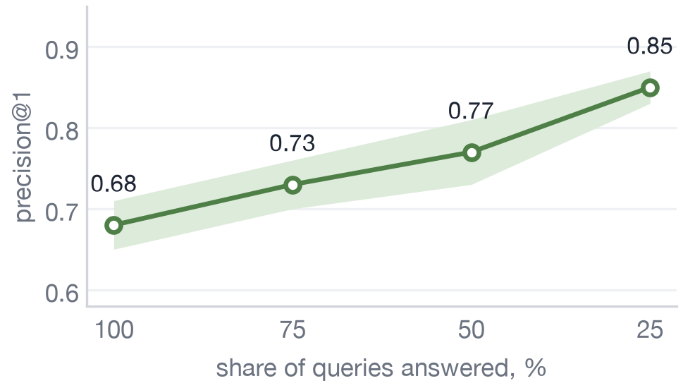
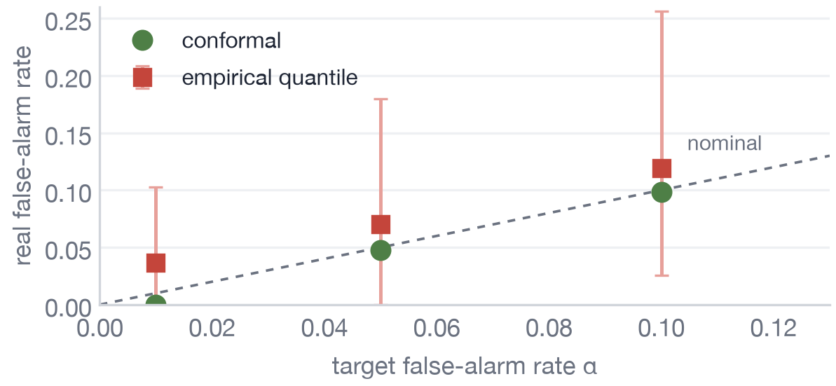
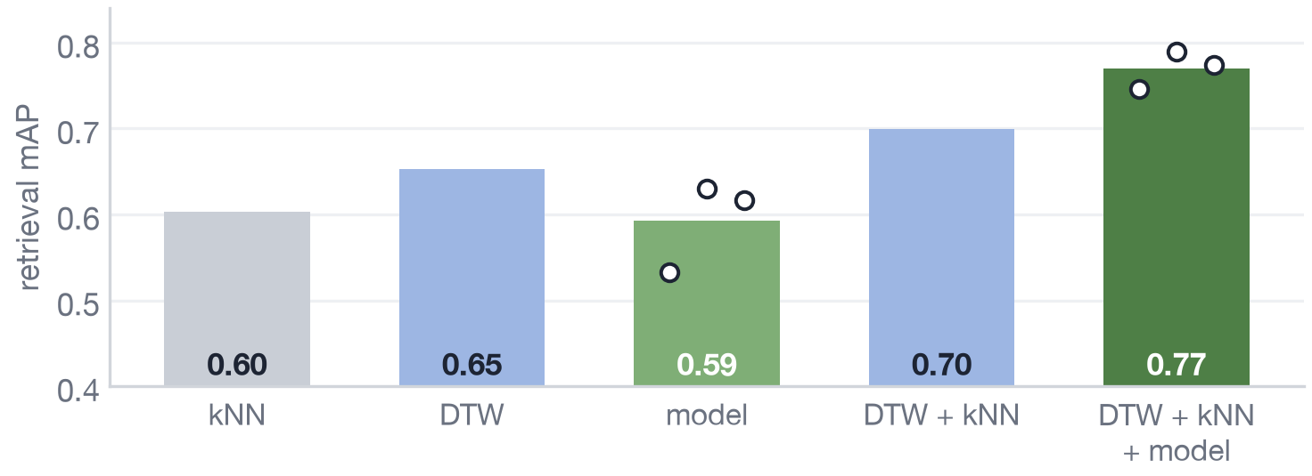
STATUS · since the proposal
Status: five experiments on AIST++ are complete; the side-view retraining and three comparisons are open
1
Skeletons from video
2
Matching
3
Trained model
4
Where the detail lives
5
AI-copy provenance
›
›
›
›
4–6 cm
3 matchers
0.70 → 0.77
0.99 → 0.30
AUC 0.96–0.997
pose error on 9 cameras; 11 cm with the arms hidden
kNN, DTW and our ChoreoMatch behind one web interface
mAP when the model joins DTW + kNN, in all 3 seeds
true match after one arm is swapped; 0.68 → 0.85 if we answer only when sure
with a library of real clips; conformal threshold holds the nominal false-alarm rate
STILL RUNNING AND STILL OPEN
IN PROGRESS
OPEN
OPEN
OPEN
Side view
Offline estimator
Direct-video baseline
Social media dataset
retrain with the full yaw range, 2 of 3 seeds done
WHAM, GVHMR against CoMotion
is a skeleton needed at all?
threshold needs 99+ real clips for 1 %
CV801 · progress report
4
Notes:
Status of the work. One: skeletons from video with CoMotion on nine AIST++ cameras; the pose costs four to six centimetres, eleven when the arms are hidden. Two: matching, with kNN, DTW and our reproduction of Choreo, behind one web interface. Three: a trained model on three seeds; alone it is 0.59, fused with the simple matchers it goes from 0.70 to 0.77 in every seed. Four: where the detail lives; swapping one arm drops the true match from 0.99 to 0.30 and answering only the confident queries raises precision from 0.68 to 0.85. Five: AI-copy provenance; with a library of real clips the copy is found at AUC 0.96 to 0.997 and a conformal threshold holds the nominal false-alarm rate. Still running: the side-view retraining, two of three seeds done. Still open: an offline pose estimator, a direct-video baseline and the threshold on the social media dataset. Report in week 12, orals in weeks 13 and 14.

Slide 5
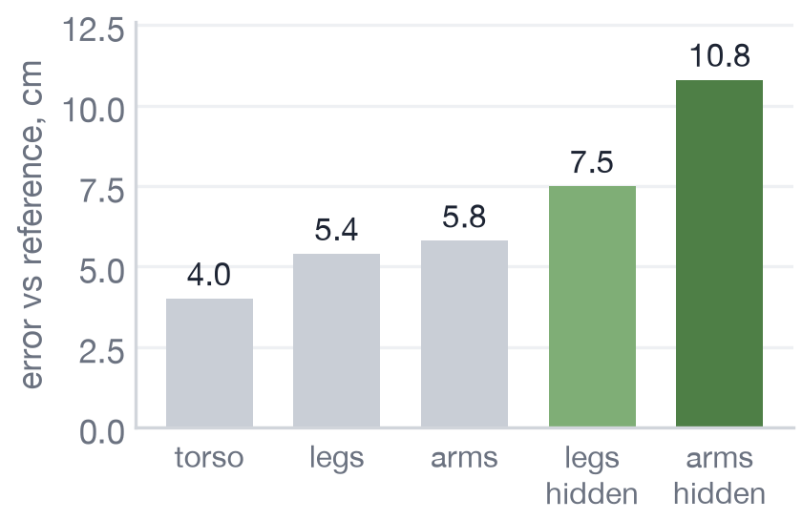
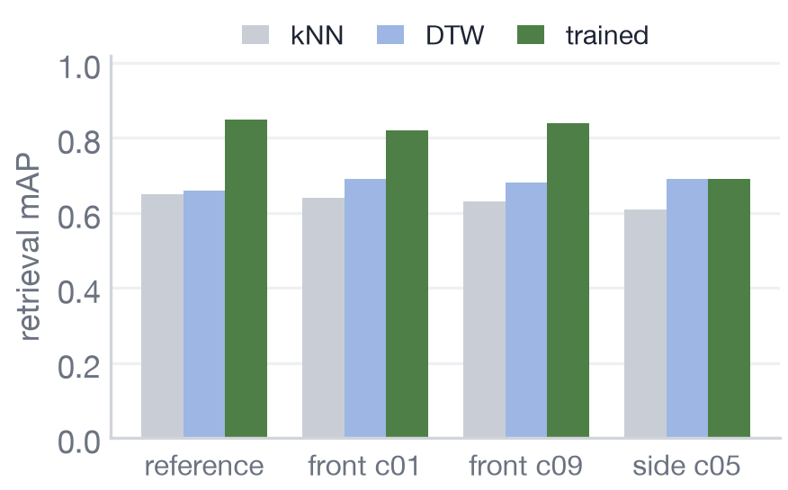
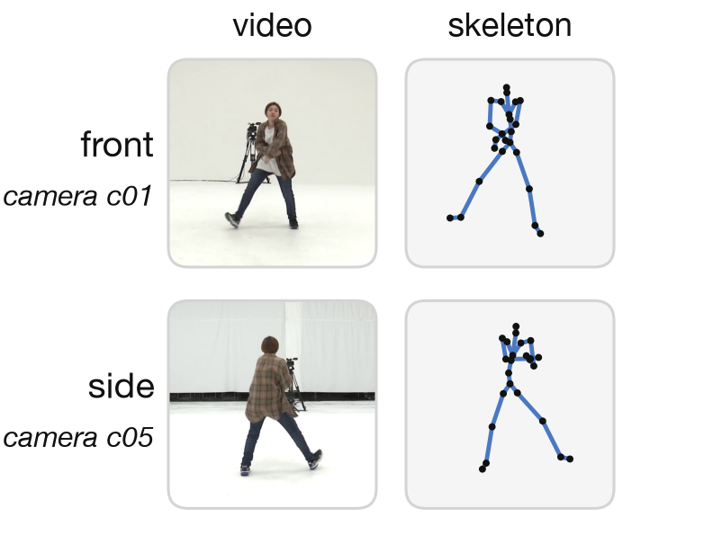
RESULT 1 · what the video step costs
Pose-estimation error is small on front views and grows on the side view and for hidden limbs
POSE ERROR BY BODY PART
RETRIEVAL MAP BY CAMERA
THE SAME MOMENT
hidden = painted out of the video
same matcher, reference vs CoMotion skeletons
front and side camera
CV801 · progress report
5
Notes:
Same matcher on reference skeletons and on CoMotion skeletons. On front views almost nothing is lost. The trained matcher breaks on the side camera c05 (yaw -113 degrees; 98 percent of its frames lie outside the plus-minus 30 degrees the trained matcher saw); the fixed matchers hardly move. A hidden limb (painted out of the video) gets about twice the error.

Slide 6
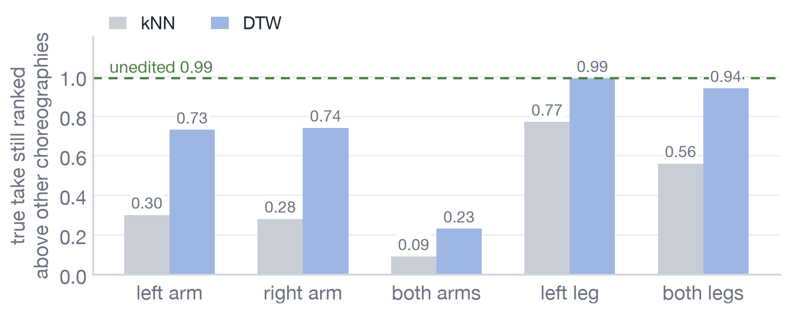
RESULT 2 · where the detail lives
Replacing one arm removes the match for kNN; abstaining on low confidence raises precision
REPLACE ONE LIMB BY ANOTHER CHOREOGRAPHY'S LIMB
ANSWER ONLY THE MOST CONFIDENT QUERIES
3 training seeds
CV801 · progress report
6
Notes:
We build near-identical pairs ourselves: replace one limb of a skeleton with the limb of another choreography. One arm swapped: kNN 0.99 to 0.30; legs matter less. Answering only the 25 percent most confident queries raises precision from 0.68 to 0.85.

Slide 7
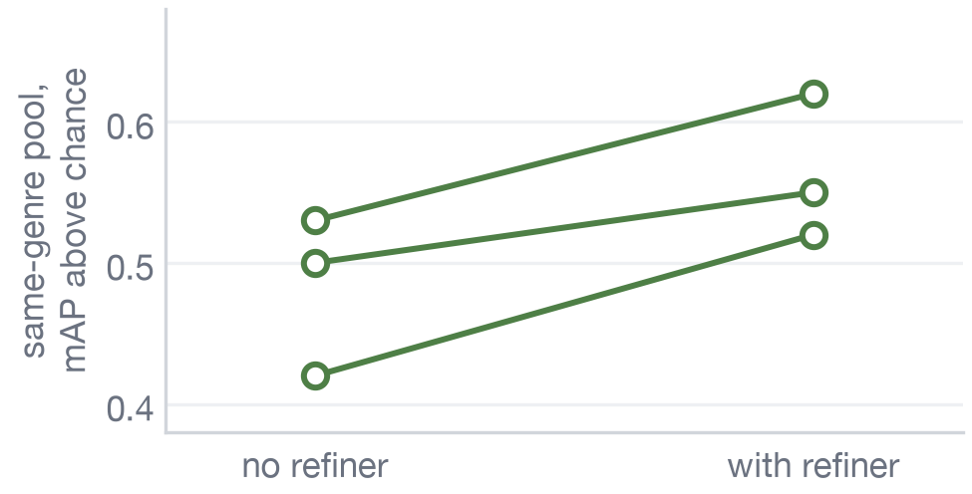
RESULT 3 · the trained model, three seeds
The trained model matches kNN alone; added to DTW + kNN it raises mAP from 0.70 to 0.77
MAP ON THE AIST++ CONFIRMATION SPLIT
REFINER ON SAME-GENRE NEGATIVES
circles = single training runs
one line per training seed
CV801 · progress report
7
Notes:
Model 0.59 plus-minus 0.05 versus kNN 0.60 and DTW 0.65; averaged over three training runs the model ties kNN and is below DTW, and runs differ by up to ten points. Fused DTW+kNN 0.699 to 0.770 with the model: seven points in every seed. The refiner helps on same-genre negatives in every seed.

Slide 8
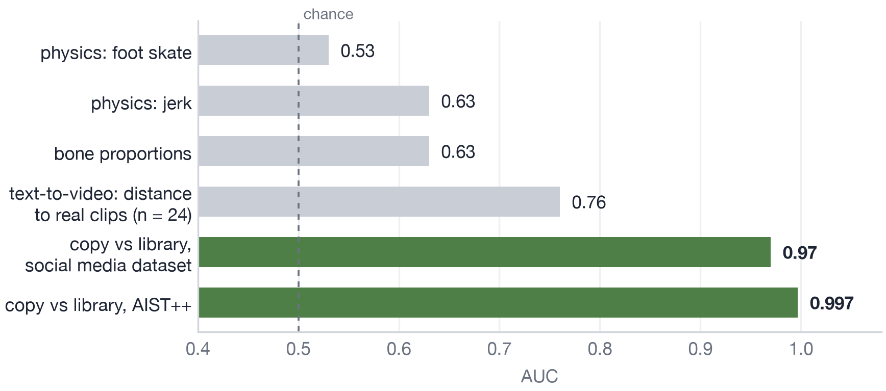
RESULT 4 · AI-generated video, with and without a library
Without a library of real clips AI-generated video is weakly detectable (AUC 0.53–0.76); with one, copies reach AUC 0.96–0.997
AUC BY SIGNAL
chance = 0.5 · text-to-video: 24 clips · copies: Wan-Animate re-dressings
LEVEL 1 · no database: weakly detectable
LEVEL 2 · with a database: detects
CV801 · progress report
8
Notes:
Level 1, no database: judge the motion alone (foot skate, jerk, bone proportions, distance to real clips); weak, AUC 0.53 to 0.76. Level 2, with a database: flag a clip when its best match among real clips is too strong; works, AUC 0.96 to 0.997. Chance is 0.5. Text-to-video: 24 clips. Copies: Wan-Animate re-dressings.

Slide 9
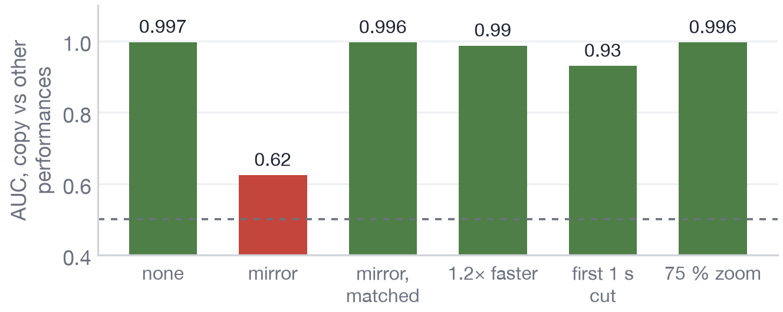
RESULT 5 · calibrated false-alarm threshold
The empirical 1 % threshold gave 3.7 % false alarms; a conformal threshold holds the nominal rate
FALSE-ALARM RATE ON 2000 RANDOM SPLITS
EDITED COPIES
78 real clips, half to calibrate, half to test
AUC against other performances (AIST++, DTW)
CV801 · progress report
9
Notes:
The old one percent threshold was the 99th percentile of 78 real clips, which is one or two values. On repeated splits the real false-alarm rate was 3.7 percent. A conformal p-value guarantees at most alpha for any number of clips, but one percent needs at least 99 real clips. At alpha 5 percent: false alarms 4.5 to 4.8 percent, about 89 percent of the copies caught.

Slide 10
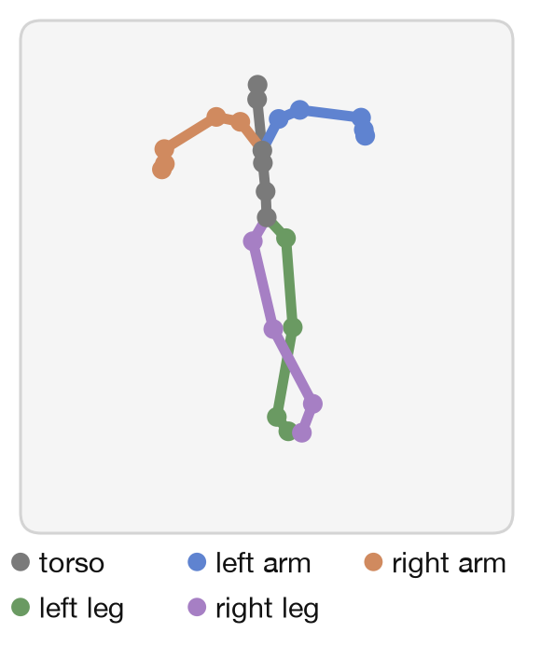
GENERALIZATION · to any motion
The method assumes no choreography-specific label: only a skeleton and takes of the same motion
INPUT
Any skeleton split into parts (here 23 joints → 5 parts)
IDENTITY
Positives P(i): the same motion from another take. No choreography-specific label.
COMPARISON
Part-wise cosines with visibility weights; camera-free through one similarity alignment A.
NEXT TEST
NTU RGB+D everyday actions
CV801 · progress report
10
Notes:
What makes the method general. Any skeleton can be split into parts. Identity is defined by the same motion from another take, so no choreography-specific label is needed. Comparison is camera-free through a similarity alignment. Next test is NTU RGB+D actions. The math is written on the tablet.

Slide 11
NEXT · what is still open
Open items: side view, offline pose estimator, direct-video baseline, calibration on the social media dataset
FOUND ON THE WAY
NEXT
Visibility does not drop when the arms are hidden
1
Side view: retrain with the full yaw range
Path signatures no gain (mAP 0.49)
2
Offline estimator (WHAM, GVHMR) against CoMotion
One seed is not enough (sd 0.04–0.08)
3
Direct-video baseline: is a skeleton needed?
4
Conformal threshold on the social media dataset and edited copies
CV801 · progress report
11
Notes:
What did not work and what comes next. Learned visibility does not drop when the arms are hidden (0.026 to 0.044). Path signatures: mAP 0.49 below kNN 0.60, no gain when fused. One seed is not enough: sd 0.04 to 0.08 between runs. Margin under occlusion: no clear drop. Next: retrain with the full yaw range, compare an offline estimator (WHAM, GVHMR), add a direct-video baseline, calibrate the threshold on the social media dataset and edited copies, report in week 12, orals in weeks 13 to 14.

