Slide 1
Aegis IDS
Intelligent ML-Based Intrusion Detection
& Attack–Defense Simulation System
Team members · College · Year

Slide 2
Problem
Why a classic IDS alert is not enough
• Typical IDS output: “Attack detected.”
• Analysts still need: attack type · why · severity · recommended action
• Students/evaluators also need a visual attack → defense story
• Gap: detection alone ≠ security decision support

Slide 3
Our solution (one pipeline)
• Detect → Classify → Explain → Assess risk → Recommend → Simulate
• Platform name: Aegis IDS
• Contribution: integration framework — not a claim of a new IDS algorithm

Slide 4
Architecture
• React UI ↔ FastAPI ↔ ML + Risk + Recommendations + Simulation
• Data: CICIDS2017 flows · trained models · SQLite incidents
• Two-stage ML: binary (benign vs attack) then attack-family multiclass
• XAI: SHAP (primary) + LIME (secondary)

Slide 5
Dataset & preprocessing
CICIDS2017 MachineLearningCVE
• Clean · normalize labels · drop rare classes (<50 samples)
• ~2.52M flows after cleaning; stratified train/val/test
• Scaler + SelectKBest fit on train only (no leakage)
• Families: BENIGN, DoS, DDoS, PortScan, BruteForce, WebAttack, Bot

Slide 6
Two-stage ML results (RQ1)
Best model: XGBoost
• Binary test: F1 ≈ 0.993 · Recall ≈ 0.990 · ROC-AUC ≈ 0.9999
• Multiclass test: weighted F1 ≈ 0.998 · macro F1 ≈ 0.917
• Compared LR, Decision Tree, Random Forest, XGBoost
• For IDS, recall/precision/F1 matter more than raw accuracy

Slide 7
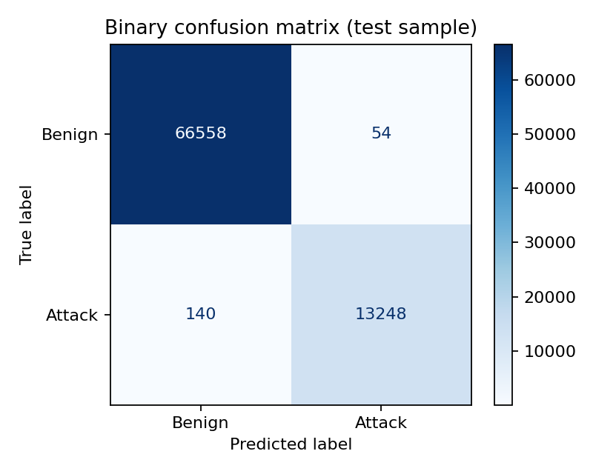
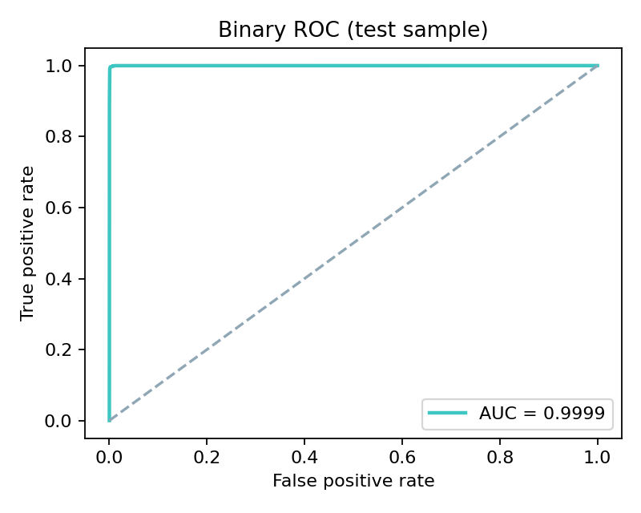
Evaluation figures
Confusion matrix & ROC

Slide 8
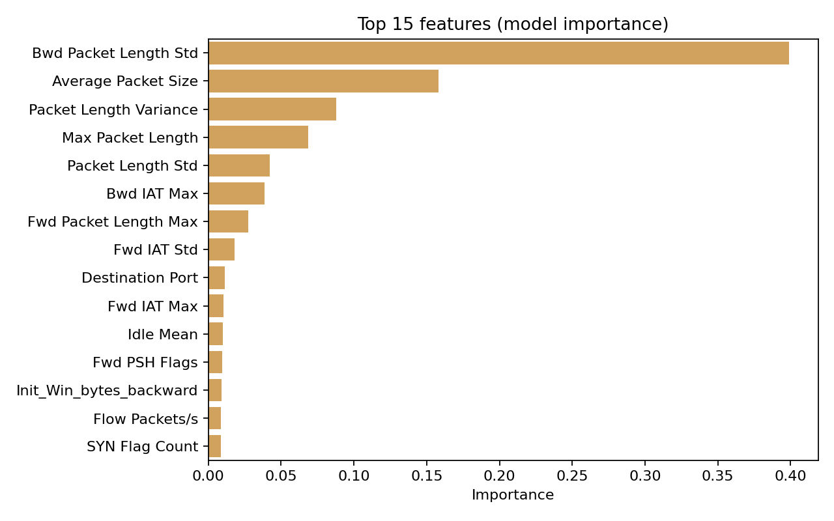
Explainability (RQ2 / RQ3)
• SHAP: feature contributions for each prediction (primary)
• LIME: local surrogate explanation (secondary)
• Live demo: Detection → Why? → SHAP / LIME tabs
• Supports analyst trust — not treated as causal proof

Slide 9
Risk & recommendations (RQ4)
• Risk blends attack-family base + confidence + traffic intensity
• Severity bands: LOW / MEDIUM / HIGH / CRITICAL (configurable)
• Playbooks: rate limiting, filtering, WAF, isolation, …
• Advisory only — platform does not auto-block real networks

Slide 10
Simulation (RQ5) — LIVE DEMO
Attack → Detect → Defend → Recover
• Simplified topology: Attacker → Firewall → Router → Server / PCs + IDS
• Step through: normal → attack → impact → IDS alert → defense → recovery
• Safety: controlled visualization only — no real cyberattacks
• Open UI → Simulation → New scenario → Next / Apply defense

Slide 11
Contribution & limitations
• Contribution: integrated decision-support + visualization for ML-IDS
• Limits: CICIDS2017 age / concept drift; pedagogical simulator
• Limits: rule-mapped recommendations (not learned policies)
• Future: live PCAP→flows, PostgreSQL, analyst feedback loop

Slide 12
Questions?
Demo script: docs/DEMO.md · Report: docs/Aegis_IDS_Project_Report.docx

