Slide 1
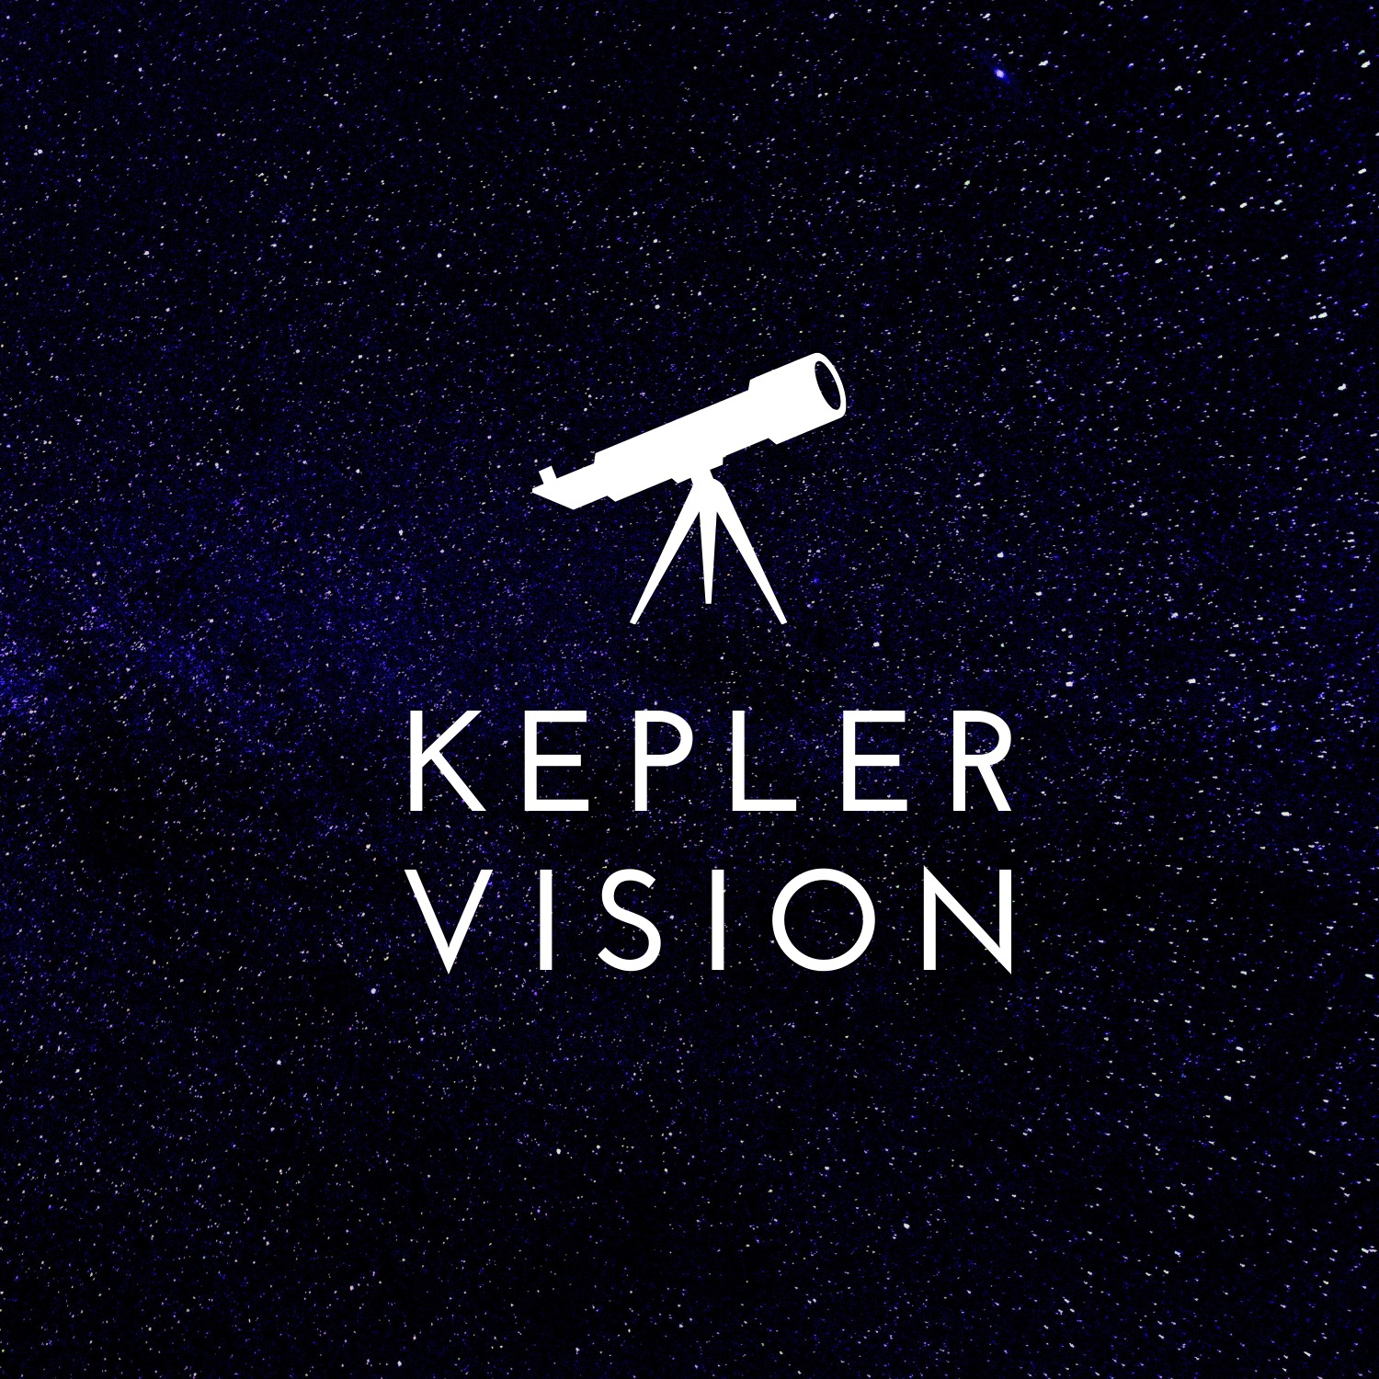
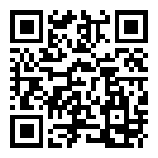


Kepler Vision
Arad Zekler 305600579
Dolev Hindy 312126642
Naor Dahan 308399393
Logo
(Goals) Our project puts its focus on the ability to use modern data technologies and artificial networks to give a quick and accurate classification of exoplanets in our Milky Way galaxy. In addition, analysis of information from space
2 (Introduction). With the current rise of information and artificial intelligence technologies, scientists can utilize large amounts of data in order to help them solve problems that were only solvable through deep investigation on mathematical and physical observations.
We want to help Astronomers by minimizing the time spent on making those predictions ‘by hand’ and letting artificial models a go on predicting complicated values.
3. With our goal in mind, we use distributed deep artificial networks to achieve an accurate prediction of star classifications. With that we wanted to create a light and easy configurable system for easy and fast use.
4. Selected Approach
5. Solution Description (Algorithms, Modulation, Patterns, Infrastructure, UI, Functionality)
Visit Us
Scan QRCode for full Instructions

