Slide 1
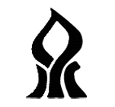
Ben-Gurion University of the Negev
Faculty of Engineering Sciences
Dept. of Electrical and Computer Engineering
Fourth-Year Engineering Project
Progress Presentation
Geometric Shaping in the FSO Turbulent Channel
Project Number: P-2026-093
Students: Dolev Ishay (211721451), Adi Shlomo (211619226)
Supervisor: Prof. Derevyanko Stanislav
Submission Date: 15.03.2026

Slide 2
Introduction
Free-Space Optical (FSO) communication enables high data rates over atmospheric links, but suffers from turbulence-induced scintillation and AWGN
Under weak turbulence (log-normal fading), standard uniform-PAM constellations are suboptimal - equal spacing wastes achievable capacity
Geometric Shaping (GS) optimizes constellation point locations to maximize the Average Mutual Information (AMI)
Optimization via Simulated Annealing (SA) - a global metaheuristic that escapes local optima in the non-convex AMI landscape
↻ ~20-50K iterations
Uniform
PAM-M
→
SA
Optimizer
→
Optimized
Constellation
→
Validation &
Evaluate Gain
uses
uses
Fast AMI
(Gauss–Hermite)
Validated AMI
(Adaptive Integral)
P-2026-093 | Geometric Shaping in the FSO Turbulent Channel
2 / 10

Slide 3
Technical Objectives
Optimization Goal
Maximize AMI for an FSO IM/DD link under weak log-normal turbulence + AWGN
Find optimal M-point 1D positive-intensity PAM constellation via Geometric Shaping
Enforce average transmit power constraint and non-negativity (x ≥ 0)
Target: shaping gain > 0.2 dB over standard uniform PAM
Implementation Strategy
SA-based optimizer with multi-start parallel architecture for global search
Dual AMI evaluators: fast Gauss-Hermite (SA loop) + adaptive integral (validation)
P-2026-093 | Geometric Shaping in the FSO Turbulent Channel
3 / 10

Slide 4
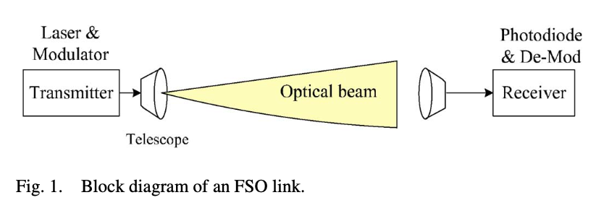
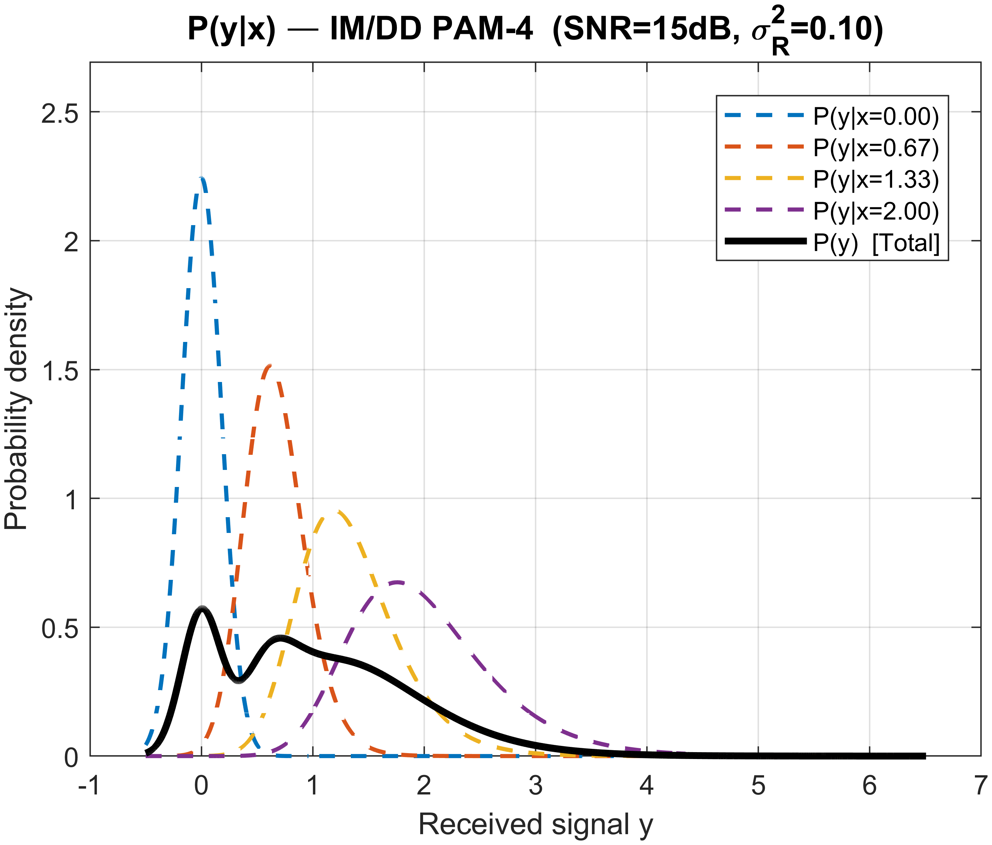
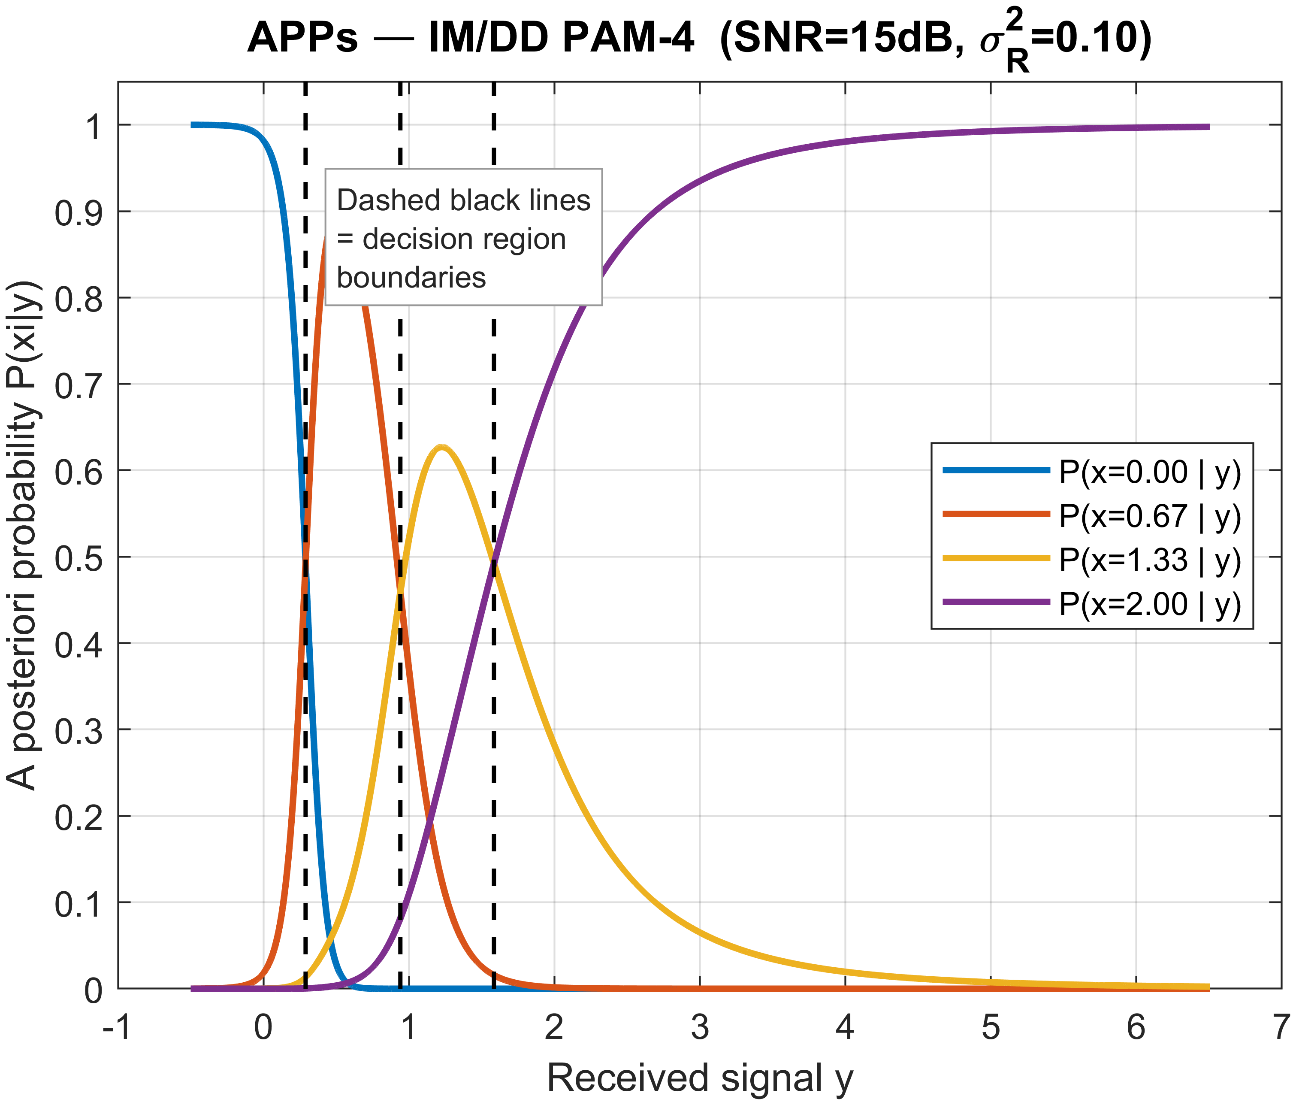
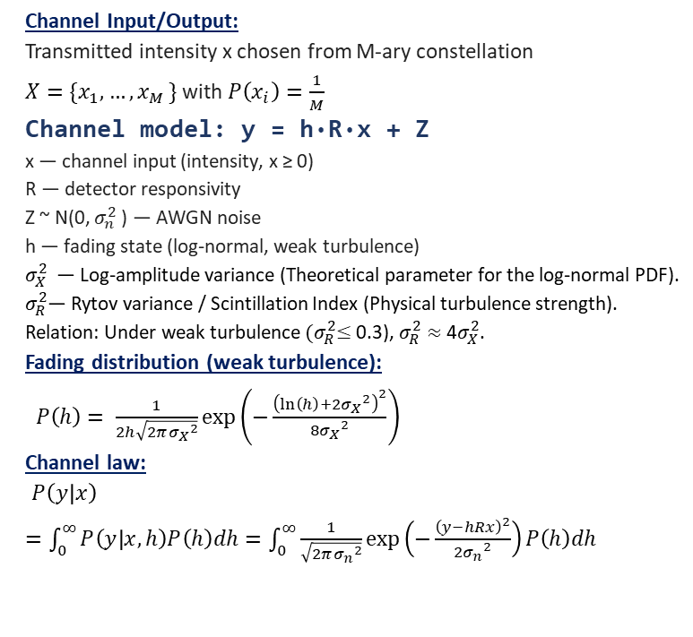
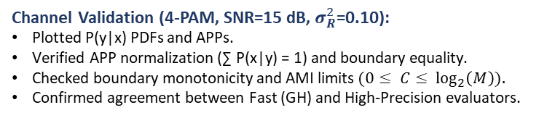
FSO Channel Model [1]
Channel Input/Output:
Transmitted intensity x chosen from M-ary constellation
$X=\{x_{1},…{,x}_{M}\}$ with $P\left(x_{i}\right)=\frac{1}{M}$
Channel model: y = h·R·x + Z
x — channel input (intensity, x ≥ 0)
R — detector responsivity
Z ~ N(0, $σ_{n}^{2}$ ) — AWGN noise
h — fading state (log-normal, weak turbulence)
$σ_{X}^{2}$— Log-amplitude variance (Theoretical parameter for the log-normal PDF).
$σ_{R}^{2}$— Rytov variance / Scintillation Index (Physical turbulence strength).
Relation: Under weak turbulence ${(σ}_{R}^{2}≤$0.3), $σ_{R}^{2}≈$4$σ_{X}^{2}$.
Fading distribution (weak turbulence):
$P\left(h\right)= \frac{1}{2h\sqrt{2π{σ_{X}}^{2}}}\exp\left(−\frac{{\left(\ln\left(h\right)+{{2σ}_{X}}^{2}\right)}^{2}}{{{8σ}_{X}}^{2}}\right)$
Channel law:
$P\left(y | x\right)=\int_{0}^{∞}{P\left(y | x,h\right)P\left(h\right)dh=\int_{0}^{∞}{\frac{1}{\sqrt{2π{σ_{n}}^{2}}}\exp\left(−\frac{{\left(y−hRx\right)}^{2}}{{{2σ}_{n}}^{2}}\right)P\left(h\right)dh }}$
Channel Validation (4-PAM, SNR=15 dB, $σ_{R}^{2}$=0.10):
Plotted P(y|x) PDFs and APPs.
Verified APP normalization ($\text{∑}$ P(x|y) = 1) and boundary equality.
Checked boundary monotonicity and AMI limits $(0≤ C≤ \log_{2}\left(M\right)).$
Confirmed agreement between Fast (GH) and High-Precision evaluators.
[1] Farid & Hranilovic, J. Lightwave Technol. 25, 1702 (2007)
P-2026-093 | Geometric Shaping in the FSO Turbulent Channel
5 / 10

Slide 5
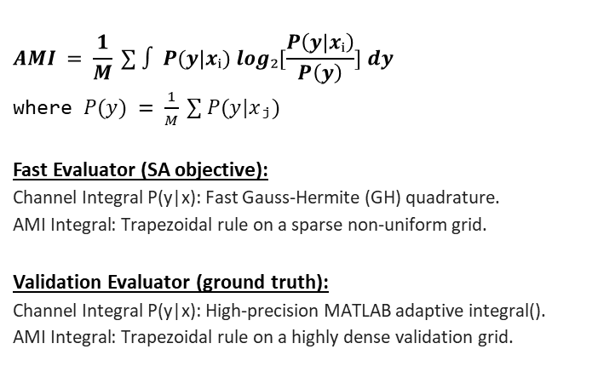
Geometric Shaping & AMI Evaluator [2]
Geometric Shaping Strategy
Dual AMI Evaluator Architecture
The Concept: Optimizing constellation coordinates to match channel statistics.
The Goal: Maximize Average Mutual Information (AMI) the true capacity limit.
System Impact: Higher data rates, better power efficiency, and extended link reach.
The Method: Simulated Annealing (SA) to escape local-maxima traps.
$$AMI = \frac{1}{M} ∑ ∫ P(y|xᵢ) log₂[\frac{P\left(y | xᵢ\right)}{P\left(y\right)}] dy$$
where $P(y) = \frac{1}{M} ∑ P(y|xⱼ)$
Fast Evaluator (SA objective):
Channel Integral P(y|x): Fast Gauss-Hermite (GH) quadrature.
AMI Integral: Trapezoidal rule on a sparse non-uniform grid.
Validation Evaluator (ground truth):
Channel Integral P(y|x): High-precision MATLAB adaptive integral().
AMI Integral: Trapezoidal rule on a highly dense validation grid.
[2] Kayhan & Montorsi, IEEE T. Wirel. Commun. 13, 2874 (2014)
P-2026-093 | Geometric Shaping in the FSO Turbulent Channel
4 / 10

Slide 6
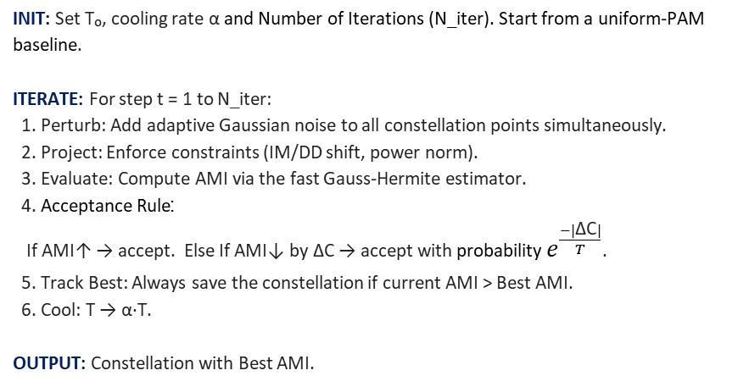
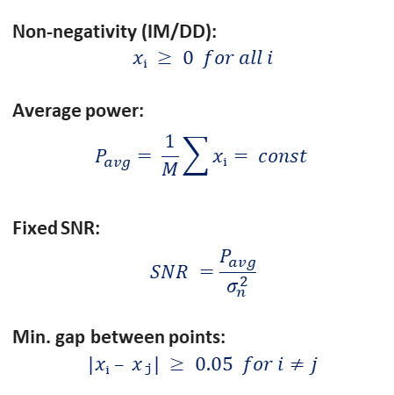
Simulated Annealing Algorithm [3]
SA for AMI Maximization
Constraints
INIT: Set T₀, cooling rate α and Number of Iterations (N_iter). Start from a uniform-PAM baseline.
ITERATE: For step t = 1 to N_iter:
1. Perturb: Add adaptive Gaussian noise to all constellation points simultaneously.
2. Project: Enforce constraints (IM/DD shift, power norm).
3. Evaluate: Compute AMI via the fast Gauss-Hermite estimator.
4. Acceptance Rule:
If AMI↑ → accept. Else If AMI↓ by ΔC → accept with probability $e^{\frac{−|\text{Δ}\text{C}|}{T}}$.
5. Track Best: Always save the constellation if current AMI > Best AMI.
6. Cool: T → α·T.
OUTPUT: Constellation with Best AMI.
Non-negativity (IM/DD):
$$xᵢ ≥ 0 for all i$$
Average power:
$$P_{avg}= \frac{1}{M}\sum{xᵢ}= const$$
Fixed SNR:
$$SNR =\frac{P_{avg}}{σ_{n}^{2}}$$
Min. gap between points:
$$|xᵢ – xⱼ| ≥ 0.05 for i≠j$$
[3] Qu & Djordjevic, IEEE Access 7, 21454 (2019)
P-2026-093 | Geometric Shaping in the FSO Turbulent Channel
6 / 10

Slide 7
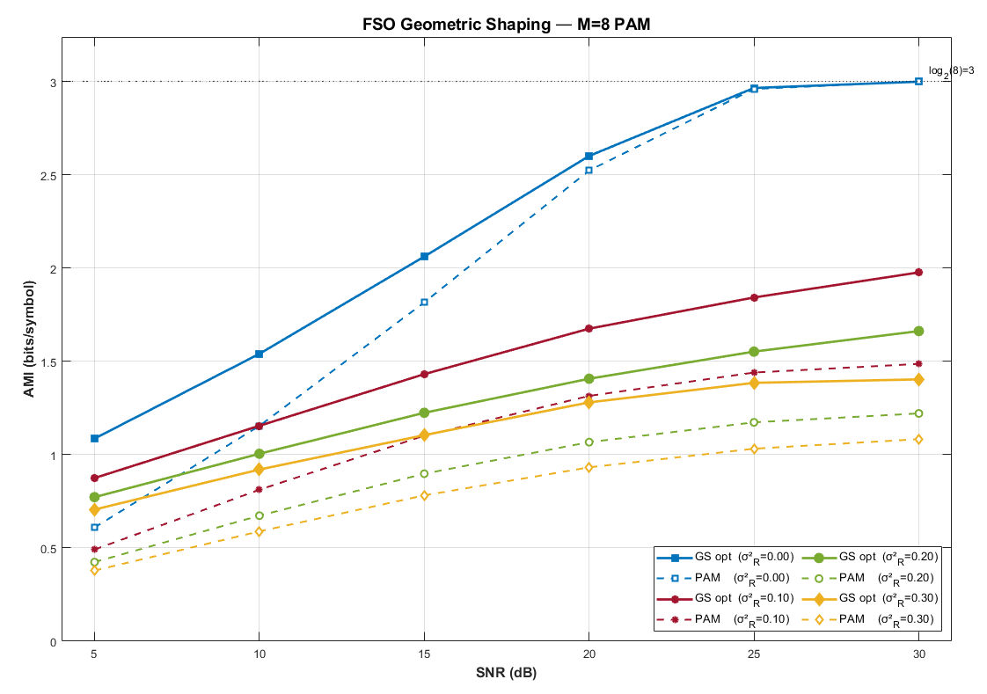
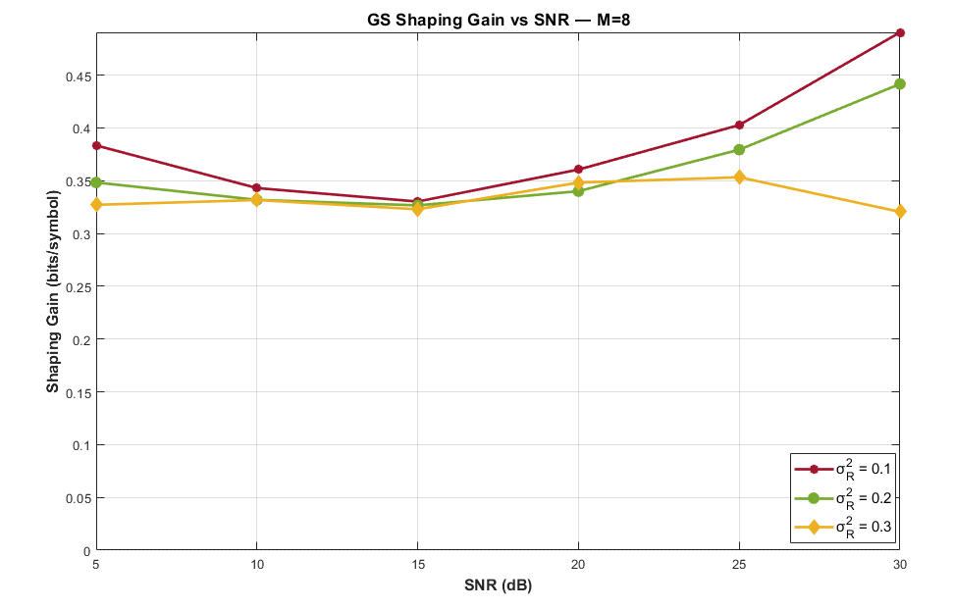
Results: AMI vs SNR - M=8 PAM
Setup: M = 8 (PAM Baseline) | SNR ∈ {5,10,15,20,25,30} dB × 4 turbulence levels ($σ_{R}^{2}$ ∈ {0.0, 0.1, 0.2, 0.3}| 3 STARTS/pt | 30K iter/start)
Graph Analysis: The first graph compares absolute AMI capacity against SNR and turbulence level (Solid = Optimized vs. Dashed = Uniform), while the second isolates the net shaping gain.
The Trend: Across the entire 5–30 dB SNR sweep, the shaping gain remains remarkably consistent (0.32–0.49 bits/sym), proving robustness to baseline noise.
P-2026-093 | Geometric Shaping in the FSO Turbulent Channel
8 / 10

Slide 8
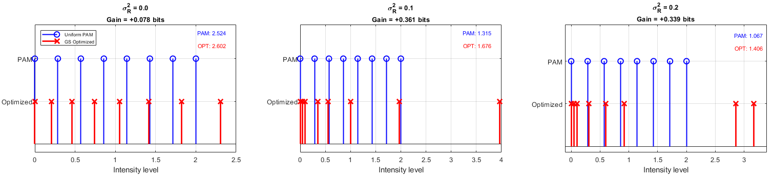
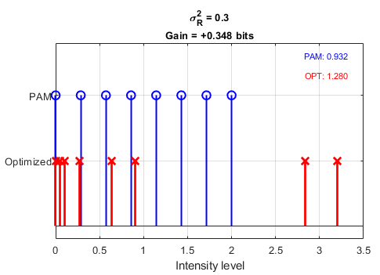
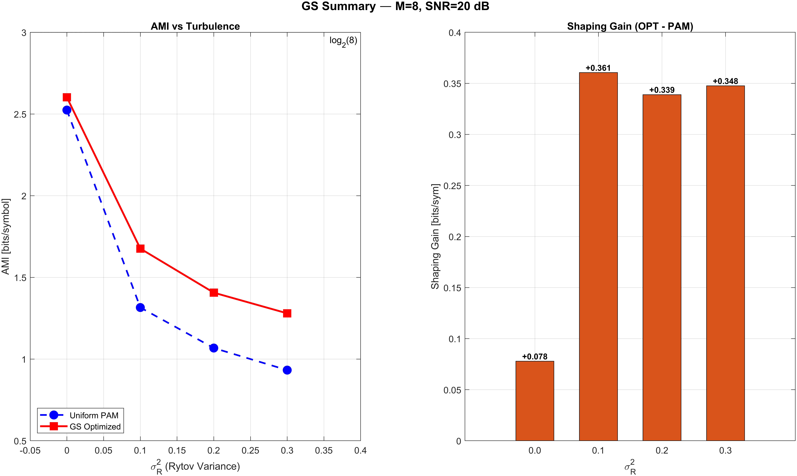
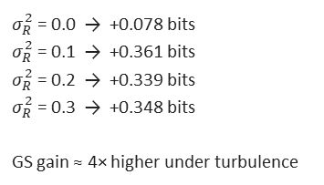
Results: Optimized Constellations & Shaping Gain
Setup: M = 8 (PAM Baseline) | SNR = 20 dB × 4 turbulence levels ($σ_{R}^{2}$ ∈ {0.0, 0.1, 0.2, 0.3}| 6 STARTS/level | 50K iter/start)
Blue (Uniform) vs. Red (Optimized): Visualizes how the algorithm shifts symbols from the evenly spaced baseline.
The Trend: As turbulence increases, symbols are actively clustered toward lower intensities (left) to avoid multiplicative noise.
Performance Summary: AMI & Shaping Gain:
Shaping Gain (M=8, 20 dB)
$σ_{R}^{2}$ = 0.0 → +0.078 bits
$σ_{R}^{2}$ = 0.1 → +0.361 bits
$σ_{R}^{2}$ = 0.2 → +0.339 bits
$σ_{R}^{2}$ = 0.3 → +0.348 bits
GS gain ≈ 4× higher under turbulence
P-2026-093 | Geometric Shaping in the FSO Turbulent Channel
7 / 10

Slide 9

Challenges & Solutions
Numerical instability in P(y|x)
Solution:
Log-normal integration prone to severe errors
Variable change (t = ln h) and strictly bounded limits for stable Gaussian integration.
SA computational bottleneck
Solution:
~20-50K AMI evaluations per run is extremely slow
Dual-Evaluator: Fast Gauss-Hermite (GH) for the SA loop, and high-precision integral() for validation.
Local-maxima traps
Solution:
Non-convex landscape traps optimizer
Parallel Multi-Start, and "Track Best" elitism
Gain verification & channel correctness
Solution:
Must ensure gain is real, not artifact of approximation
Strict validation suite verifying APP rules, decision boundaries, and theoretical AMI limits and high-precision AMI evaluator for Gain validation.
P-2026-093 | Geometric Shaping in the FSO Turbulent Channel
9 / 10

Slide 10
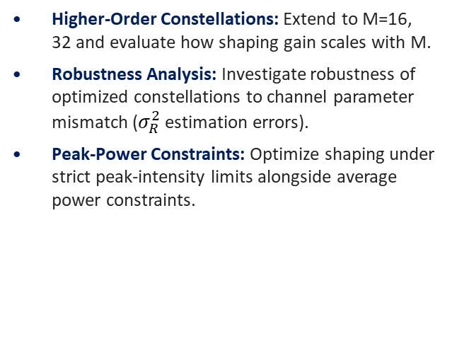
Conclusions & Next Steps
Achievements
Next Steps
Complete GS Framework: Built a robust SA optimization engine for M-PAM geometric shaping in FSO channels.
Rigorous Validation: Verified the physical channel model and dual-AMI evaluators via strict statistical tests.
Demonstrated Gains: Achieved significant shaping gains (e.g., +0.36 bits/sym for 8-PAM at 20dB SNR under weak turbulence).
Consistent Superiority: Full SNR sweep (5–30 dB) confirms GS consistently outperforms
Higher-Order Constellations: Extend to M=16, 32 and evaluate how shaping gain scales with M.
Robustness Analysis: Investigate robustness of optimized constellations to channel parameter mismatch ($σ_{R}^{2}$ estimation errors).
Peak-Power Constraints: Optimize shaping under strict peak-intensity limits alongside average power constraints.
P-2026-093 | Geometric Shaping in the FSO Turbulent Channel
10 / 10

