Slide 1

Chapter 1:
Introduction
to
Computers
and
Programming

Slide 2
Why Program?
Computer – programmable machine designed to follow instructions
Program – instructions in computer memory to make it do something
Programmer – person who writes instructions (programs) to make computer perform a task
SO, without programmers, no programs; without programs, a computer cannot do anything

Slide 3

Programs and Programming Languages
A program is a set of instructions that the computer follows to perform a task
We start with an algorithm, which is a set of well-defined steps.

Slide 4
Machine Language
Although the previous algorithm defines the steps for calculating the gross pay, it is not ready to be executed on the computer.
The computer only executes machine language instructions

Slide 5
Machine Language
Machine language instructions are binary numbers, such as
1011010000000101
Rather than writing programs in machine language, programmers use programming languages.

Slide 6
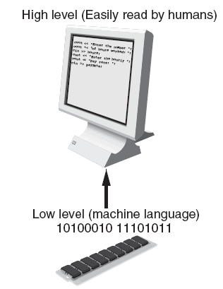
Programs and Programming Languages
Types of languages:
  Low-level: used for communication with computer hardware directly. Often written in binary machine code (0’s/1’s) directly.
  High-level: closer to human language

Slide 7
Some Well-Known Programming Languages (Table 1-1 on Page 10)
C++
BASIC
Ruby
Java
FORTRAN
Visual Basic
C#
COBOL
JavaScript
C
Python

Slide 8
From a High-Level Program to an Executable File
Create file containing the program with a text editor.
Run preprocessor to convert source file directives(begin with # symbol) to source code program statements.
Run compiler to convert source program into machine instructions.
Run linker to combine the object file with the necessary library routines. Once the linker has finished, the executable file is created.
Steps b–d are often performed by a single command or button click.
Errors detected at any step will prevent execution of following steps.

Slide 9
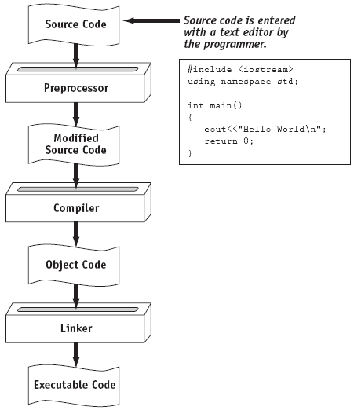
From a High-Level Program to an Executable File

Slide 10
Integrated Development Environments (IDEs)
An integrated development environment, or IDE, combine all the tools needed to write, compile, and debug a program into a single software application.
Examples are Microsoft Visual C++, Turbo C++ Explorer, CodeWarrior, etc.

Slide 11
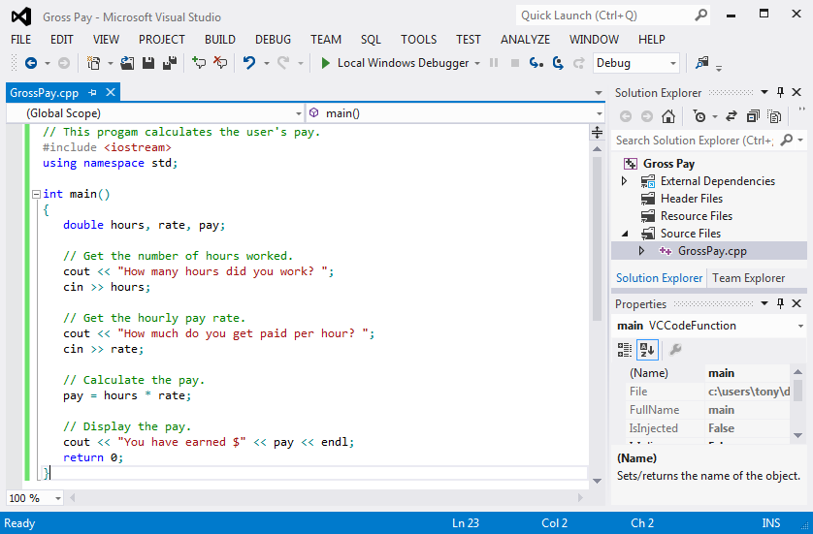
Integrated Development Environments (IDEs)

Slide 12
What is a Program Made of?
Common elements in programming languages:
  Key Words
  Programmer-Defined Identifiers
  Operators
  Punctuation
  Syntax

Slide 13
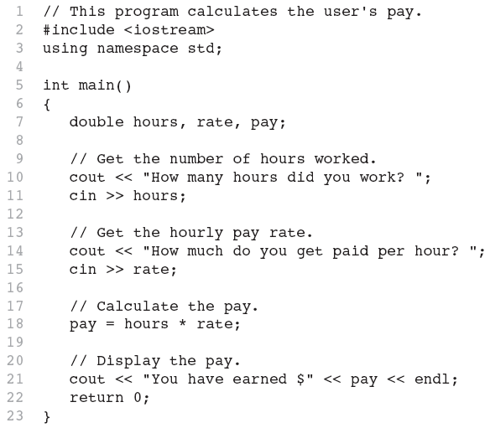
Program 1-1

Slide 14
Key Words
Also known as reserved words
Have a special meaning in C++
Can not be used for any other purpose
Key words in the Program 1-1: using, namespace, int, double, and return

Slide 15
Key Words

Slide 16
Programmer-Defined Identifiers
Names made up by the programmer
Not part of the C++ language
Used to represent various things: variables (memory locations), functions, etc.
In Program 1-1: hours, rate, and pay.

Slide 17
Operators
Used to perform operations on data
Many types of operators:
  Arithmetic - ex: +,-,*,/
  Assignment – ex: =
Some operators in Program1-1:
<< >> = *

Slide 18
Operators

Slide 19
Punctuation
Characters that mark the end of a statement, or that separate items in a list
In Program 1-1: , and ;

Slide 20
Punctuation

Slide 21
Syntax
The rules of grammar that must be followed when writing a program
Controls the use of key words, operators, programmer-defined symbols, and punctuation

Slide 22
Variables
A variable is a named storage location in the computer’s memory for holding a piece of data.
In Program 1-1 we used three variables:
  The hours variable was used to hold the hours worked
  The rate variable was used to hold the pay rate
  The pay variable was used to hold the gross pay

Slide 23
Variable Definitions
To create a variable in a program you must write a variable definition (also called a variable declaration)
Here is the statement from Program 1-1 that defines the variables:
double hours, rate, pay;

Slide 24
Variable Definitions
There are many different types of data, which you will learn about in this course.
A variable holds a specific type of data.
The variable definition specifies the type of data a variable can hold, and the variable name.

Slide 25
Variable Definitions
Once again, line 7 from Program 1-1:
double hours, rate, pay;
The word double specifies that the variables can hold double-precision floating point numbers. (You will learn more about that in Chapter 2)

Slide 26
Input, Processing, and Output
Three steps that a program typically performs:
  Gather input data:
    from keyboard
    from files on disk drives
  Process the input data
  Display the results as output:
    send it to the screen
    write to a file

Slide 27
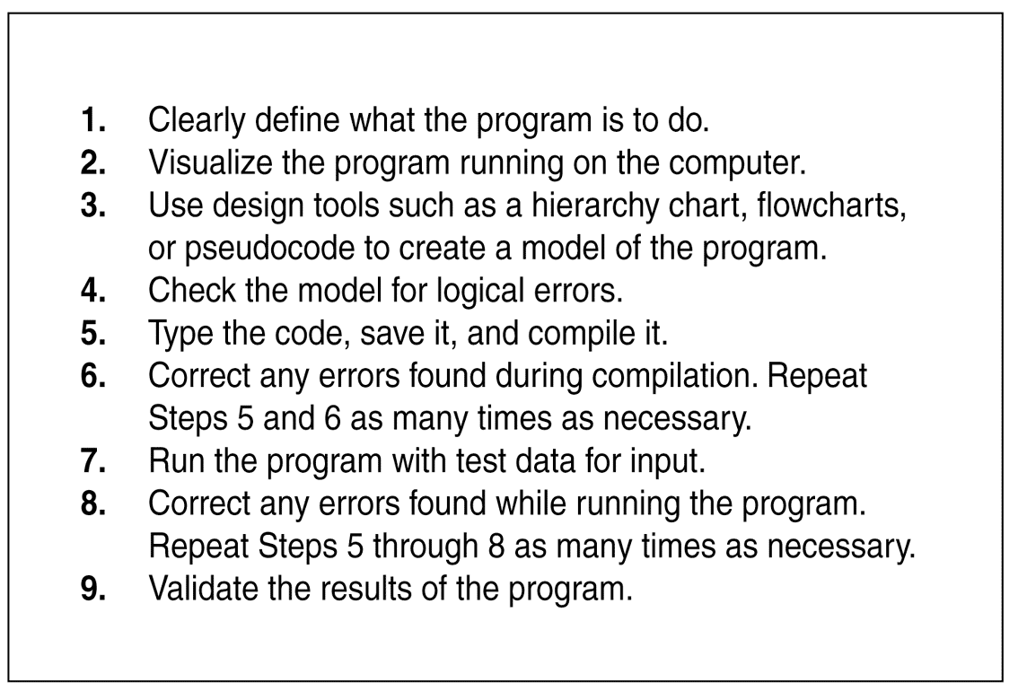
The Programming Process

Slide 28
Procedural and Object-Oriented Programming
Procedural programming: focus is on the process. Procedures/functions are written to process data.
Object-Oriented programming: focus is on objects, which contain data and the means to manipulate the data. Messages sent to objects to perform operations.

