Slide 1

Chapter 10:
Characters, C-Strings, and
More About the string Class

Slide 2
Character Testing
Requires cctype header file
FUNCTION | MEANING
isalpha | true if arg. is a letter, false otherwise
isalnum | true if arg. is a letter or digit, false otherwise
isdigit | true if arg. is a digit 0-9, false otherwise
islower | true if arg. is lowercase letter, false otherwise
isprint | true if arg. is a printable character, false otherwise
ispunct | true if arg. is a punctuation character, false otherwise
isupper | true if arg. is an uppercase letter, false otherwise
isspace | true if arg. is a whitespace character, false otherwise
Notes:
C++ library provides several functions that allow you to test the value of a character.
These functions test a single char argument and return either true of false.

Slide 3
Examples
char ch1 = 'h'; char ch2 = '!';
cout << isupper(ch1) << endl; //Display false(0)
cout << isalpha(ch1) << endl; //Display true
cout << ispunct(ch2) << endl; //Display true
cout << isalnum(ch1) << endl; //Display true
cout << isspace(ch1) << endl; //Display false(0)

Slide 4
Character Case Conversion Function
toupper:
  if char argument is lowercase letter, return uppercase equivalent; otherwise, return input unchanged
Example
  char ch1 = 'h'; char ch2 = '!';
  cout << toupper(ch1) << endl; // Display ASCII code of A
  cout << static_cast<char>(toupper(ch1)) << endl; // displays 'H‘
  cout << (char)(toupper(ch2)) << endl; // displays ‘!'

Slide 5
Character Case Conversion Function
tolower:
if char argument is uppercase letter, return lowercase
equivalent; otherwise, return input unchanged
Example
  char ch1 = 'H';
  char ch2 = 'e';
  char ch3 = '!';
  cout << (char)tolower(ch1); // displays 'h'
  cout << (char)tolower(ch2); // displays 'e'
  cout << (char)tolower(ch3); // displays '!'

Slide 6

C-Strings
C-string: sequence of characters stored in adjacent memory locations and terminated by NULL character. C-style strings are really arrays.
String literal (string constant): sequence of characters enclosed in double quotes " " : "Hi there!"
H
i
t
h
e
r
e
!
\0
Notes:
In C++. All string literals are stored in memory as C-string.
String literals are enclosed in double quotation marks.

Slide 7
C-Strings
Array of chars can be used to define storage for string:
const int SIZE = 20;
char city[SIZE];
Leave room for NULL at end
Can enter a value using cin or >>
  Input is whitespace-terminated
  No check to see if enough space
For input containing whitespace, and to control amount of input, use cin.getline()
  e.g., cin.getline(city, SIZE);
Notes:
For the string type,
string name;
getline(cin, name);

Slide 8
#include <iostream>
using namespcase std;
void main()
{
const int SIZE = 80;
char line[SIZE];
int count = 0;
cout << "Enter a sequence of no more than 79 characters: << endl;
cin.getline(line, SIZE);
while (line[count] != '\0')
{
cout << line[count];
count++;
}
}

Slide 9
Library Functions for Working with C-Strings
Require the cstring header file
strlen(str): returns length of C-string str
char city[SIZE] = "Missoula";
cout << strlen(city); // prints 8
strcat(str1, str2): appends str2 to the end of str1. Note: Make sure str1 is large enough to hold str1 plus str2 plus a null terminator
char location[SIZE] = “Peoria, “;
char state[3] = “IL”;
strcat(location, state);//location has “Peoria, IL"

Slide 10
Library Functions for Working with C-Strings
strcpy(str1, str2): copies str2 to str1
const int SIZE = 20;
char fname[SIZE] = "Maureen", name[SIZE];
strcpy(name, fname); // name has “Maureen”
strstr(str1, str2): search for a string inside of a string
finds the first occurrence of str2 in str1. Returns a pointer
to match, or NULL if no match.
char river[] = "Wabashaba";
char word[] = "aba";
cout << strstr(river, word);// displays "abashaba"

Slide 11
Library Functions for Working with C-Strings
strcmp(str1, str2): returns 0 if two strings are same; returns negative if str1 comes before str2 in alphabetic order; returns positive if str1 comes after str2.
char str1[40] = “Alfonso”, str2[40]= “Alfonso”;
if(strcmp(str1, str2) == 0)
cout << “two strings are same”;

Slide 12
Find Errors
Q1:
char str[] = “Stop”;
if(isupper(str) == “STOP”)
exit(0);
Q2:
    char str1[] = "Billy";
    char str2[] = "Bon Jones";
    strcat(str1, str2);
    cout << str1 << endl;
Q3:
    char x = 'a', y = 'a';
    if (strcmp(x, y) == 0)
    exit(0);

Slide 13
Practice
Write a statement that will copy the string “Beethoven” to the array composer.
When complete, the following program skeleton will search for the string “Windy” in the array place. If place contains “Windy” the program will display the message “Windy found”. Otherwise, it displays “Windy no found”.
  int main()
  {
  char place[] = “The Windy City”;
  //complete the program . It should search the array place for the string
  //“Windy” and display the message “Windy found” if it finds the string.
  //Otherwise, it should display the message “Windy no found.”
  return 0;
  }

Slide 14
String/Numeric Conversion Functions
Requires cstdlib header file
FUNCTION | PARAMETER | ACTION
atoi | C-string | converts C-string to an int value, returns the value
atol | C-string | converts C-string to a long value, returns the value
atof | C-string | converts C-string to a double value, returns the value
Examples:
  int iNum;
  Long lNum;
  double dNum;
  iNum = atoi("1234"); // puts 1234 in iNum
  lNum = atol("5678"); // puts 5678 in lNum
  dNum = atof("35.7"); // puts 35.7 in dNum
Notes:
Several functions exist in C++library for converting c string representation of numbers into numeric values.

Slide 15
Passing C-string as an argument
int countChars(char[], char);
void main()
{
const int SIZE = 20;
char inputStr[SIZE];
char letter;
cout << "enter a string:";
cin.getline(inputStr, SIZE);
cout << "enter a character:";
cin >> letter;
int count = countChars(inputStr, letter);
cout << "count:" << count << endl;
}
int countChars(char strArray[], char ch)
{
int i = 0; int count = 0;
while (strArray[i] != '\0')
{
if (strArray[i] == ch)
count++;
i++;
}
return count;
}

Slide 16
Using pointers to pass C-string arguments
int countChars(char *, char);
void main()
{
const int SIZE = 20;
char *inputStr;
char letter;
cout << "enter a string:";
cin.getline(inputStr, SIZE);
cout << "enter a character:";
cin >> letter;
int count = countChars(inputStr, letter);
cout << "count:" << count << endl;
}
int countChars(char *ptrStr, char ch)
{
int i = 0; int count = 0;
while (*ptrStr != '\0')
{
if (*ptrStr == ch) count++;
ptrStr++;
}
return count;
}

Slide 17
The C++ string Class
Special data type supports working with strings
#include <string>
Can define string variables in programs:
  string firstName, lastName;
Can receive values with assignment operator:
  firstName = "George";
  lastName = "Washington";
Can be displayed via cout
  cout << firstName << " " << lastName;

Slide 18
Input into a string Object
Use cin >> to read an item into a string:
  string firstName;
  cout << "Enter your first name: ";
  cin >> firstName;
  cout << “Good Morning “ << firstName << endl;

Slide 19
Input into a string Object
Use getline function to put a line of input, possibly including spaces, into a string:
  string address;
  cout << "Enter your address: ";
  getline(cin,address);
  Note: for C-String, cin.getline(c_string, size)

Slide 20
Input into a string Object and access using array
Output:
Enter your name: Scott
S
c
o
t
t
string name;
cout << "Enter your name: ";
getline(cin, name);
for (int i = 0; i< name.length();i++)
{
cout << name[i] << endl;
}

Slide 21
string Comparison
Can use relational operators directly to compare string objects:
  string str1 = "George", str2 = "Georgia";
  if (str1 < str2) //alphabetic order
  cout << str1 << " is less than “ << str2;

Slide 22
string Operators
OPERATOR | MEANING
>> | extracts characters from stream up to whitespace, insert into string
<< | inserts string into stream
= | assigns string on right to string object on left
+= | appends string on right to end of contents on left
+ | concatenates two strings
[] | references character in string using array notation
>, >=, <, <=, ==, != | relational operators for string comparison. Return true or false

Slide 23
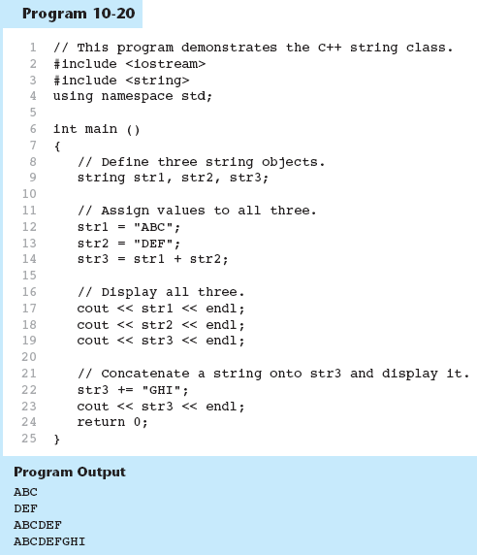

Slide 24
string Member Functions
Are behind many overloaded operators
Categories:
  assignment: assign, copy, data
  modification: append, clear, erase, insert, replace, swap
  space management: capacity, empty, length, resize, size
  substrings: find, front, back, at, substr
  comparison: compare
See Table 10-8 for a list of functions.

Slide 25
Find function
Return the first position at or beyond position x, default is 0
Examples
  string str1 = "Ja yo Afu! Yo yo yo!";
  string str2 = “yo”;
  string str3 = “you”;
  int temp;
  temp = str1.find(str2); // temp is 3
  temp = str1.find(str2, 4); // temp is 14
  temp = str1.find(str3); // temp is -1, if not found, function returns string::npos. The value of npos is -1
0 | 1 | 2 | 3 | 4 | 5 | 6 | 7 | 8 | 9 | 10 | 11 | 12 | 13 | 14 | 15 | 16 | 17 | 18 | 19 | 20
J | a |  | y | o |  | A | f | u | ! |  | Y | o |  | y | o |  | y | o | ! | \0

Slide 26
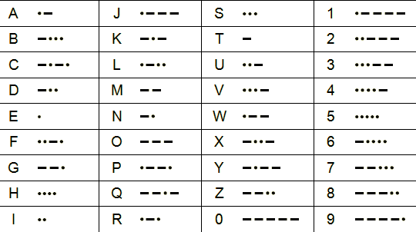
Lab 10
Morse code is a code where each letter if the English alphabet, each digit, and various punctuation characters are represented by a series of dots and dashes. Write a program that asks the user to enter a string and then converts that string to Morse code.

Slide 27
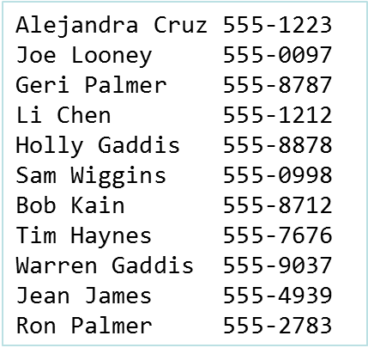
Lab 10 (contd.)
This program starts with reading input file which holds people’s names and phone numbers and then save this input data to array.
The program should ask the user to enter a name or partial name to search for.
Any entries in the array that match the string entered should be displayed. For example, if user enters ‘Palmer’ the program should displays the following names from the array. Hint: you may use the find function.
    Geri Palmer, 555-8787
    Ron Palmer, 555-2783
Note: To ignore the white spaces
when you read data from the file, use ‘inFile >> ws;’

