Slide 1

Chapter 13:
Introduction to Classes

Slide 2
13.1
Procedural and Object-Oriented Programming

Slide 3

Object-Oriented Programming
Terminology
class: like a struct (allows bundling of related variables), but variables and functions in the class can have different properties than in a struct
object: an instance of a class, in the same way that a variable can be an instance of a struct

Slide 4
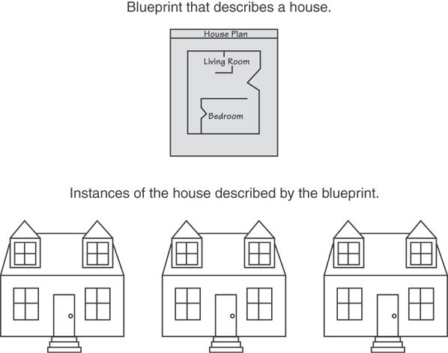
Classes and Objects
A Class is like a blueprint and objects are like houses built from the blueprint

Slide 5
Object-Oriented Programming
Terminology
attributes: members of a class
methods or behaviors: member functions of a class

Slide 6
More on Objects
data hiding: restricting access to certain members of an object
public interface: members of an object that are available outside of the object. This allows the object to provide access to some data and functions without sharing its internal details and design, and provides some protection from data corruption

Slide 7
13.2
Introduction to Classes

Slide 8
Introduction to Classes
Objects are created from a class
Format:
  class ClassName
  {
  declaration;
  declaration;
  };

Slide 9
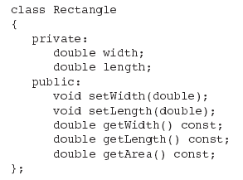
Class Example

Slide 10
Access Specifiers
Used to control access to members of the class
public: can be accessed by functions outside of the class
private: can only be called by or accessed by functions that are members of the class

Slide 11
Class Example
Private Members
Public Members

Slide 12
More on Access Specifiers
Can be listed in any order in a class
Can appear multiple times in a class
If not specified, the default is private

Slide 13

Using const With Member Functions
const appearing after the parentheses in a member function declaration specifies that the function will not change any data in the calling object.

Slide 14
Defining a Member Function
When defining a member function:
  Put prototype in class declaration
  Define function using class name and scope resolution operator (::)
    int Rectangle::setWidth(double w)
    {
    width = w;
    }

Slide 15
Accessors and Mutators
Mutator: a member function that stores a value in a private member variable, or changes its value in some way
Accessor: function that retrieves a value from a private member variable. Accessors do not change an object's data, so they should be marked const.

Slide 16
13.3
Defining an Instance of a Class

Slide 17
Defining an Instance of a Class
An object is an instance of a class
Defined like structure variables:
  Rectangle r;
Access members using dot operator:
  r.setWidth(5.2);
  cout << r.getWidth();
Compiler error if attempt to access private member using dot operator

Slide 18
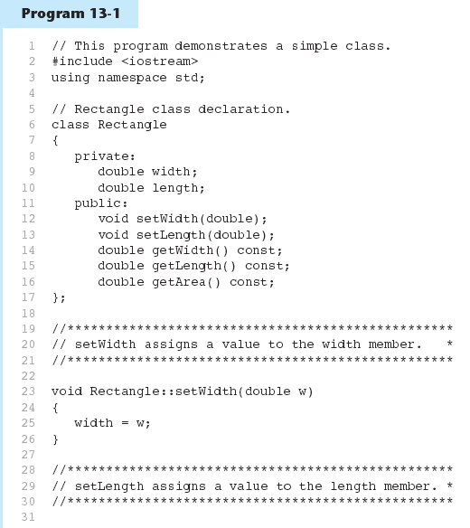

Slide 19
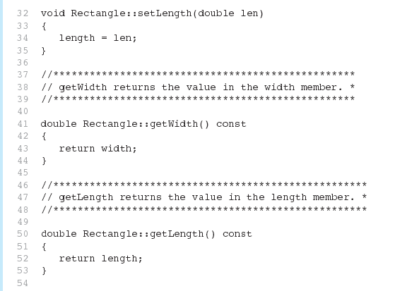
Program 13-1 (Continued)

Slide 20
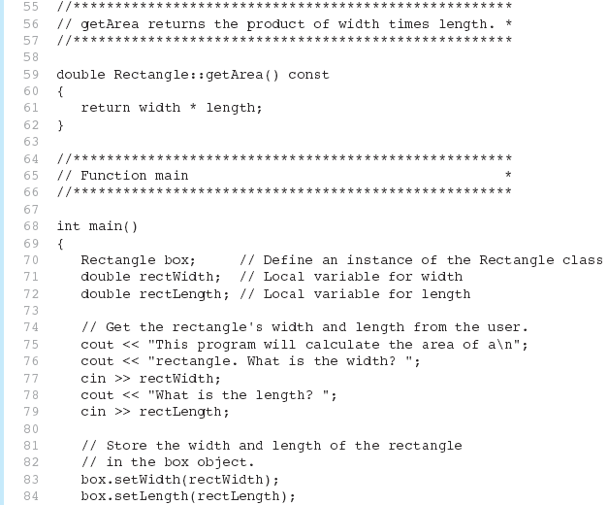
Program 13-1 (Continued)

Slide 21
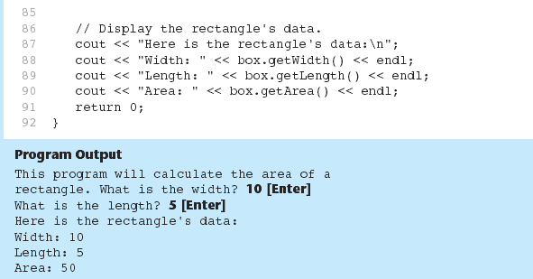
Program 13-1 (Continued)

Slide 22
Pointer to an Object
Can define a pointer to an object:
  Rectangle *rPtr = nullptr;
Can access public members via pointer:
  rPtr = &otherRectangle;
  rPtr->setLength(12.5);
  cout << rPtr->getLength() << endl;

Slide 23
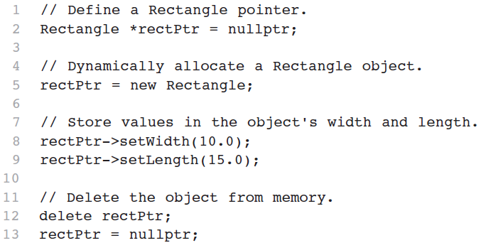
Dynamically Allocating an Object
We can also use a pointer to dynamically allocate an object.

Slide 24
13.4
Why Have Private Members?

Slide 25
Why Have Private Members?
Making data members private provides data protection
Data can be accessed only through public functions
Public functions define the class’s public interface

Slide 26

Code outside the class must use the class's public member functions to interact with the object.

Slide 27
13.5
Separating Specification from Implementation

Slide 28
Separating Specification from Implementation
  Place class declaration in a header file that serves as the class specification file. Name the file ClassName.h, for example, Rectangle.h
  Place member function definitions in ClassName.cpp, for example, Rectangle.cpp File should #include the class specification file
  Programs that use the class must #include the class specification file, and be compiled and linked with the member function definitions

Slide 29
13.6
Inline Member Functions

Slide 30
Inline Member Functions
Member functions can be defined
  inline: in class declaration
  after the class declaration
Inline appropriate for short function bodies:
  int getWidth() const
  { return width; }

Slide 31
Rectangle Class with Inline Member Functions
1 // Specification file for the Rectangle class
2 // This version uses some inline member functions.
3 #ifndef RECTANGLE_H
4 #define RECTANGLE_H
5
6 class Rectangle
7 {
8 private:
9 double width;
10 double length;
11 public:
12 void setWidth(double);
13 void setLength(double);
14
15 double getWidth() const
16 { return width; }
17
18 double getLength() const
19 { return length; }
20
21 double getArea() const
22 { return width * length; }
23 };
24 #endif
The include guide(also called macro guard) prevents the header file from being included more than once.
If RECTANGLE_H has not been defined, everything between #ifndef and #endif directives is included. Otherwise, everything #ifndef and #endif directives is skipped.

Slide 32
Inline vs. Regular Member Functions
Regular functions – when called, compiler stores return address of call, allocates memory for local variables, etc.
Code for an inline function is copied into program in place of call, but no function call overhead, hence faster execution

Slide 33
13.7
Constructors

Slide 34
Constructors
Member function that is automatically called when an object is created
Purpose is to construct an object
Constructor function name is class name
Has no return type

Slide 35
Default Constructors
A default constructor is a constructor that takes no arguments.
If you write a class with no constructor at all, C++ will write a default constructor for you, one that does nothing.
A simple instantiation of a class (with no arguments) calls the default constructor:
  Rectangle r;

Slide 36
Constructors
Class Demo
{
public:
Demo(); //Constructor
};
Demo::Demo()
{
cout << “Welcome to the constructor!\n”;
}
int main()
{
Demo demoObject; //Define a Demo object;
Demo *demoPtr = nullptr; //Declare pointer variable which holds the address of Demo object. At this
//statement, constructor does not execute
ptrDemo = new Demo; //Demo object is created by the new operator, its default constructor is
//executed automatically
return 0;
}

Slide 37
13.8
Passing Arguments to Constructors

Slide 38
Passing Arguments to Constructors
indicate parameters in prototype:
Rectangle(double, double);
Use parameters in the definition:
Rectangle::Rectangle(double w, double len)
{
width = w;
length = len;
}
You can pass arguments to the constructor when you create an object:
Rectangle r(10, 5);

Slide 39
More About Default Constructors
If all of a constructor's parameters have default arguments, then it is a default constructor.
  For example:
  Rectangle(double = 0, double = 0);
Creating an object and passing no arguments will cause this constructor to execute:
Rectangle r;

Slide 40
Classes with No Default Constructor
When all of a class's constructors require arguments, then the class has NO default constructor.
When this is the case, you must pass the required arguments to the constructor when creating an object.

Slide 41
13.9
Destructors

Slide 42
Destructors
Member function automatically called when an object is destroyed
Destructor name is ~classname, e.g., ~Rectangle
Has no return type; takes no arguments
Only one destructor per class, i.e., it cannot be overloaded
If constructor allocates dynamic memory, destructor should release it

Slide 43
//ContactInfo.h
#ifndef CONTACT_INFO_H
#define CONTACT_INFO_H
Class ContactInfo
{
private:
char *name;
char *phone;
public:
ContactInfo(char *n, char *p)
{
name = new char[strlen(n) +1];
phone = new char[strlen(p) +1];
strcpy(name, n);
strcpy(phone, p);
}
~ContactInfo()
{
delete [] name;
delete [] phone;
}
char *getName() { return name;}
char *getPhone() { return phone;}
};
#endif
//TestDr.cpp
#include <iostream>
#include “ContactInfo.h”
Using namespace std;
int main()
{
ContactInfo entry(“Kristen Lee”, “555-6666”);
cout << entry.getName(); << endl;
cout << entry.getPhone(); << endl;
return 0;
}

Slide 44
Constructors, Destructors, and Dynamically Allocated Objects
When an object is dynamically allocated with the new operator, its constructor executes:
Rectangle *r = new Rectangle(10, 20);
When the object is destroyed, its destructor executes:
delete r;

Slide 45
Lab 13-1
Write a Circle class that has the following member variables:
  radius: a double
  pi: a double initialized with the value 3.14159
The class should have the following member functions:
Default constructor: set radius to 0.0
Constructor: accepts the radius of the circle as an argument
setRadius: a mutator function for the radius variable
getRadius: a accedssor function for the radius variable
geArea: returns the area of the circle, which is calculated as area = pi * radius * radius
getDiameter: returns the diameter of the circle, which is calculated as diameter = 2 * radius
getCircumference: returns the circumference of the circle, which is calculated as circumference = 2 * pi * radius
Write a program that demonstrates the Circle class by asking the user for the circle’s radius, creating a Circle object, and then reporting the circle’s area, diameter, and circumference.

Slide 46
13.10
Overloading Constructors

Slide 47
Overloading Constructors
A class can have more than one constructor
Overloaded constructors in a class must have different parameter lists:
  Rectangle();
  Rectangle(double);
  Rectangle(double, double);

Slide 48
Only One Default Constructor and One Destructor
Do not provide more than one default constructor for a class: one that takes no arguments and one that has default arguments for all parameters
  Square();
  Square(int = 0); // will not compile
Since a destructor takes no arguments, there can only be one destructor for a class

Slide 49
Member Function Overloading
Non-constructor member functions can also be overloaded:
  void setCost(double);
  void setCost(char *);
Must have unique parameter lists as for constructors

Slide 50
3.11
Using Private Member Functions

Slide 51
Using Private Member Functions
A private member function can only be called by another member function
It is used for internal processing by the class, not for use outside of the class

Slide 52
//ContactInfo.h
#ifndef CONTACT_INFO_H
#define CONTACT_INFO_H
Class ContactInfo
{
private:
char *name;
char *phone;
void initName(char *n)
{
name = new char[strlen(n) + 1];
strcpy(name, p);
}
public:
ContactInfo(char *n, char *p)
{
initName(n);
phone = new char[strlen(p) +1];
strcpy(phone, p);
}
~ContactInfo()
{
delete [] name; delete [] phone;
}
char *getName() { return name;}
char *getPhone() { return phone;}
};
#endif
//TestDr.cpp
#include <iostream>
#include “ContactInfo.h”
Using namespace std;
int main()
{
ContactInfo entry(“Kristen Lee”, “555-6666”);
cout << entry.getName(); << endl;
cout << entry.getPhone(); << endl;
return 0;
}

Slide 53
13.12
Arrays of Objects

Slide 54
Arrays of Objects
Objects can be the elements of an array:
  InventoryItem inventory[40];
Default constructor for object is used when array is defined

Slide 55
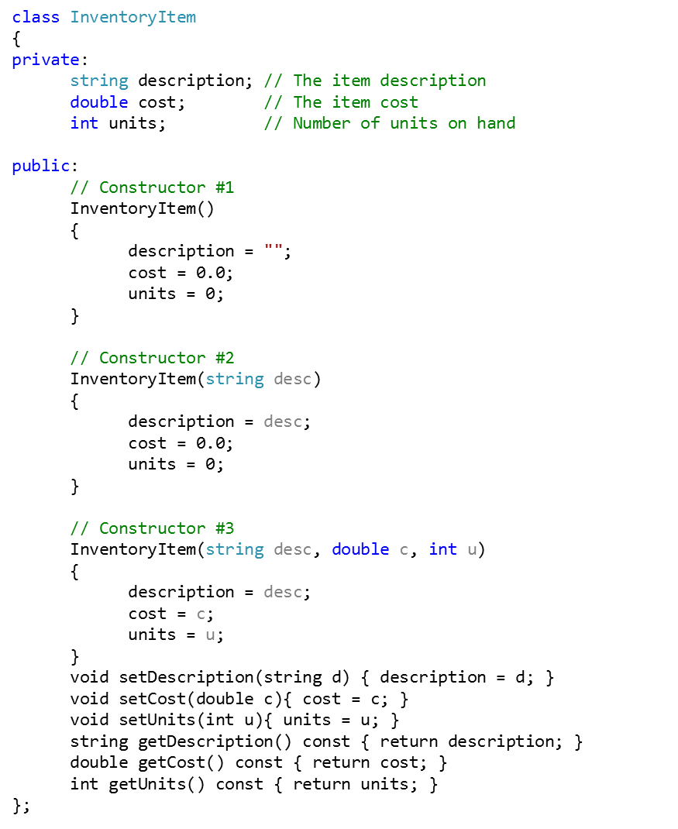

Slide 56
Arrays of Objects
Must use initializer list to invoke constructor that takes arguments:
  InventoryItem inventory[3] =
  { "Hammer", "Wrench", "Pliers" };

Slide 57

Arrays of Objects
If the constructor requires more than one argument, the initializer must take the form of a function call:

Slide 58

Arrays of Objects
It isn't necessary to call the same constructor for each object in an array:

Slide 59
Accessing Objects in an Array
Objects in an array are referenced using subscripts
Member functions are referenced using dot notation:
  inventory[2].setUnits(30);
  cout << inventory[2].getUnits();

Slide 60
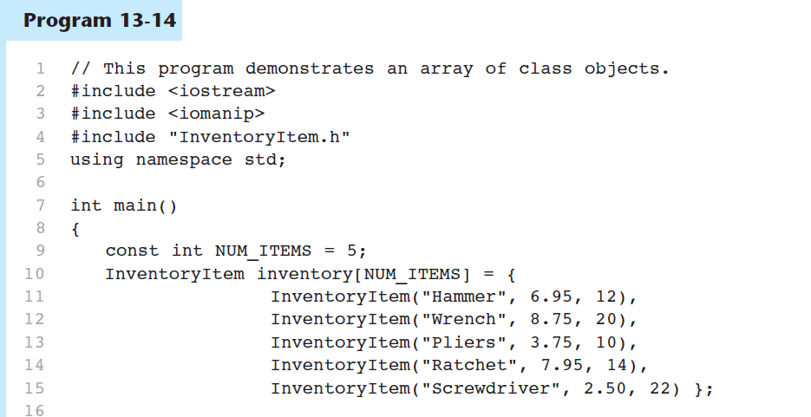
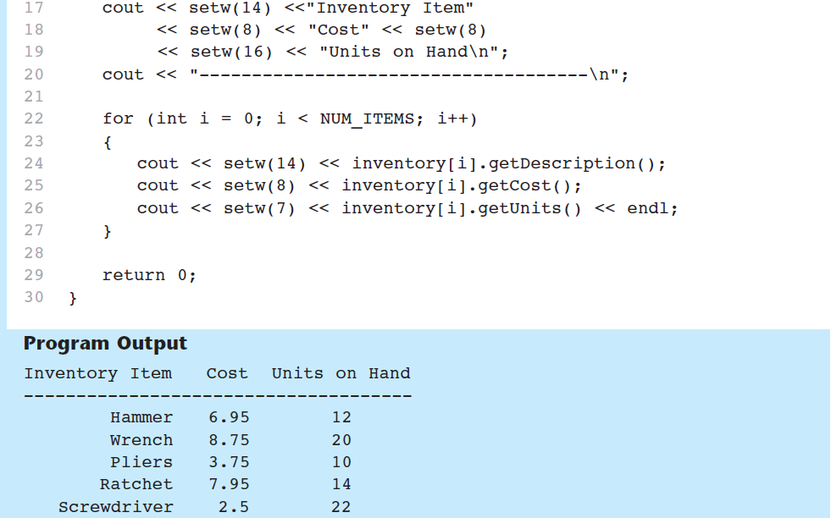

Slide 61
Lab 13-2
Write a class named Coin. The Coin class should have the following member variable:
  A string named sideUp. The sideUp member variable will hold either “head” or “tails” indicating the side of the coin that is facing up.
The Coin class should have the following member functions:
Default constructor that randomly determines the side of the coin that is facing up (“head or tail) and initializes the sideUp member variable accordingly
The void member function named the toss that simulates the tossing of the coin. When the toss member function is called, it randomly determines the side of the coin that is facing up(head or tail) and sets the sideUp member variable accordingly
A member function named getSideUp that returns the value of the sideUp member variable
Write a program that demonstrates the Coin class. The program should create an instance of the class and display the side that is initially facing up. Then, use a loop to toss the coin 20 times. Each time the coin is tossed, display the side that is facing. The program should keep count of the number of times heads is facing up and the number of times tails is facing up, and display those values after the loop finishes. Note: header, implementation, testDriver programs separately and also include a macro guard, named COIN_H

