Slide 1

Chapter 14 & 15:
More About Classes

Slide 2

Instance and Static Members
instance variable: a member variable in a class. Each object has its own copy.
static variable: one variable shared among all objects of a class
static member function: can be used to access static member variable; can be called before any objects are defined

Slide 3
static member variable
Contents of Tree.h
1 // Tree class
2 class Tree
3 {
4 private:
5 static int objectCount; // Static member variable.
6 public:
7 // Constructor
8 Tree()
9 { objectCount++; }
10
11 // Accessor function for objectCount
12 int getObjectCount() const
13 { return objectCount; }
14 };
15
16 // Definition of the static member variable, written
17 // outside the class.
18 int Tree::objectCount = 0;
Static member declared here.
Static member defined here.
Notes:
Line 18, this statement causes the variable to be created in the memory and is required.
Even if C++ stores 0 to the static variable automatically, it is good practice to initialize the variable anyway.
Static variable should not be initialized inside the class. Therefore, static variable should be initialized outside of the class.

Slide 4
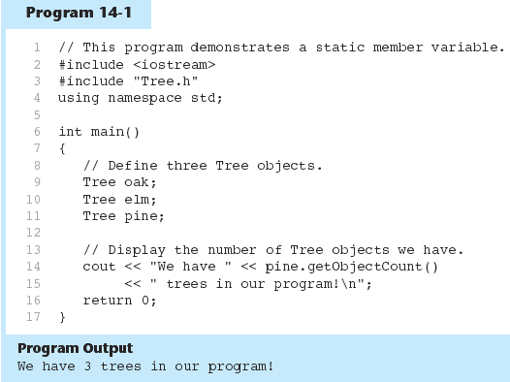

Slide 5
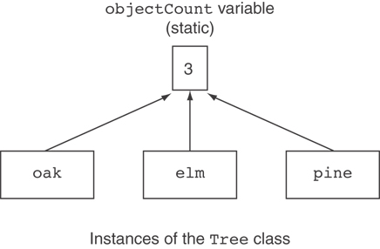
Three Instances of the Tree Class, But Only One objectCount Variable

Slide 6
static member function
Declared with static before return type:
  static int getObjectCount() const
  { return objectCount; }
Static member functions can only access static member data
Can be called independent of objects:
int num = Tree::getObjectCount();

Slide 7
Modified Version of Tree.h
1 // Tree class
2 class Tree
3 {
4 private:
5 static int objectCount; // Static member variable.
6 public:
7 // Constructor
8 Tree()
9 { objectCount++; }
10
11 // Accessor function for objectCount
12 static int getObjectCount() const
13 { return objectCount; }
14 };
15
16 // Definition of the static member variable, written
17 // outside the class.
18 int Tree::objectCount = 0;
//Now we can call the function like this:
void main(){
cout << "There are " << Tree::getObjectCount() << " objects.\n";
}
// Notice that no instance of the Budget class have been defined

Slide 8
Friends of Classes
Friend: a function or class that is not a member of a class, but has access to private members of the class
A friend function can be a stand-alone function or a member function of another class
It is declared a friend of a class with friend keyword in the function prototype

Slide 9
friend Function Declarations
Stand-alone function:
  friend void setAVal(intVal&, int);
  // declares setAVal function to be
  // a friend of this class
Member function of another class:
  friend void SomeClass::setNum(int num)
  // setNum function from SomeClass
  // class is a friend of this class

Slide 10
friend Class Declarations
  class FriendClass
  {
  ...
  };
  class NewClass
  {
  public:
  friend class FriendClass; // declares
  // entire class FriendClass as a friend
  // of this class
  …
  };

Slide 11
#include <iostream>
class Count
{
friend void setX(Count &, int); // friend declaratio
public:
Count() { x= 0 ;}
void print() const { count << x << endl;}
private:
int x;
};
//Can modify private data of Count because setX is declared as a friend function of Count
void setX(Count &c, int val) { c.x = val; } //Access the private variable x
int main(void)
{
Count counter;
cout << “counter.x after instantiation:”;
counter.print();
cout << “counter.x after call to setX friend function:”;
setX( counter, 8);
counter.print();
return 0;
}
Result:
Counter.x after instantiation:0
Counter.x after call to setX friend function: 8

Slide 12
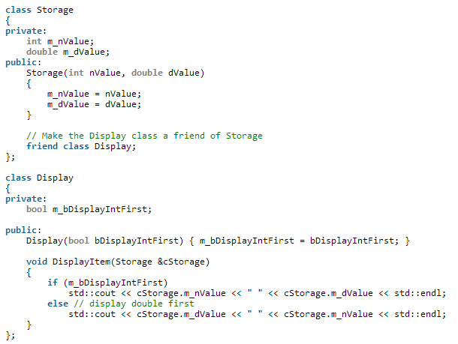
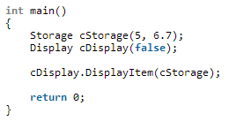

Because the Display class is a friend of Storage, any of Display’s members that use a Storage class object can access the private members of Storage directly.
Result:

Slide 13
The this Pointer
this: predefined pointer available to a class’s member functions
Always points to the instance (object) of the class whose function is being called
Is passed as a hidden argument to all non-static member functions
Can be used to access members that may be hidden by parameters with same name

Slide 14
class SomeClass
{
private:
int num;
public:
void setNum(int num)
{ this->num = num; }
};
int main()
{
SomeClass c1 = new someClass;
SomeClass c2 = new someClass;
c1.setNum(10); //”this” pointer is pointing to c1
c2.setNum(10); //”this” pointer is pointing to c2
return 0;
}

Slide 15
What Is Inheritance?
Inheritance allows a new class to be based on an existing class.
The new class inherits all the member variables and functions of the class it is based on.

Slide 16
Inheritance – Terminology
Base class (or parent) – inherited from
Derived class (or child) – inherits from the base class
Notation:
  class Student // base class
  {
  . . .
  };
  class UnderGrad : public student
  { // derived class
  . . .
  };

Slide 17
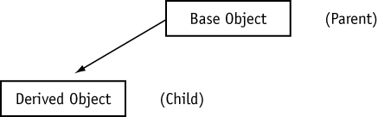
Inheritance

Slide 18
Class Access Specifiers
public – object of derived class can be treated as object of base class (not vice-versa)
protected – more restrictive than public, but allows derived classes to know details of parents
private – prevents objects of derived class from being treated as objects of base class.

Slide 19
Inheritance vs. Access
How inherited base class members
appear in derived class
Base class members
private: x
protected: y
public: z
private
base class
x is inaccessible
private: y
private: z
private: x
protected: y
public: z
protected
base class
x is inaccessible
protected: y
protected: z
private: x
protected: y
public: z
public
base class
x is inaccessible
protected: y
public: z

Slide 20
More Inheritance vs. Access
class Grade
class Test : public Grade
private members:
char letter;
float score;
void calcGrade();
public members:
void setScore(float);
float getScore();
char getLetter();
private members:
int numQuestions;
float pointsEach;
int numMissed;
public members:
Test(int, int);
private members:
int numQuestions:
float pointsEach;
int numMissed;
public members:
Test(int, int);
void setScore(float);
float getScore();
float getLetter();
When Test class inherits
from Grade class using
public class access, it looks like this:

Slide 21
More Inheritance vs. Access (2)
class Grade
class Test : protected Grade
private members:
char letter;
float score;
void calcGrade();
public members:
void setScore(float);
float getScore();
char getLetter();
private members:
int numQuestions;
float pointsEach;
int numMissed;
public members:
Test(int, int);
private members:
int numQuestions:
float pointsEach;
int numMissed;
public members:
Test(int, int);
protected members:
void setScore(float);
float getScore();
float getLetter();
When Test class inherits
from Grade class using
protected class access, it looks like this:

Slide 22
More Inheritance vs. Access (3)
class Grade
class Test : private Grade
private members:
char letter;
float score;
void calcGrade();
public members:
void setScore(float);
float getScore();
char getLetter();
private members:
int numQuestions;
float pointsEach;
int numMissed;
public members:
Test(int, int);
private members:
int numQuestions:
float pointsEach;
int numMissed;
void setScore(float);
float getScore();
float getLetter();
public members:
Test(int, int);
When Test class inherits
from Grade class using
private class access, it looks like this:

Slide 23
Passing Arguments to Base Class Constructors
Assume a class called Cube is derived from a class called Rect.
Rect constructor:
Cube constructor:
Rect::Rect(float w, float l)
{
width = w;
length = l;
area = length * width;
}
Cube::Cube(float wide, float long, float high) : Rect(wide, long)
{
height = high;
volume = area * high;
}

Slide 24
General Form
<class name>::<class name>(parameter list) : <base class name> (parameter list)
Note that the derived class constructor must take enough arguments to be able to pass to the base class constructor

Slide 25
//Rect.h
class Rect
{
protected:
float width;
float length;
float area;
public:
Rect(void) { width = length = area = 0.0; }
Rect(float w, float l)
{
width = w;
length = l;
area = width * length;
}
float getArea(void) { return area; }
float getLen(void) { return length; }
float getWidth(void) { return width; }
};
//Cube.h
class Cube : public Rect
{
protected:
float height;
float volume;
public:
Cube(float wide, float len, float high) :Rect(wide, len)
{
height = high;
volume = area * high;
}
float getHeight(void) { return height; }
float getVol(void) { return volume; }
};

Slide 26
//TestDr.cpp
#include <iostream>
#include “Cbe.h“
Using namespace std;
void main(void)
{
float cubeWide, cubeLong, cubeHigh;
cout << "Enter the dimensions of a Cube:\n";
cout << “Width: "; cin >> cubeWide;
cout << “Length: "; cin >> cubeLong;
cout << “Height: "; cin >> cubeHigh;
Cube holder(cubeWide, cubeLong, cubeHigh);
cout << "Here are the Cube's properties:\n";
cout << “Width: " << holder.getWidth() << endl;
cout << “Length: " << holder.getLen() << endl;
cout << “Height: " << holder.getHeight() << endl;
cout << “Base area: " << holder.getArea() << endl;
cout << “Volume: " << holder.getVol() << endl;
}
Output:
Enter the dimensions of a Cube:
Width: 10 [Enter]
Length: 15 [Enter]
Height: 12 [Enter]
Here are the Cube's properties:
Width: 10
Length: 15
Height: 12
Base area: 150
Volume: 1800

Slide 27
Overriding Base Class Functions
A member function of a derived class may have the same name as a member function of a base class.

Slide 28
//Miledist.h
class MileDist
{
protected:
float miles;
public:
void setDist(float d) { miles = d; }
float getDist(void) { return miles; }
};
//Ftdist.h
#include “Miledist.h"
class FtDist : public MileDist
{
protected:
float feet;
public:
void setDist(float ft)
{
feet = ft;
MileDist::setDist(feet / 5280); // Call base class function
}
float getDist(void) { return feet; }
float getMiles(void) { return miles; }
};
//testDr.cpp
#include <iostream.h>
#include “Ftdist.h“
void main(void)
{
FtDist feet;
float ft;
cout << "Enter a feet value : ";
cin >> ft;
feet.setDist(ft);
cout << feet.getDist() << " feet equals ";
cout << feet.getMiles() << " miles.\n";
}
Output:
Enter a feet value : 12600 [Enter]
12600 feet equals 2.4 miles.

Slide 29
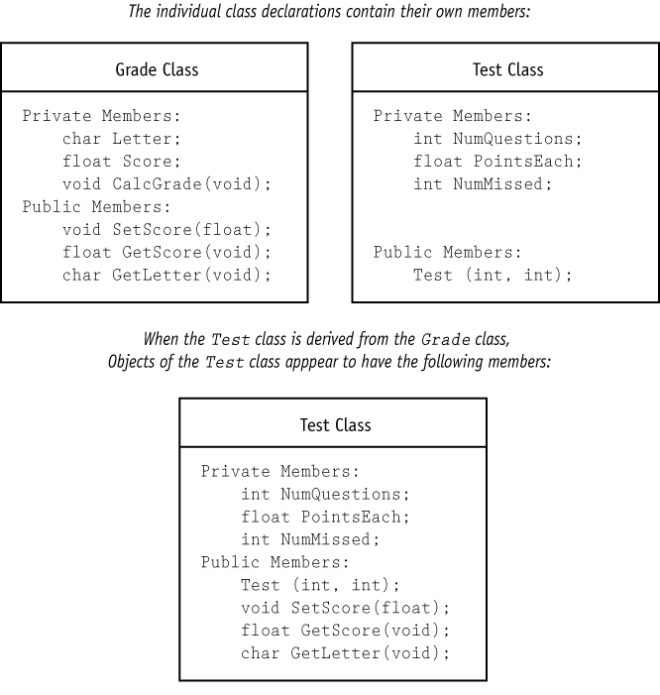
Lab 14 - inheritance

Slide 30
//Grade.h
class Grade
{
private:
char letter;
float score;
void calcGrade(void);
public:
void setScore(float s){
// set score and letter
}
float getScore(void) { return score; }
char getLetter(void) { return letter; }
};
void Grade::calcGrade() {
if (score > 89) letter = 'A';
else if (score > 79)
letter = 'B';
else if (score > 69)
letter = 'C';
else if (score > 59)
letter = 'D';
else letter = 'F';
}
//Test.h
#include “Grade.h"
class Test : public Grade
{
private:
int numQuestions;
float pointsEach;
int numMissed;
public:
Test(int, int);
};
// Parameters: q = Number of questions, m = number of questions missed.
Test::Test(int q, int m)
{
float numericGrade;
numQuestions = q;
numMissed = m;
pointsEach = 100.0 / numQuestions;
numericGrade = 100.0 - (numMissed * pointsEach);
// your code - set score
}
//TestDr.cpp
#include <iostream>
#include <iomanip>
#include “Test.h”
void main(void) {
int questions, missed;
cout << "How many questions are on the test? ";
cin >> questions;
cout << "How many questions did the student miss? ";
cin >> missed;
Test exam(questions, missed);
cout.precision(2);
//display the score and grade
}
Result:
How many questions are on the test? 20 [Enter]
How many questions did the student miss? 3 [Enter]
The score is 85
The grade is B

