Slide 1

Chapter 3:
Expressions
and Interactivity

Slide 2
3.1
The cin Object

Slide 3

The cin Object
Standard input object
Like cout, requires iostream file
Used to read input from keyboard
Information retrieved from cin with >>
Input is stored in one or more variables

Slide 4
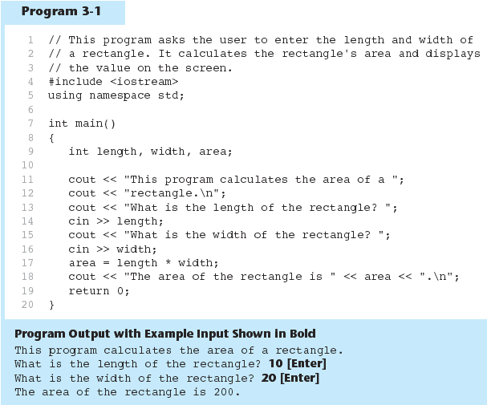
The cin Object in Program 3-1

Slide 5
The cin Object
cin converts data to the type that matches the variable:
  int height;
  cout << "How tall is the room? ";
  cin >> height;

Slide 6
Displaying a Prompt
A prompt is a message that instructs the user to enter data.
You should always use cout to display a prompt before each cin statement.
cout << "How tall is the room? ";
cin >> height;

Slide 7
The cin Object
Can be used to input more than one value:
  cin >> height >> width;
Multiple values from keyboard must be separated by spaces
Order is important: first value entered goes to first variable, etc.

Slide 8
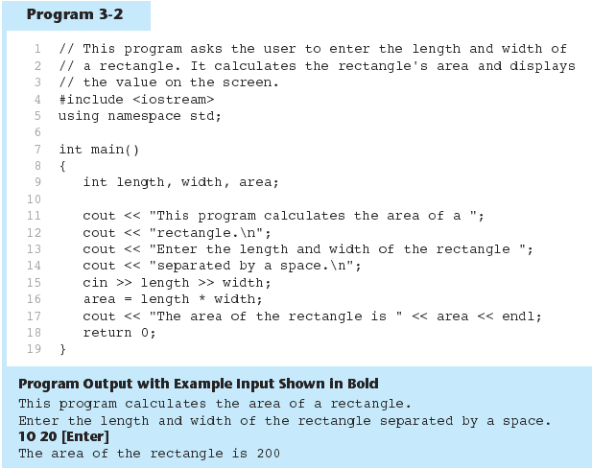
The cin Object Gathers Multiple Values in Program 3-2

Slide 9
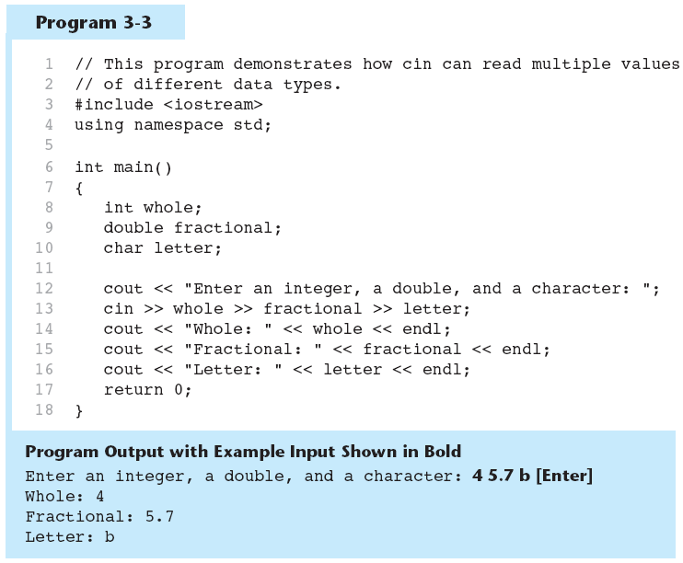
The cin Object Reads Different Data Types in Program 3-3

Slide 10
3.2
Mathematical Expressions

Slide 11
Mathematical Expressions
Can create complex expressions using multiple mathematical operators
An expression can be a literal, a variable, or a mathematical combination of constants and variables
Can be used in assignment, cout, other statements:
  area = 2 * PI * radius;
  cout << "border is: " << 2*(l+w);

Slide 12
Order of Operations
In an expression with more than one operator, evaluate in this order:
  - (unary negation), in order, left to right
  * / %, in order, left to right
  + -, in order, left to right
In the expression 2 + 2 * 2 – 2
evaluate
first
evaluate
third
evaluate
second

Slide 13
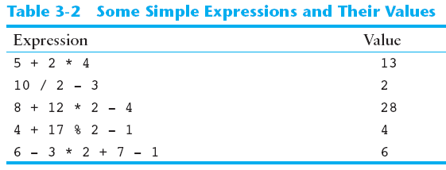
Order of Operations

Slide 14
Associativity of Operators
- (unary negation) associates right to left
  E.g., -(-5)
parentheses ( ) can be used to override the order of operations:
  2 + 2 * 2 – 2 = 4
  (2 + 2) * 2 – 2 = 6
  2 + 2 * (2 – 2) = 2
  (2 + 2) * (2 – 2) = 0

Slide 15
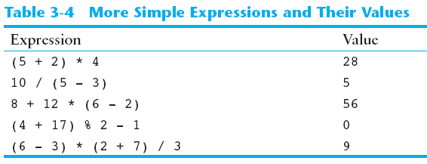
Grouping with Parentheses

Slide 16
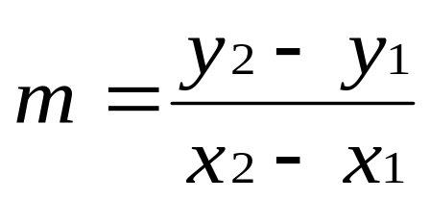
Algebraic Expressions
Multiplication requires an operator:
  Area=lw is written as Area = l * w;
There is no exponentiation operator:
  Area=s² is written as Area = pow(s, 2);
Parentheses may be needed to maintain order of operations:
  is written as
  m = (y2-y1) /(x2-x1);

Slide 17
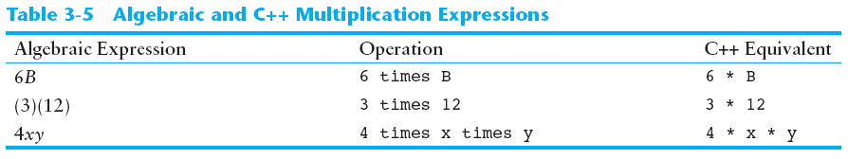
Algebraic Expressions

Slide 18
3.3
When You Mix Apples with Oranges: Type Conversion

Slide 19
When You Mix Apples with Oranges: Type Conversion
Operations are performed between operands of the same type.
If not of the same type, C++ will convert one to be the type of the other
This can impact the results of calculations.

Slide 20
Hierarchy of Types
Highest:
Lowest:
Ranked by largest number they can hold
long double
double
float
unsigned long
long
unsigned int
int

Slide 21
Type Coercion
Type Coercion: automatic conversion of an operand to another data type
Promotion: convert to a higher type
Demotion: convert to a lower type

Slide 22
Coercion Rules
1) char, short, unsigned short automatically promoted to int
2) When operating on values of different data types, the lower one is promoted to the type of the higher one.
3) When using the = operator, the type of expression on right will be converted to type of variable on left

Slide 23
Example 1:
  int year;
  float interestRate;
  year * interestRate; // the result is float, year is promoted to a float
Example 2:
  int x, y = 4;
  float z = 2.7;
  x = y * z; // the result is 10 rather than 10.8 because the type of x is int.
Example 3: integer divided by integer is integer
  Double parts;
  Part = 15 / 6 ; // the result is 2 rather than 2.5.
Example 4:
  Double parts;
  Part = 15.0 / 6; // the result is 2.5

Slide 24
3.4
Overflow and Underflow

Slide 25
Overflow and Underflow
Occurs when assigning a value that is too large (overflow) or too small (underflow) to be held in a variable
Variable contains value that is ‘wrapped around’ set of possible values
Different systems may display a warning/error message, stop the program, or continue execution using the incorrect value

Slide 26
//this program demonstrates integer overflow and underflow
#include <iostream>
using namespace std;
int main()
{
  short testVval = 32767; // short range from -32768 to 32767
  cout<< testVal << endl;
  testval = testVal + 1; //make it overflow
  cout<< testVal << endl;
  testVal = testVal - 1; //make it underflow
  cout<< testVal << endl;
  return 0;
}
Result:
32767
-32768
32767
Note: when integer overflows, its contents wrap around to that data type’s lowest value

Slide 27
3.5
Type Casting

Slide 28
Type Casting
Used for manual data type conversion
Useful for floating point division using ints: double m;
m = static_cast<double>(y2-y1)/(x2-x1);
Useful to see int value of a char variable:
char ch = 'C';
cout << ch << " is "
<< static_cast<int>(ch);

Slide 29
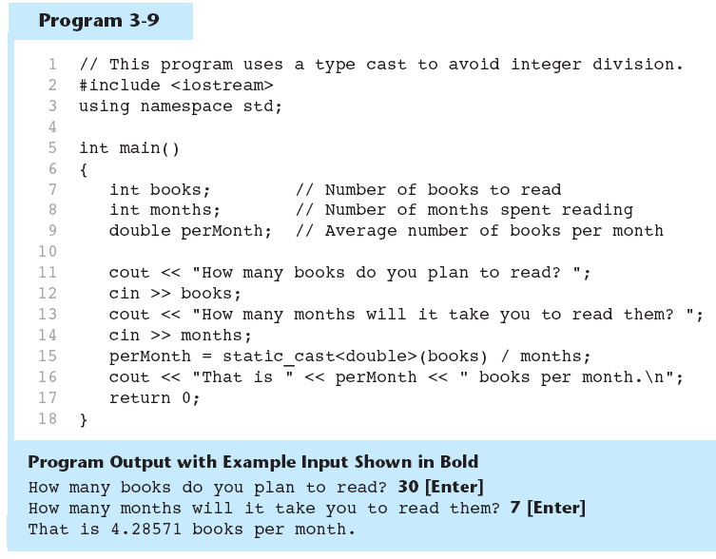
Type Casting in Program 3-9

Slide 30
C-Style and Prestandard Type Cast Expressions
C-Style cast: data type name in ()
cout << ch << " is " << (int)ch;
Prestandard C++ cast: value in ()
cout << ch << " is " << int(ch);
Both are still supported in C++, although static_cast is preferred

Slide 31
3.6
Multiple Assignment and Combined Assignment

Slide 32
Multiple Assignment and Combined Assignment
The = can be used to assign a value to multiple variables:
  x = y = z = 5;
Value of = is the value that is assigned
Associates right to left:
  x = (y = (z = 5));
value
is 5
value
is 5
value
is 5

Slide 33
Combined Assignment
Look at the following statement:
  sum = sum + 1;
  This adds 1 to the variable sum.

Slide 34
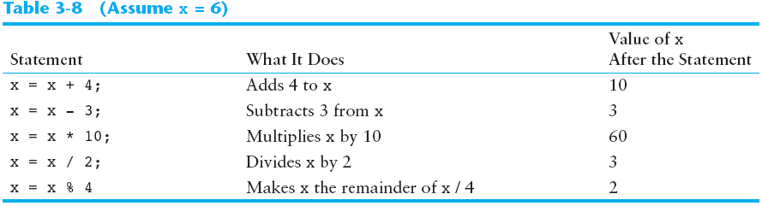
Other Similar Statements

Slide 35
Combined Assignment
The combined assignment operators provide a shorthand for these types of statements.
The statement
  sum = sum + 1;
  is equivalent to
  sum += 1;

Slide 36
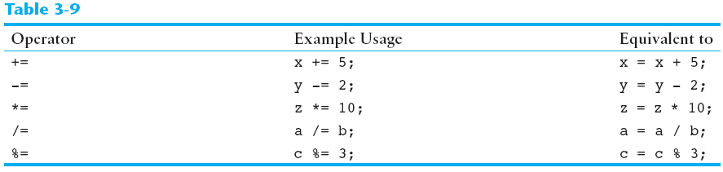
Combined Assignment Operators

Slide 37
What is the output?
  int x, y, z;
  x = y = z = 5;
  x += 4;
  y *= 2;
  z -= 3;
  x /= 3;
  y += z;
  cout << x << “ “ << y << “ “ << z;

Slide 38
3.7
Formatting Output

Slide 39
Formatting Output
Can control how output displays for numeric, string data:
  size
  position
  number of digits
Requires iomanip header file

Slide 40
Stream Manipulators
Used to control how an output field is displayed
Some affect just the next value displayed:
  setw(x): print in a field at least x spaces wide. Use more spaces if field is not wide enough

Slide 41
Example
#include <iostream>
#include <iomanip>
void main()
{
int num1 = 2897;
double num2 = 91.5;
string str = “John Doe”;
cout << setw(6) << num1 << setw(8) << num2 << setw(10) << str;
}
 |  | 2 | 8 | 9 | 7
 |  |  |  | 9 | 1 | . | 5
Default: Right-justified
 |  | J | o | h | n |  | D | o | e

Slide 42
Stream Manipulators
fixed:
  use decimal notation for floating-point values
setprecision(x):
  when used with fixed, print floating-point value using x digits after the decimal.
  Without fixed, print floating-point value using x significant digits(total number of digits that appear before and after the decimal point)
showpoint:
  always print decimal for floating-point values

Slide 43
Example
#include <iostream>
#include <iomanip>
void main()
{
double result, num1= 132.364, num2=26.91;
result = num1 / num2;
cout << result; // displays 4.91877( default: 6 significant digits without setprecision)
//use setprecision without fixed
cout << setprecision(5) << result; // display 4.9188
cout << setprecision(4) << result; // display 4.919
cout << setprecision(1) << result; // display 5
}

Slide 44
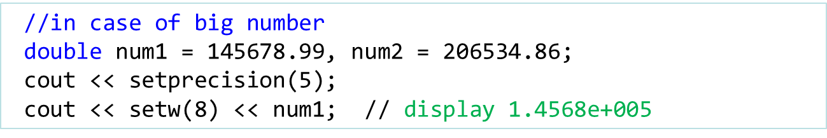
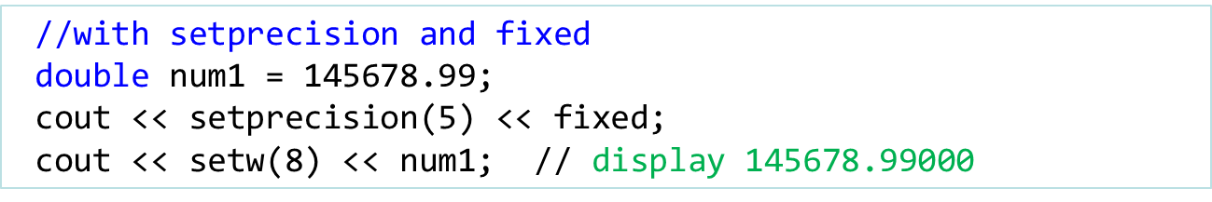
Fixed Manipulator

Slide 45
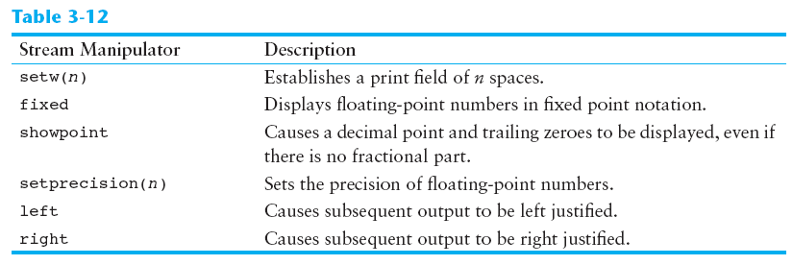
Stream Manipulators

Slide 46
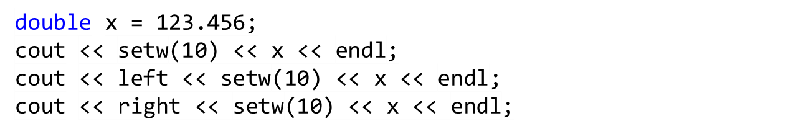

Left and right manipulators

Slide 47
3.8
Working with Characters and string Objects

Slide 48
Working with Characters and string Objects
Using cin with the >> operator to input strings can cause problems:
It passes over and ignores any leading whitespace characters (spaces, tabs, or line breaks)
To work around this problem, you can use a C++ function named getline.

Slide 49
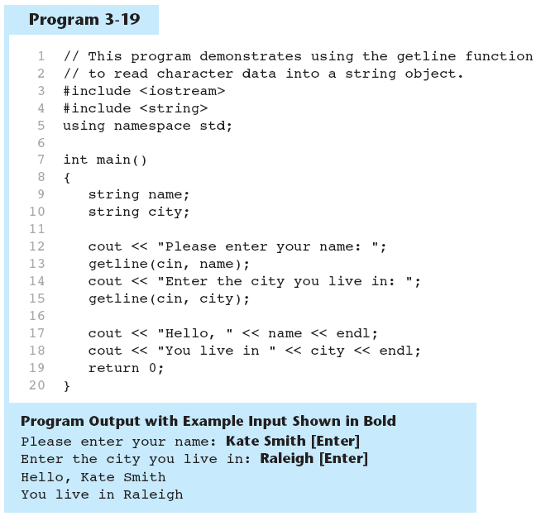
Using getline in Program 3-19

Slide 50
Working with Characters and string Objects
To read a single character:
  Use cin:
    char ch;
    cout << "Strike any key to continue";
    cin >> ch;
    Problem: will skip over blanks, tabs, <CR>
  Use cin.get():
    cin.get(ch);
    Will read the next character entered, even whitespace

Slide 51
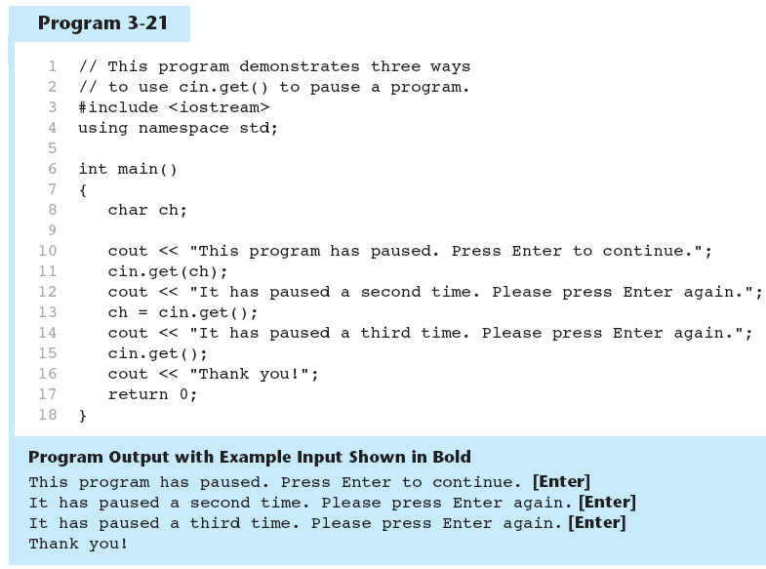
Using cin.get() in Program 3-21

Slide 52
Working with Characters and string Objects
Mixing cin >> and cin.get() in the same program can cause input errors that are hard to detect
To skip over unneeded characters that are still in the keyboard buffer, use cin.ignore():
  cin.ignore(); // skip next char
  cin.ignore(10, '\n'); // skip the next 10 chars or
  // until a newline is encountered

Slide 53
string Member Functions and Operators
To find the length of a string:
To concatenate (join) multiple strings:
string state = "Texas";
int size = state.length(); // return 5
greeting2 = greeting1 + name1;
greeting1 = greeting1 + name2;
Or using the += combined assignment operator:
greeting1 += name2;

Slide 54
3.9
More Mathematical Library Functions

Slide 55
More Mathematical Library Functions
Require cmath header file
Take double as input, return a double
Commonly used functions:
sin | Sine
cos | Cosine
tan | Tangent
sqrt | Square root
log | Natural (e) log
abs | Absolute value (takes and returns an int)

Slide 56
More Mathematical Library Functions
These require cstdlib header file
rand():
  returns a random number (int) between 0 and the largest int the compute holds.
  yields same sequence of numbers each time program is run.
srand(x):
  initializes random number generator with unsigned int x
  srand() accepts unsigned argument that acts as a seed value. By specifying different seed values, rand() generate different values.
  To get unique seed value, use time() function which is in <ctime> header file

Slide 57
Random generator example
#include <iostream>
#include <ctime> // for time()
#include <cstdlib> // for rand() and srand()
void main()
{
unsigned seed = time(0);
srand(seed);
cout << rand() % 100 << endl; // random number between 0 and 99
}

Slide 58
What is ASCII?
ASCII is a code for representing English characters as numbers, with each letter assigned a number from 0 to 127.
  For example, the ASCII code for uppercase M is 77.
Most computers use ASCII codes to represent text
Standard ASCII character set uses just 7 bits for each character.
Exercise:
  for (int i = 0; i < 128; i++)
  cout << i << " " << static_cast<char>(i) << endl;

Slide 59
