Slide 1

Chapter 5:
Loops and Files

Slide 2

The Increment and Decrement
Operators
++ is the increment operator.
It adds one to a variable.
  val++; is the same as val = val + 1;
++ can be used before (prefix) or after (postfix) a variable:
  ++val; val++;

Slide 3
The Increment and Decrement
Operators
-- is the decrement operator.
It subtracts one from a variable.
  val--; is the same as val = val - 1;
-- can be also used before (prefix) or after (postfix) a variable:
  --val; val--;

Slide 4
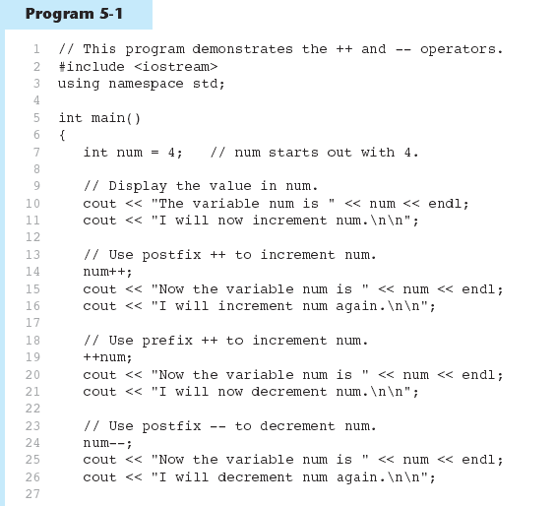
Increment and Decrement
Operators in Program 5-1
Continued…

Slide 5
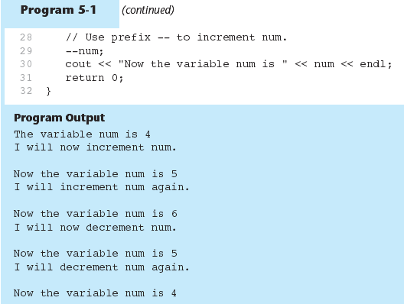
Increment and Decrement
Operators in Program 5-1

Slide 6
Prefix vs. Postfix
++ and -- operators can be used in complex statements and expressions
In prefix mode (++val, --val) the operator increments or decrements, then returns the value of the variable
In postfix mode (val++, val--) the operator returns the value of the variable, then increments or decrements

Slide 7
Prefix vs. Postfix - Examples
int x=10, y=20, z;
z = x++;
cout << z << “ “ << x ; // z: 10, x:11
z = ++x;
cout << z << “ “ << x ; // z: 12, x:12

Slide 8
5.2
Introduction to Loops: The while Loop

Slide 9
Introduction to Loops:
The while Loop
Loop: a control structure that causes a statement or statements to repeat
General format of the while loop:
  while (expression)
  statement;
statement; can also be a block of statements enclosed in { }

Slide 10
The while Loop – How It Works
  while (expression)
  statement;
expression is evaluated
  if true, then statement is executed, and expression is evaluated again
  if false, then the loop is finished and program statements following statement execute

Slide 11
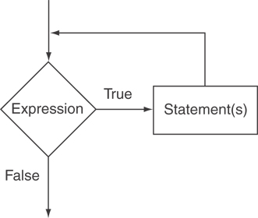
The Logic of a while Loop

Slide 12
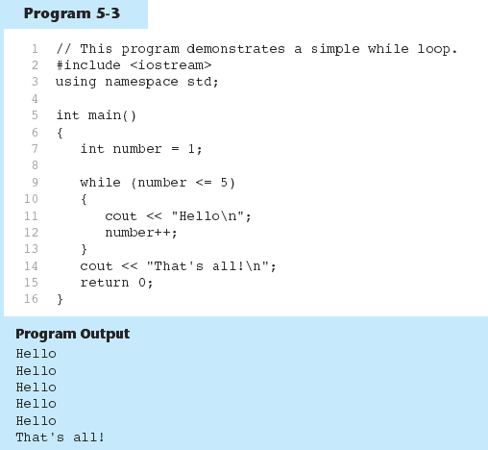
The while loop in Program 5-3

Slide 13
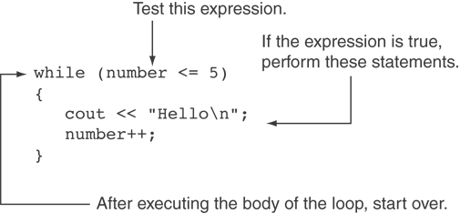
How the while Loop in Program 5-3 Lines 9 through 13 Works

Slide 14
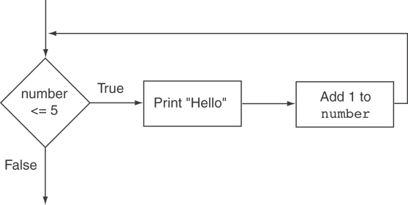
Flowchart of the while Loop in Program 5-3

Slide 15
The while Loop is a Pretest Loop
expression is evaluated before the loop executes. The following loop will never execute:
int number = 6;
while (number <= 5)
{
cout << "Hello\n";
number++;
}

Slide 16
Watch Out for Infinite Loops
The loop must contain code to make expression become false
Otherwise, the loop will have no way of stopping
Such a loop is called an infinite loop, because it will repeat an infinite number of times

Slide 17
Example of an Infinite Loop
int number = 1;
while (number <= 5)
{
cout << "Hello\n";
}

Slide 18
5.3
Using the while Loop for Input Validation

Slide 19
Using the while Loop for Input Validation
Input validation is the process of inspecting data that is given to the program as input and determining whether it is valid.
The while loop can be used to create input routines that reject invalid data, and repeat until valid data is entered.

Slide 20
Using the while Loop for Input Validation
Here's the general approach, in pseudocode:
Read an item of input.
While the input is invalid
Display an error message.
Read the input again.
End While

Slide 21
Input Validation Example
cout << "Enter a number less than 10: ";
cin >> number;
while (number >= 10)
{
cout << "Invalid Entry!"
<< "Enter a number less than 10: ";
cin >> number;
}

Slide 22
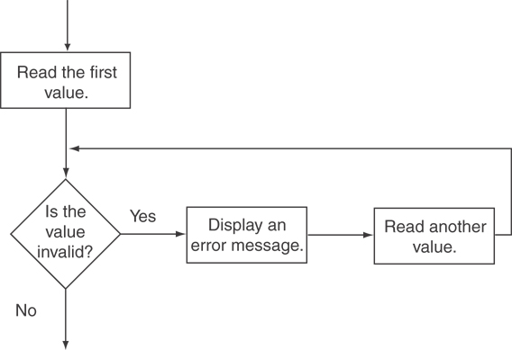
Flowchart for Input Validation

Slide 23
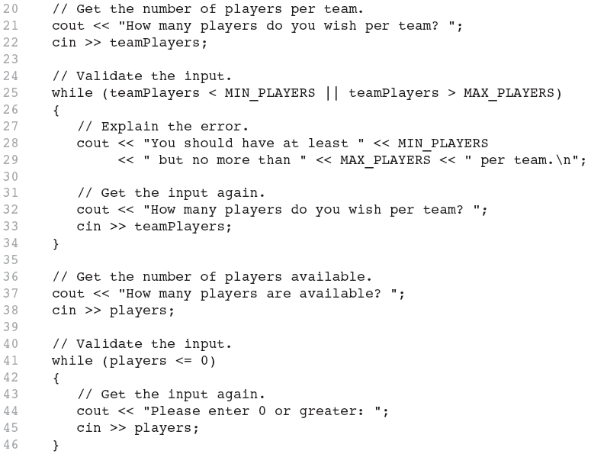
Input Validation in Program 5-5
Notes:
says execute the code while players is less than or equal to 0

Slide 24
5.4
Counters

Slide 25
Counters
Counter: a variable that is incremented or decremented each time a loop repeats
Can be used to control execution of the loop (also known as the loop control variable)
Must be initialized before entering loop

Slide 26
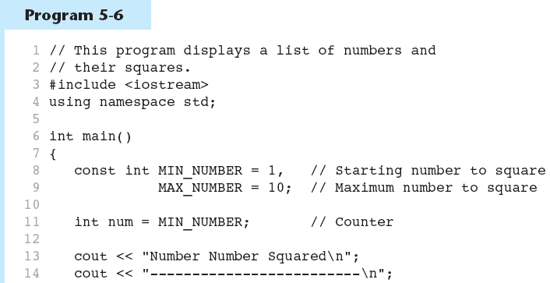
A Counter Variable Controls the Loop in Program 5-6
Continued…

Slide 27
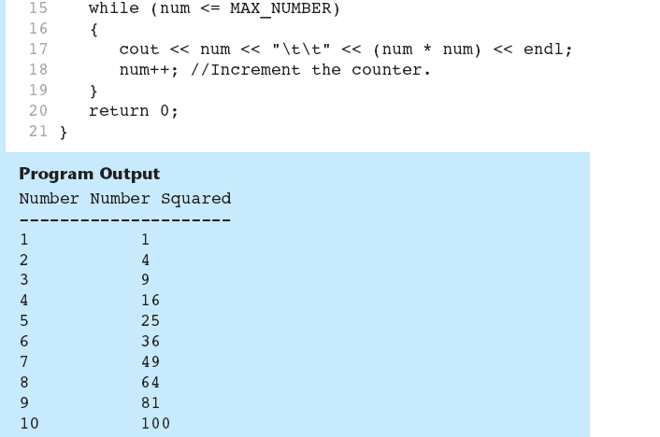
A Counter Variable Controls the Loop in Program 5-6

Slide 28
5.5
The do-while Loop

Slide 29
The do-while Loop
do-while: a posttest loop – execute the loop, then test the expression
General Format:
  do
  statement; // or block in { }
  while (expression);
Note that a semicolon is required after (expression)

Slide 30
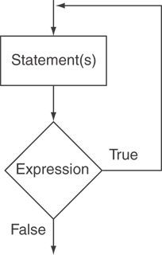
The Logic of a do-while Loop

Slide 31
An Example do-while Loop
int x = 1;
do
{
cout << x << endl;
} while(x < 0);
Although the test expression is false, this loop will execute one time because do-while is a posttest loop.

Slide 32
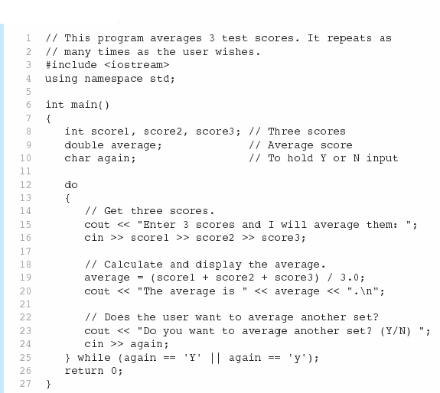

A do-while Loop in Program 5-7
Continued…

Slide 33
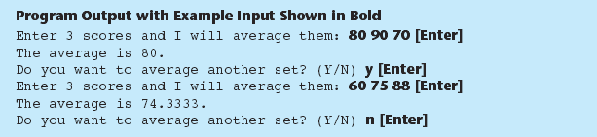
A do-while Loop in Program 5-7

Slide 34
do-while Loop Notes
Loop always executes at least once
Execution continues as long as expression is true, stops repetition when expression becomes false
Useful in menu-driven programs to bring user back to menu to make another choice (see Program 5-8 on pages 245-246)

Slide 35
Practice
Open MailListMenu.cpp and modify the code to perform the following:
  Check whether user wants to exit or not using “do while” loop. Exit means the user enters -1
  If the user enter -1, exit the while loop.
  Otherwise, keep asking until user enters -1

Slide 36
WARM UP
Write a code that generates a random number and asks the user to guess what the number is. If user ;s guess is higher than the random number, the program should display “Too high, try again.” if the user’s guess is lower than the random number, the program should display “Too low, try again.” the program should use a loop that repeats until the user correctly guesses the random number.

Slide 37
5.6
The for Loop

Slide 38
The for Loop
Useful for counter-controlled loop
General Format:
  for(initialization; test; update)
  statement; // or block in { }
No semicolon after the update expression or after the )
Notes:
for(startExpression; testExpression; countExpression)
{
block of code;
}
The startExpression is evaluated before the loop begins. It is acceptable to declare and assign in thestartExpression (such as int x = 1;). ThisstartExpression is evaluated only once at the beginning of the loop.
The testExpression will evaluate to TRUE (nonzero) orFALSE (zero). While TRUE, the body of the loop repeats. When the testExpression becomes FALSE, the looping stops and the program continues with the statement immediately following the for loop body in the program code.
The countExpression executes after each trip through the loop. The count may increase/decrease by an increment of 1 or of some other value.

Slide 39
for Loop - Mechanics
for(initialization; test; update)
  statement; // or block in { }
Perform initialization
Evaluate test expression
  If true, execute statement
  If false, terminate loop execution
Execute update, then re-evaluate test expression

Slide 40
for Loop - Example
int count;
for (count = 1; count <= 5; count++)
  cout << "Hello" << endl;
Notes:
For statement has three parameters
First : initialized
Second: condition, go to loop as long as the second condition is true
Third: how much you want to increment by, such as increment 1 or 2 at a time.

Slide 41
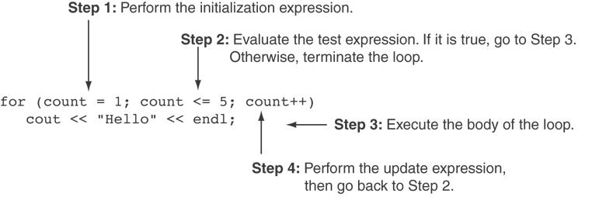
A Closer Look at the Previous Example

Slide 42
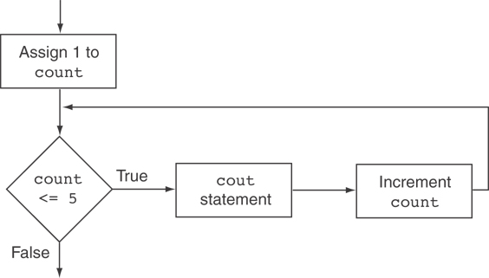
Flowchart for the Previous Example

Slide 43
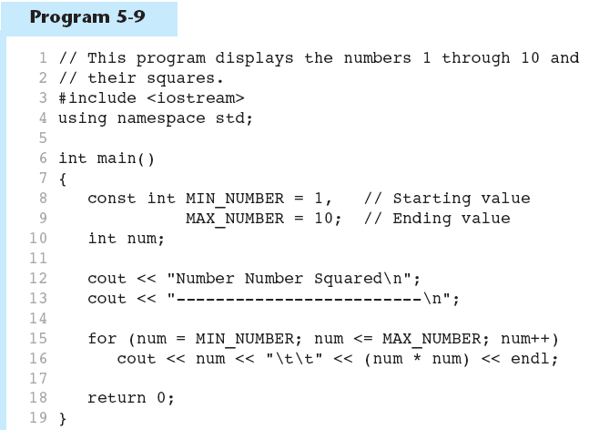
A for Loop in Program 5-9
Continued…

Slide 44
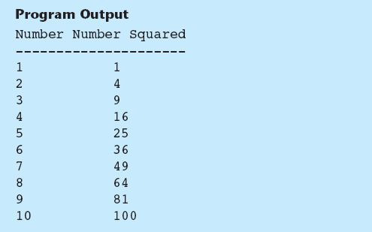
A for Loop in Program 5-9

Slide 45
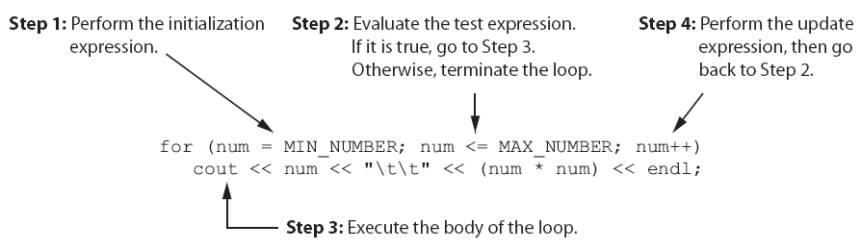
A Closer Look at Lines 15 through 16 in Program 5-9

Slide 46
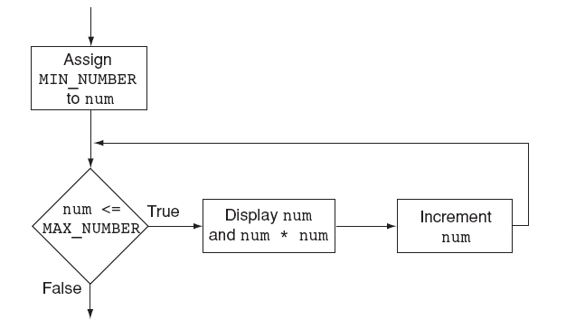
Flowchart for Lines 15 through 16 in Program 5-9

Slide 47
When to Use the for Loop
In any situation that clearly requires
  an initialization
  a false condition to stop the loop
  an update to occur at the end of each iteration

Slide 48
The for Loop is a Pretest Loop
The for loop tests its test expression before each iteration, so it is a pretest loop.
The following loop will never iterate:
for (count = 11; count <= 10; count++)
cout << "Hello" << endl;

Slide 49
for Loop - Modifications
You can have multiple statements in the initialization expression. Separate the statements with a comma:
int x, y;
for (x=1, y=1; x <= 5; x++)
{
cout << x << " plus " << y
<< " equals " << (x+y)
<< endl;
}
Initialization Expression

Slide 50
for Loop - Modifications
You can also have multiple statements in the test expression. Separate the statements with a comma:
int x, y;
for (x=1, y=1; x <= 5; x++, y++)
{
cout << x << " plus " << y
<< " equals " << (x+y)
<< endl;
}
Test Expression

Slide 51
for Loop - Modifications
You can omit the initialization expression if it has already been done:
int sum = 0, num = 1;
for (; num <= 10; num++)
sum += num;

Slide 52
for Loop - Modifications
You can declare variables in the initialization expression:
  int sum = 0;
  for (int num = 0; num <= 10; num++)
  sum += num;
  The scope of the variable num is the for loop.

Slide 53
Lab 5-1
Write a program that uses a loop to display the characters for the ASCII codes 0 through 127, Display 16 characters on each line.
Write a program that ask the users to enter today’s sales for five stores. The program should then display a bar graph comparing each store’s sales. Create each bar n the bar graph by displaying a row of asterisks. Each asterisk should represent $100 of sales.
  Sample Example:
  Enter today’s sales for store 1: 1000
  Enter today’s sales for store 2: 1200
  Enter today’s sales for store 3: 1800
  Enter today’s sales for store 4: 800
  Enter today’s sales for store 5: 1900
  SALES BAR CHART
  Store 1: **********
  Store 2: ************
  Store 3: ******************
  Store 4: ********
  Store 5: *******************

Slide 54
5.7
Keeping a Running Total

Slide 55
Keeping a Running Total
running total: accumulated sum of numbers from each repetition of loop
accumulator: variable that holds running total
  int sum=0, num=1; // sum is the
  while (num <= 10) // accumulator
  { sum += num;
  num++;
  }
  cout << "Sum of numbers 1 – 10 is"
  << sum << endl;

Slide 56
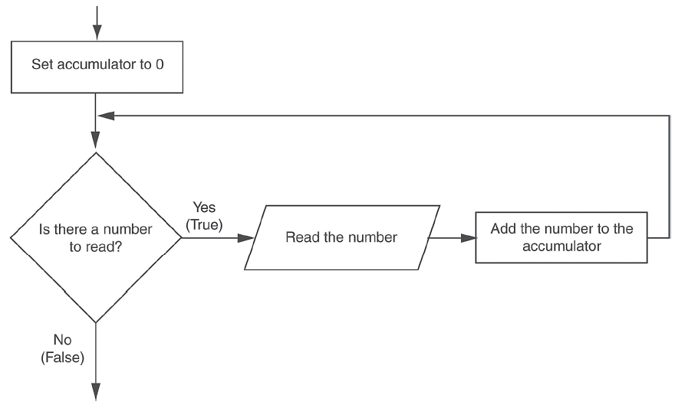
Logic for Keeping a Running Total

Slide 57

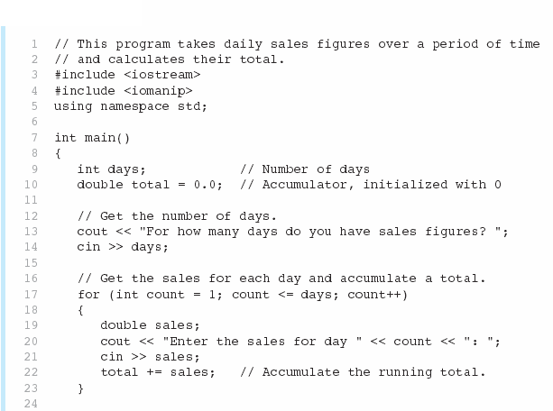
A Running Total in Program 5-12
Continued…

Slide 58
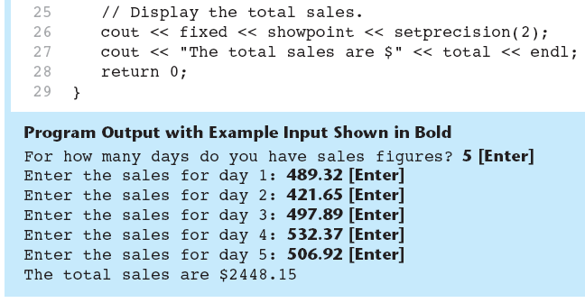
A Running Total in Program 5-12

Slide 59
5.8
Sentinels

Slide 60
Sentinels
sentinel: value in a list of values that indicates end of data
Special value that cannot be confused with a valid value, e.g., -999 for a test score
Used to terminate input when user may not know how many values will be entered

Slide 61
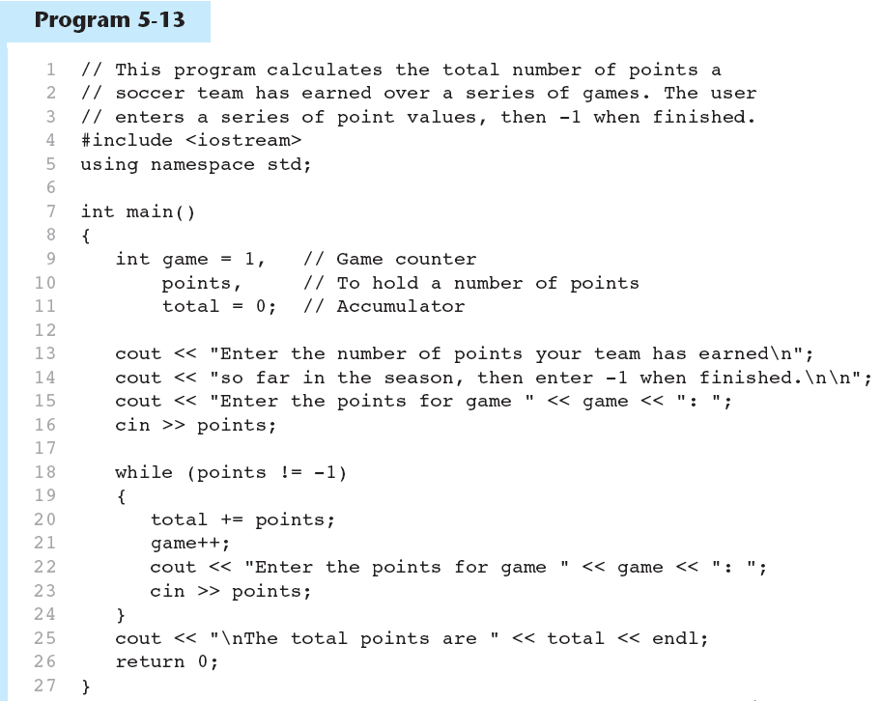
A Sentinel in Program 5-13
Continued…

Slide 62
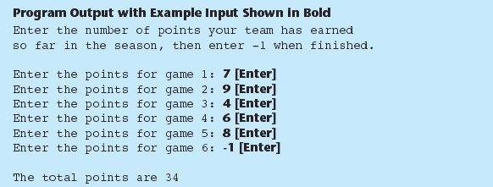
A Sentinel in Program 5-13

Slide 63
5.9
Deciding Which Loop to Use

Slide 64
Deciding Which Loop to Use
The while loop is a conditional pretest loop
  Iterates as long as a certain condition exits
  Validating input
  Reading lists of data terminated by a sentinel
The do-while loop is a conditional posttest loop
  Always iterates at least once
  Repeating a menu
The for loop is a pretest loop
  Built-in expressions for initializing, testing, and updating
  Situations where the exact number of iterations is known

Slide 65
5.10
Nested Loops

Slide 66
Nested Loops
A nested loop is a loop inside the body of another loop
Inner (inside), outer (outside) loops:
  for (row=1; row<=3; row++) //outer
  for (col=1; col<=3; col++)//inner
  cout << row * col << endl;

Slide 67
Nested Loops
A nested loop is a loop inside the body of another loop
Inner (inside), outer (outside) loops:
  for (int row=1; row<=3; row++) //how many rows
  {
  for (int col=1; col<=3; col++) //how many times the asterisk are printed on each row
  {
  cout << ‘*’ ;
  }
  cout << endl; //each time inner loop exits
  }
Inner Loop
outer Loop

Slide 68
Nested Loops - Notes
Inner loop goes through all repetitions for each repetition of outer loop
Inner loop repetitions complete sooner than outer loop
Total number of repetitions for inner loop is product of number of repetitions of the two loops.

Slide 69
Lab 5-2
Write a program that uses a loop to display the pattern A below, followed by another loop that displays pattern B.
Pattern A:
+
++
+++
++++
+++++
++++++
+++++++
++++++++
+++++++++
++++++++++
Pattern B:
++++++++++
+++++++++
++++++++
+++++++
++++++
+++++
++++
+++
++
+

Slide 70
5.11
Using Files for Data Storage

Slide 71
Using Files for Data Storage
Can use files instead of keyboard, monitor screen for program input, output
Allows data to be retained between program runs
Steps:
  Open the file
  Use the file (read from, write to, or both)
  Close the file

Slide 72
Files: What is Needed
Use fstream header file for file access
File stream types:
  ifstream for input from a file
  ofstream for output to a file
  fstream for input from or output to a file
Define file stream objects:
  ifstream infile;
  ofstream outfile;

Slide 73
Opening Files
Create a link between file name (outside the program) and file stream object (inside the program)
Use the open member function:
  infile.open("inventory.dat");
  outfile.open("report.txt");
Filename may include drive, path info.
Output file will be created if necessary; existing file will be erased first
Input file must exist for open to work

Slide 74
Testing for File Open Errors
Can test a file stream object to detect if an open operation failed:
  infile.open("test.txt");
  if (!infile)
  {
  cout << "File open failure!";
  }
Can also use the fail member function

Slide 75
Using Files
Can use output file object and << to send data to a file:
  outfile << "Inventory report";
Can use input file object and >> to copy data from file to variables:
  infile >> partNum;
  infile >> qtyInStock >> qtyOnOrder;

Slide 76
Using Loops to Process Files
The stream extraction operator >> returns true when a value was successfully read, false otherwise
Can be tested in a while loop to continue execution as long as values are read from the file:
  while (inputFile >> number) ...

Slide 77
Closing Files
Use the close member function:
  infile.close();
  outfile.close();
Don’t wait for operating system to close files at program end:
  may be limit on number of open files
  may be buffered output data waiting to send to file

Slide 78
Letting the User Specify a Filename
In many cases, you will want the user to specify the name of a file for the program to open.
string objects have a member function named c_str
  It returns the contents of the object formatted as a null-terminated C-string.
  Syntax:
stringObject.c_str()
    Example:
    inputFile.open(filename.c_str());

Slide 79
#include <fstream>
#include <string>
using namespace std;
void main()
{
  ifstream inFile;
  string fileName;
  cin >> fileName;
  inFile.open(fileName.c_str());
  // Read the numbers from the file.
  while (inFile >> number) //true when a value was successfully read
  {
  count++;
  total += number;
  }
  inFile.close(); // Close the file
}

Slide 80
5.12
Breaking and Continuing a Loop

Slide 81
Breaking Out of a Loop
Can use break to terminate execution of a loop
When used in an inner loop, terminates that loop only and goes back to outer loop

Slide 82
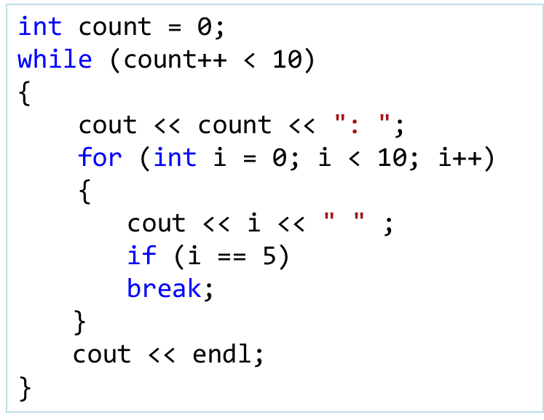
#include <iostream>
using namespace std;
void main()
{
  int count = 0;
  while (count++ < 10)
  {
  cout << count << endl;
  If(cont == 5)
  break;
  }
}
Result:
1
2
3
4
5
Result:
1: 0 1 2 3 4 5
2: 0 1 2 3 4 5
3: 0 1 2 3 4 5
4: 0 1 2 3 4 5
5: 0 1 2 3 4 5
6: 0 1 2 3 4 5
7: 0 1 2 3 4 5
8: 0 1 2 3 4 5
9: 0 1 2 3 4 5
10: 0 1 2 3 4 5

Slide 83
Continuing a loop
The continue statement causes a loop to stop its current iteration and begin the next one

Slide 84
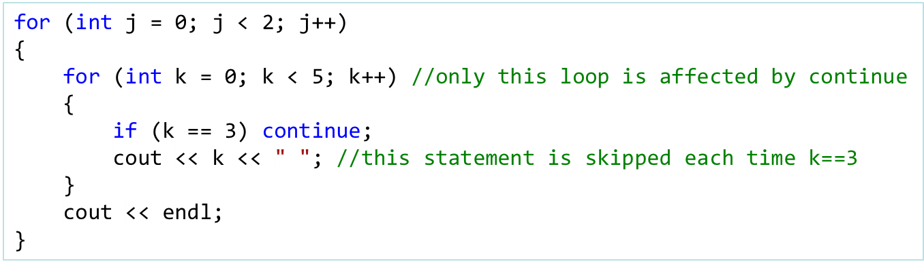
for (int i = 0; i < 10; i++)
{
if (i != 5) continue;
cout << i << " "; //this statement is skipped each time i!=5
}
Result:
5
Result:
0 1 2 4
0 1 2 4

Slide 85
Lab 5-3
Download random.txt form the blackboard
Write a program that open the file, reads all the numbers from the file, and calculate the following:
The number of numbers in the file
The sum of all the numbers in the file
The average of all the numbers in the file
The program should display the number of numbers found in the file, the sum of the numbers, and the average of the numbers

