Slide 1

Chapter 6:
Functions

Slide 2
6.1
Modular Programming

Slide 3

Modular Programming
Modular programming: breaking a program up into smaller, manageable functions or modules
Function: a collection of statements to perform a task
Motivation for modular programming:
  Improves maintainability of programs
  Simplifies the process of writing programs

Slide 4
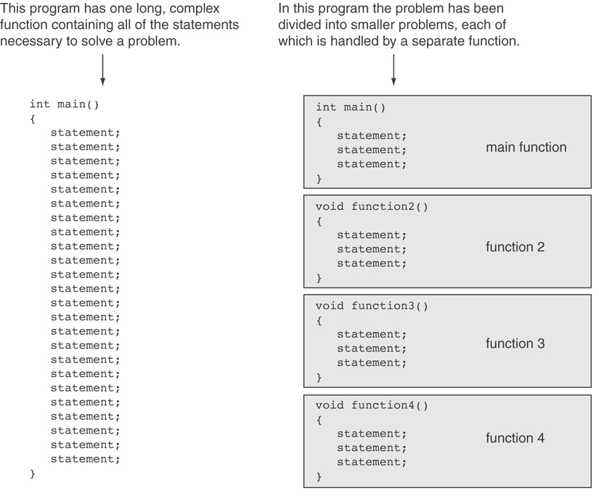

Slide 5
6.2
Defining and Calling Functions

Slide 6
Defining and Calling Functions
Function call: statement causes a function to execute
Function definition: statements that make up a function

Slide 7
Function Definition
Definition includes:
  return type: data type of the value that function returns to the part of the program that called it
  name: name of the function. Function names follow same rules as variables
  parameter list: variables containing values passed to the function
  body: statements that perform the function’s task, enclosed in {}

Slide 8
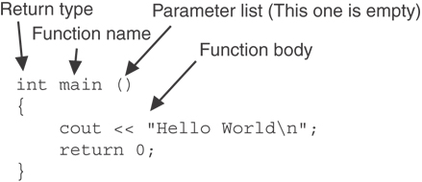
Function Definition
Note: The line that reads int main()is the function header.

Slide 9
Function Return Type
If a function returns a value, the type of the value must be indicated:
  int main()
If a function does not return a value, its return type is void:
  void printHeading()
  {
  cout << "Monthly Sales\n";
  }

Slide 10
Calling a Function
To call a function, use the function name followed by () and ;
  printHeading();
When called, program executes the body of the called function
After the function terminates, execution resumes in the calling function at point of call.

Slide 11
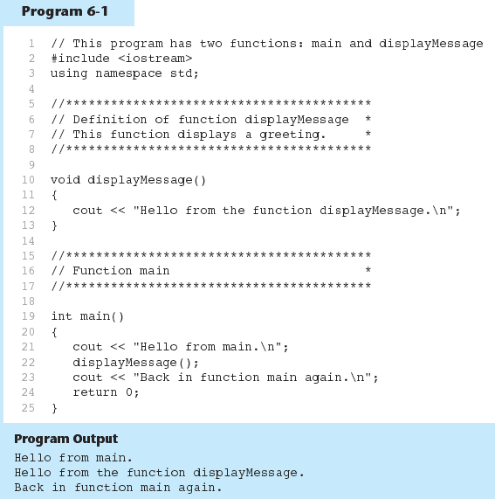
Functions in Program 6-1

Slide 12
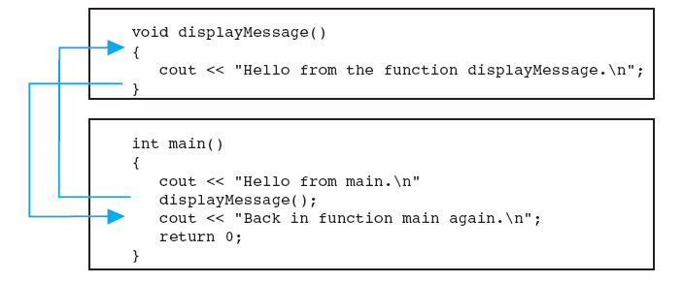
Flow of Control in Program 6-1

Slide 13
Calling Functions
main can call any number of functions
Functions can call other functions
Compiler must know the following about a function before it is called:
  name
  return type
  number of parameters
  data type of each parameter

Slide 14
6.3
Function Prototypes

Slide 15
Function Prototypes
Ways to notify the compiler about a function before a call to the function:
  Place function definition before calling function’s definition
  Use a function prototype (function declaration) – like the function definition without the body
    Header: void printHeading()
    Prototype: void printHeading();

Slide 16
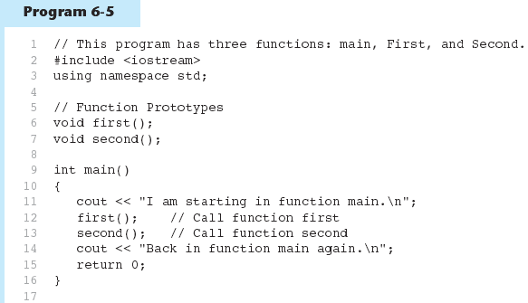
Function Prototypes in Program 6-5
(Program Continues)

Slide 17
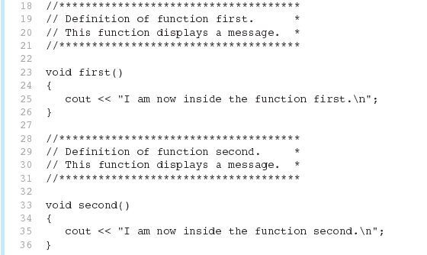
Function Prototypes in Program 6-5

Slide 18
Prototype Notes
Place prototypes near top of program
Program must include either prototype or full function definition before any call to the function – compiler error otherwise
When using prototypes, can place function definitions in any order in source file

Slide 19
6.4
Sending Data into a Function

Slide 20
Sending Data into a Function
Can pass values into a function at time of call:
  c = pow(a, b);
Values passed to function are arguments
Variables in a function that hold the values passed as arguments are parameters

Slide 21
A Function with a Parameter Variable
void displayValue(int num)
{
cout << "The value is " << num << endl;
}
The integer variable num is a parameter. It accepts any integer value passed to the function.

Slide 22
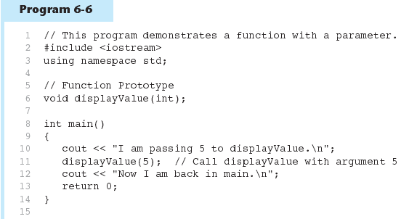
Function with a Parameter in Program 6-6
(Program Continues)

Slide 23
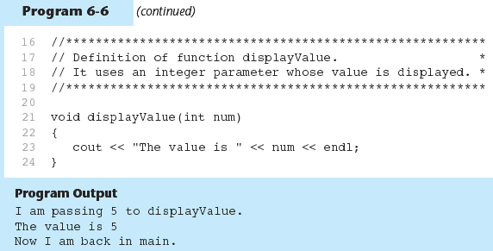
Function with a Parameter in Program 6-6

Slide 24
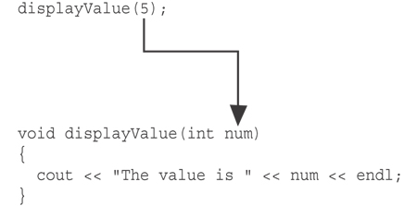
Function with a Parameter in Program 6-6
The function call in line 11 passes the value 5
as an argument to the function.

Slide 25
#include <iostream>
using namespace std;
void displayValue(int); //Function Prototype
int main()
{
displayValue(5); //calling the function
displayValue(6);
displayValue(15);
return 0;
}
void displayValue(int num) //Function header
{
cout << “the value is “ << num << endl;
}

Slide 26
Other Parameter Terminology
A parameter can also be called a formal parameter or a formal argument
An argument can also be called an actual parameter or an actual argument

Slide 27
Parameters, Prototypes, and Function Headers
For each function argument,
  the prototype must include the data type of each parameter inside its parentheses
  the header must include a declaration for each parameter in its ()
  void evenOrOdd(int); //prototype
  void evenOrOdd(int num) //header
  evenOrOdd(val); //call

Slide 28
Function Call Notes
Value of argument is copied into parameter when the function is called
A parameter’s scope is the function which uses it
Function can have multiple parameters
There must be a data type listed in the prototype () and an argument declaration in the function header () for each parameter
Arguments will be promoted/demoted as necessary to match parameters

Slide 29
Passing Multiple Arguments
When calling a function and passing multiple arguments:
  the number of arguments in the call must match the prototype and definition
  the first argument will be used to initialize the first parameter, the second argument to initialize the second parameter, etc.

Slide 30
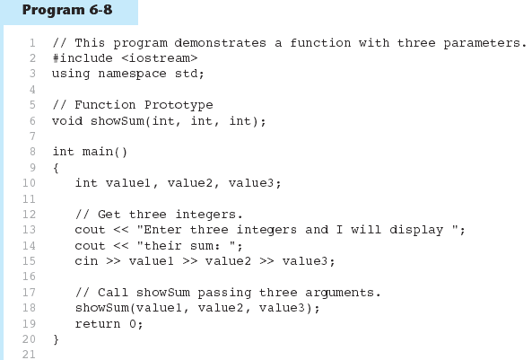
Passing Multiple Arguments in Program 6-8
(Program Continues)

Slide 31
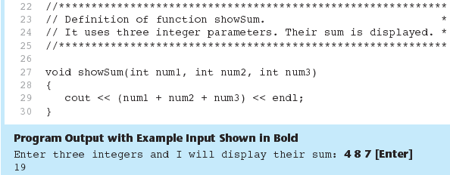
Passing Multiple Arguments in Program 6-8

Slide 32
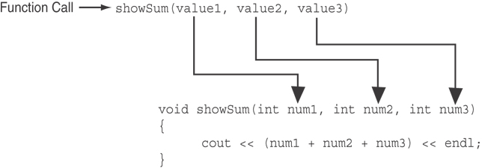
Passing Multiple Arguments in Program 6-8
The function call in line 18 passes value1,
value2, and value3 as a arguments to the
function.

Slide 33
Lab 6-1
Write a code that asks the user to enter an item’s wholesale cost and it’s markup percentage. It should display the item’s retail price.
For example.
If an item’s wholesale cost is 5.00 and it’s markup percentage is 100%, then the item’s retail price is 10.00
If an item’s wholesale cost is 5.00 and it’s markup percentage is 50%, then the item’s retail price is 7.50
The program should have a function named “calculateRetail” that receives the wholesale cost and the markup percentage as arguments and returns the retail price of the item
Input validation: do not accept negative values foe either the wholesale cost of the item or markup percentage.

Slide 34
6.5
Passing Data by Value

Slide 35
Passing Data by Value
Pass by value: when an argument is passed to a function, its value is copied into the parameter.
Changes to the parameter in the function do not affect the value of the argument

Slide 36
Passing Information to Parameters by Value
Example: int val=5;
  evenOrOdd(val);
evenOrOdd can change variable num, but it will have no effect on variable val
val
num
5
5
argument in
calling function
parameter in
evenOrOdd function

Slide 37
#include <iostream>
int Cube(int); // prototype
using namespace std;
int Cube(int n)
{
return n * n * n;
}
void main()
{
int yourNumber = 2, myNumber = 3;
cout << “My Number = “ << myNumber;
cout << “its cube is “ << Cube(myNumber) << endl;
cout << “Your Number = “ << yourNumber;
cout << “its cube is “ << Cube(yourNumber) << endl;
}

Slide 38
Practice
Write a void function called DisplayMessage(), which you can call from main(), to describe the pollution index value it receives as a parameter
Your city describes a pollution index
  less than 35 as “Pleasant”,
  35 through 60 as “Unpleasant”,
  and above 60 as “Health Hazard”

Slide 39
#include <iostream>
void DisplayMessage(int); // Prototype
using namespace std;
int main()
{
int pollutionIndex;
cout << “Enter air pollution index”;
cin >> pollutionIndex;
DisplayMessage(pollutionIndex); // Call
return 0;
}
void DisplayMessage(int index)
{
if(index < 35)
cout << “Pleasant”;
else if(index <= 60)
cout << “Unpleasant”;
else
cout << “Health Hazard”;
}
parameter

Slide 40
The return Statement
Used to end execution of a function
Can be placed anywhere in a function
  Statements that follow the return statement will not be executed
Can be used to prevent abnormal termination of program
In a void function without a return statement, the function ends at its last }

Slide 41
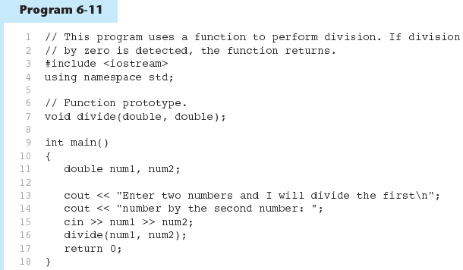
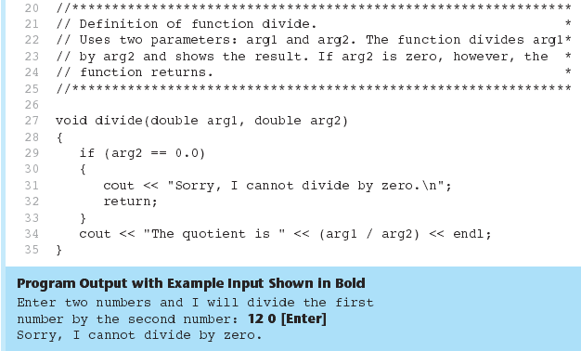

Slide 42
Returning a Value From a Function
A function can return a value back to the statement that called the function.
You've already seen the pow function, which returns a value:
double x;
x = pow(2.0, 10.0);

Slide 43
Returning a Value From a Function
the return statement returns a value from function to the point of call.
Example:
int sum(int num1, int num2)
{
int result;
result = num1 + num2;
return result;
}

Slide 44
A Value-Returning Function
Return Type
int sum(int num1, int num2)
{
int result;
result = num1 + num2;
return result;
}
Value Being Returned

Slide 45
A Value-Returning Function
int sum(int num1, int num2)
{
return num1 + num2;
}
Functions can return the values of expressions, such as num1 + num2

Slide 46
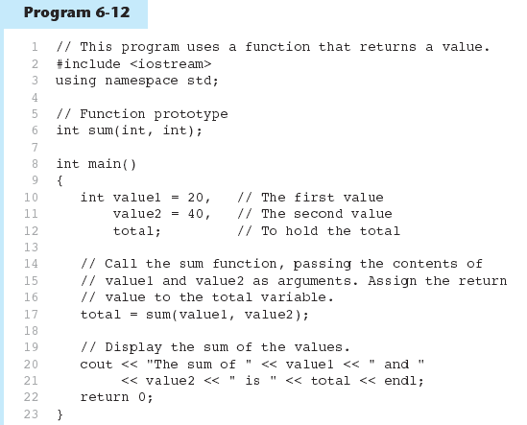
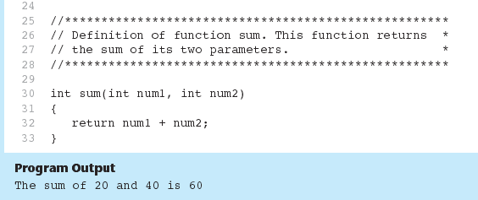

Slide 47
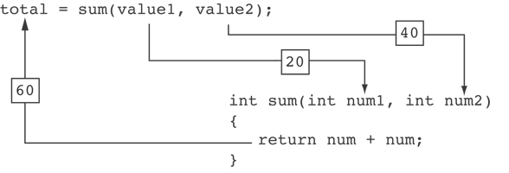
Function Returning a Value in Program 6-12
The statement in line 17 calls the sum function, passing value1 and value2 as arguments. The return value is assigned to the total variable.

Slide 48
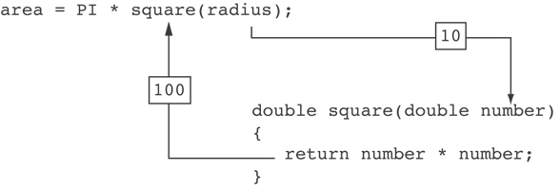
Another Example from Program 6-13

Slide 49
Returning a Value From a Function
The prototype and the definition must indicate the data type of return value (not void)
Calling function should use return value:
  assign it to a variable
  send it to cout
  use it in an expression

Slide 50
Question ?
Each of the following functions has errors. Locate as many errors as you can.
void total(int val1, val2, val3)
{
return val1 + val2 + val3;
}

Slide 51
Answer
void total(int val1, val2, val3)
{
return val1 + val2 + val3;
}
ANSWER:
int total(int val1, int val2, int val3)
{
return val1 + val2 + val3;
}

Slide 52
Practice
Write the cubic and square functions
These two functions will be invoked inside the main function
The input number from the user has been passed to the functions which do calculation and return the results to the main function to display the results to the standard output.

Slide 53
#include <iostream>
using namespace std;
int Square(int); // Prototypes
int Cube(int);
int main()
{
cout << “The square of 3 is “ << Square(3) << endl;
cout << “The cube of 3 is “ << Cube(3) << endl;
return 0;
}
int Square(int n) { // Header and body
return n * n;
}
int Cube(int n) { // Header and body
return n * n * n;
}

Slide 54
6.9
Returning a Boolean Value

Slide 55
Returning a Boolean Value
Function can return true or false
Declare return type in function prototype and heading as bool
Function body must contain return statement(s) that return true or false
Calling function can use return value in a relational expression

Slide 56
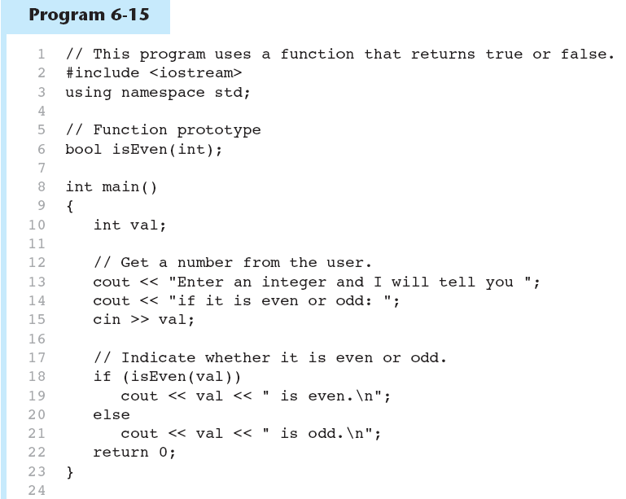
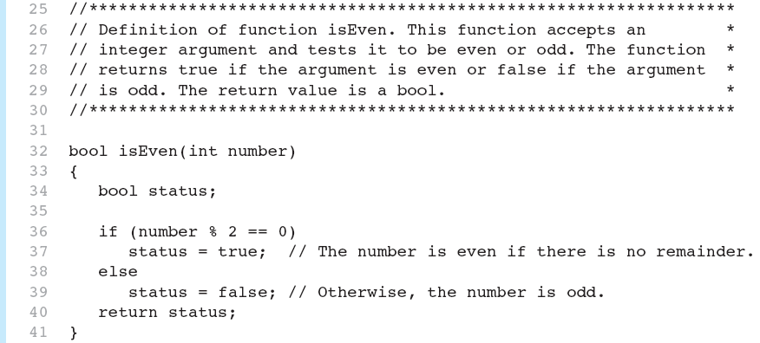


Slide 57
Lab 6-2
Write a program that lets the user play the game of Rock, Paper, Scissors against the computer.
When the program begins, a random number in the range of 1 through 3 is generated. If the number is 1, then the computer has chosen rock. If the number is 2, then the computer has chosen paper. If the number is 3, then the computer has chosen scissors.(Do not display the computer’s choice yet)
The user enters his(her) choice of “rock”, “paper”, or “scissors” at the keyboard.( create the menu)
The computer’s choice is displayed
A winner is selected according to the following rules:
  If one player chooses rock and the other player chooses scissors, then rock wins
  If one player chooses scissors and the other player chooses paper, then scissors wins
  If one player chooses paper and the other player chooses rock, then paper wins
  If one player makes the same choice, the game must be played again to determine the winner
Be sure to divide the program into functions that perform each major task
getComputerChoice(), getuserChoice(), determineWinner(), displayChoice()
You have to decide the parameters and also the return types of each function

Slide 58
Result
Game Menu
---------
1) Rock
2) Paper
3) Scissors
4) Quit
Enter your choice: 1
You selected: Rock
The computer selected: Scissors
YOU win! Rock smashes scissors.
Game Menu
---------
1) Rock
2) Paper
3) Scissors
4) Quit
Enter your choice:

Slide 59
6.10
Local and Global Variables

Slide 60
Local and Global Variables
Variables defined inside a function are local to that function. They are hidden from the statements in other functions, which normally cannot access them.
Because the variables defined in a function are hidden, other functions may have separate, distinct variables with the same name.

Slide 61
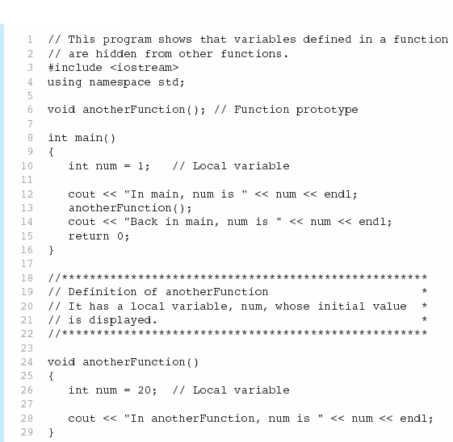

Local Variables in Program 6-16

Slide 62

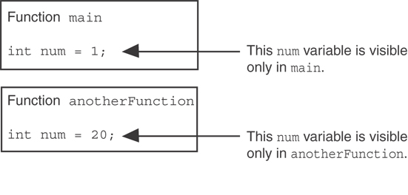
Local Variables in Program 6-16
When the program is executing in main, the num variable defined in main is visible. When anotherFunction is called, however, only variables defined inside it are visible, so the num variable in main is hidden.

Slide 63
Local Variable Lifetime
A function’s local variables exist only while the function is executing. This is known as the lifetime of a local variable.
When the function begins, its local variables and its parameter variables are created in memory, and when the function ends, the local variables and parameter variables are destroyed.
This means that any value stored in a local variable is lost between calls to the function in which the variable is declared.

Slide 64
Global Variables and Global Constants
A global variable is any variable defined outside all the functions in a program.
The scope of a global variable is the portion of the program from the variable definition to the end.
This means that a global variable can be accessed by all functions that are defined after the global variable is defined.

Slide 65
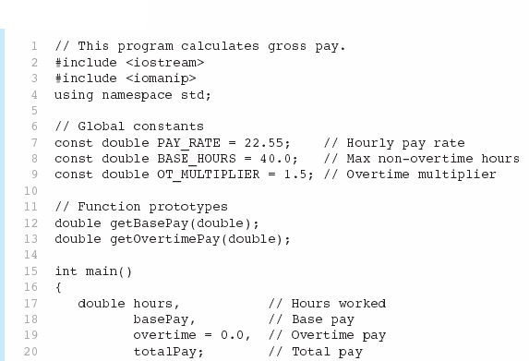

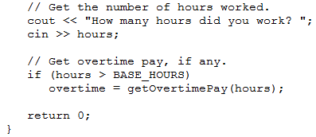
Global constants defined for values that do not change throughout the program’s execution.

Slide 66
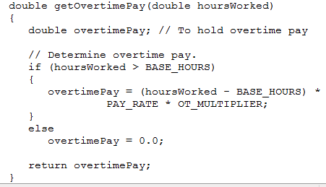

Slide 67
Initializing Local and Global Variables
Local variables are not automatically initialized. They must be initialized by programmer.
Global variables (not constants) are automatically initialized to 0 (numeric) or NULL (character) when the variable is defined.

Slide 68
6.11
Static Local Variables

Slide 69
Static Local Variables
Local variables only exist while the function is executing. When the function terminates, the contents of local variables are lost.
static local variables retain their contents between function calls.
static local variables are defined and initialized only the first time the function is executed. 0 is the default initialization value.

Slide 70

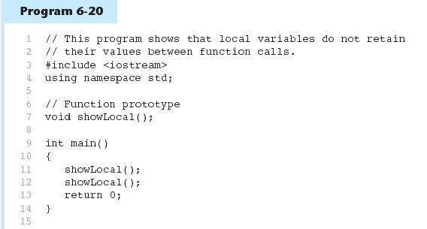
Local Variables Do Not Retain Values Between Function calls in Program 6-21
(Program Continues)

Slide 71
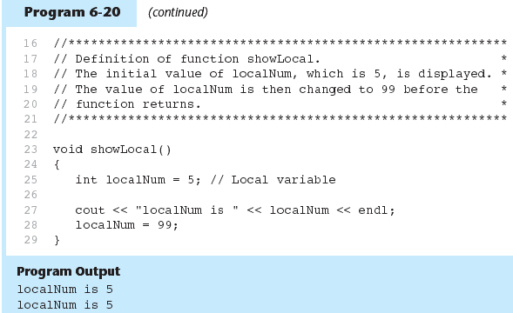
Local Variables Do Not Retain Values Between Function calls in Program 6-21
In this program, each time showLocal is called, the localNum variable is re-created and initialized with the value 5.

Slide 72
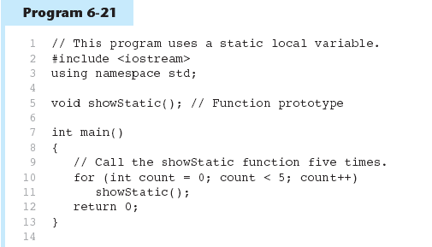

A Different Approach, Using a Static Variable in Program 6-22
(Program Continues)

Slide 73
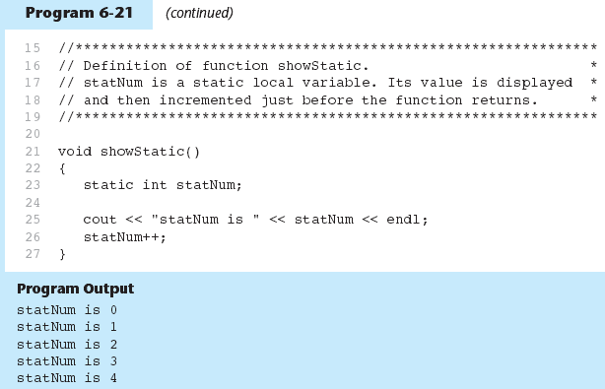
A Different Approach, Using a Static Variable in Program 6-22
statNum is automatically initialized to 0. Notice that it retains its value between function calls.

Slide 74
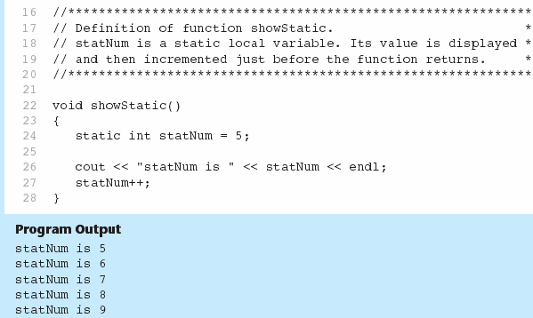
If you do initialize a local static variable, the initialization only happens once. See Program 6-23.

Slide 75
6.12
Default Arguments

Slide 76
Default Arguments
A Default argument is an argument that is passed automatically to a parameter if the argument is missing on the function call.
Must be a constant declared in prototype:
  void evenOrOdd(int = 0);
Can be declared in header if no prototype
Multi-parameter functions may have default arguments for some or all of them:
  int getSum(int, int=0, int=0);

Slide 77
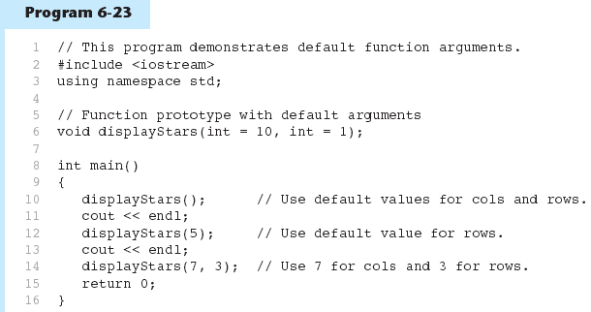

Default Arguments in Program 6-24
Default arguments specified in the prototype
(Program Continues)

Slide 78
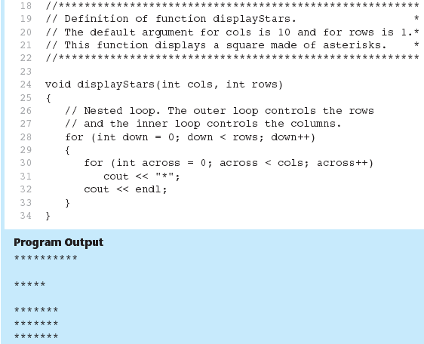
Default Arguments in Program 6-24

Slide 79
Default Arguments
If not all parameters to a function have default values, the defaultless ones are declared first in the parameter list:
  int getSum(int, int=0, int=0);// OK
  int getSum(int, int=0, int); // NO
When an argument is omitted from a function call, all arguments after it must also be omitted:
  sum = getSum(num1, num2); // OK
  sum = getSum(num1, , num3); // NO

Slide 80
Find the errors
void total(int value1, value2, value3)
{
return value1+value2+value3;
}
void area(int len = 30, int width)
{
return len * width;
}

Slide 81
Find the errors
void total(int value1, value2, value3) //data type of value2 and value3 must be defined.
{
return value1+value2+value3; //The function is defined void but returns a value.
}
void area(int len = 30, int width) //width should have a default argument value.
{
return len * width; //The function is defined void but returns a value.
}

Slide 82
6.13
Using Reference Variables as Parameters

Slide 83
Using Reference Variables as Parameters
A mechanism that allows a function to work with the original argument from the function call, not a copy of the argument
Allows the function to modify values stored in the calling environment
Provides a way for the function to ‘return’ more than one value

Slide 84
Passing by Reference
A reference variable is an alias for another variable
Defined with an ampersand (&)
  void getDimensions(int&, int&);
Changes to a reference variable are made to the variable it refers to
Use reference variables to implement passing parameters by reference

Slide 85
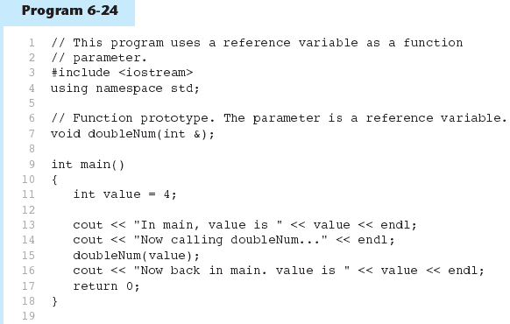

Passing a Variable By Reference in Program 6-25
The & here in the prototype indicates that the parameter is a reference variable.
Here we are passing value by reference.
(Program Continues)

Slide 86
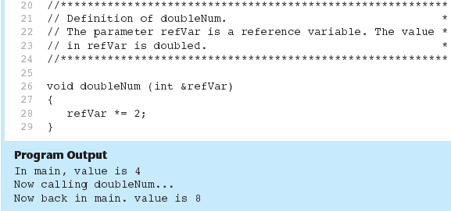
Passing a Variable By Reference in Program 6-25
The & also appears here in the function header.

Slide 87
Reference Variable Notes
Each reference parameter must contain &
Space between type and & is unimportant
Must use & in both prototype and header
Argument passed to reference parameter must be a variable – cannot be an expression or constant
Use when appropriate – don’t use when argument should not be changed by function, or if function needs to return only 1 value

Slide 88
6.14
Overloading Functions

Slide 89
Overloading Functions
Overloaded functions have the same name but different parameter lists
Can be used to create functions that perform the same task but take different parameter types or different number of parameters
Compiler will determine which version of function to call by argument and parameter lists

Slide 90
Function Overloading Examples
Using these overloaded functions,
  void getDimensions(int); // 1
  void getDimensions(int, int); // 2
  void getDimensions(int, double); // 3
  void getDimensions(double, double);// 4
the compiler will use them as follows:
  int length, width;
  double base, height;
  getDimensions(length); // 1
  getDimensions(length, width); // 2
  getDimensions(length, height); // 3
  getDimensions(height, base); // 4

Slide 91
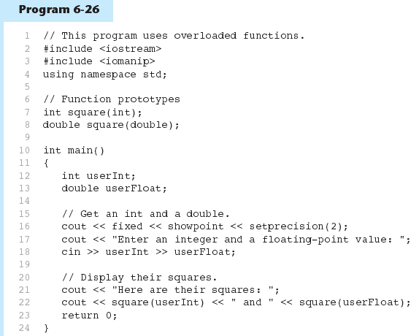

Function Overloading in Program 6-27
The overloaded functions have different parameter lists
Passing a double
Passing an int
(Program Continues)

Slide 92
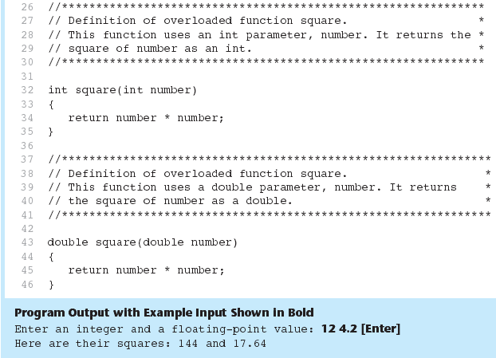
Function Overloading in Program 6-27

Slide 93
6.15
The exit() Function

Slide 94
The exit() Function
Terminates the execution of a program
Can be called from any function
Can pass an int value to operating system to indicate status of program termination
Usually used for abnormal termination of program
Requires cstdlib header file

Slide 95
The exit() Function
Example:
exit(0);
The cstdlib header defines two constants that are commonly passed, to indicate success or failure:
exit(EXIT_SUCCESS);
exit(EXIT_FAILURE);

Slide 96
Lab 6-3
Write a program(lab6-3.cpp) that computes the average, the highest, and the lowest scores of a test for a class. All test scores are stored (one score per line) in a file called "lab6-3.dat".
Create a user-defined function "ProcessTest" that computes and returns the average, the highest, and the lowest test scores. It has 4 parameters:
(1) the input file containing test data,
(2) the average test score,
(3) the highest score, and
(4) the lowest score.
Determine whether each parameter should be declared as a value parameter or a reference parameter

Slide 97
//File name: lab6-3.dat
98
87
74
96
85
84
77
65
38
90
100
83
54
75
79
85
99
94
65
85
94
88
74
95
94
85
86
85
88
58
93
//File name : lab6-3.cpp
#include < iostream >
#include < fstream >
using namespace std;
// declare function "ProcessTests" here
int main()
{
float highest, lowest, average;
ifstream datafile; //an input file stream object
//open the data file
datafile.open("lab6-3.dat");
// fill in the activation statement for function "ProcessTests" here
cout << "The highest score is " << highest << endl;
cout << "The lowest score is " << lowest << endl;
cout << "The average score is " << average << endl;
datafile.close();
return 0;
}
// define the function here
// ProcessTests
// This function finds the highest, lowest, and the average test score
void ProcessTests( , , , )
{
}

