Slide 1

Chapter 7:
Arrays

Slide 2
7.1
Arrays Hold Multiple Values

Slide 3

Arrays Hold Multiple Values
Array: variable that can store multiple values of the same type
Values are stored in adjacent memory locations
Declared using [] operator:
  int tests[5];

Slide 4
Array - Memory Layout
The definition:
  int tests[5];
allocates the following memory:
first element | second element | third element | fourth element | fifth element

Slide 5
Array Terminology
In the definition int tests[5];
int is the data type of the array elements
tests is the name of the array
5, in [5], is the size declarator. It shows the number of elements in the array.
The size of an array is (number of elements) * (size of each element)

Slide 6
Array Terminology
The size of an array is:
  the total number of bytes allocated for it
  (number of elements) * (number of bytes for each element)
Examples:
  int tests[5] is an array of 20 bytes, assuming 4 bytes for an int
  long double measures[10]is an array of 80 bytes, assuming 8 bytes for a long double

Slide 7
Size Declarators
Named constants are commonly used as size declarators.
const int SIZE = 5;
int tests[SIZE];
This eases program maintenance when the size of the array needs to be changed.

Slide 8
7.2
Accessing Array Elements

Slide 9
Accessing Array Elements
Each element in an array is assigned a unique subscript.
Subscripts start at 0
subscripts:
0 | 1 | 2 | 3 | 4

Slide 10
Accessing Array Elements
The last element’s subscript is n-1 where n is the number of elements in the array.
subscripts:
0 | 1 | 2 | 3 | 4

Slide 11
Accessing Array Elements
Array elements can be used as regular variables:
  tests[0] = 79;
  cout << tests[0];
  cin >> tests[1];
  tests[4] = tests[0] + tests[1];
Arrays must be accessed via individual elements:
  cout << tests; // not legal

Slide 12
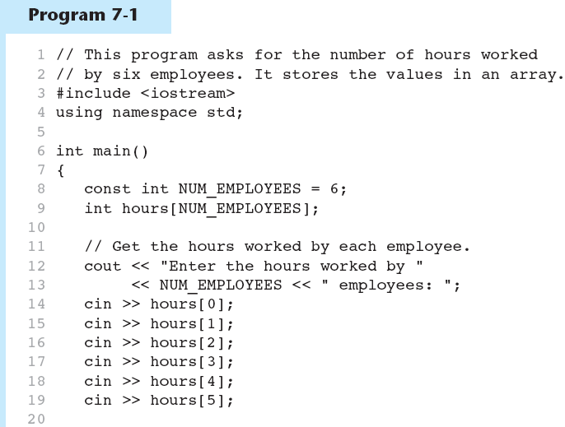
Accessing Array Elements in Program 7-1
(Program Continues)

Slide 13
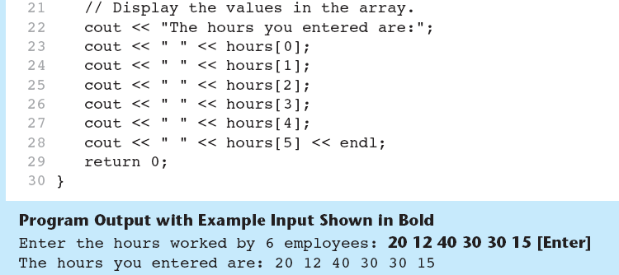
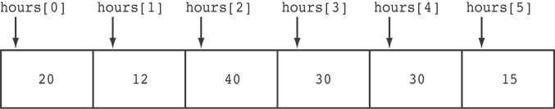
Accessing Array Elements in Program 7-1
Here are the contents of the hours array, with the values entered by the user in the example output:

Slide 14
Accessing Array Contents
Can access element with a constant or literal subscript:
  cout << tests[3] << endl;
Can use integer expression as subscript:
  int i = 5;
  cout << tests[i] << endl;

Slide 15
Using a Loop to Step Through an Array
Example – The following code defines an array, numbers, and assigns 99 to each element:
const int ARRAY_SIZE = 5;
int numbers[ARRAY_SIZE];
for (int count = 0; count < ARRAY_SIZE; count++)
numbers[count] = 99;

Slide 16
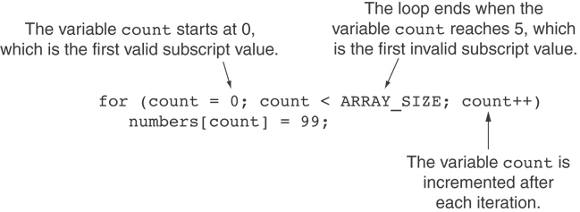
A Closer Look At the Loop

Slide 17
Default Initialization
Global array → all elements initialized to 0 by default
Local array → all elements uninitialized by default

Slide 18
7.3
No Bounds Checking in C++

Slide 19
No Bounds Checking in C++
When you use a value as an array subscript, C++ does not check it to make sure it is a valid subscript.
In other words, you can use subscripts that are beyond the bounds of the array.

Slide 20
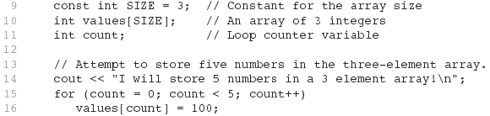
Code From Program 7-5
The following code defines a three-element array, and then writes five values to it!

Slide 21
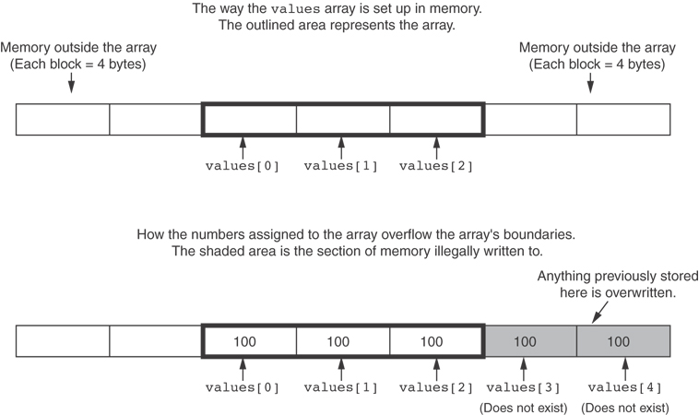
What the Code Does

Slide 22
No Bounds Checking in C++
Be careful not to use invalid subscripts.
Doing so can corrupt other memory locations, crash program, or lock up computer, and cause elusive bugs.

Slide 23
Off-By-One Errors
An off-by-one error happens when you use array subscripts that are off by one.
This can happen when you start subscripts at 1 rather than 0:
// This code has an off-by-one error.
const int SIZE = 100;
int numbers[SIZE];
for (int count = 1; count <= SIZE; count++)
numbers[count] = 0;

Slide 24
Lab 7-1
Write a program that lets user enter the total rainfall for each 12 months onto an array of doubles. The program calculates and displays the total rainfall for the year, the average monthly rainfall, and the months with the highest and lowest amount. Represent the results with two decimal places.
  // Function prototypes: data: array name, size: total number of elements, //script: the subscript of the largest value(to be displayed)
    double getTotal(double [] data, int size);
    double getAverage(double [] data, int size);
    double getLargest(double [] data, int size, int &script);
    double getSmallest(double [] data, int size, int &script);
  Input validation: do not accept negative numbers for monthly rainfall figures

Slide 25
7.4
Array Initialization

Slide 26
Array Initialization
Arrays can be initialized with an initialization list:
const int SIZE = 5;
int tests[SIZE] = {79,82,91,77,84};
The values are stored in the array in the order in which they appear in the list.
The initialization list cannot exceed the array size.

Slide 27
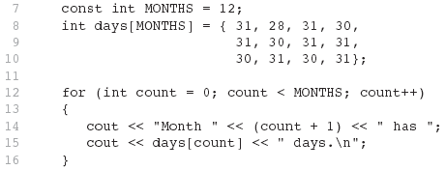
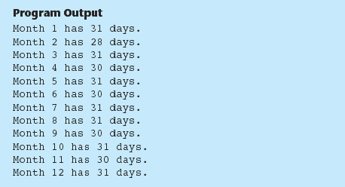
Code From Program 7-6

Slide 28
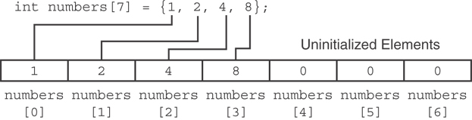
Partial Array Initialization
If array is initialized with fewer initial values than the size declarator, the remaining elements will be set to 0:

Slide 29
Implicit Array Sizing
Can determine array size by the size of the initialization list:
  int quizzes[]={12,17,15,11};
Must use either array size declarator or initialization list at array definition
12 | 17 | 15 | 11

Slide 30
7.6
Processing Array Contents

Slide 31
Processing Array Contents
Array elements can be treated as ordinary variables of the same type as the array
When using ++, -- operators, don’t confuse the element with the subscript:
  tests[i]++; // add 1 to tests[i]
  tests[i++]; // increment i, no
  // effect on tests

Slide 32
Array Assignment
To copy one array to another,
Don’t try to assign one array to the other:
  newTests = tests; // Won't work
Instead, assign element-by-element:
  for (i = 0; i < ARRAY_SIZE; i++)
  newTests[i] = tests[i];

Slide 33
Printing the Contents of an Array
You can display the contents of a character array by sending its name to cout:
char fName[] = "Henry";
  cout << fName << endl;
  But, this ONLY works with character arrays!

Slide 34
Printing the Contents of an Array
For other types of arrays, you must print element-by-element:
  for (i = 0; i < ARRAY_SIZE; i++)
  cout << tests[i] << endl;

Slide 35
Summing and Averaging Array Elements
Use a simple loop to add together array elements:
  int tnum;
  double average, sum = 0;
  for(tnum = 0; tnum < SIZE; tnum++)
  sum += tests[tnum];
Once summed, can compute average:
  average = sum / SIZE;

Slide 36
Finding the Highest Value in an Array
int count;
int highest;
highest = numbers[0];
for (count = 1; count < SIZE; count++)
{
if (numbers[count] > highest)
highest = numbers[count];
}
When this code is finished, the highest variable will contains the highest value in the numbers array.

Slide 37
Finding the Lowest Value in an Array
int count;
int lowest;
lowest = numbers[0];
for (count = 1; count < SIZE; count++)
{
if (numbers[count] < lowest)
lowest = numbers[count];
}
When this code is finished, the lowest variable will contains the lowest value in the numbers array.

Slide 38
Partially-Filled Arrays
If it is unknown how much data an array will be holding:
  Make the array large enough to hold the largest expected number of elements.
  Use a counter variable to keep track of the number of items stored in the array.

Slide 39
Comparing Arrays
To compare two arrays, you must compare element-by-element:
const int SIZE = 5;
int firstArray[SIZE] = { 5, 10, 15, 20, 25 };
int secondArray[SIZE] = { 5, 10, 15, 20, 25 };
bool arraysEqual = true; // Flag variable
int count = 0; // Loop counter variable
// Compare the two arrays.
while (arraysEqual && count < SIZE)
{
if (firstArray[count] != secondArray[count])
arraysEqual = false;
count++;
}
if (arraysEqual)
cout << "The arrays are equal.\n";
else
cout << "The arrays are not equal.\n";

Slide 40
7.7
Using Parallel Arrays

Slide 41
Using Parallel Arrays
Parallel arrays: two or more arrays that contain related data
A subscript is used to relate arrays: elements at same subscript are related
Arrays may be of different types

Slide 42
Parallel Array Example
const int SIZE = 5; // Array size
int id[SIZE]; // student ID
double average[SIZE]; // course average
char grade[SIZE]; // course grade
...
for(int i = 0; i < SIZE; i++)
{
cout << "Student ID: " << id[i]
<< " average: " << average[i]
<< " grade: " << grade[i]
<< endl;
}

Slide 43
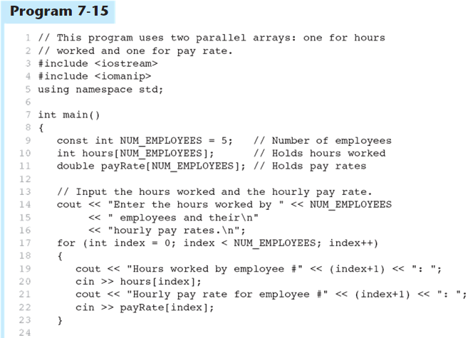
Parallel Arrays in Program 7-15
(Program Continues)

Slide 44
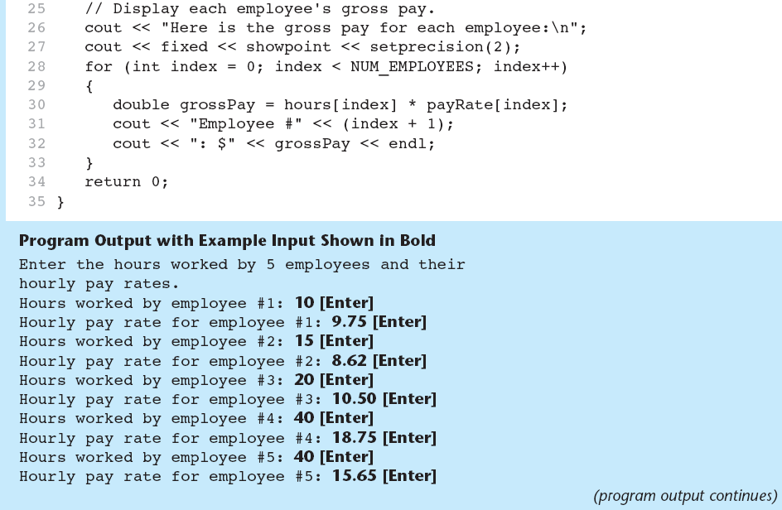
Parallel Arrays in Program 7-15

Slide 45
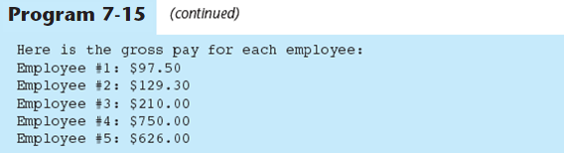
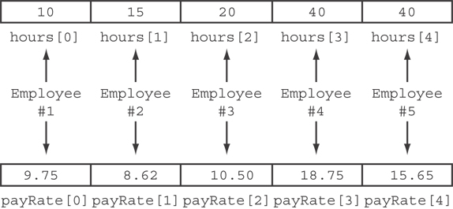
Parallel Arrays in Program 7-15
The hours and payRate arrays are related through their subscripts:

Slide 46
7.8
Arrays as Function Arguments

Slide 47
Arrays as Function Arguments
To pass an array to a function, just use the array name:
  showScores(tests);
To define a function that takes an array parameter, use empty [] for array argument:
  void showScores(int []);
  // function prototype
  void showScores(int tests[])
  // function header

Slide 48
Arrays as Function Arguments
When passing an array to a function, it is common to pass array size so that function knows how many elements to process:
  showScores(tests, ARRAY_SIZE);
Array size must also be reflected in prototype, header:
  void showScores(int [], int);
  // function prototype
  void showScores(int tests[], int size)
  // function header
7-<number>

Slide 49
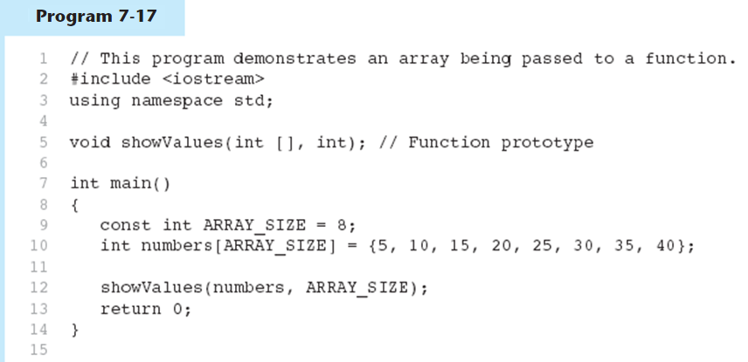
Passing an Array to a Function in Program 7-17
(Program Continues)

Slide 50
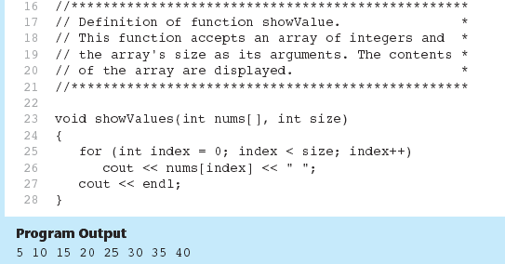
Passing an Array to a Function in Program 7-17

Slide 51
Modifying Arrays in Functions
Array names in functions are like reference variables – changes made to array in a function are reflected in actual array in calling function
Need to exercise caution that array is not inadvertently changed by a function

Slide 52
Lab 7-2
Write a function that accepts three arguments: an array, the size of the array, and a number n. Assume that the array contains integers. The function should display all of the numbers in the array that are greater than the number n. use the following statement in your code:
  int numbers[SIZE] = { 1, 23, 43, 54, 4, 34, 2, 5, 7, 9 };

Slide 53
7.9
Two-Dimensional Arrays

Slide 54
Two-Dimensional Arrays
Can define one array for multiple sets of data
Like a table in a spreadsheet
Use two size declarators in definition:
  const int ROWS = 4, COLS = 3;
  int exams[ROWS][COLS];
First declarator is number of rows; second is number of columns

Slide 55
Two-Dimensional Array Representation
const int ROWS = 4, COLS = 3; int exams[ROWS][COLS];
Use two subscripts to access element:
  exams[2][2] = 86;
columns
exams[0][0] | exams[0][1] | exams[0][2]
exams[1][0] | exams[1][1] | exams[1][2]
exams[2][0] | exams[2][1] | exams[2][2]
exams[3][0] | exams[3][1] | exams[3][2]
r
o
w
s

Slide 56
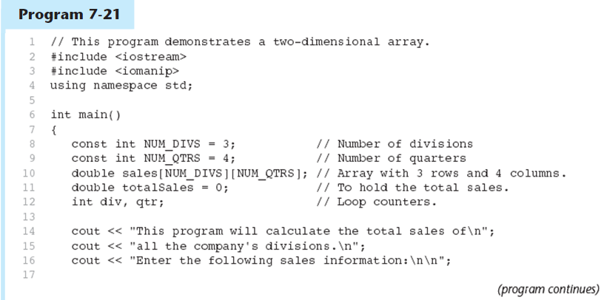
A Two-dimensional Array in Program 7-21

Slide 57
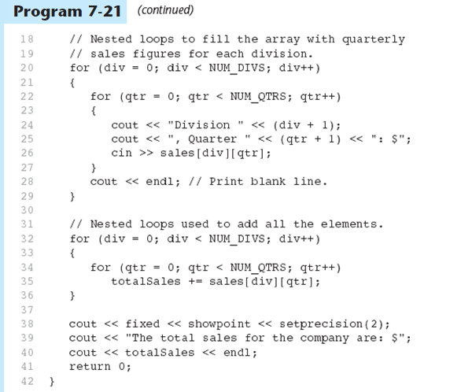
A Two-dimensional Array in Program 7-21

Slide 58
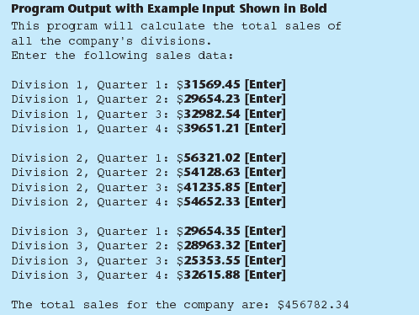
A Two-dimensional Array in Program 7-21

Slide 59
2D Array Initialization
Two-dimensional arrays are initialized row-by-row:
const int ROWS = 2, COLS = 2;
int exams[ROWS][COLS] = { {84, 78},
  {92, 97} };
Can omit inner { }, some initial values in a row – array elements without initial values will be set to 0 or NULL
84 | 78
92 | 97

Slide 60
Two-Dimensional Array as Parameter, Argument
Use array name as argument in function call:
  getExams(exams, 2);
Use empty [] for row, size declarator for column in prototype, header:
const int COLS = 2;
// Prototype
void getExams(int [][COLS], int);
// Header
void getExams(int exams[][COLS], int rows)

Slide 61
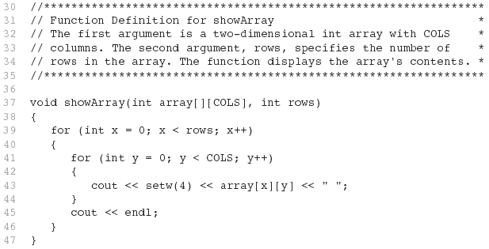
Example – The showArray Function from Program 7-22

Slide 62
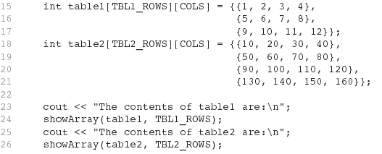
How showArray is Called

Slide 63
Summing All the Elements in a Two-Dimensional Array
Given the following definitions:
const int NUM_ROWS = 5; // Number of rows
const int NUM_COLS = 5; // Number of columns
int total = 0; // Accumulator
int numbers[NUM_ROWS][NUM_COLS] =
{{2, 7, 9, 6, 4},
{6, 1, 8, 9, 4},
{4, 3, 7, 2, 9},
{9, 9, 0, 3, 1},
{6, 2, 7, 4, 1}};

Slide 64
Summing All the Elements in a Two-Dimensional Array
// Sum the array elements.
for (int row = 0; row < NUM_ROWS; row++)
{
for (int col = 0; col < NUM_COLS; col++)
total += numbers[row][col];
}
// Display the sum.
cout << "The total is " << total << endl;

Slide 65
Summing the Rows of a Two-Dimensional Array
Given the following definitions:
const int NUM_STUDENTS = 3;
const int NUM_SCORES = 5;
double total; // Accumulator
double average; // To hold average scores
double scores[NUM_STUDENTS][NUM_SCORES] =
{{88, 97, 79, 86, 94},
{86, 91, 78, 79, 84},
{82, 73, 77, 82, 89}};

Slide 66
Summing the Rows of a Two-Dimensional Array
// Get each student's average score.
for (int row = 0; row < NUM_STUDENTS; row++)
{
// Set the accumulator.
total = 0;
// Sum a row.
for (int col = 0; col < NUM_SCORES; col++)
total += scores[row][col];
// Get the average
average = total / NUM_SCORES;
// Display the average.
cout << "Score average for student "
<< (row + 1) << " is " << average <<endl;
}

Slide 67
Summing the Columns of a Two-Dimensional Array
Given the following definitions:
const int NUM_STUDENTS = 3;
const int NUM_SCORES = 5;
double total; // Accumulator
double average; // To hold average scores
double scores[NUM_STUDENTS][NUM_SCORES] =
{{88, 97, 79, 86, 94},
{86, 91, 78, 79, 84},
{82, 73, 77, 82, 89}};

Slide 68
Summing the Columns of a Two-Dimensional Array
// Get the class average for each score.
for (int col = 0; col < NUM_SCORES; col++)
{
// Reset the accumulator.
total = 0;
// Sum a column
for (int row = 0; row < NUM_STUDENTS; row++)
total += scores[row][col];
// Get the average
average = total / NUM_STUDENTS;
// Display the class average.
cout << "Class average for test " << (col + 1)
<< " is " << average << endl;
}

Slide 69
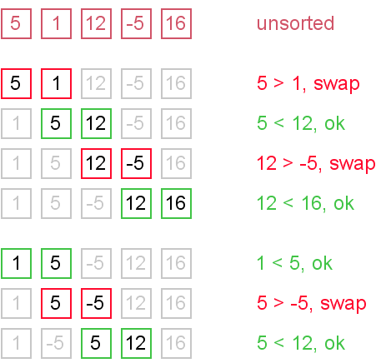
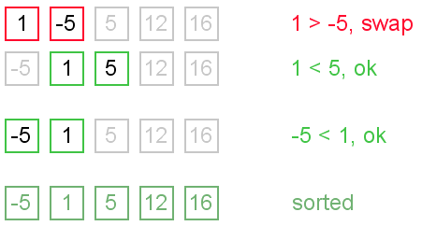
Lab 7-3
Write sort code for the following data: {5, 1, 12, -5, 16}

