Slide 1

WIPRO NGA Program – C++ LSP Batch
Capstone Project Presentation –
Project Title - A Distributed Real-Time Messaging System Using Client-Server Architechture
Presented by – Dolly Kumari
www. rpsconsulting. in

Slide 2
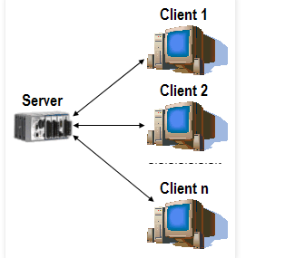

INTRODUCTION
A multi-user chat system using C++ is a program that allows multiple users to communicate with each other in real-time through text messages.
The communication between various users is done using client server model.

Slide 3
Various application tools used
Compiler/IDE:
GCC/G++: g++-11 -std=c++11 -pthread chat_client.cpp -o chat_client.
Text editor
Networking Libraries:
POSIX Sockets: Utilized for network communication.
Operating System:
Linux (Debian): Used for development and execution of the project.
Threading Library:
pthread: For multithreading support, included via -pthread flag in g++ compilation.
Debugging tools:
GDB(GNU debugger)

Slide 4
HOW THIS SYSTEM WORKS?
HOW THIS SYSTEM WORKS?
Server Initialization
Socket Creation: The server creates a socket using socket(AF_INET, SOCK_STREAM, 0).
Bind to Address: The server binds the socket to an IP address and port (e.g., PORT 8080) using bind().
Listening for Connections: The server listens for incoming client connections with listen().
Accepting Clients: It accepts connections from clients using accept(), creating a new socket for each client.

Slide 5
HOW THIS SYSTEM WORKS? (CONTINUE...)
2. Client Initialization
Socket Creation: Each client creates a socket using socket(AF_INET, SOCK_STREAM, 0).
Connecting to Server: The client connects to the server using connect(), specifying the server’s IP address and port.
Sending Username: After connecting, the client sends its username to the server using send().

Slide 6
3. Handling Messages
Receiving Messages: Both client and server use separate threads to handle incoming messages. They use recv() to receive data from the socket.
Displaying Messages: Received messages are displayed to the user (on the console) using std::cout.
4. Multithreading
Client Threads: The client application starts a separate thread to handle message reception (receive_messages function).
Server Threads: The server would typically use threads to handle multiple clients concurrently.

Slide 7
5. Sending Messages
User Input: The client reads user input from the console and sends it to the server using send().
Broadcasting: The server receives messages from clients and can broadcast them to other connected clients
6. Error Handling
Socket Operations: The system checks for errors during socket operations (creation, binding, connection) and handles them by printing error messages to the console.
7. Connection Management
Closing Connections: When either side finishes communication or encounters an error, it closes the socket using close() to release resources.

Slide 8
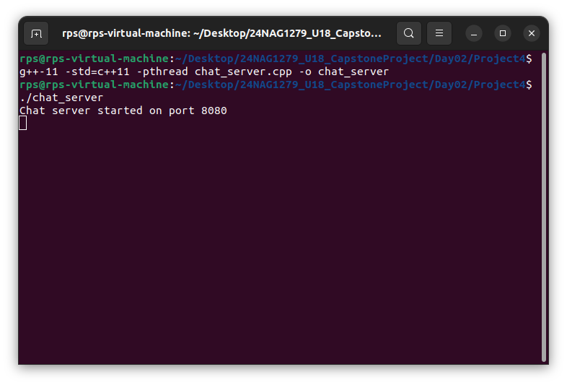
OUTPUT SCREENSHOT
Server terminal

Slide 9
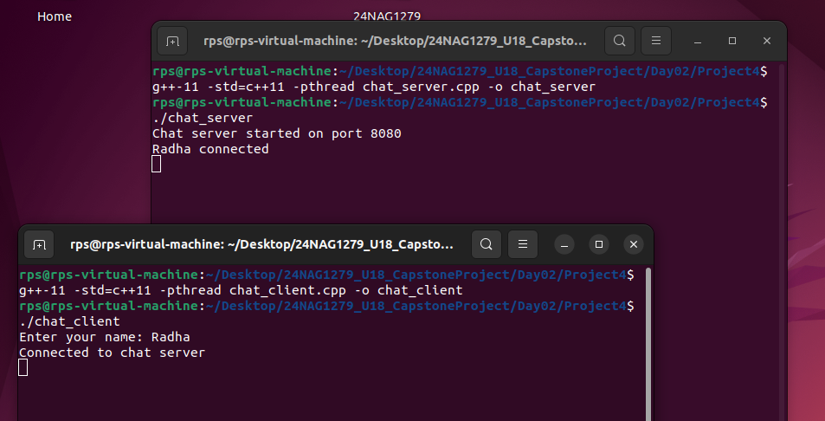
Client 1 connected

Slide 10
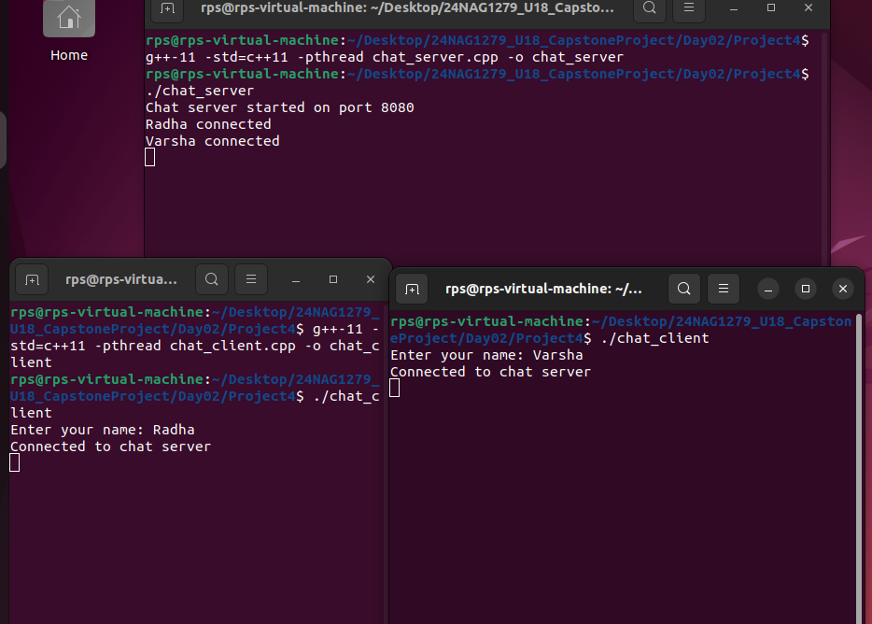
Client 2 terminal connected

Slide 11
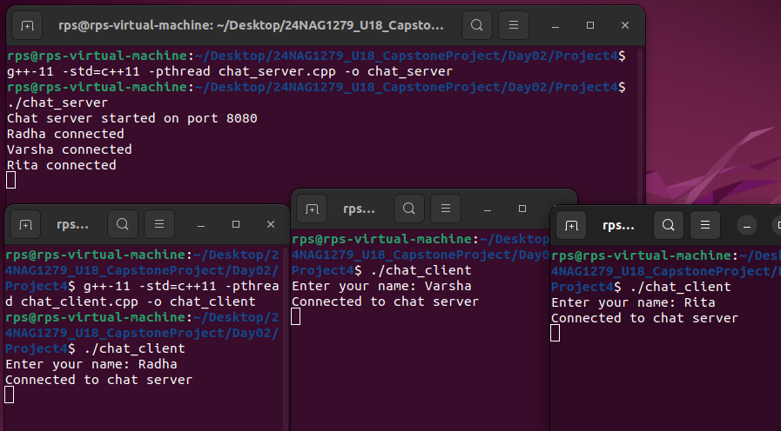
Client 3 connected

Slide 12
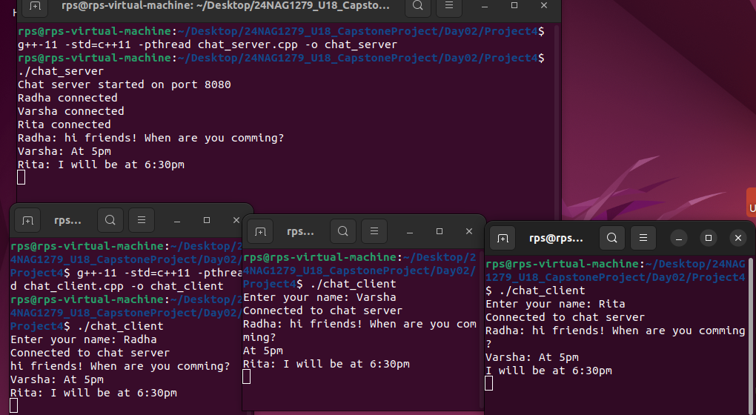
Final Output

Slide 13
FUTURE IMPROVEMENTS
Advanced Features
Current State: Basic messaging functionality is implemented.
Proposed Improvement: Introduce advanced features such as file sharing, message reactions, and group chats to enhance functionality and user engagement.
Enhanced Scalability
Current State: The system handles multiple clients but may face limitations with a high number of concurrent users.
Proposed Improvement: Implement load balancing and server clustering to handle more clients and improve performance.
Security Enhancements
Current State: Communication is currently unencrypted, which may expose data to interception.
Proposed Improvement: Integrate encryption protocols (e.g., TLS/SSL) to secure message transmissions and protect user data.

Slide 14
CONCLUSION
This project successfully developed a distributed real-time messaging system using C++ and POSIX sockets, demonstrating effective client-server communication and multithreading capabilities. The system enables concurrent messaging between multiple users. Challenges such as managing multiple connections and error handling were addressed. Overall, this project provided practical experience in real-time system development and set the stage for further advancements in functionality and performance.

Slide 15
Thankyou

