Slide 1
Investigation on statistics-driven neural network interpretation based on PCA and MLR: a case study on written digit recognition
Qin Huang, Ziming Zhou
Sep. 2023

Slide 2
STAR Approach
Situation
- XAI is crucial for enhancing transparency and interpretability in 2D image recognition
- Conventional decomposition approaches lacks statistical foundation and are greatly sensitive to the quality of dataset.
Target
- Enhance robustness and flexibility of XAI diagnostic approaches by introducing statistical foundation.
Action
- Build a PCA + MLR model
Result
- Sufficient classification / regression accuracy
- Strong discernability of global shape and local texture info
- Higher interpretability and robustness compared with decompositional approaches
- Better efficiency and maneuverability of model finetuning from new samples

Slide 3
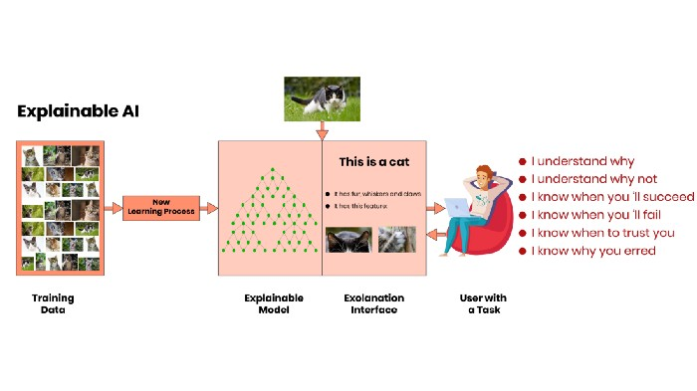


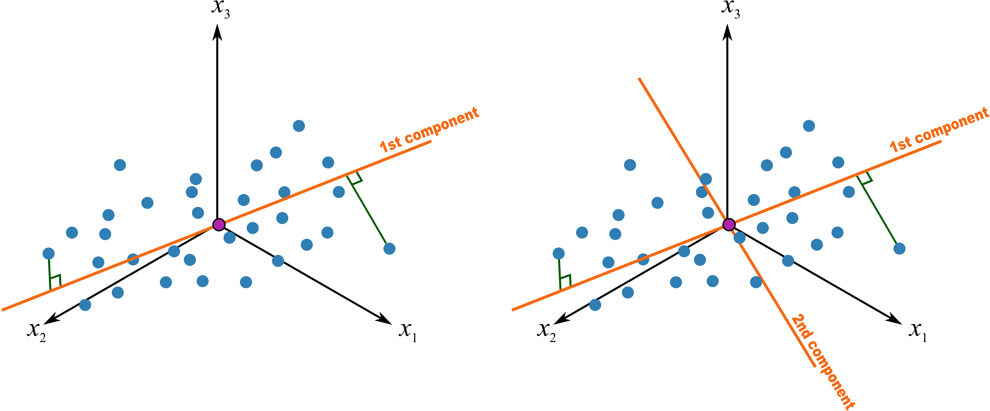
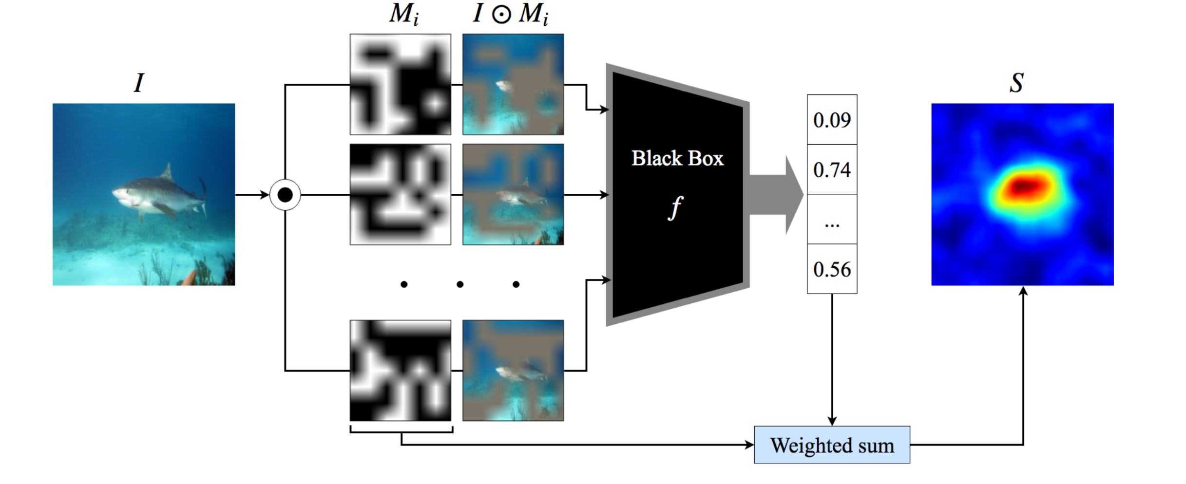
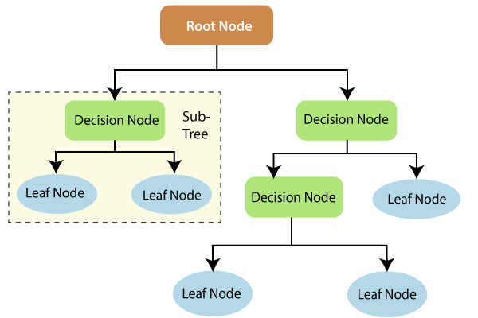
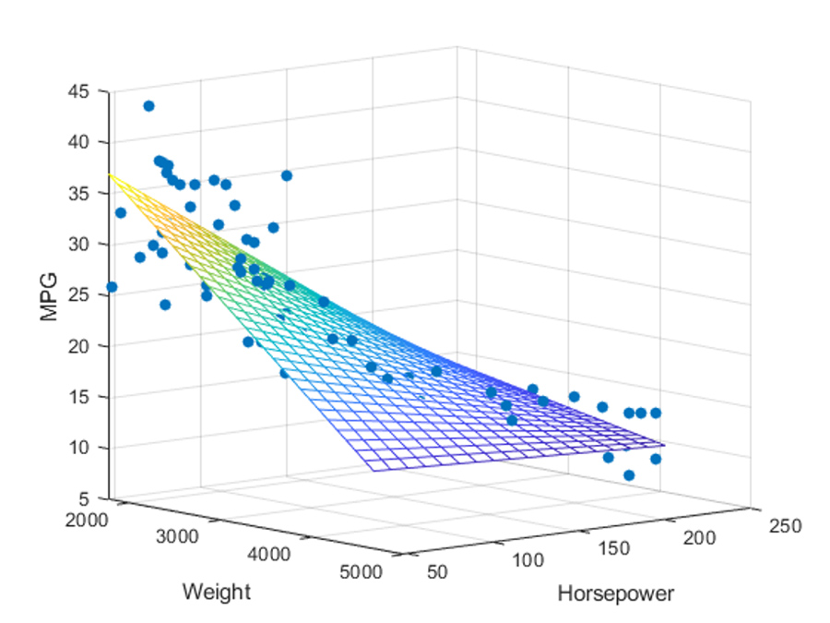



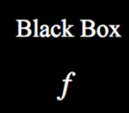


Background
Explainable AI(XAI) for Image Recognition
Cat Image Dataset
New Image
Reasoning
This is a cat.
New Learning Process
Furry Ears
Small Claws
Decompositional Approaches
Pedagogical Approaches
Feature Importance Analysis
Diagnostic Models
Current Solution
Raw Features + Decision Trees
PCA Extracted Features + MLR
Our Approaches
Potential Drawback
Potential Drawback
Our proposed method
(a) Strong correlations between pixels
(b) A Black-box to Black-box Strategy
Data overfitting
Diagnostics with strong statistical foundations
$$P(label)$$
Decision Criteria
Useless
？
Useless
Orthogonalized features that reduces feature correlations;
Rigorous hypothesis tests that supports comparison for different inputs and NN structures;
$$Feature$$
$$Importance$$
Useful
Features are not independent
Lacks statistical foundations
Useless decision layers hinders effective diagnostics

Slide 4
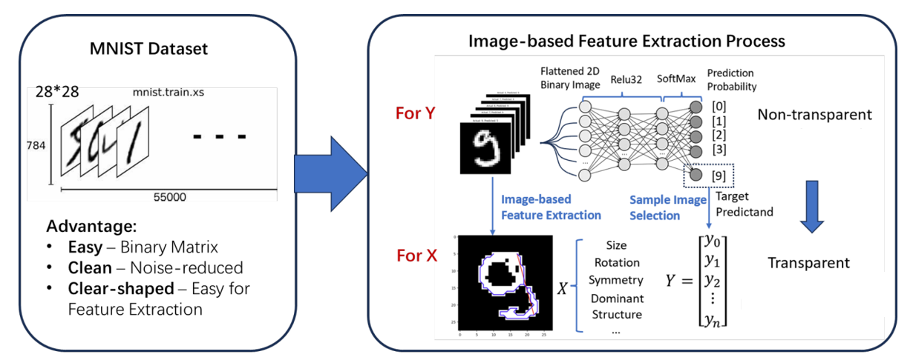
Data Establishment

Slide 5

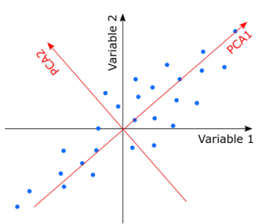


Methodology-how to perform regression
Feature Extraction process
Teacher Model
Neural Network
Learning x
Diagnose √
Feature 1
Feature 2
Feature 3
Feature 4
Feature 5
Student Model
$$MLR:Y\sim X$$
PCA

Slide 6
Methodology-how to perform diagnosis
Coefficient Analysis:
Examine the coefficients of the independent variables. Positive coefficients suggest a positive relationship with the dependent variable, while negative coefficients indicate a negative relationship.
R-squared (R2) Score:
Calculate the R-squared value to measure the goodness of fit. A higher R2 indicates a better fit of the model to the data.
Adjusted R-squared:
Adjusted R-squared takes into account the number of predictors in the model and penalizes the addition of irrelevant variables.
Residual Analysis:
Plot residuals (the differences between actual and predicted values) to check for patterns. Residuals should ideally be normally distributed and randomly scattered around zero.
Normality of Residuals:
Use statistical tests or visualizations (e.g., Q-Q plots) to assess whether the residuals are normally distributed. Deviations from normality may suggest model issues.
Homoscedasticity:
Check for homoscedasticity by plotting residuals against predicted values. Homoscedasticity implies that the variance of residuals is constant across all levels of the independent variable.
Multicollinearity:
Calculate variance inflation factors (VIFs) or correlation matrices to detect multicollinearity among independent variables. High VIF values or strong correlations may indicate multicollinearity.
Outlier Detection:
Identify and investigate potential outliers that can disproportionately influence the model. You can use box plots, scatter plots, or statistical tests for this purpose.
Durbin-Watson Statistic:
Calculate the Durbin-Watson statistic to test for the presence of autocorrelation in the residuals. Values close to 2 indicate no autocorrelation.
Feature Importance:
Assess the importance of each independent variable in explaining the variation in the dependent variable. Techniques like feature importance scores or hypothesis testing can be useful.
Cross-Validation:
Implement cross-validation techniques such as k-fold cross-validation to estimate the model's generalization performance on unseen data.
Model Comparison:
Compare the MLR model with alternative models (e.g., polynomial regression, decision trees, or other regression algorithms) to determine if a different model type provides a better fit.
Predictive Performance Metrics:
Evaluate the model's predictive performance using metrics such as Mean Absolute Error (MAE), Mean Squared Error (MSE), and Root Mean Squared Error (RMSE) on a test dataset.
Bias-Variance Trade-off:
Analyze the bias-variance trade-off by examining the training error and test error. High training error and low test error may indicate overfitting.
Feature Engineering and Selection:
Consider feature engineering techniques or feature selection methods to improve the model's performance and interpretability.
Heteroscedasticity Tests:
Conduct formal statistical tests for heteroscedasticity, such as the Breusch-Pagan test or White test.
W.r.t. Accuracy
R-square/Adjusted R-square
Residual Analysis
Feature Selection
Outlier analysis
W.r.t. predictors
Statistical test: p-value
Multicollinearity
Predictive performance matrics
W.r.t. models
Pros/Cons: MLR(GLR) / Decision-tree / SVM / NN as tools for model interpretability analysis
Test on model robustness w.r.t. input
Test on model interpretability
Test on model flexibility: Application with fine-tuning (weighted MLR with higher weight for latter input)

Slide 7
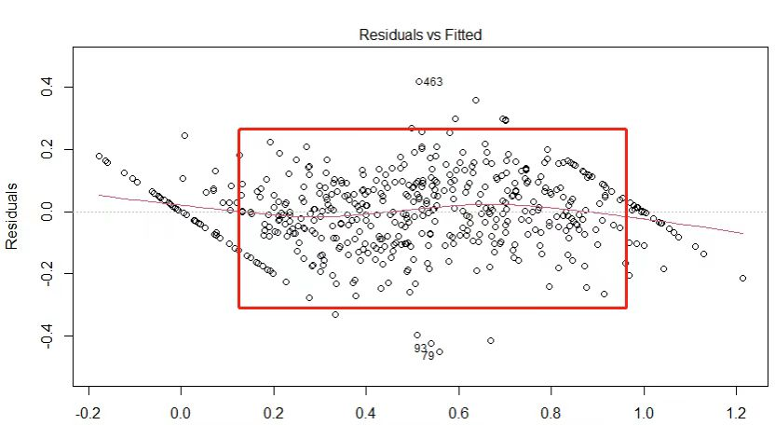
Results – Classification Accuracy
Classification Accuracy > 90%

Slide 8
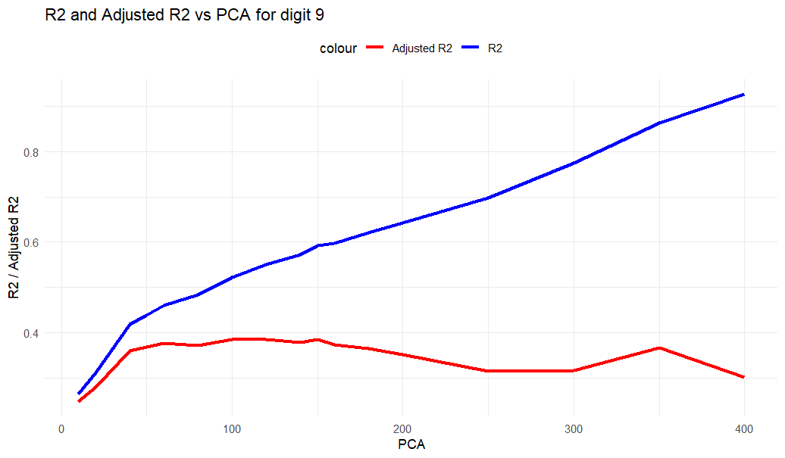
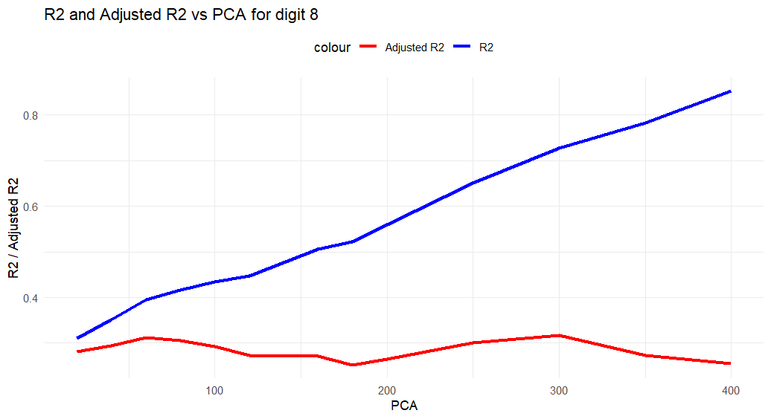
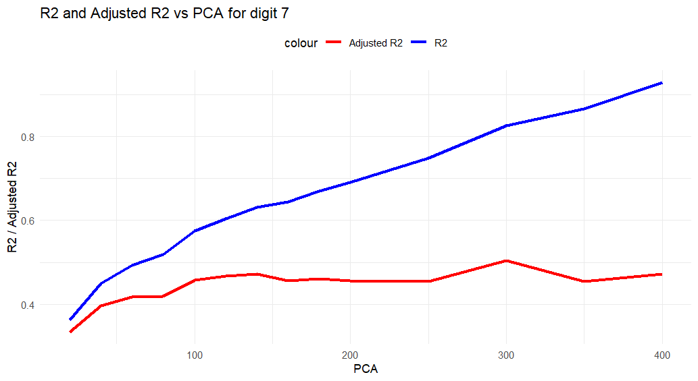
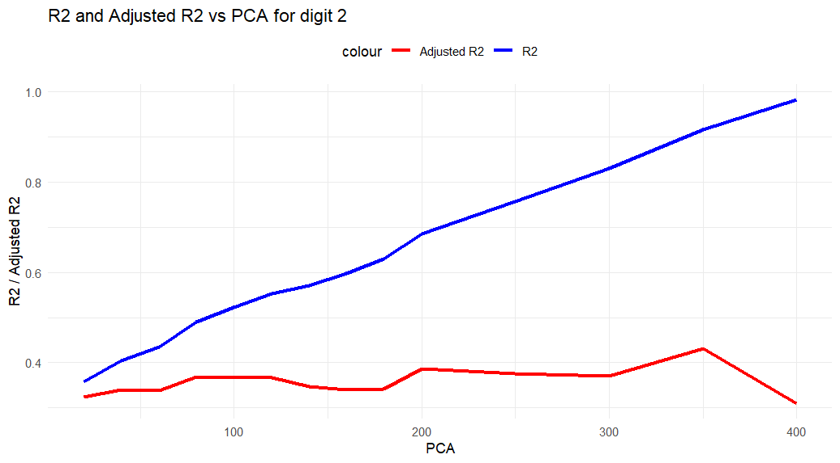
Results – Regression Accuracy
Why two increasing region?
Are there local maximal?
low-dimension
high-dimension

Slide 9
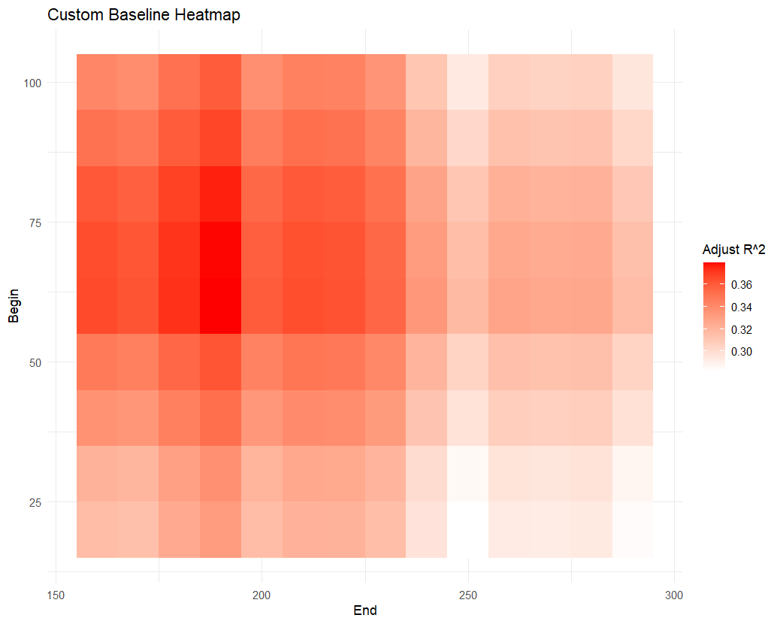
Results - Optimization
shows the gradient
local maximum
x - axis: region A from x to 300 features
y - axis: region B from 1 to y features
Heatmaps compare the adjust R-squared values in the model built by MLR on region A + region B

Slide 10
Results - define low/high-dimension region
2 features
3 features
10 features
50 features
100 features

Slide 11
Results - define low/high-dimension region
Reconstruction based on 300 features
White noise in the background faked
Low-dimension: shape
High-dimension: noise
Reconstruction based on 350 features

Slide 12
Discussion
Robustness: Decompositional Approaches vs Decision Tree(TODO) vs MLR
Conclusion: MLR has higher flexibility / adaptability to random noise and edge blurring
Persuasiveness (Interpretability)
Conclusion: MLR could well be used to determine the optimal structure of the NN design
Efficiency for fine-tuning
Introducing Iteratively re-weighted least squares (IRLS) approach

Slide 13
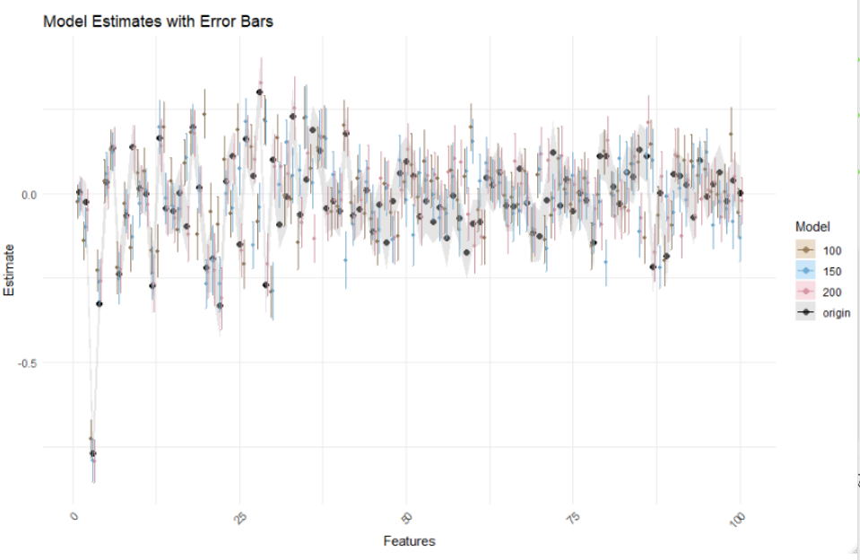
Discussion - robustness
Reconstruct based on diff. amount of features
Recapture PCA 100 features
Refit MLR models

Slide 14
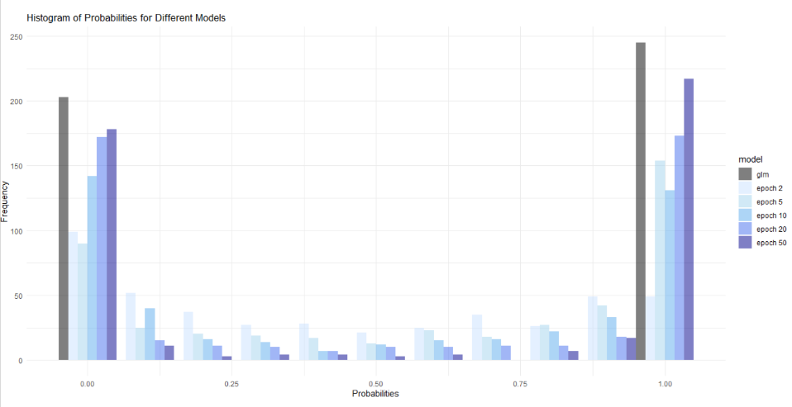
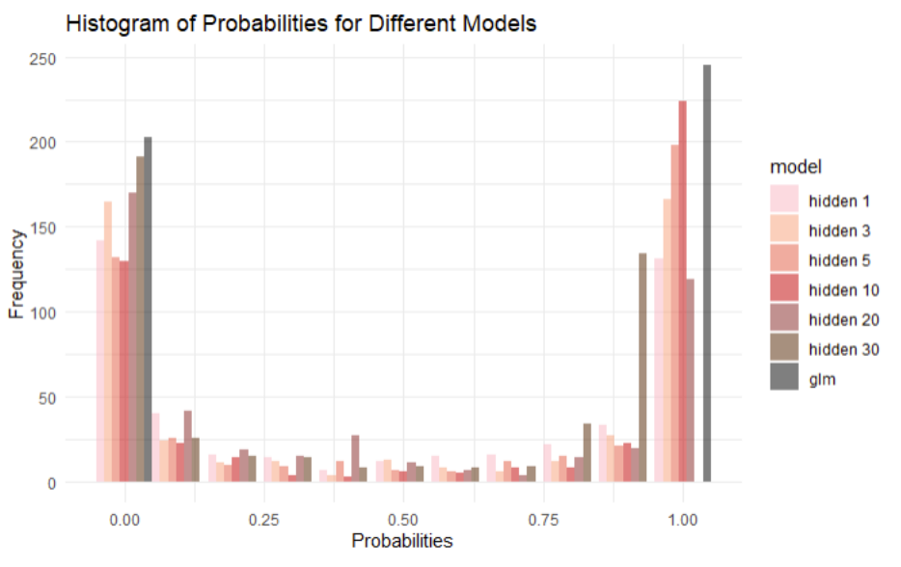
Discussion - performance for diff. layer/epoch

Slide 15
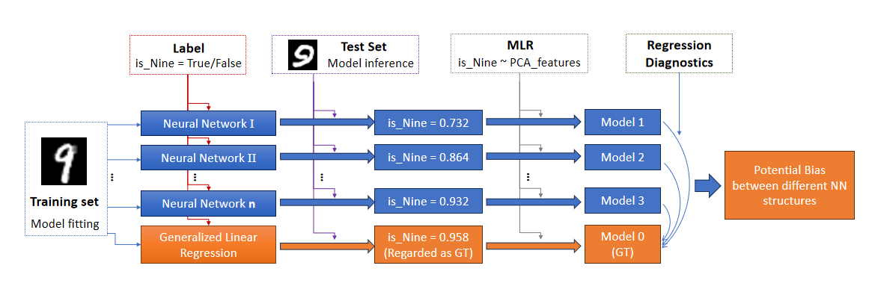
Discussion - compared with glm

Slide 16
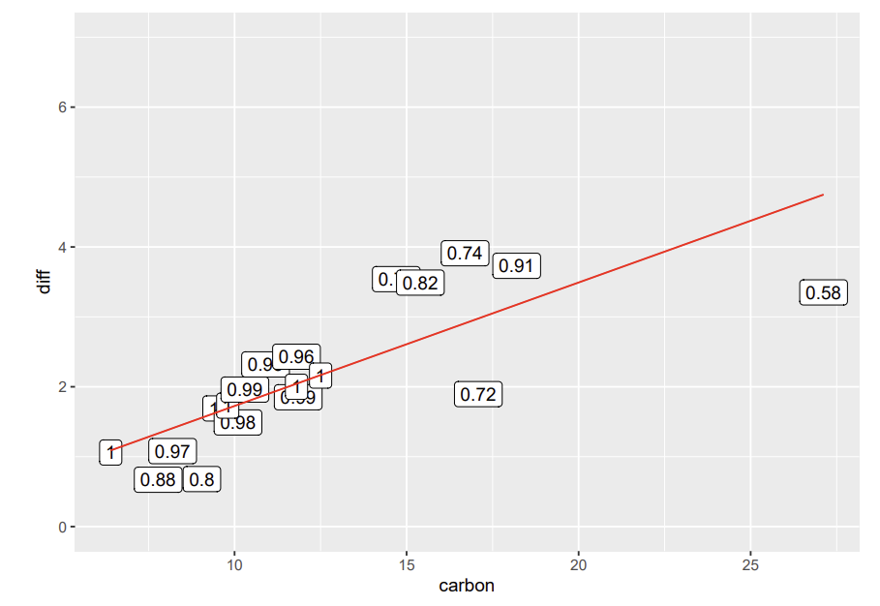
Discussion – efficiency for introducing new data from robust regressions
IRLS Steps
Iteratively re-weighted least squares
Also useful to deal with the outliers

