Slide 1
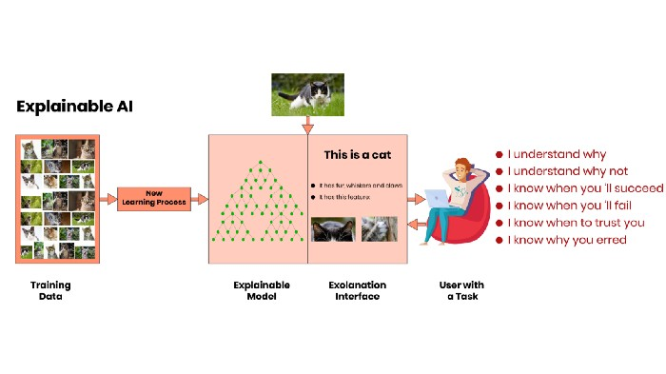
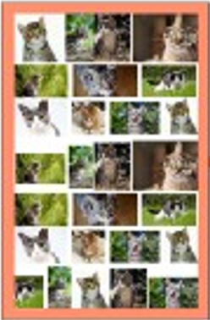
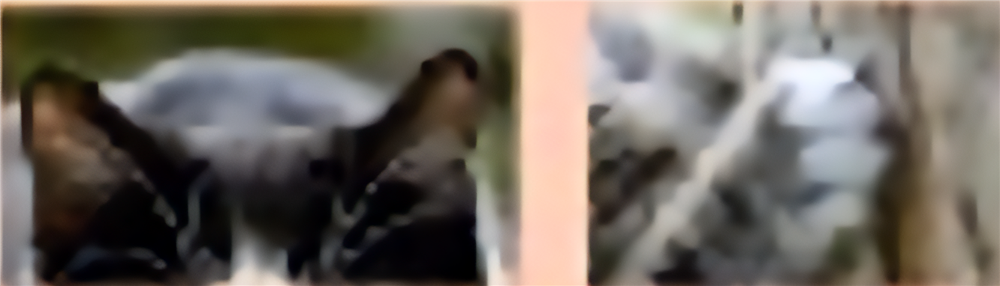
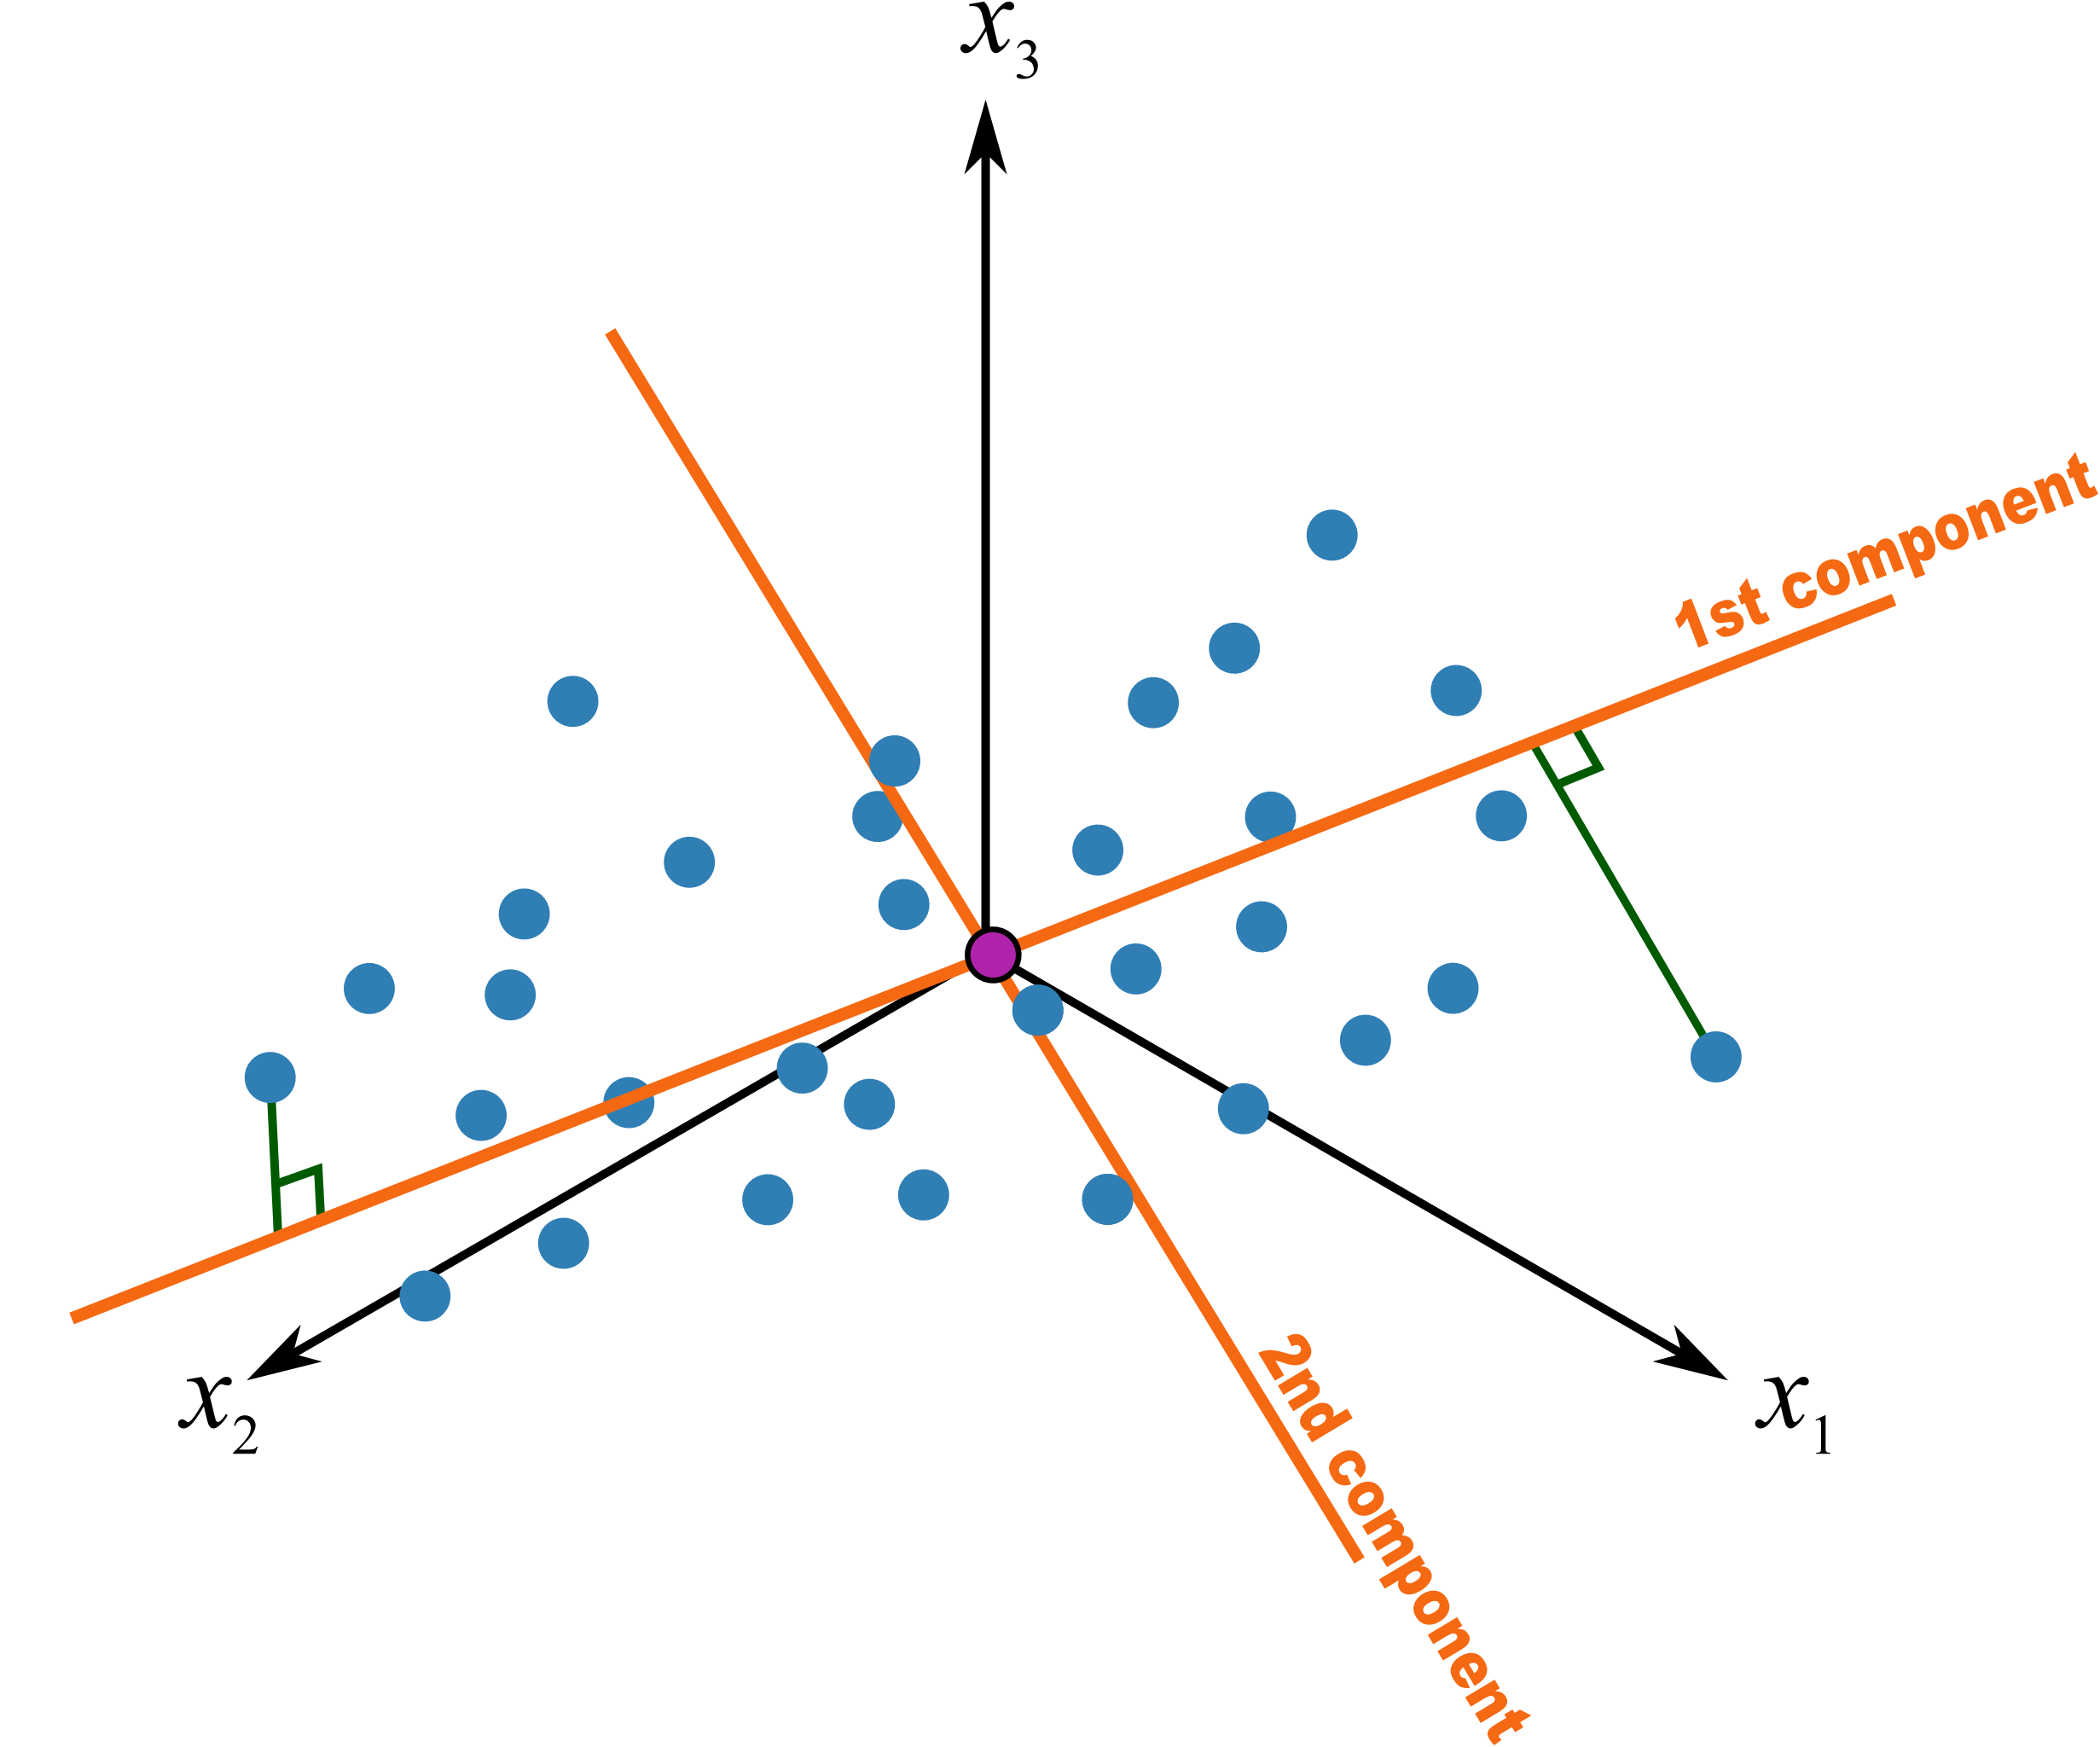
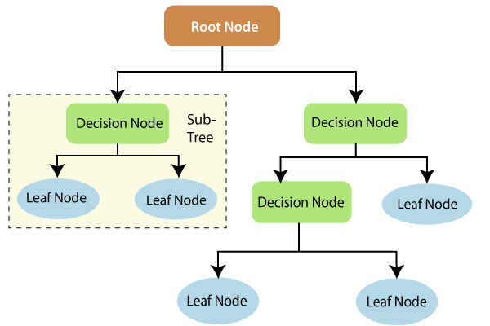
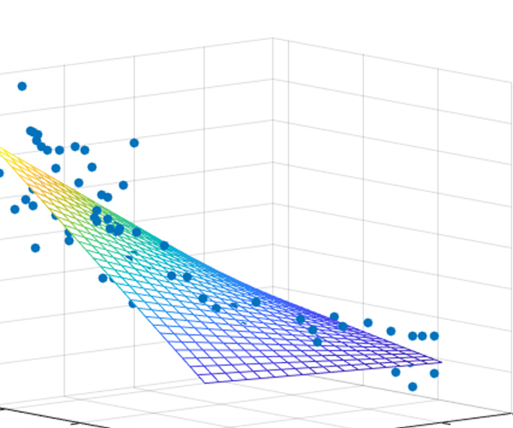
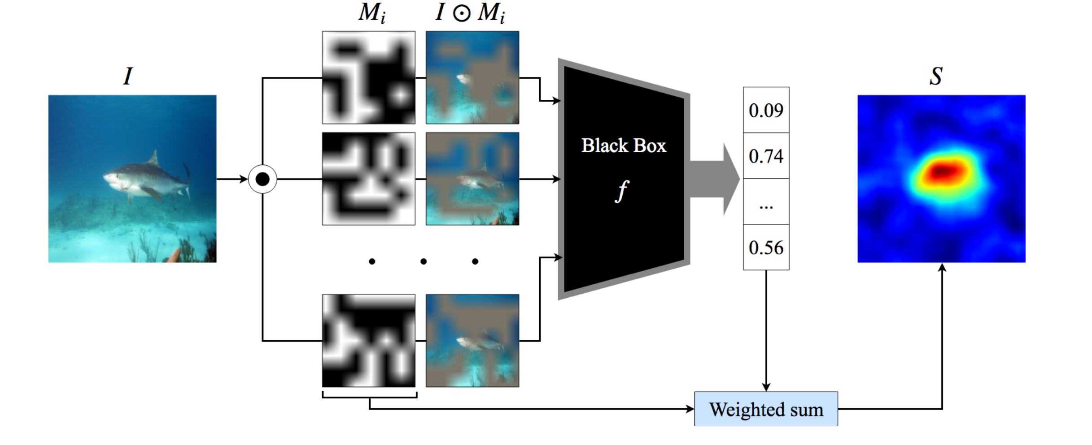



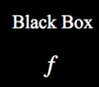


Explainable AI(XAI) for Image Recognition
Cat Image Dataset
New Image
Reasoning
This is a cat.
New Learning Process
Furry Ears
Small Claws
Decompositional Approaches
Pedagogical Approaches
Feature Importance Analysis
Diagnostic Models
…
Raw Features + Decision Trees
PCA Extracted Features + MLR
Potential Drawback
Potential Drawback
Potential Drawback
(a) Multi-correlation between pixels
(b) A Black-box to Black-box Strategy
overfitting
poor data interpretability
$$P(label)$$
？
structure limitation
information loss
$$Feature$$
$$Importance$$
Features are not independent
Lacks statistical foundations

Slide 4



Cat Image Recognition
Reasoning
This is a cat.
Explainable AI(XAI)
New Learning Process
Furry Ears
Small Claws
Any better alternative?
Feature Importance Extraction Method
(a) Multi-correlation between pixels
(b) A Black-box to Black-box Strategy
$$P(label)$$
Potential
Caveats
？
$$Feature$$
$$Importance$$

Slide 5
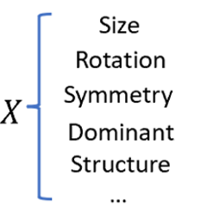
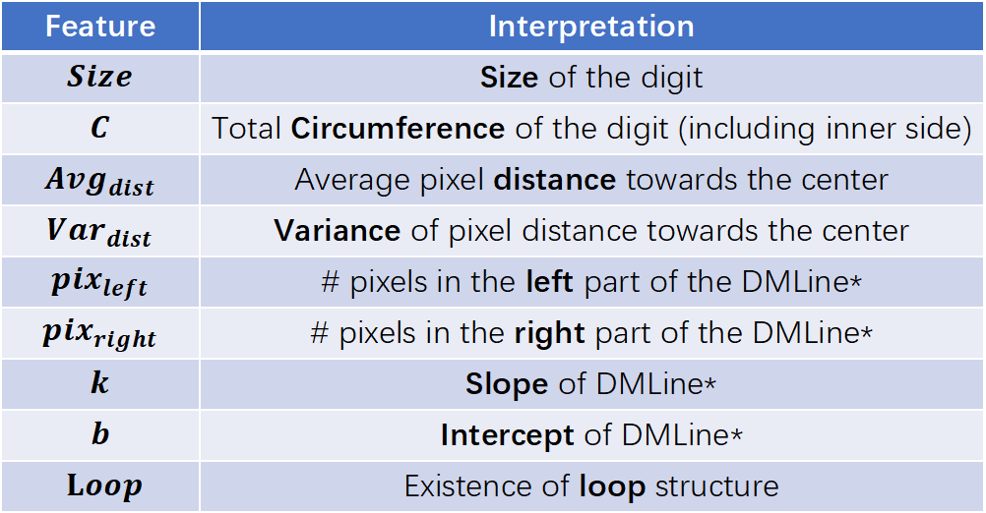
Feature | Interpretation
$$Size$$ | Size of the digit
$$C$$ | Total Circumference of the digit (including inner side)
$$Avg_{dist}$$ | Average pixel distance towards the center
$$Var_{dist}$$ | Variance of pixel distance towards the center
$$pix_{left}$$ | # pixels in the left part of the DMLine*
$$pix_{right}$$ | # pixels in the right part of the DMLine*
$$k$$ | Slope of DMLine*
$$b$$ | Intercept of DMLine*
$Loop$ | Existence of loop structure
Compactness
Note: *DMLine (Dominant Line) stands for the longest connected line within digits

