Slide 1
CS2311 Computer Programming
Introduction to PASS

Slide 2
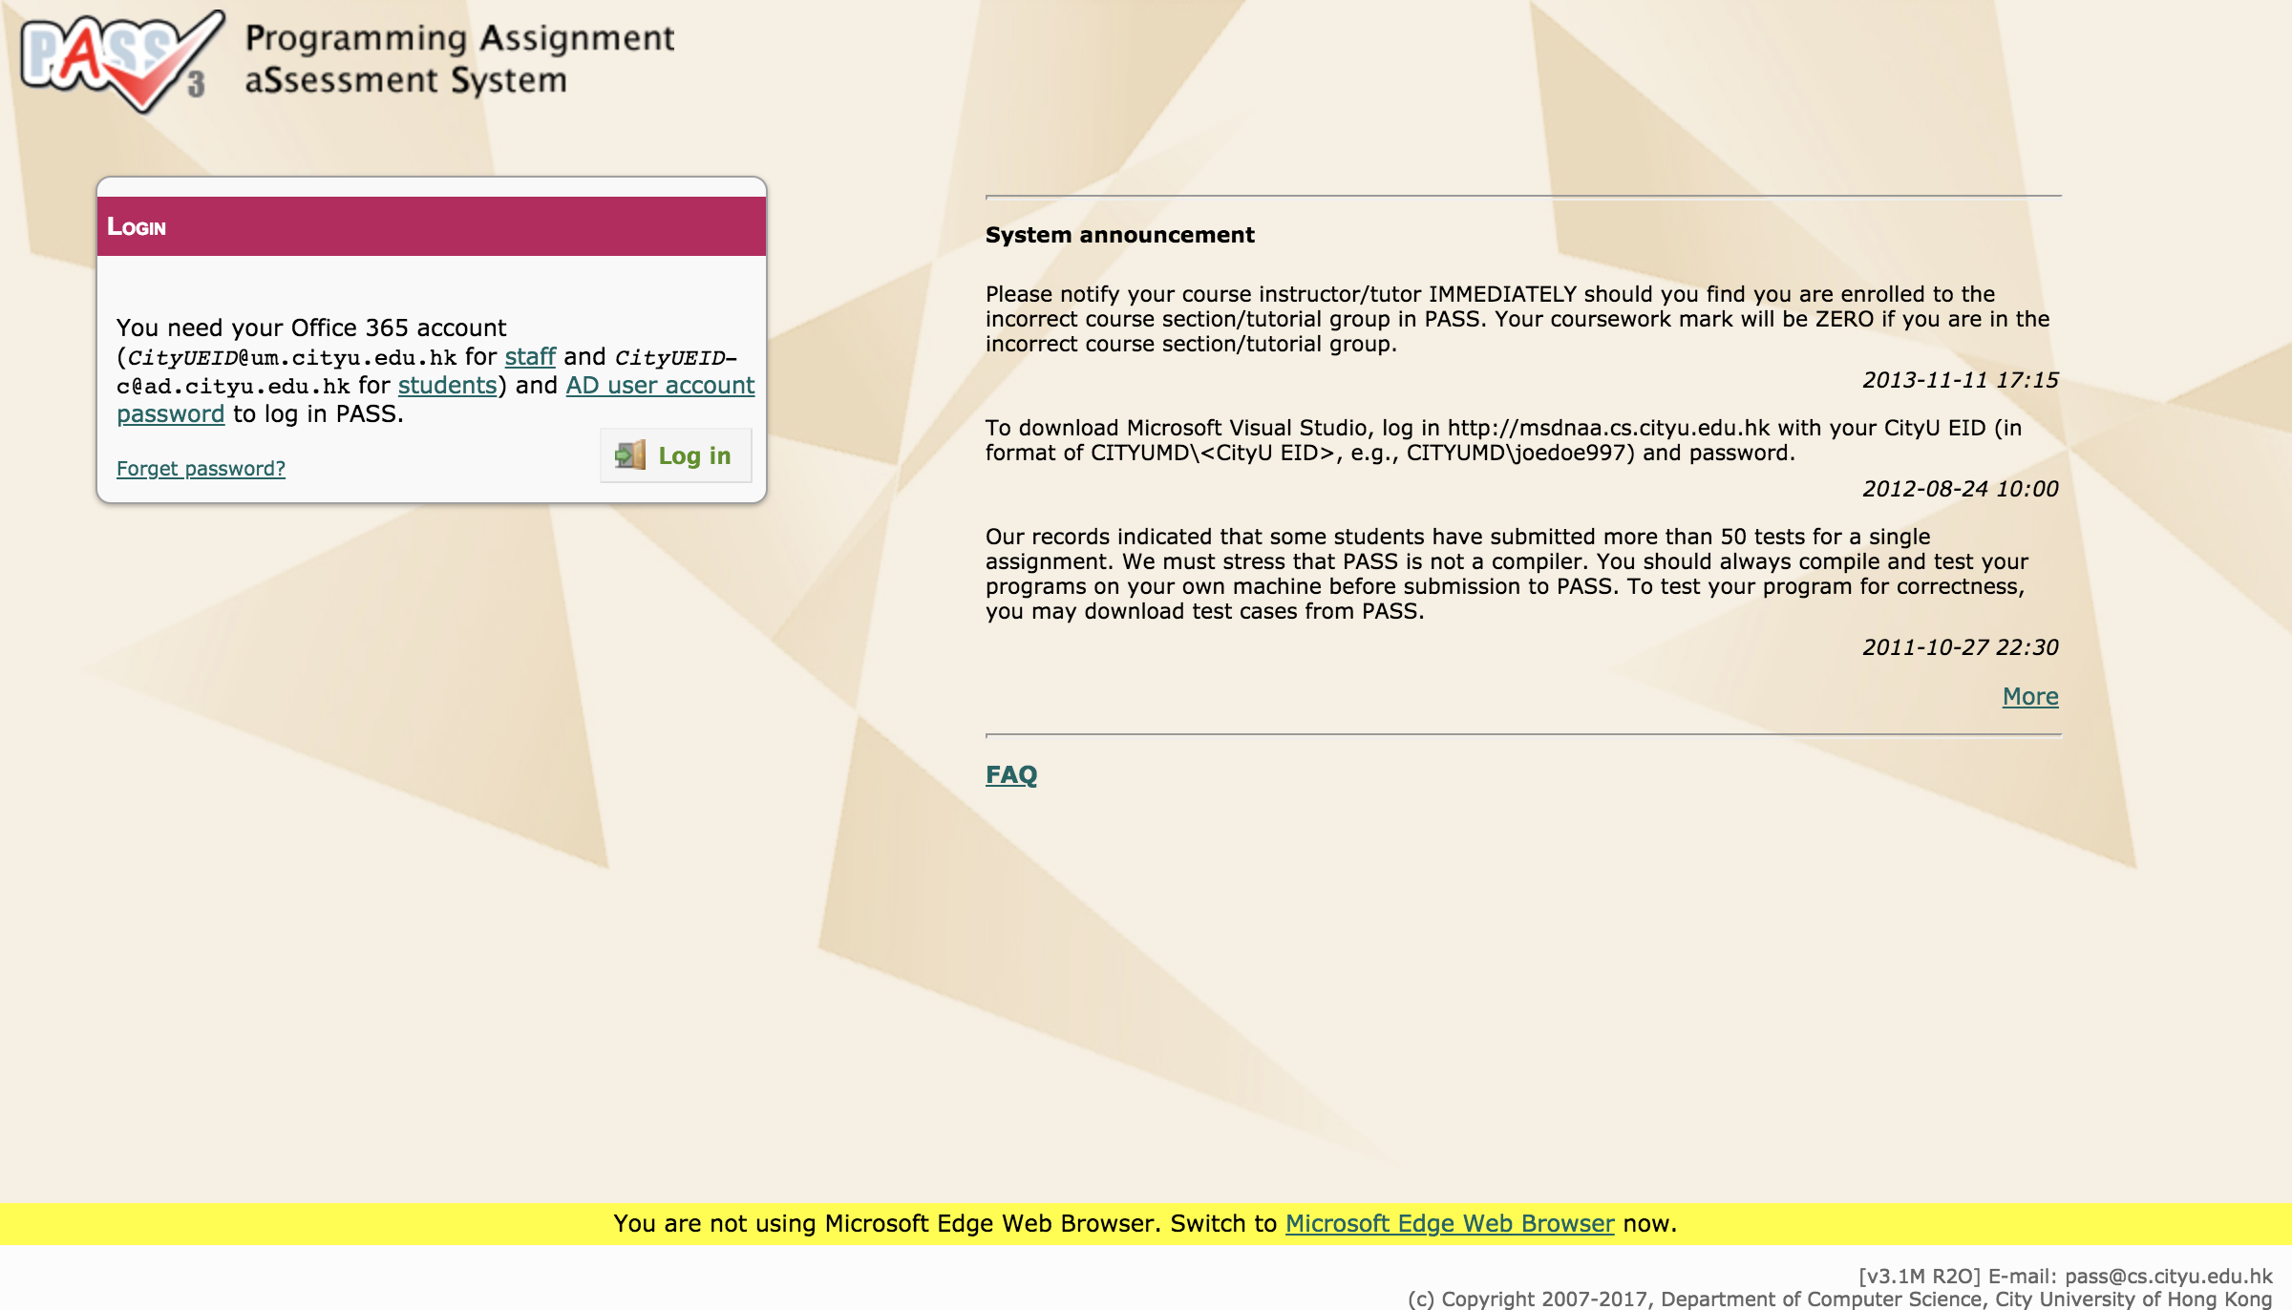
Programming Assignment aSsessment System (PASS)
https://pass3.cs.cityu.edu.hk/index.jsp

Slide 3
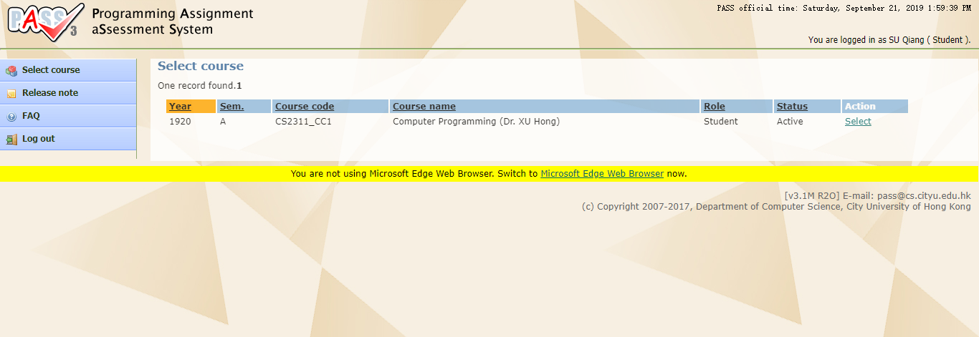
PASS: Select course

Slide 4
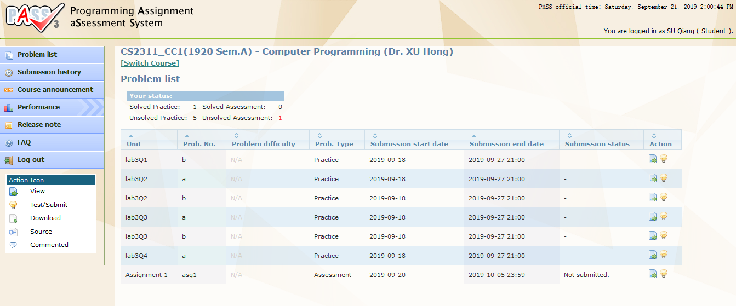
PASS: Problem list

Slide 5
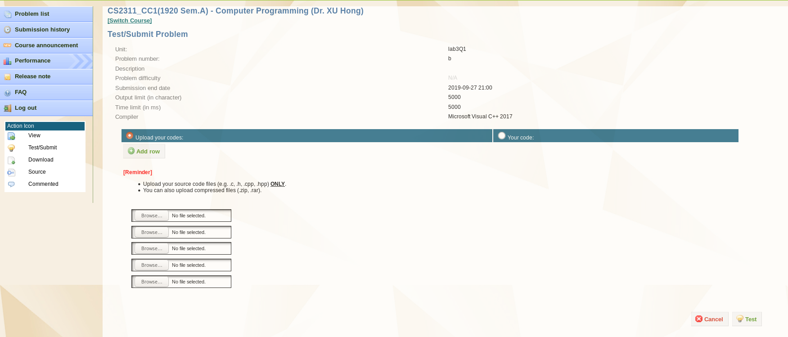
PASS: Test/Submit Problem

Slide 6
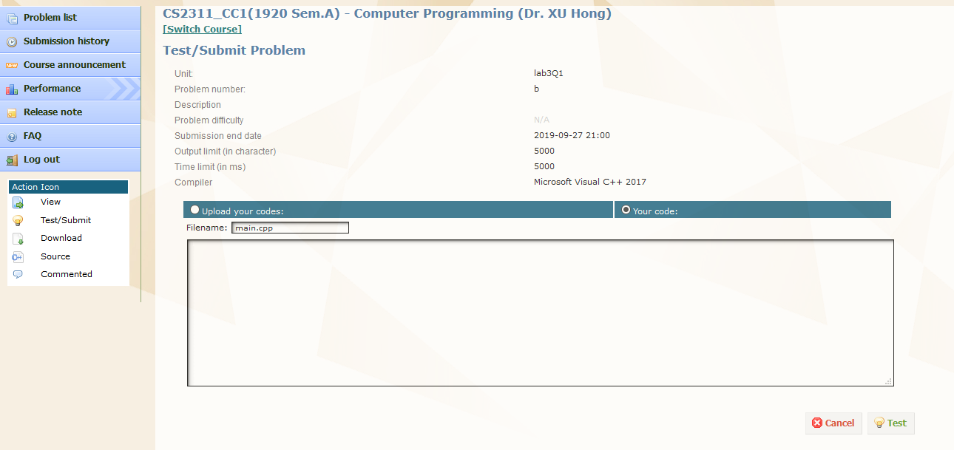
PASS: Test/Submit Problem

Slide 7

PASS: Test/Submit Problem

Slide 8
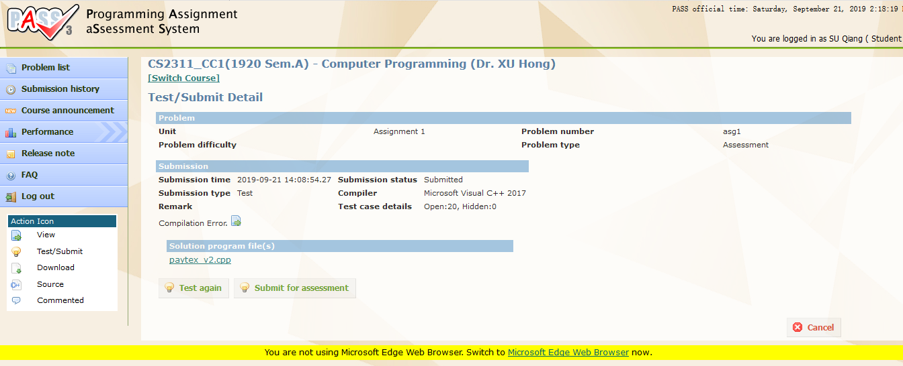
PASS: Test/Submit Problem

Slide 9
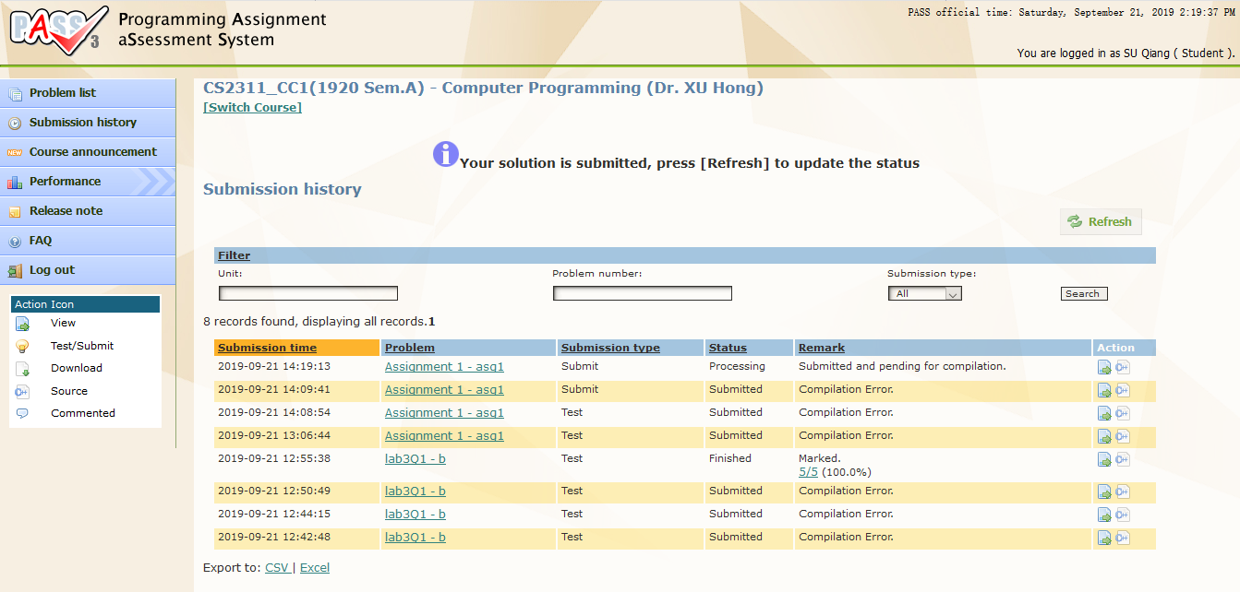
PASS: Submission History

Slide 10
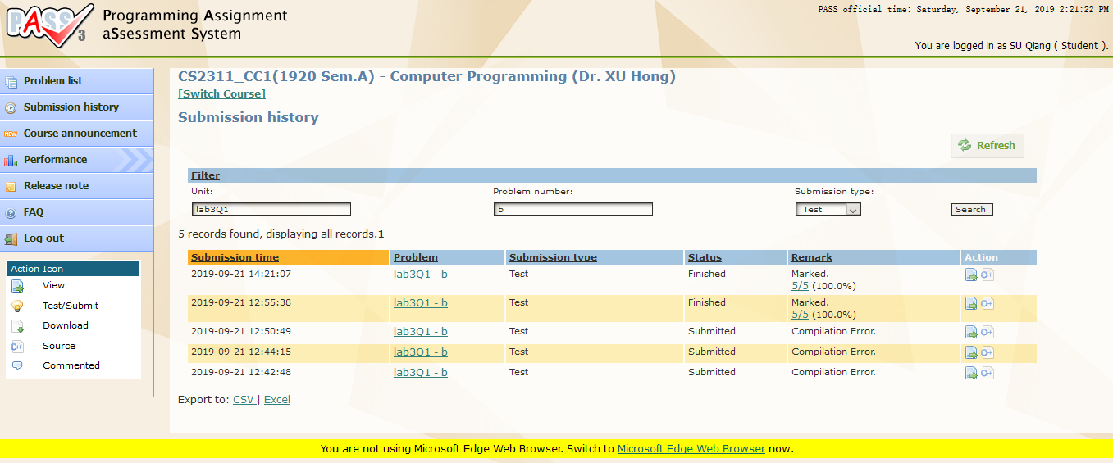
PASS: Submission History

Slide 11
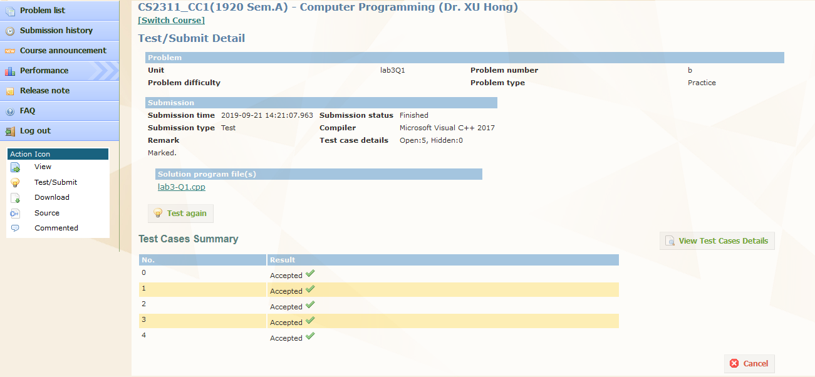
PASS: Test/Submit Details

Slide 12
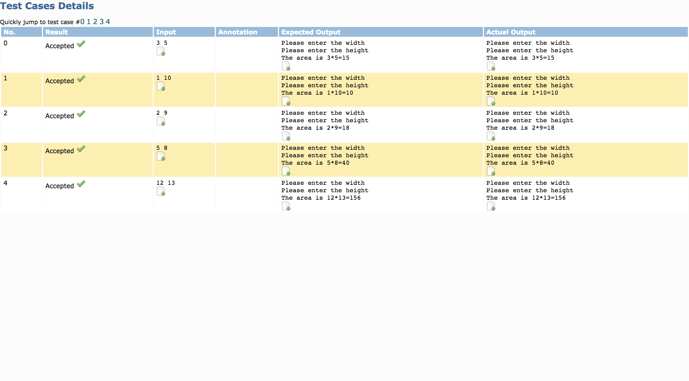
PASS: Test Cases Details

Slide 13
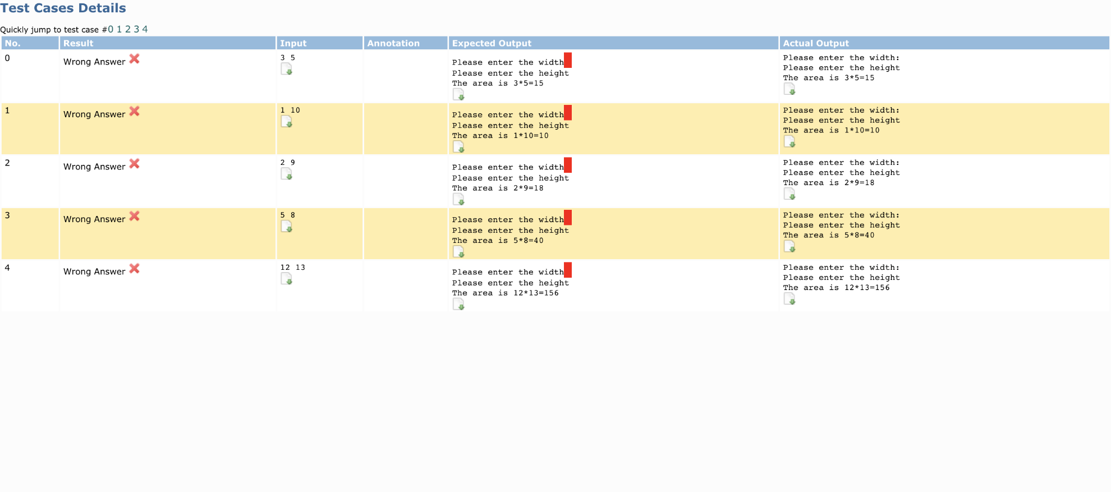
PASS: Test Cases Details
Note: Your program should follow the input and output format EXACTLY (i.e. identical spacing, new lines and letter case).
Otherwise the PASS system will say that your program's output is incorrect.

Slide 14
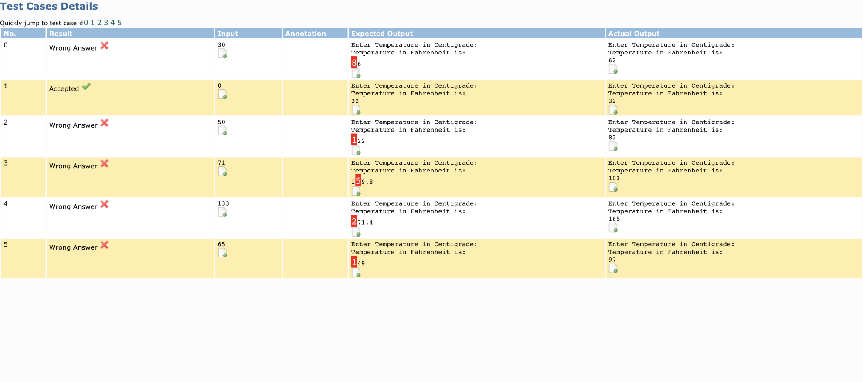
PASS: Test Cases Details

