Slide 1
CS2311 Computer Programming
LT01: Introduction
Computer Science, City University of Hong Kong
Semester B 2022-23

Slide 2
About the Course
Lecture Instructor:
Dr. Junqiao QIU, YEUNG Y7708
Email: junqiqiu@cityu.edu.hk
Lab Instructor:
Dr. Junqiao QIU 1000-1050 Wednesday
Runze MAO 1000-1050 Monday (runzemao2-c@my.cityu.edu.hk)
Wentao DONG 1200-1250 Monday (wentdong-c@my.cityu.edu.hk)
Rui LIAN 1300-1350 Monday (rui.lian@my.cityu.edu.hk)
Post your questions on Canvas for quick response
Canvas => Discussions

Slide 3
About the Course
Teaching pattern
Lectures
Explain the terminologies, concepts, methodologies, …
Face-to-face at 15:00 ~ 17:50, Friday, YEUNG LT-9
Labs
Each lecture will have a corresponding Lab (4 sessions on Monday/Wednesday)
Analyzing and solving example problems
Hands-on programming practice

Slide 4
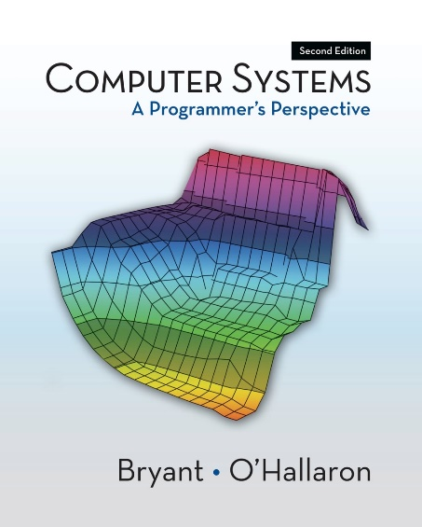
About the Course
Resources
Canvas-based course website
Teaching materials are all in Canvas
It is your own responsibility to check Canvas and University emails regularly for updates
Textbook (NIL)
Reference books
Computer Systems: A Programmer’s Perspective, by Randal E. Bryant and David R. O'Hallaron, Prentice Hall, 2011
Microsoft Visual Studio 2019 (Windows)
Develop environment for compiling & debugging
PASS (program assignment assessment system)
Program testing and submission

Slide 5
About the Course
Assessment
Coursework (40%)
Assignments (15%)
Midterm quiz (15%)
Lab exercises (10%)
Final exam (60%)

Slide 6
About the Course
Assessment
To pass the course you must obtain at least 30% of the final exam marks (No. 1 reason to fail this course)
Student | Coursework | Exam | Final Mark | Grade
1 | 94.3 | 95.5 | 95.14 | A+
2 | 33.8 | 34 | 34 | D
3 | 86.8 | 26.5 | 44.59 | F

Slide 7
About the Course
Key to success
Just Do It
But, do it yourself

Slide 8
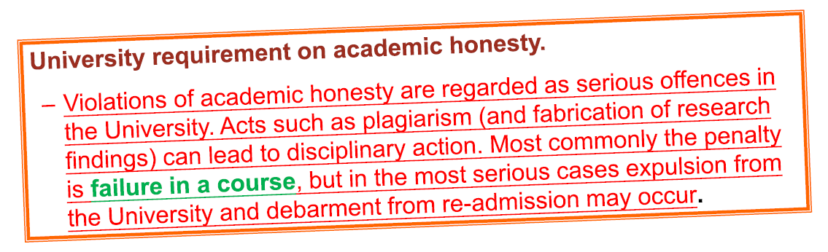
About the Course
“Do it yourself” means
Discuss the problems with any other people
Study materials on the internet
Refer to any books
But, the details and write-ups must be entirely your own work

Slide 9
About the Course
Plagiarism
Punishment ranges from warning to course failure
May cause you be forced out of CityU
Can be automatically detected by PASS system
How to prevent
In plagiarism cases, both the giver and copier get punishments
Protect your code
As instructors
We have the responsibility to report academic dishonesty cases so as not to compromise the quality of education
We take suspected plagiarism cases very seriously.

Slide 10
Outline for Today
What’s a computer
Programming languages
Basics of computer programming

Slide 11
Decimal vs Binary
10² | 10¹ | 10⁰
1 | 0 | 3

Slide 12
Decimal vs Binary
10² | 10¹ | 10⁰
1 | 0 | 3
2⁷ | 2⁶ | 2⁵
0 | 1 | 1
2⁴ | 2³ | 2²
0 | 0 | 1
2¹ | 2⁰
1 | 1

Slide 13
Decimal vs Binary
10² | 10¹ | 10⁰
1 | 0 | 3
2⁷ | 2⁶ | 2⁵
0 | 1 | 1
2⁴ | 2³ | 2²
0 | 0 | 1
2¹ | 2⁰
1 | 1
0+64+32+0+0+4+2+1
= 103

Slide 14
Decimal to Binary
what’s the binary expression of (30)₁₀?

Slide 15
Hexadecimal
 | 16³ | 16² | 16¹ | 16⁰
0x | 0 | 1 | 0 | 1 | = | ?
0x | 0 | 0 | a | f | = | ?

Slide 16
Hexadecimal
what’s the hex expression of 4387?

Slide 17


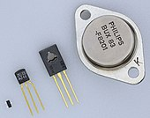
Logic Gate
Logic gate to a computer is like a brick to a skyscraper
It’s a circuit that implements a Boolean function
Typically implemented using diodes or transistors
V_IN |  | V_OUT
A | B | Q
0 | 0 | 0
1 | 0 | 0
0 | 1 | 0
1 | 1 | 1
V_IN |  | V_OUT
A | B | Q
0 | 0 | 0
1 | 0 | 1
0 | 1 | 1
1 | 1 | 0
A AND B
A XOR B

Slide 18
Arithmetic Circuits
You can build a simple arithmetic circuits using logic gates
E.g., a 1-bit adder
0 + 0 = 00
1 + 0 = 01
0 + 1 = 01
1 + 1 = 10

Slide 19
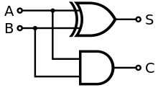
Arithmetic Circuits
You can build a simple arithmetic circuits using logic gates
E.g., a 1-bit adder
0 + 0 = 00
1 + 0 = 01
0 + 1 = 01
1 + 1 = 10
Input |  | Output
A | B | C | S
0 | 0 | 0 | 0
1 | 0 | 0 | 1
0 | 1 | 0 | 1
1 | 1 | 1 | 0
XOR
AND

Slide 20
Arithmetic Circuits
You can build a simple arithmetic circuits using logic gates
E.g., a 1-bit adder
Implementing more complex arithmetic is similar
e.g., multiplier …
0 + 0 = 00
1 + 0 = 01
0 + 1 = 01
1 + 1 = 10
Input |  | Output
A | B | C | S
0 | 0 | 0 | 0
1 | 0 | 0 | 1
0 | 1 | 0 | 1
1 | 1 | 1 | 0

Slide 21
From Arithmetic Circuits to Computer

Slide 22
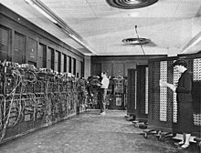
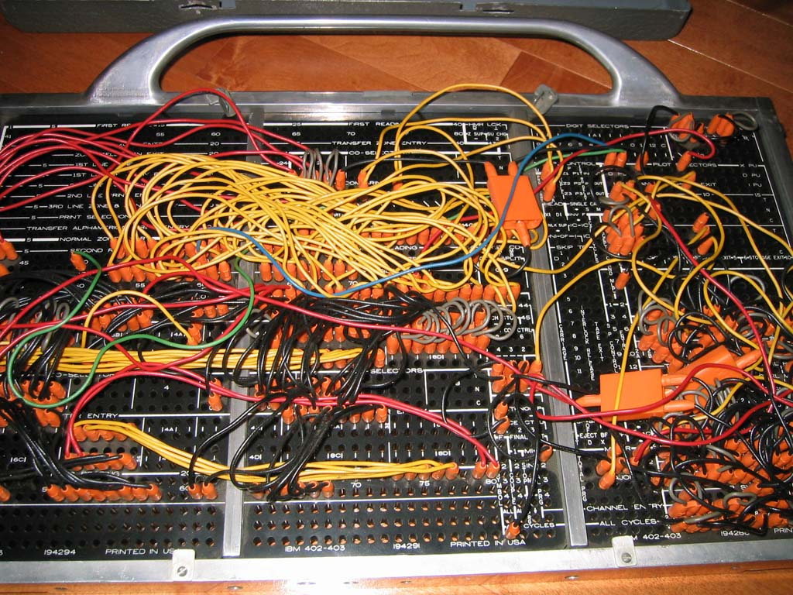
Computers in 1940’s
A large collection of arithmetic machines
A computer program in 1940’s is an interconnection of arithmetic machines, which require significant wiring

Slide 23

Stored Program Computer
Wiring
Task
Diagram

Slide 24
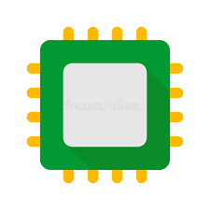

Stored Program Computer
Wiring
Task
Diagram
Instructions
Command
Task
Memory
Controller

Slide 25
Stored Program Computer
A.k.a Von Neumann machine (proposed in 1945)
How does it work?

Slide 26
Stored Program Computer
CPU
Main Memory: stores both data and program, i.e., a list of instructions
CPU (Central Processing Unit):
ALU: performs arithmetic and bitwise operations
Control Unit: read instructions from memory, direct ALU to execute instructions
Control Unit
Arithmetic/Logic Unit (ALU)
Mian Memory

Slide 27
Stored Program Computer
CPU
Main Memory: stores both data and program, i.e., a list of instructions
CPU (Central Processing Unit):
ALU: performs arithmetic and bitwise operations
Control Unit: read instructions from memory, direct ALU to execute instructions
External storage: (slow) mass storage
Input/output: keyboard, microphone, display, speaker…
Control Unit
Input
Output
Arithmetic/Logic Unit (ALU)
Mian Memory
External Storage

Slide 28
Instruction
A sequence of bits that defines a single operation of a CPU
E.g., addition, subtraction, read, write
Instruction size can be fixed (e.g., 16-bit, 32-bit, 64-bit) or variable
Example: a 32-bit Add Immediate instruction
001000
00001
00010
0000000101011110
OPCode
Addr 1
Addr 2
Immediate value
addi $r1 $r2 350

Slide 29
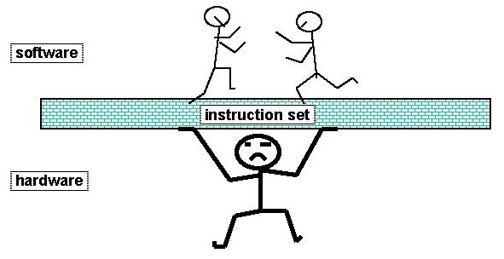
Instruction Set Architecture (ISA)
ISA: the specification of instructions supported by a CPU
The dictionary of CPU language
E.g., x86, RISC …
ISA is the interface between hardware and software
Different CPUs can run the same computer program as long as they support the same ISA
Example: 8086 (1978) and Skylake (2015) both implement x86 ISA, so they can run the same software

Slide 30
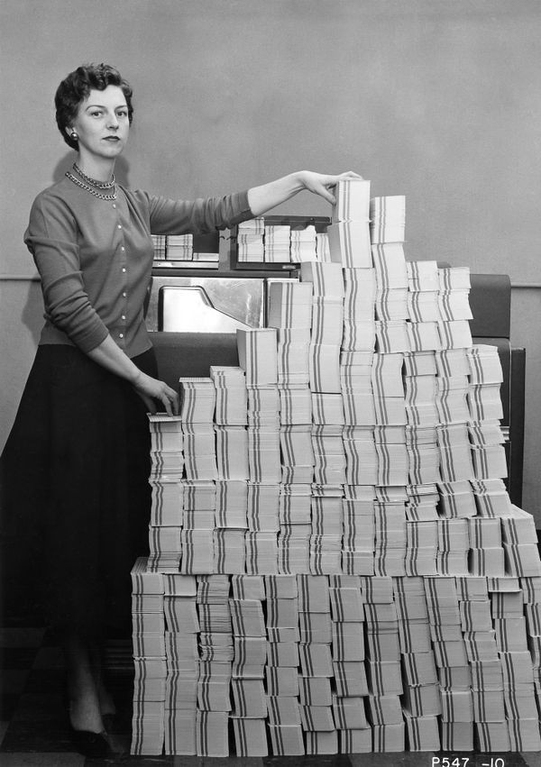
Why is Software Programming Important?
It is almost impossible to run an electronic device without software
Printers, MRI machines, disk drives, remote controls, vehicle control system, etc.
More cost effective to implement functionality in software than hardware
Software bugs easy to fix
Systems increasingly complex, bugs unavoidable
Allows new features to be added later
Notes:
Punched cards & tapes

Slide 31
Outline for Today
What’s a computer
Programming languages
Basics of computer programming

Slide 32
Programming Languages
Computer program
A sequence of instructions for a computer to execute
Programming language
Notation for writing computer programs

Slide 33
Programming Languages
Machine Language
Language directly understood by the computer.
Defined by ISA
x86, RISC …

Slide 34
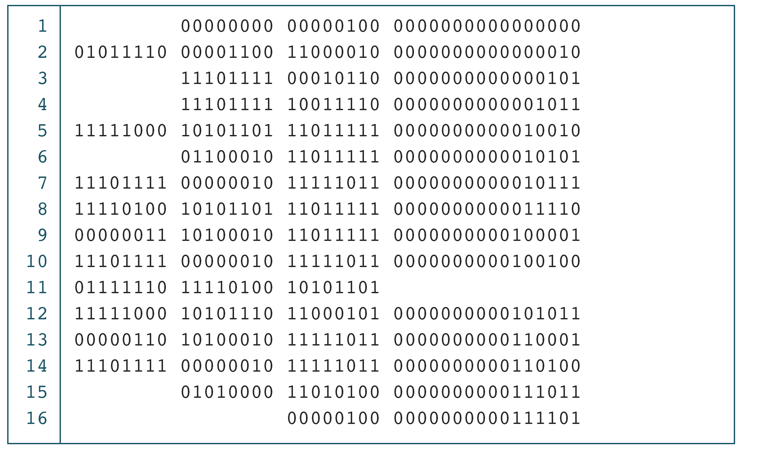
PROGRAM 1-1
The Multiplication Program in Machine Language

Slide 35
Programming Languages
Machine Language
Language directly understood by the computer
Defined by ISA
Symbolic Language
English-like abbreviations representing elementary computer operations
x86, RISC …
Assembly language

Slide 36
Programming Languages
Symbolic language uses symbols to represent the various machine language instructions
Example: a 32-bit Add Immediate instruction
001000
00001
00010
0000000101011110
OPCode
Addr 1
Addr 2
Immediate value
addi
$r1
$r2
350

Slide 37
PROGRAM 1-2
The Multiplication Program in Symbolic Language

Slide 38
Programming Languages
Machine Language
Language directly understood by the computer
Defined by ISA
Symbolic Language
English-like abbreviations representing elementary computer operations
High-level Language
Close to human language.
Example: a = a + b
[add vales of a and b, and store the result in a, replacing the previous value]
x86, RISC …
Assembly language
C/C++, Java, Python

Slide 39
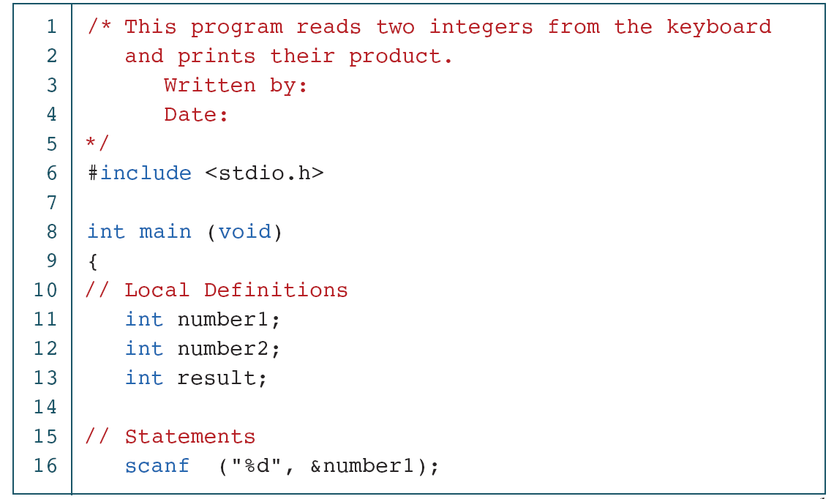
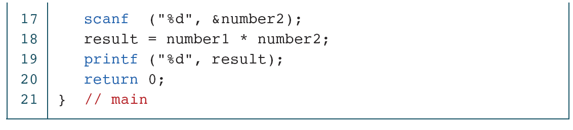
PROGRAM 1-3
The Multiplication Program in C

Slide 40
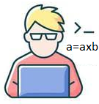
Compiler
Computers only understand machine language (binary code)
Human write programs using high-level programming language
?

Slide 41

Compiler
Computers only understand machine language (binary code)
Human write programs using high-level programming language
Need a compiler to translate programs written in high-level programming language to binary code

Slide 42
Compiled Languages
printf (“hello!”);
High-level programming language
Programs are compiled to binary machine code (for a specific hardware), which is then directly executed by the hardware
E.g., C/C++, Rust, Pascal …
Cons: need to re-compile a program before you execute it on a different hardware
Pros: fast
Compiler
for machine A
Compiler
for machine B
00101110101010001011
00101110101010001011
Machine code
for A
Machine code
for B

Slide 43
Interpreted Languages
High-level programming language
print (“hello!”);
Compiler
Programs are first compiled to an intermediate representation (IR), which is then converted by a Virtual Machine (VM) to machine code and executed on the hardware
E.g., Java, Python…
Pros: better portability
Cons: slow
00101110101010001
Intermediate representation
VM for machine A
VM for
machine B
00101110101010001011
00101110101010001011
Machine code
for A
Machine code
for B

Slide 44
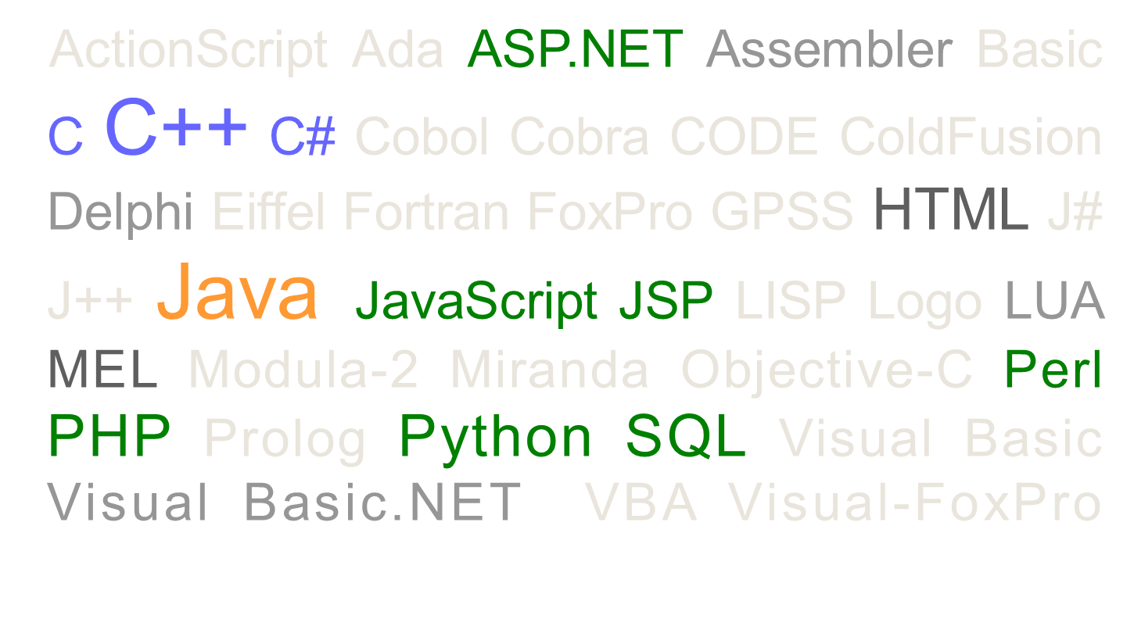
Different Programming Languages

Slide 45
Syntax
Programming languages differ in syntax and libraries
C/C++
Python
if (a < b) {
printf( “a is smaller than b\n”);
} else {
printf(“b is not greater than a\n”);
}
if a < b:
print(“a is smaller than b”)
else:
print(“b is not greater than a”)

Slide 46
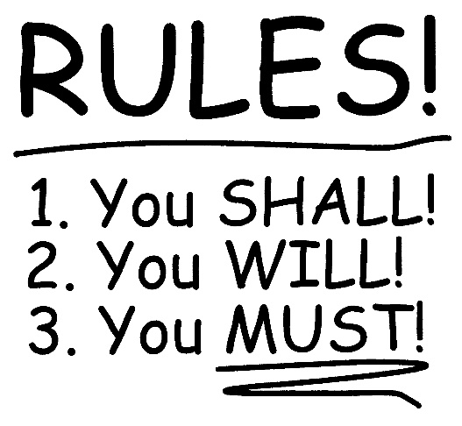
Syntax
Programming languages differ in syntax and libraries
Syntax is well-defined, NO exceptions
if (...) {…} else {…}
for (;;;) {…}
Basic components
Variable/structure/function declaration
Variable/structure/function access
Conditional statement
Iteration statement

Slide 47
Libraries
Programming languages differ in syntax and libraries
Most programming languages have an associated core library
Libraries typically include definitions for
Commonly used algorithms (e.g., sorting)
Data structures (e.g., lists, trees, and hash tables)
Commonly used constants and functions (e.g., math)
Input/output
if (a < b) {
printf ( “a is smaller than b\n”);
} else {
printf (“b is not greater than a\n”);
}
printf(“%f\n”, cos(M_PI));

Slide 48
For CS2311: C/C++
Created in 1970s by Dennis Ritchie in Bell Labs
Found lasting use in
Supercomputers, microcontrollers, embedded systems
Operating systems, device drivers, network stacks
Many programming languages are based on/influenced by C/C++
Go, Java, JavaScript …
Easy to move from C++ to other languages
But often not in the other direction
Cons: requires explicit low-level manipulation
Pros: very efficient

Slide 49
Outline for Today
What’s a computer
Programming languages
Basics of computer programming

Slide 50
Computer Program (External View)
Basic elements of a computer program
Input
Process
Output

Slide 51
Computer Program (Internal View)
A list of instructions ordered logically
Usually involve data access

Slide 52
Logic Flow
The logic of problem solving
You may implement the same logic flow using different languages
E.g. Calculate BMI (Body Mass Index‎)
Read weight from keyboard
Read height from keyboard
Weight x weight/height
Write BMI to screen

Slide 53
Logic Flow
Read temperature sensor
Temperature < 25ºC ?
no
Cooling
yes
Heating

Slide 54
Logic Flow
Find the maximum number in 2, 1, 3, Ø
max = 2
read the next number in the sequence, and write the value to x
x > max ?
x = Ø?
x <= max?
max = x
Output max

Slide 55
Logic Flow
Sort 8, 5, 2, 9, 4 in descending order
8, 5, 2, 9, 4
Find the maximum number
Output that number

Slide 56
Logic Flow
Sort 8, 5, 2, 9, 4 in descending order
8, 5, 2, 9, 4
Find the maximum number
Output that number
9, 8, 5, 4, 2

Slide 57
Logic Flow
Sort 8, 5, 2, 9, 4 in descending order
8, 5, 2, 4
Find the maximum number
Output that number
9, 8, 5, 4, 2

Slide 58
Logic Flow
Sort 8, 5, 2, 9, 4 in descending order
5, 2, 4
Find the maximum number
Output that number
9, 8, 5, 4, 2

Slide 59
Logic Flow
Sort 8, 5, 2, 9, 4 in descending order
2, 4
Find the maximum number
Output that number
9, 8, 5, 4, 2

Slide 60
Logic Flow
Sort 8, 5, 2, 9, 4 in descending order
2,
Find the maximum number
Output that number
9, 8, 5, 4, 2

Slide 61
Developing a C++ Program
Coding
Write your source code into a file
e.g., “hello.cpp”
You can use different editors or IDEs

Slide 62




Editors and IDEs
Editor: simply where you write your codes
Vim, Emacs, nano, vi, or even notepad …
IDE: integrated development environment
Integrate compiler, build tools, and debuggers
With syntax highlighting
Popular IDEs
Visual Studio, Visual Studio Code, JetBrains Clion, Apple Xcode …

Slide 63
Developing a C++ Program
Coding
Write your source code into a file
e.g., “hello.cpp”
You can use different editors or IDEs
Compile your source code
Check grammatical rules (syntax)
Source code is converted to object code in machine language
e.g., “hello.obj”

Slide 64
C++ Compilers
MSVC (Microsoft Visual C++)
Microsoft’s compiler for their custom implementation of the C++ standard, known as Visual C++
GCC/g++
Mainly targets Unix-like platforms
Windows support is provided through the Cygwin or MinGW runtime libraries
Clang
Strict adherence to C++ standards
Minimal modification to source code’s structure during compilation
GCC-compatible or MSVC-compatible through compiler drivers

Slide 65
Developing a C++ Program
Coding
Write your source code into a file
e.g., “hello.cpp”
You can use different editors or IDEs
Compile your source code
Check grammatical rules (syntax)
Source code is converted to object code in machine language
e.g., “hello.obj”
Link
Combines objects and libraries to create a binary executable
e.g., “hello.exe”

Slide 66
An Example
/* The traditional first program in honor of Dennis Ritchie who invented C at Bell Labs in 1972 */
#include <iostream>
using namespace std;
void main()
{
cout << "Hello world!” << endl;
}

Slide 67
Function
/* The traditional first program in honor of Dennis Ritchie who invented C at Bell Labs in 1972 */
#include <iostream>
using namespace std;
void main()
{
cout << "Hello world!” << endl;
}
A sequence of instructions grouped together (contained within braces { and }), which implement a specific task
Syntax:
ReturnType FunctionName (input parameters)
{
instructions within function body
}

Slide 68
Example: void main()
/* The traditional first program in honor of Dennis Ritchie who invented C at Bell Labs in 1972 */
#include <iostream>
using namespace std;
void main()
{
cout << "Hello world!” << endl;
}
main is the name of the function
main is a special function
The starting point of a C++ program. Every C++ program must have a main
Note: C/C++ is case sensitive
E.g., Main() or MAIN() is incorrect
void means there is NO return value

Slide 69
Statement
/* The traditional first program in honor of Dennis Ritchie who invented C at Bell Labs in 1972 */
#include <iostream>
using namespace std;
void main()
{
cout << "Hello world!” << endl;
}
A syntactic unit that expresses some action to be carried out
Ended with a semicolon “;”

Slide 70
Example: cout
/* The traditional first program in honor of Dennis Ritchie who invented C at Bell Labs in 1972 */
#include <iostream>
using namespace std;
void main()
{
cout << "Hello world!” << endl;
}
An output function provided by iostream library
cout: “Console OUTput” allows our program to output values to the standard output stream (the screen)
<<: output operator, which output values to an output device
The right-hand side of the << (i.e., Hello world! between a pair of double quotes) is the string to output
endl: end of the line. advance the cursor on the screen to the beginning of the next line

Slide 71
#include
/* The traditional first program in honor of Dennis Ritchie who invented C at Bell Labs in 1972 */
#include <iostream>
using namespace std;
void main()
{
cout << "Hello world!” << endl;
}
Include the libraries you want to use
Syntax: #include <library name>
For example
iostream has implemented commonly used functions for input/output, including cout
cmath is another commonly used library that has math functions like sin(), cos(), log() …

Slide 72
using namespace
/* The traditional first program in honor of Dennis Ritchie who invented C at Bell Labs in 1972 */
#include <iostream>
using namespace std;
void main()
{
cout << "Hello world!” << endl;
}
namespace: a declarative region that provides a scope to the identifiers (the names of types, functions, variables, etc) inside it
Declare namespace to avoid writing the full name
Syntax: using namespace xxx
For example
Standard (std) namespace is used such that we can write cout instead of std::cout

Slide 73
Comments
/* The traditional first program in honor of Dennis Ritchie who invented C at Bell Labs in 1972 */
#include <iostream>
using namespace std;
void main()
{
cout << "Hello world!” << endl;
}
Enclosed by “/*” and “*/”
Or begin with “//”
Single line comments
Comments improves readability of source code
Will NOT be compiled into machine code

Slide 74
Syntax errors
/* The traditional first program in honor of Dennis Ritchie who invented C at Bell Labs in 1972 */
#include <iostream>
using namespace std;
void main()
{
cout < Hello world! < endl
}

Slide 75
Another Example
#include <iostream>
#include <cmath>
using namespace std;
double cosofsum(double x, double y) {
double sum = x+y;
double result = cos(sum);
return result;
}
int main() {
double a = 0.2;
cout << cosofsum(a, M_PI) << endl;
return 0;
}

