Slide 1
CS2311 Computer Programming
LT02: Data, Operators, and BasicIO
Computer Science, City University of Hong Kong
Semester B 2022-23

Slide 2
Quick Review: What’s a Computer
von Neumann machine (stored program computer)
Main Memory: stores both data and program, i.e., a list of instructions
CPU (Central Processing Unit):
ALU: performs arithmetic and bitwise operations
Control Unit: read instructions from memory, direct ALU to execute instructions
External storage: (slow) mass storage
Input/output: keyboard, display …
CPU
Control Unit
Input
Output
Arithmetic/Logic Unit (ALU)
Mian Memory
External Storage

Slide 3
Quick Review: What’s a Computer Program

Slide 4
Quick Review: Programming Languages
Compiler
Machine Language
Language directly understood by the computer
Defined by ISA
Symbolic Language
English-like abbreviations representing elementary computer operations
High-level Language
Close to human language.
Example: a = a + b
[add vales of a and b, and store the result in a, replacing the previous value]
x86, RISC …
Assembly language
C/C++, Java, Python

Slide 5
Quick Review: Basic Syntax and Program
/* What’s wrong with the following program? */
#include <iostream>
using namespace std;
int main()
{
cout < Hello world! < endl
return 0;
}

Slide 6
Today’s Outline
C++ basic syntax
Variable and constant
Operators
Basic I/O

Slide 7
A Simple C++ Program
#include <iostream>
using namespace std;
int main() {
float r, area; // the radius and area of the circle
cout << “Input circle radius ”; // print prompt on screen
cin >> r; // let user input r from keyboard
area = 3.1415926 * r * r; // calculate circle area
cout << “Area is ” << area << endl; // print result on screen
return 0;
}

Slide 8
Syntax of C++
Like any language, C++ has an alphabet and rules for putting together words and punctuations to make a legal program.
This is called syntax of the language.
C++ compilers detect any violation of the syntax rules in a program
C++ compiler collects the characters of the program into tokens, which form the basic vocabulary of the language
Tokens are separated by space

Slide 9
Tokens in C++
Tokens in C++ can be categorized into:
Keywords
Identifiers
Operators
String
constants
Numeric constants
Punctuators

Slide 10
Tokens in C++: An Example
using namespace std ; .
int main ( ) { .
float r , area ; .
cout << “input circle radius ” ; .
cin >> r ; .
area = 3.1415926 * r * r ; .
cout << “area is ” << area << endl ; .
return 0 ; .
} .
preprocessor
#include <iostream>
keywords
identifiers
operators
string constants
numeric constants
punctuators

Slide 11
Keywords
Words reserved by the programming language
Each keyword in C++ has a reserved meaning and cannot be used for other purpose
#include <iostream>.
using namespace std;
int main() {
float r, area;
cout << “input circle radius ”;
cin >> r;
area = 3.1415926 * r * r;
cout << “area is ” << area << endl;
return 0;
} .

Slide 12
Keywords (cont’d)
Data type | char | double | float | int | bool
 | long | short | signed | unsigned | void

Slide 13
Keywords (cont’d)
Data type | char | double | float | int | bool
 | long | short | signed | unsigned | void
Flow control | if | else | switch | case | while
 | break | default | for | do | continue

Slide 14
Keywords (cont’d)
Data type | char | double | float | int | bool
 | long | short | signed | unsigned | void
Flow control | if | else | switch | case | while
 | break | default | for | do | continue
Others | using | namespace | true | false | sizeof
 | return | const | class | new | delete
 | operator | public | protected | private | friend
 | this | try | catch | throw | struct
 | typedef | enum | union

Slide 15
Identifiers
Identifiers give unique names to various objects in a program like the name of variables, functions, libraries, and namespace
Keywords cannot be used as identifiers
#include <iostream>.
using namespace std;
int main() {
float r, area;
cout << “input circle radius ”;
cin >> r;
area = 3.1415926 * r * r;
cout << “area is ” << area << endl;
return 0;
} .

Slide 16
Identifiers (cont’d)
An identifier is composed of a sequence of letters, digits and underscore
E.g., myRecord, point3D, last_file
An identifier must begin with either an underscore or a letter
Valid identifiers: _income, _today_record, record1
Invalid identifiers: 3D_point, 2ppl_login, -right-
Identifier is case sensitive
Always use meaningful names for identifiers

Slide 17
Identifiers (cont’d)
float a (float b, float c, float d)
{
return (b + c) * d / 2;
}

Slide 18
Identifiers (cont’d)
float a (float b, float c, float d)
{
return (b + c) * d / 2;
}
float trapezoid_area (float upper_edge, float lower_edge, float height)
{
return (upper_edge + lower_edge) * height / 2;
}

Slide 19
Today’s Outline
C++ language syntax
Variable and constant
Operators
Basic I/O

Slide 20
Variable and Constant
Computer programs typically involve data access
Two categories of data in C++ program
Variable: memory storage whose value can be changed during program execution
Constant: memory storage whose value does NOT change during program execution

Slide 21
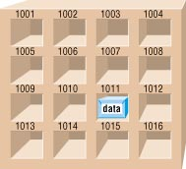
Variable and Constant
Every variable/constant has 5 attributes
Address: location of data in memory storage
Value: content in memory storage

Slide 22
Variable and Constant
Every variable/constant has 5 attributes
Address: location of data in memory storage
Value: content in memory storage
Name: identifier of the variable

Slide 23
Variable and Constant
Every variable/constant has 5 attributes
Address: location of data in memory storage
Value: content in memory storage
Name: identifier of the variable
Type: C++ is a strictly typed language, variables and constants must belong to a data type
E.g., numerical, character, logic, other…
Scope: it defines the region within a program where the variable/constant can be accessed, and also the conflict domain
more detail soon

Slide 24
Variable Declaration
Variable and constants must be declared before use
Variable declaration format
data_type variable_identifier ;
Optionally, you can set the initial value of variable during declaration
Examples
int age ;
float bathroom_temperature = 28, bedroom_temperature = 30 ;
char initial ;
char student_name[20] ;

Slide 25
C++ Predefined Data Types
Numerical
int, short, long: integer number
float, double: real number
Character
char: ASCII character (a, e, o, \n)
Logic (next lecture)
bool: Boolean (true, false)
Other
void: empty values (e.g., void main() {…})

Slide 26
int
Typically, an int is stored in 4 bytes (1 byte = 8 bits)
The most significant bit of an int data type is the sign bit
0: positive
1: negative
For example
00000000 00000000 00000000 00001111 = 15
What’s the decimal value of the following integer?
10000000 00000000 00000000 00000001 = ?

Slide 27
int
C++ uses two’s complement to encode negative numbers
E.g., for -11
reverse the sign
00000000 00000000 00000000 00001011

Slide 28
int
C++ uses two’s complement to encode negative numbers
E.g., for -11
reverse the sign
00000000 00000000 00000000 00001011
invert the bits (0 goes to 1, and 1 to 0)
11111111 11111111 11111111 11110100

Slide 29
int
C++ uses two’s complement to encode negative numbers
E.g., for -11
reverse the sign
00000000 00000000 00000000 00001011
invert the bits (0 goes to 1, and 1 to 0)
11111111 11111111 11111111 11110100
add 1 to the resulting number
11111111 11111111 11111111 11110101

Slide 30
int
A 32-bit int can store any integer in the range of -2³¹ and 2³¹-1
i.e., -2147483648 to 2147483647
max int: 01111111 11111111 11111111 11111111
min int: 10000000 00000000 00000000 00000000

Slide 31
int
A 32-bit int can store any integer in the range of -2³¹ and 2³¹-1
i.e., -2147483648 to 2147483647
max int: 01111111 11111111 11111111 11111111
min int: 10000000 00000000 00000000 00000000
When an int is assigned a value greater than its maximum value, overflow occurs
Similarly, underflow occurs when a value smaller than the minimum value is assigned
However, C++ does not inform you the errors

Slide 32
Example
#include <iostream>
using namespace std;
int main() {
int num1 = 2147483647;
int num2 = num1 + 1;
cout << num2 << endl;
return 0;
}

Slide 33
short, long and unsigned
long is used for large integers (8 bytes)
short is used for small integers (2 bytes)
For example: short minute_of_day;

Slide 34
short, long and unsigned
long is used for large integers (8 bytes)
short is used for small integers (2 bytes)
For example: short minute_of_day;
unsigned is used to declare that the integer data type is non-negative
For example
unsigned short a;
unsigned long b;
unsigned int c;
unsigned integers has no sign bit
i.e., the range of unsigned int is 0 to 2³²-1

Slide 35
char
Used to store a single character, enclosed by the single quotation mark
char c = ‘a’;
char c = ‘\n’;
Characters are treated as small integers (and vice versa)
A char type takes 1 byte (8 bits, representing up to 256 characters)
`a’ is stored as 01100001, equivalent to an integer 97
`b’ is stored as 01100010, equivalent to an integer 98
…
Notes:
Appendix DISO Country Codes for Selected Countries

Slide 36
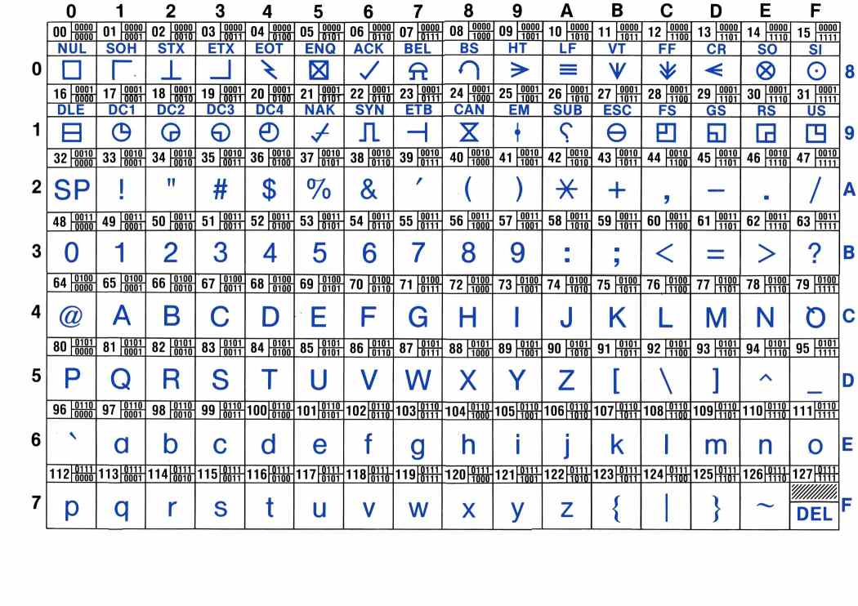
ASCII Code

Slide 37
string
A string is an array of characters
Both array and string will be introduced in detail in future lectures
Strings are delimited by double quotation marks “”, and the identifier must be followed with [] or begin with *
char course_name[] = “Computer Programming";
char *course_name= “Computer Programming";
char initial[] = "C"; vs. char initial = ‘C’;

Slide 38
Floating Types
Represent real numbers using floating point representation
float height;
double weight = 120.8;
long double number;

Slide 39
Floating Types
Represent real numbers using floating point representation
float height;
double weight = 120.8;
long double number;
float takes 4 bytes, but is less accurate (7 digits after decimal point)
double takes 8 bytes, but more accurate (15 digits after decimal point)
the default type for floating type in C++
long double is even more precise, but rarely used

Slide 40
Floating Types
Represent real numbers using floating point representation
float height;
double weight = 120.8;
long double number;
float takes 4 bytes, but is less accurate (7 digits after decimal point)
double takes 8 bytes, but more accurate (15 digits after decimal point)
the default type for floating type in C++
long double is even more precise, but rarely used
Exponent representation is acceptable, e.g.,
double a = 1.23e3;

Slide 41
sizeof
sizeof can be used to find the number of bytes needed to store an object (which can be a variable or a data type)
Its result is typically returned as an unsigned integer
#include <iostream>
using namespace std;
int main() {
int a = 4;
cout << sizeof(a) << endl;
cout << sizeof(int) << endl;
cout << sizeof(double) << endl;
cout << sizeof(long double) << endl;
return 0;
}

Slide 42
Type Conversion
Very often, we need to convert data from one type to another
For example:
Each pig weighs 280.3 lbs (float)
Each boat can carry 615.2 lbs (float)
How many pigs a boat can carry? (int)

Slide 43
Type Conversion
Very often, we need to convert data from one type to another
For example:
Each pig weighs 280.3 lbs (float)
Each boat can carry 615.2 lbs (float)
How many pigs a boat can carry? (int)
float pig_weight = 280.3, boat_load = 615.2;
int n_pig = boat_load/pig_weight;
int
float

Slide 44
Type Conversion
9. long double
8. double
7. float
Implicit type conversion
Binary expression: lower-ranked operand is promoted to higher-ranked operand, e.g.,
6. long long
5. long
4. int
3. short
int r = 2;
double pi = 3.14159;
cout << pi * r * r << “\n”;
2. char
1. bool

Slide 45
Type Conversion
9. long double
8. double
7. float
Implicit type conversion
Binary expression: lower-ranked operand is promoted to higher-ranked operand, e.g.,
Assignment: right operand is promoted/demoted to match the variable type on the left, e.g.,
6. long long
5. long
4. int
3. short
int r = 2;
double pi = 3.14159;
cout << pi * r * r << “\n”;
2. char
double a = 1.23;
int b = a;
1. bool

Slide 46
Type Conversion
9. long double
8. double
7. float
Explicit type conversion (type-casting)
int a = 3;
double b = (double)a;
6. long long
5. long
4. int
3. short
2. char
1. bool

Slide 47
Type Conversion
9. long double
8. double
7. float
Explicit type conversion (type-casting)
int a = 3;
double b = (double)a;
Demoted values might change or become invalid
6. long long
5. long
4. int
3. short
double a = 3.1;
int b = (int)a;
cout << b << endl;
2. char
1. bool

Slide 48
Type Conversion
9. long double
8. double
7. float
Explicit type conversion (type-casting)
int a = 3;
double b = (double)a;
Demoted values might change or become invalid
6. long long
5. long
4. int
3. short
double a = 3.1;
int b = (int)a;
cout << b << endl;
double a = 3.9;
int b = (int)a;
cout << b << endl;
2. char
1. bool

Slide 49
Example
#include <iostream>
using namespace std;
int main()
{
int i = 5; char a = ‘B’;
double x = 1.57;
i = i + x; cout << i << endl;
x = x * a; cout << x << endl;
return 0;
}

Slide 50
Constants
Like variables, constant store data for program access but its value will NOT be changed after declaration
You MUST set the initial value of the constant during declaration
const data_type constant_identifier = value ;
Constants can be any data type we just studied, e.g.,
const double light_speed = 299792.458; // km per second
const int days_per_week = 7;
const char[] my_email = “jun.huang@cityu.edul.hk”;

Slide 51
Scope
#include <iostream>
using namespace std;
void foo() {
int a = 0; .
cout << “a in foo: ” << a << endl;
}
int main() {
foo();
cout << “a in main: ” << a << endl;
return 0;
}
Scope of a variable/constant refers to the region of a program where the variable/constant is visible (can be accessed)
Example I:
The accessibility of variable ‘a’ is within function ‘foo’
Trying to access ‘a’ in ‘main’ will cause an error

Slide 52
Scope
#include <iostream>
using namespace std;
int main() {
int a = 0; .
int a = 1; .
cout << “a in main: ” << a << endl;
return 0;
}
Scope of a variable/constant refers to the region of a program where the variable/constant is visible (can be accessed)
Example II:
Defined two ‘a’ within ‘main’
Will cause an error due to conflict domain

Slide 53
Scope
#include <iostream>
using namespace std;
void foo() {
int a = 0; .
cout << “a in foo: ” << a << endl;
}
int main() {
int a = 1; .
foo();
cout << “a in main: ” << a << endl;
return 0;
}
Scope of a variable/constant refers to the region of a program where the variable/constant is visible (can be accessed)
Example III:
Defined two variables with the same name ‘a’
Their accessibilities are within ‘foo’ and ‘main’, respectively

Slide 54
Scope
#include <iostream>
using namespace std;
int a = 0; .
void foo() {
cout << “a in foo: ” << a << endl;
}
int main() {
foo();
cout << “a in main: ” << a << endl;
return 0;
}
Scope of a variable/constant refers to the region of a program where the variable/constant is visible (can be accessed)
Example IV:
Defined a global variable ‘a’
Its accessibility is the entire program

Slide 55
Scope
#include <iostream>
using namespace std;
int a = 0; .
int main() {
int a = 1; .
cout << “a in main: ” << a << endl;
return 0;
}
Scope of a variable/constant refers to the region of a program where the variable/constant is visible (can be accessed)
Example V:
Defined a global variable ‘a’ and a local variable ‘a’ within ‘main’
What’s the output of the program??

Slide 56
Define Scope using Namespace
A scope can be defined in many ways: by {}, functions, classes, and namespaces
Namespace is used to explicitly define the scope. A namespace can ONLY be defined in global or namespace scope.
The scope operator :: is used to resolve scope for variables of the same name.

Slide 57
#include <iostream>
using namespace std;
int a = 0;
namespace level1 {
int a = 1;
namespace level2 {
int a = 2;
}
}
int main() {
int a = 3;
cout << ::a << endl;
cout << level1::a << endl;
cout << level1::level2::a << endl;
return 0;
}

Slide 58
#include <iostream>
using namespace std;
int a = 0;
namespace level1 {
int a = 1;
namespace level2 {
int a = 2;
}
}
int main() {
int a = 3; .
cout << ::a << endl;
cout << level1::a << endl;
cout << level1::level2::a << endl;
return 0;
}

Slide 59
#include <iostream>
using namespace std;
int a = 0;
namespace level1 {
int a = 1;
namespace level2 {
int a = 2;
}
}
int main() {
int a = 3; .
cout << ::a << endl;
cout << level1::a << endl;
cout << level1::level2::a << endl;
return 0;
}

Slide 60
Today’s Outline
C++ basic syntax
Variable and constant
Operators
Basic I/O

Slide 61
Operators
An operator specifies an operation to be performed on some values
These values are called the operands of the operator
Some examples: +, -, *, /, %, ++, --, >>, <<

Slide 62
Operators
An operator specifies an operation to be performed on some values
These values are called the operands of the operator
Some examples: +, -, *, /, %, ++, --, >>, <<
Some of these have meanings that depend on the context
e.g., << means different operations in
cout << a << endl;
int b = a << 1;

Slide 63
Assignment Operator =
Generic form: variable = expression ;
Write the value of expression into the memory storage of variable
An expression is a combination of constants, variables, and function calls that evaluate to a result
Examples:
float a = 2.0 * 4.0 * 8.0;
float b = a – sqrt(a);
char x = ‘a’;

Slide 64
Assignment Operator =
An expression itself has a value, e.g.,
a = (b = 2) + (c = 3);
An assignment statement has a value equal to the operand
In the example, the value of assignment statement “b=2” is 2 and “c=3” is 3
Therefore, “a = …” is 5

Slide 65
Assignment Operator =
An expression itself has a value, e.g.,
a = (b = 2) + (c = 3);
An assignment statement has a value equal to the operand
In the example, the value of assignment statement “b=2” is 2 and “c=3” is 3
Therefore, “a = …” is 5
= is an assignment operator that is different from the mathematical equality (which is == in C++)
Introduced in detail in the next lecture

Slide 66
Examples of Assignment Statements
/* Invalid: left hand side must be a variable */
x + 10 = y;

Slide 67
Examples of Assignment Statements
/* Invalid: left hand side must be a variable */
x + 10 = y;
/* Assignment to constant is not allowed */
const int a = 2;
a = 3;

Slide 68
Examples of Assignment Statements
/* Invalid: left hand side must be a variable */
x + 10 = y;
/* Assignment to constant is not allowed */
const int a = 2;
a = 3;
/* Valid but not easy to understand */
a = (b = 2) + (c = 3);

Slide 69
Examples of Assignment Statements
/* Invalid: left hand side must be a variable */
x + 10 = y;
/* Assignment to constant is not allowed */
const int a = 2;
a = 3;
/* Valid but not easy to understand */
a = (b = 2) + (c = 3);
/* Avoid complex expressions */
b = 2, c = 3;
a = b + c;

Slide 70
Swapping the Values
If we want to swap the content of two variables, a and b
What’s the problem of the following program?
int a = 3;
int b = 4;
a = b;
b = a;

Slide 71
Efficient Assignment Operators
Generic form of efficient assignment operators
variable op = expression ;
where op is operator; the meaning is
variable = variable op (expression) ;
Efficient assignment operators include
+=, -=, *=, /=, %=, %=, >>=, <<=, &=, ^=, |=
Examples
a += 5; // is the same as a = a+5;
a %= 5; // is the same as a = a%5;
a *= b+c; // is the same as a = a*(b+c)

Slide 72
Increment & Decrement Operators
Increment and decrement operators: ++ and --
k++ and ++k is equivalent to k=k+1;
k-- and --k is equivalent to k=k-1;

Slide 73
Increment & Decrement Operators
Increment and decrement operators: ++ and --
k++ and ++k is equivalent to k=k+1;
k-- and --k is equivalent to k=k-1;
Post-increment and post-decrement: k++ and k--
k’s value is altered AFTER the expression is evaluated
e.g., a = k++ is equivalent to (1) a = k, (2) k = k+1
Pre-increment and pre-decrement: ++k and --k
k’s value is altered BEFORE the expression is evaluated
e.g., a = ++k is equivalent to (1) k = k+1, (2) a = k

Slide 74
Example
#include <iostream>
using namespace std;
int main() {
int x = 3;
cout << ++x; // (1) x = x+1 (2) cout << x
cout << x++; // (1) cout << x (2) x = x+1
cout << x;
return 0;
}

Slide 75
Example
#include <iostream>
using namespace std;
int main() {
int x = 3;
cout << ++x;
cout << x++;
cout << x;
return 0;
}
 | old x | new x | cout
int x = 3; |  | 3
cout << ++x; | 3 | 4 | 4
cout << x++; | 4 | 5 | 4
cout << x; |  |  | 5

Slide 76
What values are printed?
int a = 0, b = 0;
cout << “b = “ << b << endl;
a = 0;
b = 1+(a++);
cout << “b= “ << b << endl;
cout << “a= “ << a << endl;
a = 0;
b = 1+(++a);
cout << “b= “ << b << endl;
cout << “a= “ << a << endl;

Slide 77
What values are printed?
int a = 0, b = 0;
cout << “b = ” << b << endl;
a = 0;
b = 1+(a++); // (1) b=1+a (2) a=a+1
cout << “b = ” << b << endl;
cout << “a = ” << a << endl;
a = 0;
b = 1+(++a); // (1) a=a+1 (2) b=1+a
cout << “b = ” << b << endl;
cout << “a = ” << a << endl;
Output:
b = 0
b = 1
a = 1
b = 2
a = 1

Slide 78
Precedence & Associativity of Operators
An expression may have more than one operators and its precise meaning depends on the precedence and associativity of the involved operators
Precedence: order of evaluation for different operators
determines how an expression like x R y S z should be evaluated, where R and S are different operators, e.g., x + y / z.
Associativity: order of evaluation for operators with the same precedence
means whether an expression like x R y R z, where R is an operator, e.g., x + y + z should be evaluated `left-to-right’ i.e. as (x R y) R z or ‘right-to-left' i.e. as x R (y R z);

Slide 79
Precedence & Associativity of Operators
What’s the value of a, b, c after executing the following statements?
int a, b = 2, c = 1;
a = b+++c;
Which of the following interpretation is right?
a = (b++) + c;
or a = b + (++c);

Slide 80
Precedence & Associativity of Operators
Operator Precedence (high to low) | Associativity
:: | None
. -> [] | Left to right
() ++(postfix) --(postfix) | Left to right
+ - ++(prefix) --(prefix) | Right to left
* / % | Left to right
+ - | Left to right
= += -= *= /= etc. | Right to left

Slide 81
Precedence & Associativity of Operators
Operator Precedence (high to low) | Associativity
:: | None
. -> [] | Left to right
() ++(postfix) --(postfix) | Left to right
+ - ++(prefix) --(prefix) | Right to left
* / % | Left to right
+ - | Left to right
= += -= *= /= etc. | Right to left
Example I: a=b+++c
a=(b++)+c; or
a=b+(++c);

Slide 82
Precedence & Associativity of Operators
Operator Precedence (high to low) | Associativity
:: | None
. -> [] | Left to right
() ++(postfix) --(postfix) | Left to right
+ - ++(prefix) --(prefix) | Right to left
* / % | Left to right
+ - | Left to right
= += -= *= /= etc. | Right to left
Example I: a=b+++c
a=(b++)+c; or
a=b+(++c);
Example II: int a, b=1;
a=b=3+1;

Slide 83
Bitwise Operators
Bitwise AND &
Compute AND on every bit of two numbers
The result of AND is 1 only if both bits are 1
short a = 3, b = 5, c = a & b;
cout << c << endl; // 1
// a = 00000011
// b = 00001001
// c = 00000001
Bitwise OR |
Compute OR on every bit of two numbers
The result of OR is 1 as long as one of the bits is 1
short a = 3, b = 5, c = a | b;
cout << c << endl; // 7
// a = 00000011
// b = 00001001
// c = 00001011

Slide 84
Bitwise Operators (cont’d)
Bitwise XOR ^
Compute XOR on every bit of two numbers
The result of XOR is 1 if the two bits are different
short a = 3, b = 5, c = a ^ b;
cout << c << endl; // 6
// a = 00000011
// b = 00001001
// c = 00001010
Bitwise NOT ~
Takes one number and inverts all of its bits
The result of XOR is 1 if the two bits are different
char a = 254; int b = ~a;
cout << b << endl; // 1
// a = 11111110
// b = 00000001

Slide 85
Bitwise Operators (cont’d)
Left shift << and right shift >>
a << n: left shifts the bits of a for n digits
a >> n: right shifts the bits of a for n digits
Note that whether << or >> is explained as bit shift depends on context
e.g., in cout << x, << is the output operator
in cout >> x, >> is the input operator
int a = 3, b = 1;
int c = a << b, d = a >> b;
cout << c << endl; // 6
cout << d << endl; // 1

Slide 86
Example I
What’s the output of the following statements?
char x = 6;
int a = (x >> 1) & 1;
cout << a << endl;
int b = (x >> 3) & 1;
cout << b << endl;

Slide 87
Example II
Print a char type in binary format
char x = 112;
int b0 = (x >> 0) & 1; int b1 = (x >> 1) & 1;
int b2 = (x >> 2) & 1; int b3 = (x >> 3) & 1;
int b4 = (x >> 4) & 1; int b5 = (x >> 5) & 1;
int b6 = (x >> 6) & 1; int b7 = (x >> 7) & 1;
cout << b0 << b1 << b2 << b3 << b4 << b5 << b6 << b7 << endl;

Slide 88
Today’s Outline
C++ basic syntax
Variable and constant
Operators (and punctuators)
Basic I/O

Slide 89
Basic I/O – Keyboard and Screen
A program can do little if it cannot take input and produce output
Most programs read user input from keyboard and secondary storage
After process the input data, result is commonly displayed on screen or write to storage (disk)

Slide 90
Basic I/O: cin and cout
C++ comes with an iostream package (library) for basic I/O
cin and cout are objects defined in iostream for keyboard input and screen display, respectively
To read data from cin and write data to cout, we need to use input operator (>>) and output operator (<<)

Slide 91
cout: Output Operator (<<)
Preprogrammed for all standard C++ data types
It sends bytes to an output stream object, e.g. cout
Predefined “manipulators” can be used to change the default format of arguments

Slide 92
cout: Output Operator (<<)
Preprogrammed for all standard C++ data types
It sends bytes to an output stream object, e.g. cout
Predefined “manipulators” can be used to change the default format of arguments

Slide 93
cout: Output Operator (<<)
Type | Expression | Output
Integer | cout << 21 | 21
Float | cout << 14.5 | 14.5
Character | cout << ‘a’; cout <<‘H’ << ‘i’ | a Hi
Bool | cout << true cout << false | 1 0
String | cout << “hello” | hello
New line (endl) | cout << ‘a’ << endl << ‘b’; | a b
Tab | cout << ‘a’ << ‘\t’ << ‘b’; | a b
Special characters | cout << ‘\”’ << “Hello” << ‘\”’ <<endl; | “Hello”
Expression | int x=1; cout << 3+4 +x; | 8

Slide 94
cout: Change the Width of Output
Calling member function width(width) or using setw manipulator
setw requires “ipmanip”, i.e., #include <iomanip>
Leading blanks are added to any value that has fewer characters than ‘width’
If formatted output exceeds the width, the entire value prints
Effect lasts for one field only
Approach | Example | Output (: space key)
1. cout.width(width) 2. setw(width) | cout.width(5); //or cout << setw(5); cout << 123 << endl; cout << 123 << endl; cout << setw(5); //or cout.width(5); cout << 1234567 << endl; | 123 123 1234567

Slide 95
cout: Floating-Point Precision and Format
You can control the precision and format of floating point print
Must #include <iomanip>
Floating-point precision is 6 digits by default
Use fixed, scientific and setprecision manipulators to change the precision value and printing format
Effect is permanent

Slide 96
cout: Floating-Point Precision and Format
Default precision (6 digits, 5 digits after decimal points) and format
Example | Default output
cout << 1.23 << endl; cout << 1.230 << endl; cout << 1.2345678 << endl; cout << 0.000012345678 << endl; | 1.23 1.23 1.23457 1.23457e-05

Slide 97
cout: Floating-Point Precision and Format
Default precision (6 digits, 5 digits after decimal points) and format
cout << fixed: always uses the fixed-point notation (6 significant digits after the decimal point)
Example | Default output | After cout << fixed;
cout << 1.23 << endl; cout << 1.230 << endl; cout << 1.2345678 << endl; cout << 0.000012345678 << endl; | 1.23 1.23 1.23457 1.23457e-05 | 1.230000 1.230000 1.234568 0.000012

Slide 98
cout: Floating-Point Precision and Format
Default precision (6 digits, 5 digits after decimal points) and format
cout << fixed: always uses the fixed-point notation (6 significant digits after the decimal point)
cout<< scientific: always uses the scientific notation
Example | Default output | After cout << fixed; | After cout << scientific;
cout << 1.23 << endl; cout << 1.230 << endl; cout << 1.2345678 << endl; cout << 0.000012345678 << endl; | 1.23 1.23 1.23457 1.23457e-05 | 1.230000 1.230000 1.234568 0.000012 | 1.230000e+00 1.230000e+00 1.234568e+00 1.234568e-05

Slide 99
cout: Floating-Point Precision and Format
Normally, setprecision(n) means output n significant digits
Example | Output
cout << setprecision(2); cout << 1.234 << endl; cout << 0.0000001234 << endl; | 1.2 1.2e-07

Slide 100
cout: Floating-Point Precision and Format
Normally, setprecision(n) means output n significant digits
But with “fixed” or “scientific”, setprecision(n) means output n significant digits after the decimal point
Example | Output
cout << setprecision(2); cout << 1.234 << endl; cout << 0.0000001234 << endl; cout << fixed; cout << 1.234 << endl; cout << 0.0000001234 << endl; cout << scientific << 1.234 << endl; cout << 0.0000001234 << endl; | 1.2 1.2e-07 1.23 0.00 1.23e+00 1.23e-07

Slide 101
cout: Other Manipulators
Manipulators | Example | Output
fill | cout << setfill(‘*’); cout << setw(10); cout << 5.6 << endl; cout << setw(10); cout << 57.68 << endl; | *******5.6 *****57.68

Slide 102
cout: Other Manipulators
Manipulators | Example | Output
fill | cout << setfill(‘*’); cout << setw(10); cout << 5.6 << endl; cout << setw(10); cout << 57.68 << endl; | *******5.6 *****57.68
radix | cout << oct << 11 << endl; // octal cout << hex << 11 << endl; // hexidecimal cout << dec << 11 << endl; | 13 b 11

Slide 103
cout: Other Manipulators
Manipulators | Example | Output
fill | cout << setfill(‘*’); cout << setw(10); cout << 5.6 << endl; cout << setw(10); cout << 57.68 << endl; | *******5.6 *****57.68
radix | cout << oct << 11 << endl; // octal cout << hex << 11 << endl; // hexidecimal cout << dec << 11 << endl; | 13 b 11
alignment | cout << setiosflags(ios::left); cout << setw(10); cout << 5.6 << endl; | 5.6

Slide 104
cin: Input Operator (>>)
Preprogrammed for all standard C++ data types
Get bytes from an input stream object
Depend on white space to separate incoming data values

Slide 105
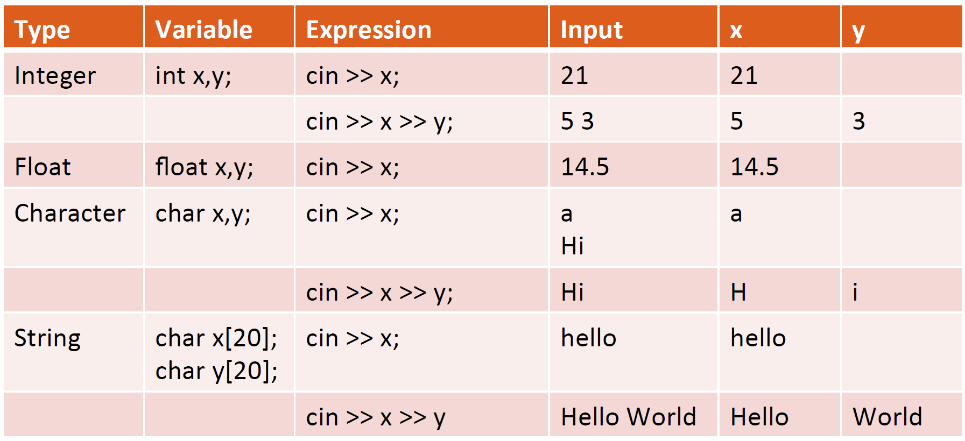
cin: Input Operator (>>)
H

Slide 106
cin: Input Operator (>>)
H

Slide 107
cin: Input Operator (>>)
H

Slide 108
Expected Outcome
Describe the basic syntax and data types of C++ language
Explain the concepts of variable, constant, and their scope
Declare variable and constant under different scopes
Perform update on variables via different operators
Able to output variables’ values to screen with different precision and format
Able to read value from keyboard and assign to variable

