Slide 1

Introduction to
Leon Anavi
@leonanavi
leon@anavi.org

Slide 2
Dolphinaric
The tour is organized by Filip Kłębczyk (fk_lx)
10 August, 15:00 CEST, Hackerspace Warszawa, Warsaw, Poland
15 August, 20:30 EEST, Hackafe, Plovdiv, Bulgaria
17 August, 18:00 CEST, H.A.C.K., Будапеща, Унгария
18 August, 16:00 CEST, Progressbar Hackerspace, Bratislava, Slovakia
22 August, 17:30 CEST, Hackerspace Silesia, Katowice, Poland

Slide 3
Agenda
History of Linux Smartphones
Jolla
SailfishOS
Mer
Sailfish OS SDK Installation
Qt & QML
FAQ

Slide 4






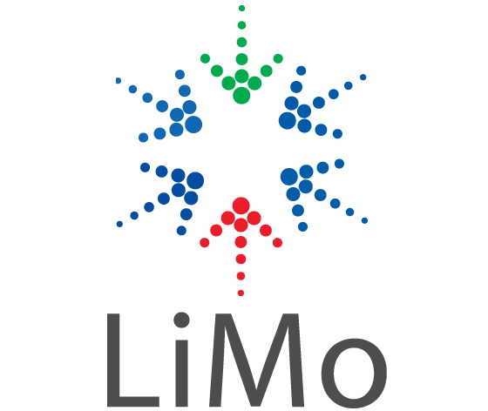

Linux Based OS

Slide 5
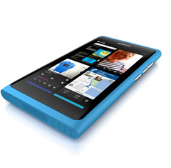
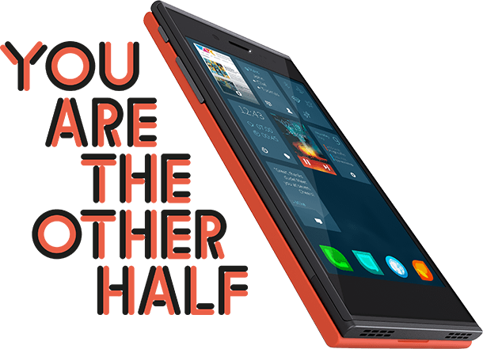
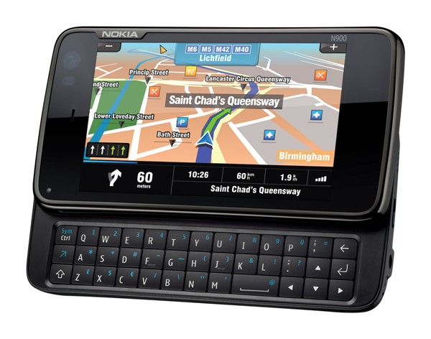
Linux Smartphones
Nokia N900
2009
Nokia N9
2011
Jolla
2013

Slide 6
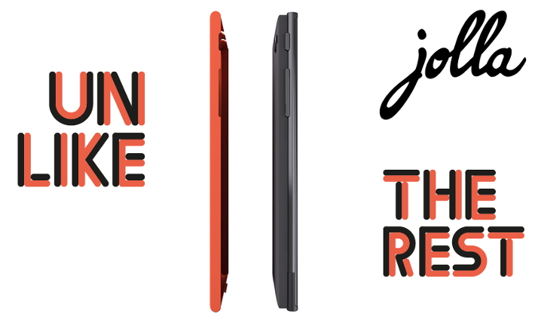
Jolla

Slide 7
What is Sailfish OS?
Linux based operating system
Built on the heritage of MeeGo
Runs Qt/QML, HTML5 and Android apps
Using Qt 5 & Wayland
Developed by Jolla

Slide 8
What is NOT Sailfish OS?
NOT another Android based OS
NOT fully open (Sailfish UI part is currently closed)

Slide 9
Architecture
Sailfish UI
Mer
Linux Kernel

Slide 10
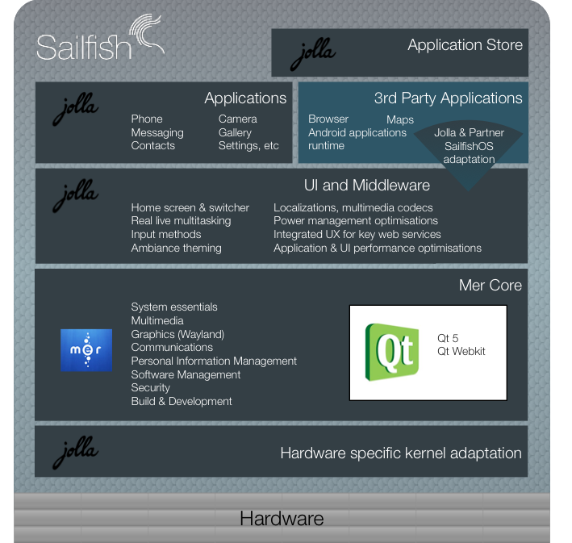
Architecture

Slide 11
Mer
Mer is FOSS mobile-optimized core distribution; powered by Qt/QML and HTML5. The project is openly developed and meritocratically governed.
Which projects and products use Mer?
Nemo Mobile
Plasma Active (като KDE за таблети)
Cordia
Seadot
Sailfish

Slide 12
Sailfish SDK
Requirements:
Oracle VirtualBox 4.1.18 or newer
About 5GB free disk space
4GB RAM (recommended)
Compatible platforms:
Windows
Linux
Mac OS X

Slide 13

Qt
Qt
QML
Qt Quick 2.0
Sailfish Silica

Slide 14
Sailfish Silica
import QtQuick 2.0
import Sailfish.Silica 1.0
ApplicationWindow {
initialPage: Page {
Button {
text: "Hello world!"
anchors.centerIn: parent
}
}
}

Slide 15
FAQ
Will Sailfish OS support HTML?
Yes, Jolla has promised suport HTML5 apps through Cordova Qt.
Will Sailfish support DRM?
No.
Is it possible to install Sailfish OS on Nokia N9?
Jolla will not realease Sailfish image for another's company product.
Are there any Sailfish OS devices on the market?
Jolla devices should be available to the market at the end of 2013 or at the beginning of 2014. Until then the developers can experiment with the Sailfish OS SDK and with Nemo Mobile on N9, N950, N900, Nexus 7, PandaBoard, etc.

Slide 16
Resources
http://jolla.com
https://sailfishos.com
http://merproject.org
http://dolphinaric.org

Slide 17
Mailing Lists
Mer
https://wiki.merproject.org/wiki/Mailing_lists
Sailfish OS
https://lists.sailfishos.org/cgi-bin/mailman/listinfo/devel
Dolphinaric
http://lists.dolphinaric.org/cgi-bin/mailman/listinfo/dolphinaric-general
Dolphinaric `BG
http://lists.dolphinaric.org/cgi-bin/mailman/listinfo/sailfish-bg

Slide 18
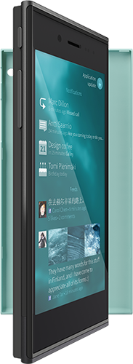
Thank You!

