Slide 1

Sailfish SDK install/hackfest at:
Warsaw Hackerspace
Today powered by: fk_lx and Stskeeps

Slide 2
Agenda
Who we are? What we do?
What is Sailfish and a bit of history
SDK and running some demo app
Hacking/discussion/Q&A/flame wars

Slide 3
Who we are? What we do?
Carsten Munk aka Stskeeps
Mer project co-founder
libhybris creator
openness and meritocracy supporter
working for Jolla as Chief Research Engineer
Stskeeps on IRC, Meet me at #mer #nemomobile, #sailfishos and more ...
Twitter: @Stskeeps

Slide 4
Who we are? What we do?
Filip Kłębczyk aka fk_lx
Dolphinaric project founder (educational project about Mer/Nemo)
PLUG, OSM-PL member, Co-founder of HS Silesia in Katowice
main organizer of PyCon PL (pl.pycon.org) and SmartDevCon (smartdevcon.eu)
Initiator of Sailfish SDK hack/installfests
fk_lx on IRC, Meet me at #mer, #nemomobile, #sailfishos, #hackerspace-silesia.
Twitter: @fk_lx

Slide 5
Sailfish
What is Sailfish?
  Linux based operating system
  Built on the heritage of MeeGo
  Runs Qt/QML, HTML5 and Android apps
  Using Qt5 + Wayland (new!)
  Developed by Jolla
What Sailfish is not:
  Yet another Android based OS
  Fully open (but it is mostly open, based on Mer/Nemo; Sailfish UI part is currently closed)

Slide 6
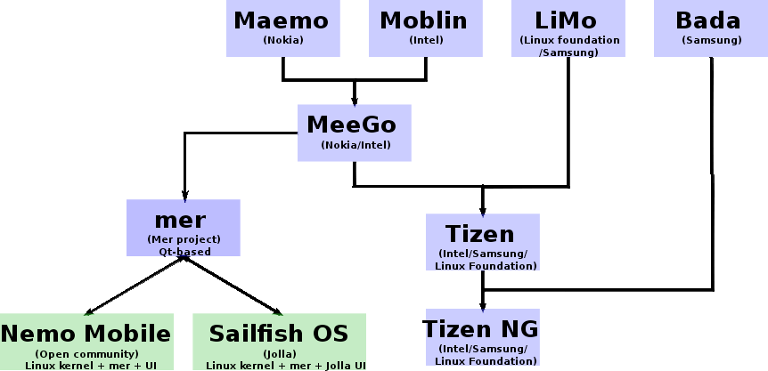
„Genealogical” tree
Image source: Wikipedia

Slide 7
What is Mer?
„Mer is an open, mobile-optimised, core distribution aimed at device manufacturers; powered by Qt/QML and HTML5 - openly developed, inclusive, and meritocratically governed.” from www.merproject.org
What projects/products use Mer
  Nemo Mobile
  Plasma Active (like KDE for tablets)
  Cordia
  Seadot
  Sailfish

Slide 8
Qt, Sailfish, ...
Switching to other presentation
(made by Lucien XU)

Slide 9
FAQ
Can I run Sailfish on my awesome <put here the name of your Android phone model> smartphone?
Currently not, but who knows what future holds ;-) Anyway now you can probably try running Nemo Mobile on your device.
When devices with Sailfish will be availiable?
End of 2013/Beginning of 2014
Where to look for information about Sailfish?
www.sailfishos.org

Slide 10
FAQ
How can I help?
  Contribute to Mer and Nemo Mobile
  People needed in different fields – see wiki, join irc channel - don't be shy, this community doesn't bite (usually ;-))
  Contribute to Dolphinaric project – help create educational material about Mer/Nemo and related projects
  Tell your friends about this stuff, help spread the word! Organize events, hackathons etc.

Slide 11
Let's move to installing Sailfish SDK

