Slide 1
Fundamentals and Methods of Computer Science
Exercise Admin
Dominik Buchegger

Slide 2
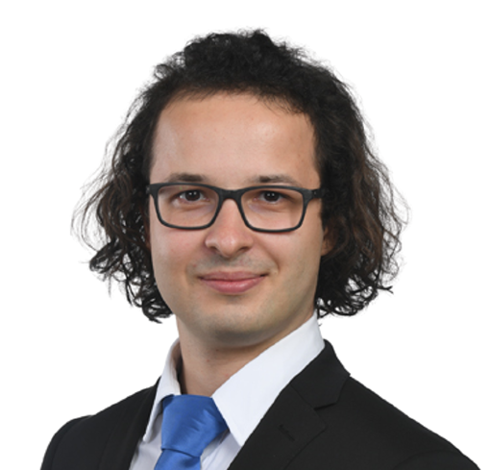
Intro
Who am I?
Dominik Buchegger, 25
I have a B.A. HSG in Law & Economics… …but didn’t enjoy the Law part that much.
Therefore, I did a B.A. HSG in Business Administration… …and realized I don’t want to do a business master.
Currently, I am studying Banking and Finance while also pursuing courses for the MSc Statistics at ETH.
I enjoy academia & teaching (possibly doing a doctorate)
6th time tutoring for this course
And if you are scared by now from the overwhelming course content: I learned programming 3 years ago in this exact course.

Slide 3
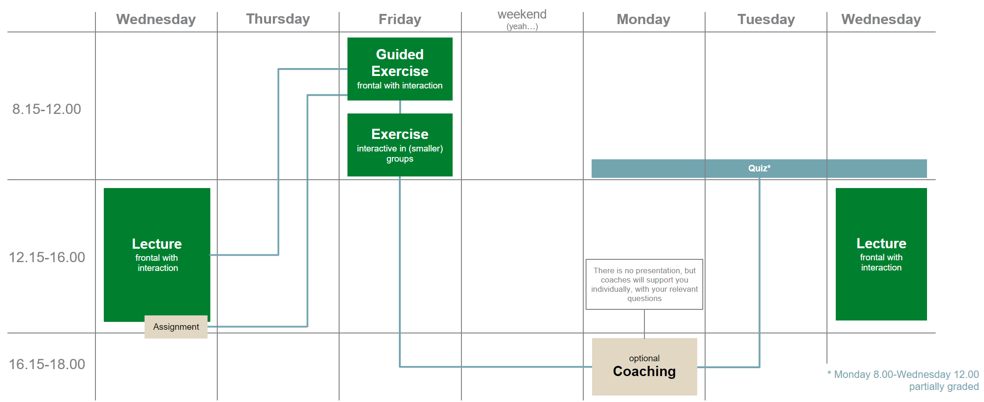
The CS Exercises
Where are we?
We are here.
Virtual Office Hour (15-16)
[Exceptions]

Slide 4
What is graded?
Please always refer to the official lecture slides!
Weekly Quizzes on Canvas (main course page)
To be taken after working on the respective assignment
Graded Quizzes (2-5); “pass” (>= 50%) or “fail” (<50%) [10%] – attention: official examination part
Ungraded Quizzes (1, 6-11)
Project group (size to be determined) work [10%] – attention: official examination part
Decentral, starting before the break
Small web application using https://streamlit.io/
Important dates:
Week 06: Group definition / assignment, Q&A for project
Week 07: Presentation of project idea / approach
Week 09: Presentation of MVP (first version of results)
Week 11: Presentation of 5 minutes video (incl. demo), 5 minutes Q&A session
Week 12: Presentation of top-3 groups in lecture
Written Exam (80%, 120 Min.)​
Central, after the course
Planned digital on BYOD (extended closed book )

Slide 5
What is the general idea of the exercises?
Computer science implementation competence cannot be achieved through frontal teaching only
Similar to learning an instrument, it is necessary that we actively practice
To guide practicing, we have weekly assignments (and their assessments, i.e., the quizzes)
In the weekly exercises we
Discuss the previous week’s assignment and respective quiz (in depth) → starting next week
Briefly summarize the current week’s lecture contents
Provide (some) time and support for the current week’s assignment
In our small(er) group we have sufficient time and opportunity for discussing your individual questions.

Slide 6
The content corresponds to what I understand to be the core contents after reviewing the lecture slides and should only be understood as an overview.
This does not necessarily correspond to the opinion of the lecturer and does not claim to be complete, nor does it allow conclusions to be drawn about the quiz questions or the exam (which are both unknown to me).
Disclaimer

Slide 7
Dominik Buchegger
dominik.buchegger@student.unisg.ch

