Slide 1
Fundamentals and Methods of Computer Science
Exercise week 9

Slide 2
Today’s Menu
Group Project Pitches
Discussion of assignment 8 and the respective quiz
Brief summary of skills necessary to solve assignment 9
Working on assignment 9

Slide 3
Discussion of Assignment 8 and Quiz 8

Slide 4
Important concepts
pd.DataFrame vs. pd.Series
How to inspect a DF?
How to access data in a DF?
How to change a DF? (hint: copy it first)
Add a column to a Df
Arithmetic with entire columns
Some more functions
Transpose a DataFrame
pd.DataFrame:
Two-dimensional, mutable, tabular data
Contains labelled axes (rows and columns)
Think: dict-like container for Series objects
columns
data
rows
Only the values and rows (index)
data of col1
pd.Series:
One-dimensional, mutable, array
Contains labels for the entries
rows

Slide 5
Important concepts
pd.DataFrame vs. pd.Series
How to inspect a DF?
How to access data in a DF?
How to change a DF? (hint: copy it first)
Add a column to a Df
Arithmetic with entire columns
Some more functions
Transpose a DataFrame
Use the documentation of Pandas—it is brilliant!
Given a pd.DataFrame DF, we can inspect it as follows:
Show first n entries: DF.head(n)
Show last n entries: DF.tail(n)
Show n entries (random): DF.sample(n)
Return list of columns DF.columns

Slide 6
Important concepts
Use the documentation of Pandas—it is brilliant!
Select data by row:
… using the index names: DF.loc[index_name] (any type)
… using the index count: DF.iloc[index_count] (int)
Select data by column:
… using the column names: DF[‘column_name’]
… using the column names: DF.column_name
Select data by row and column:
→ DF.loc[index_name, column_name] -> pd.Series
→ DF.loc[index_name, [column_name]] -> pd.DataFrame
→ DF.iloc[index_count, column_name] -> pd.Series
→ DF.iloc[slice of index count][column_name] -> pd.Series
→ ...
pd.DataFrame vs. pd.Series
How to inspect a DF?
How to access data in a DF?
How to change a DF? (hint: copy it first)
Add a column to a Df
Arithmetic with entire columns
Some more functions
Transpose a DataFrame
fname | lname | order_nr
column names
0
1
2
...
A01
A03
B20
…
data
index count
index names

Slide 7
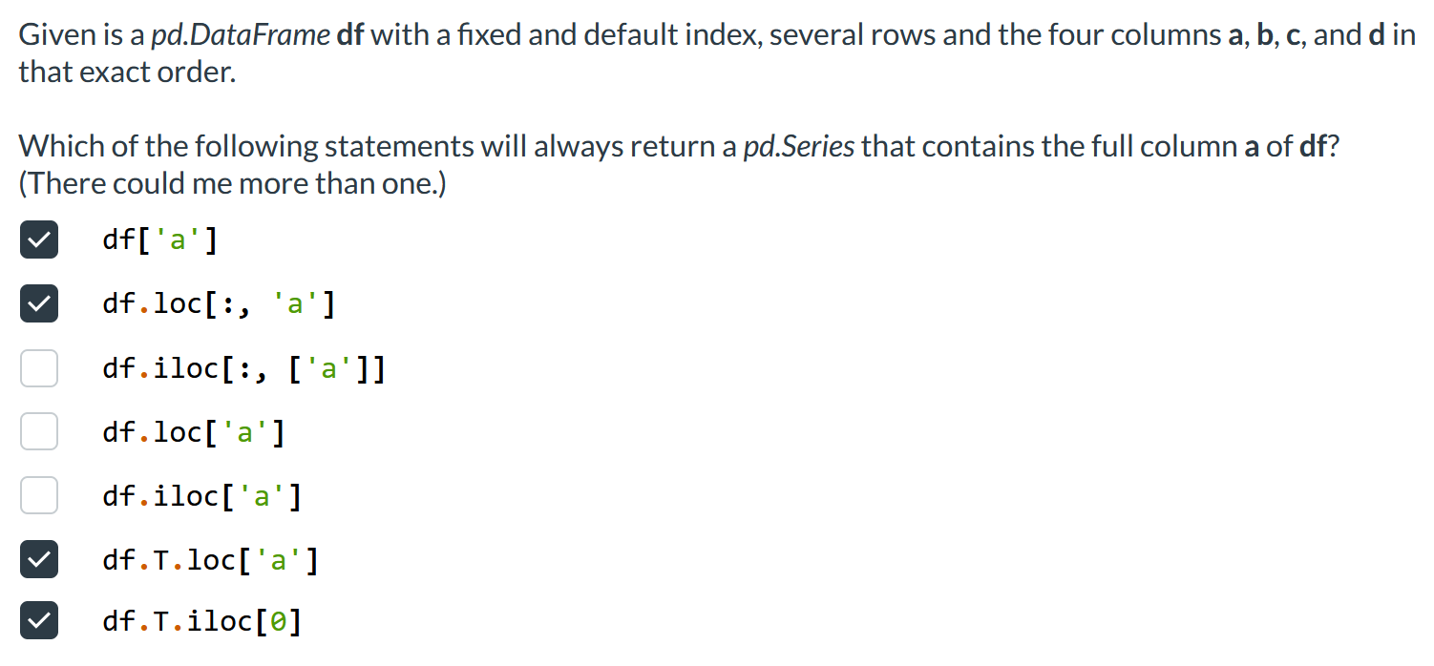
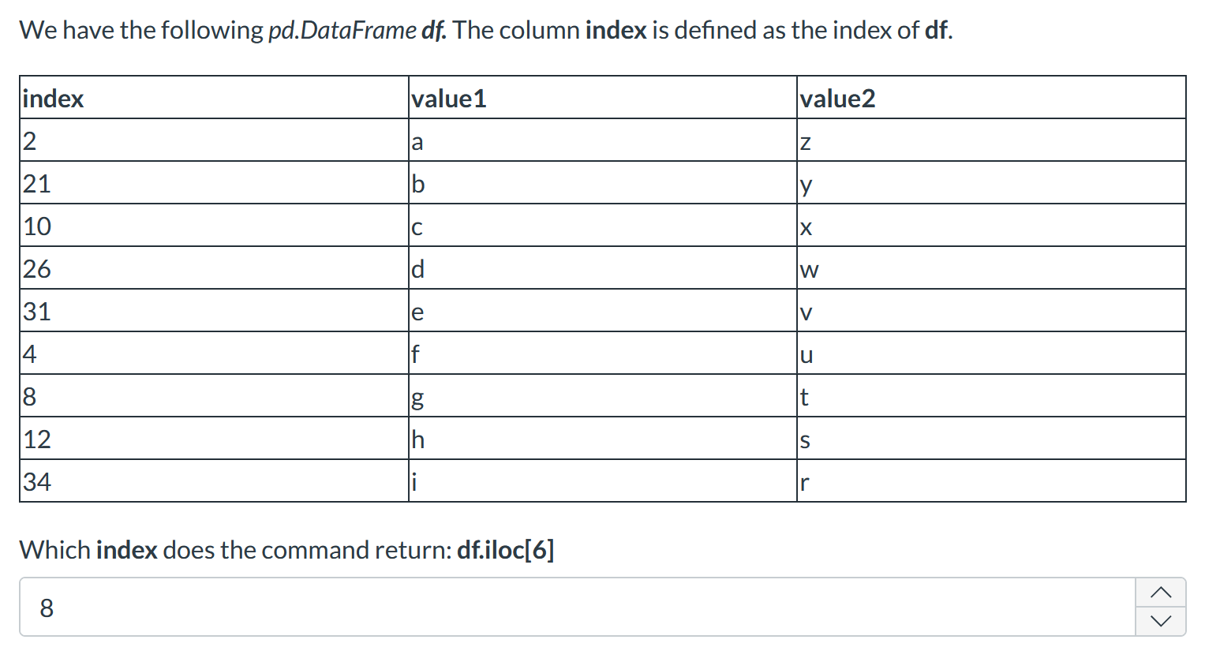
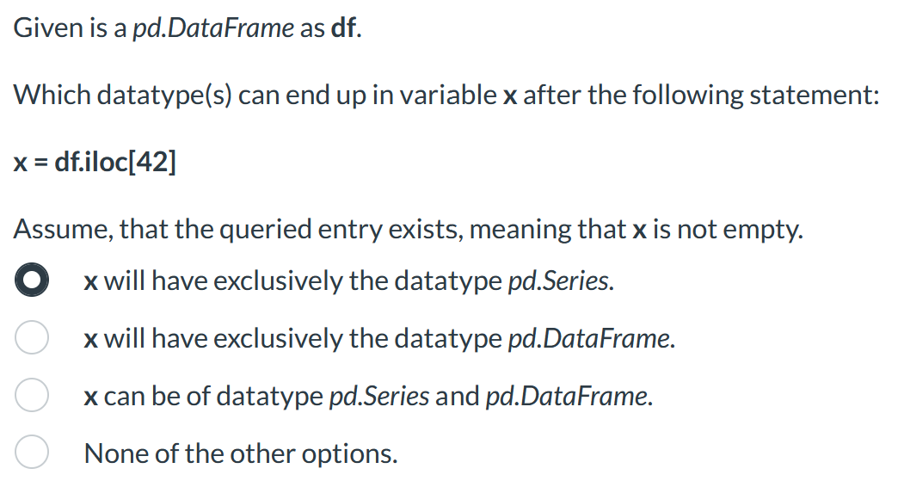
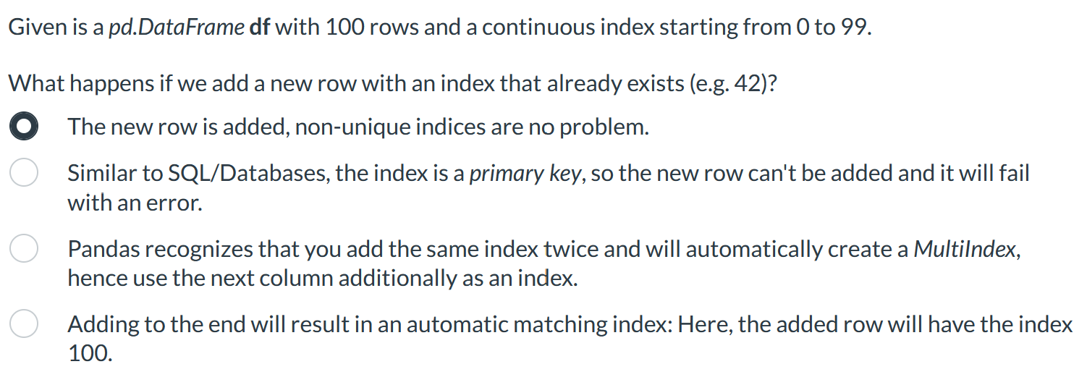
Important concepts
pd.DataFrame vs. pd.Series
How to inspect a DF?
How to access data in a DF?
How to change a DF? (hint: copy it first)
Add a column to a Df
Arithmetic with entire columns
Some more functions
Transpose a DataFrame

Slide 8
Important concepts
pd.DataFrame vs. pd.Series
How to inspect a DF?
How to access data in a DF?
How to change a DF? (hint: copy it first)
Add a column to a DF
Arithmetic with entire columns
Some more functions
Transpose a DataFrame
df = DF.copy()

Slide 9
Important concepts
pd.DataFrame vs. pd.Series
How to inspect a DF?
How to access data in a DF?
How to change a DF? (hint: copy it first)
Add a column to a DF
Arithmetic with entire columns
Some more functions
Transpose a DataFrame
Like in a dict:
DF["new_column_name"] = DF['a'] – DF['b’]
Note that you can do artithmetic operations with columns, e.g., DF['a’] / DF[‘b’].

Slide 10
Important concepts
# Drop NaN-rows (NOT columns)
df = df.dropna(axis='index')
# Set the index
df = df.set_index('director_name')
# Group (along index) and calculate average
df = df.groupby('director_name').mean()
# Sort by index
df = df.sort_index()
# Sort by specified column & descending
df = df.sort_values(by="gross/budget", ascending=False)
pd.DataFrame vs. pd.Series
How to inspect a DF?
How to access data in a DF?
How to change a DF? (hint: copy it first)
Add a column to a DF
Arithmetic with entire columns
Some more functions
Transpose a DataFrame

Slide 11
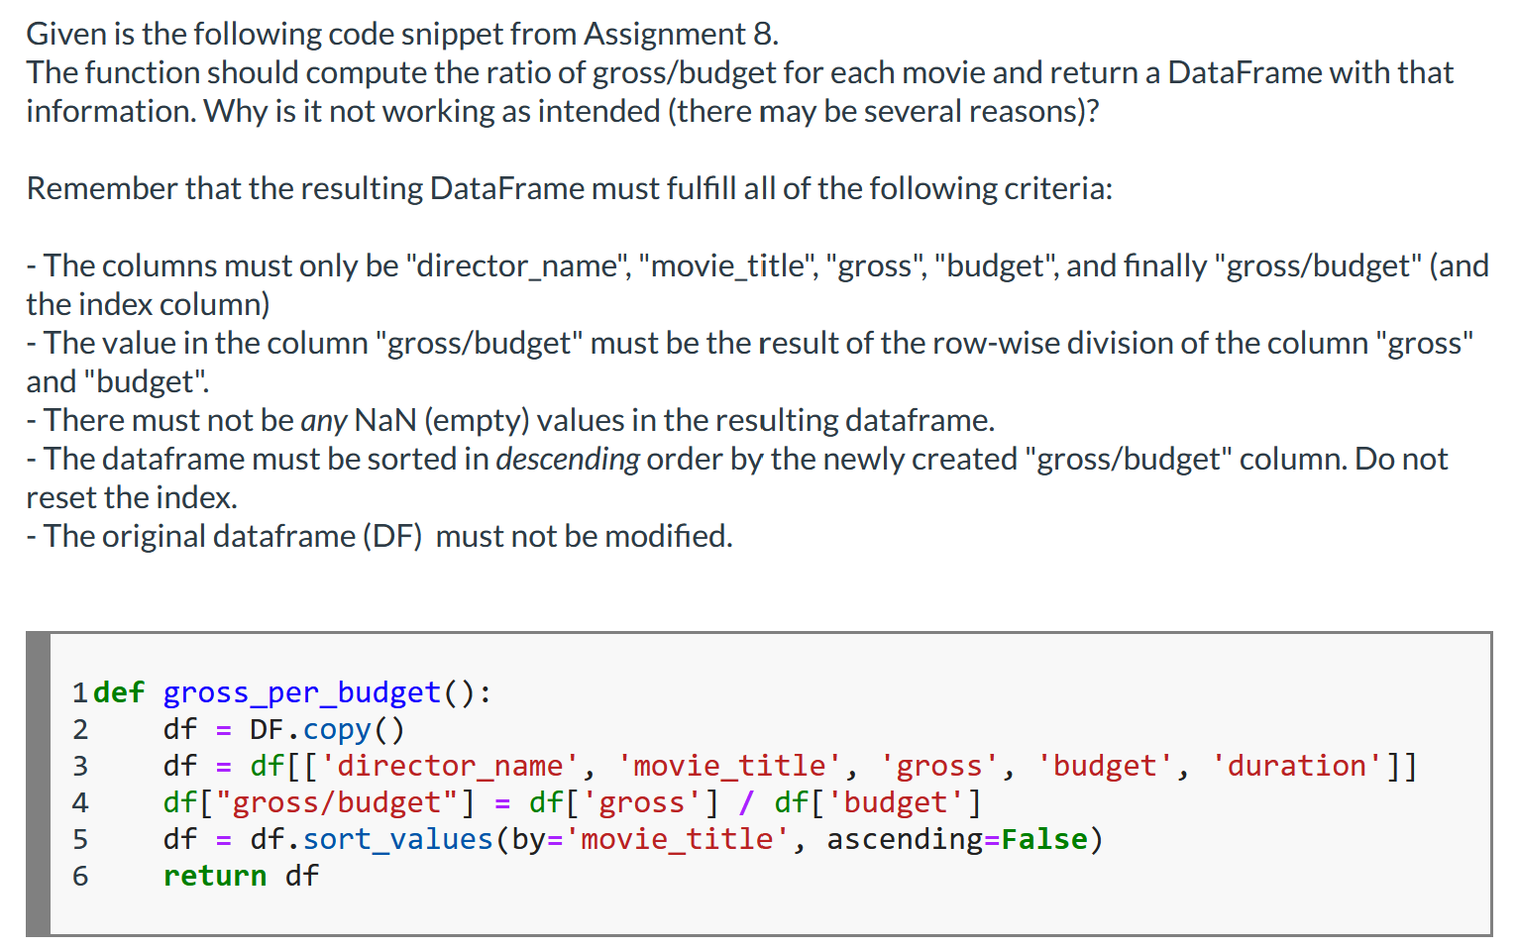
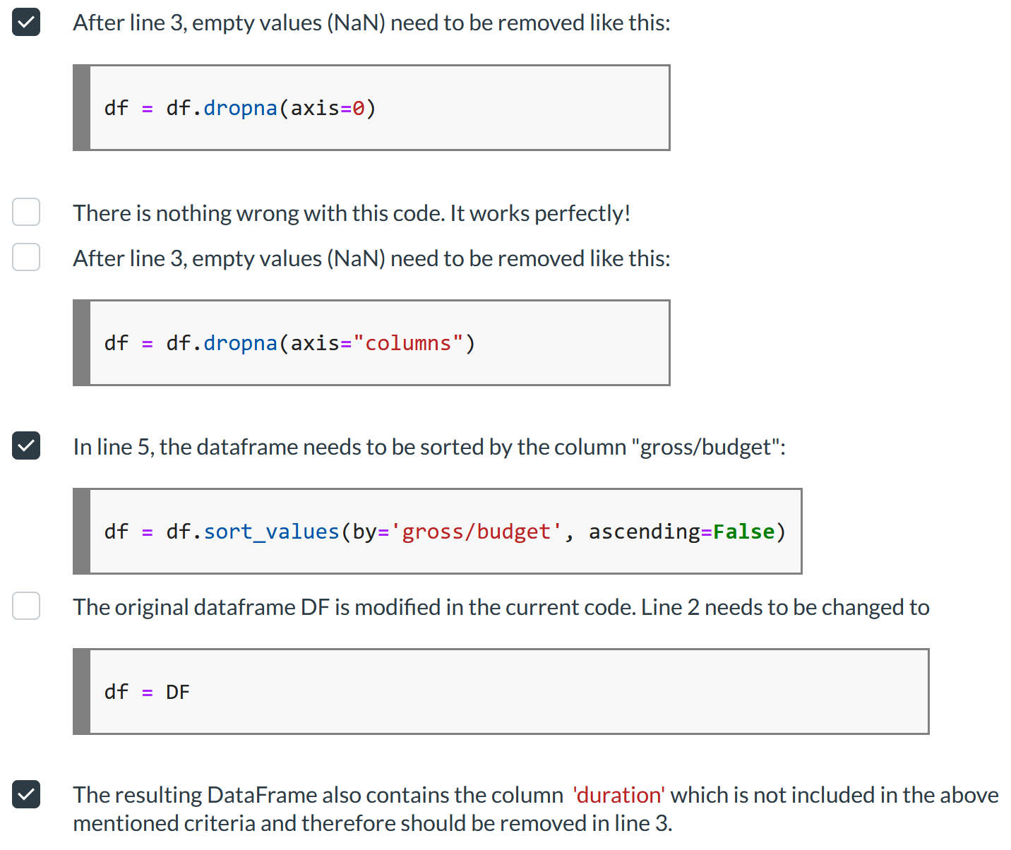
Important concepts
pd.DataFrame vs. pd.Series
How to inspect a DF?
How to access data in a DF?
How to change a DF? (hint: copy it first)
Add a column to a DF
Arithmetic with entire columns
Some more functions
Transpose a DataFrame

Slide 12
Important concepts
pd.DataFrame vs. pd.Series
How to inspect a DF?
How to access data in a DF?
How to change a DF? (hint: copy it first)
Add a column to a DF
Arithmetic with entire columns
Some more functions
Transpose a DataFrame
“Transposing” means to change the orientation of the DF. Column names become row (index) names, and row (index) names become column names.
columns
columns
data
data
row 1
DF.T
col 'c'
rows
col 'c'
columns
row 1

Slide 13
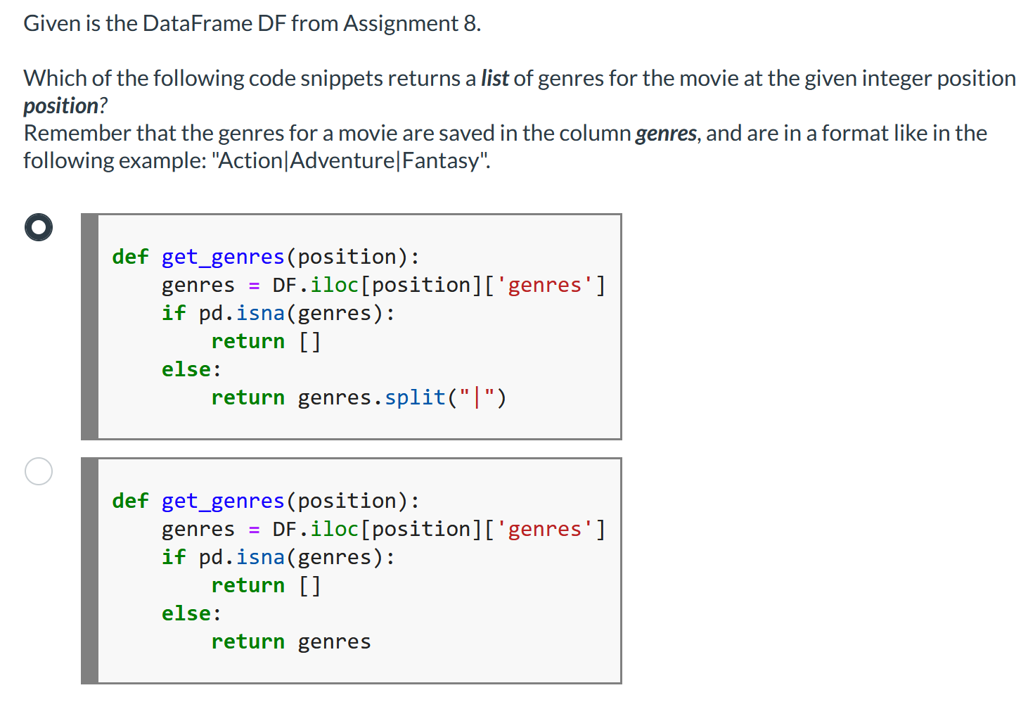
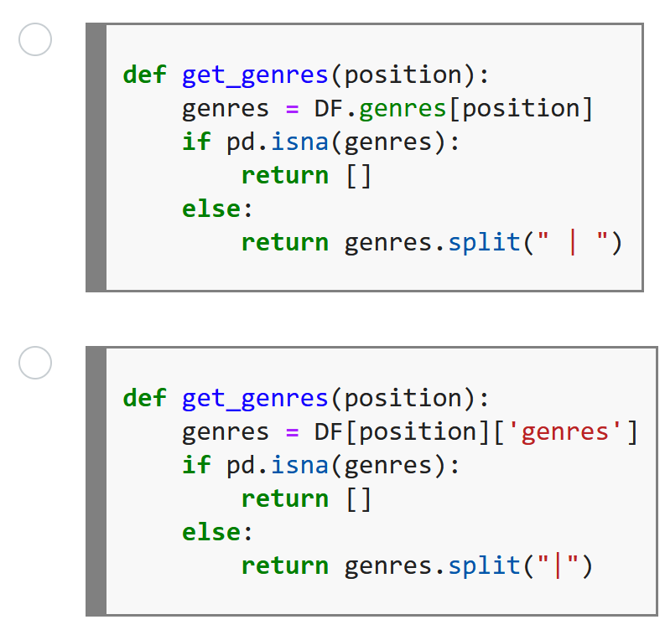
Quiz Questions putting concepts together

Slide 14
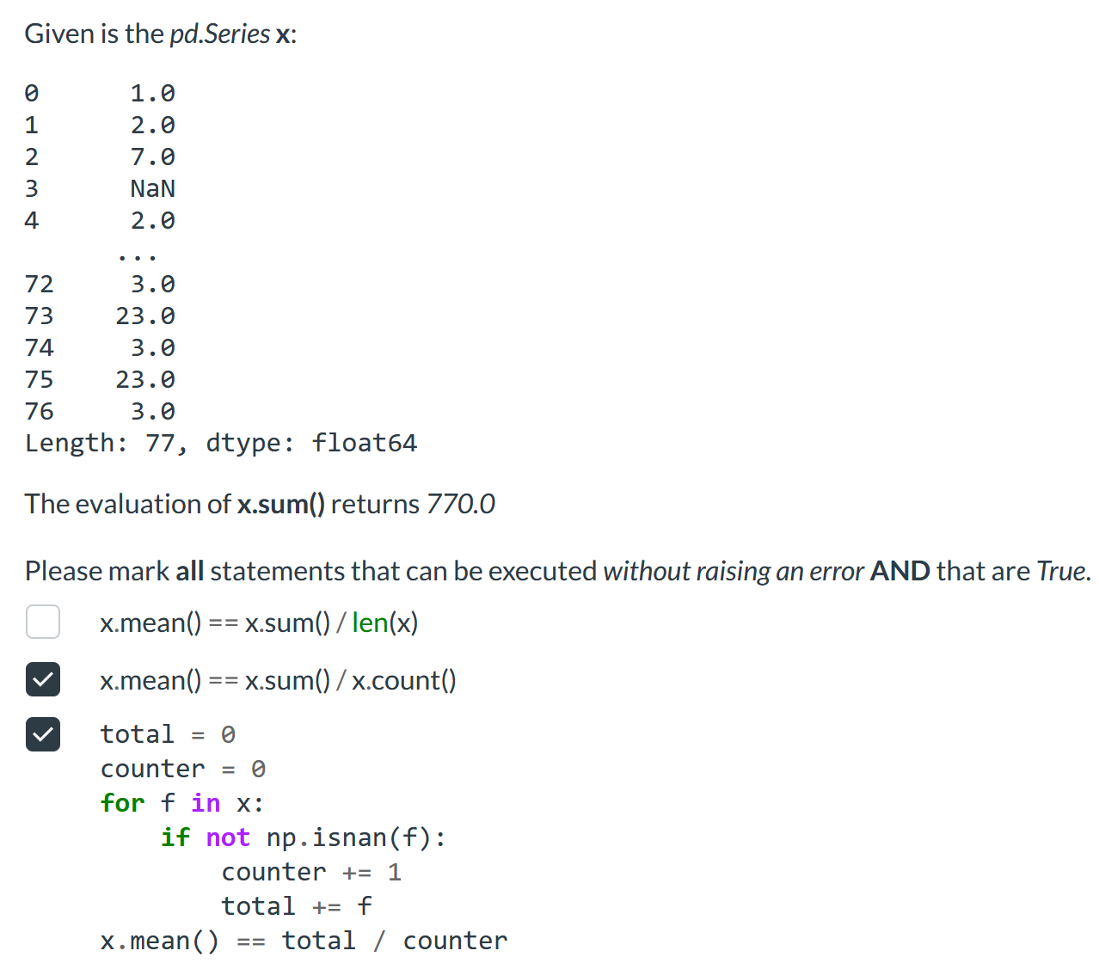
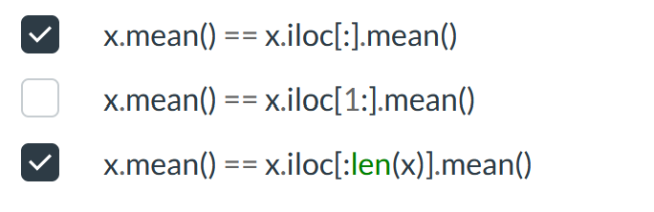
Quiz Questions putting concepts together

Slide 15
Brief summary of skills necessary to solve Assignment 9

Slide 16
Merging dataframes - on index (row)
So far, we have seen how we can merge (JOIN) SQL tables. The same can apply to pandas dataframes.
pd.merge() returns a new dataframe, based on the method of merging we use.
There are four ways to merge two dataframes:
Join type | Example command | Explanation
Outer join | pd.merge(df1, df2, how=“outer”, left_index=True, right_index=True) | The “outer” command returns the union of all rows and columns of both dataframes (df1, df2).
Inner join | pd.merge(df1, df2, how= “inner”, left_index=True, right_index=True) | The “inner” command returns the rows and columns that correspond to the intersection of the dataframes.
Left join | pd.merge(df1, df2, how= “left”, left_index=True, right_index=True) | “left” join returns all rows and columns of the left dataframe (df1) and the intersection with df2.
Right join | pd.merge(df1, df2, how= “right”, left_index=True, right_index=True) | “right” join returns all rows and columns of the right dataframe (df2) and the intersection with df1.

Slide 17
Merging dataframes – on column
We can also merge two dataframes on a column of our choice. In this case, the syntax of the merge command is:
pd.merge(df1, df2, how=“outer”, left_on=‘column_name_df1’, right_on=‘column_name_df2’)
In this case, the left/right_index changes to left/right_on. For each one we must pass a column name from the adjacent dataframe. (left_on receives a column from the left dataframe, right_on receives a column from the right dataframe). We can also pass a list of column names for left/right_on, or combine left/right_on with right/left_index.
.merge documentation: https://pandas.pydata.org/docs/reference/api/pandas.DataFrame.merge.html

Slide 18
Applying functions to dataframe rows or columns
To apply a function on dataframe rows or columns, pandas provides the .apply() method. This method is used to map a specific function on specific rows or columns of the table (or on the whole table).
Syntax: df.apply(lambda x: x operation, axis=1)
Axis: axis=1 indicates that the function is going to be applied to each row of the DataFrame.
axis=0 indicates applying the function to each column
Function: in the Syntax above, lambda is shown, but we can apply any function on a DataFrame through the .apply() method!
.apply() documentation: https://pandas.pydata.org/docs/reference/api/pandas.DataFrame.apply.html

Slide 19
Other DataFrame methods
There are many built-in functions that can be used on DataFrames. The following list shows some useful ones. These function must be applied to a column instead of a row:
Function | Explanation | Syntax
mean | Returns the mean value of the values in the column | df[‘col_name’].mean()
min | Returns the smallest value | df[‘col_name’].min()
max | Returns the biggest value | df[‘col_name’].max()
std | Returns the standard deviation from the mean | df[‘col_name’].std()
describe | Returns various statistics for the selected column | df[‘col_name’].describe()

Slide 20
Dividing a DataFrame into groups
Pandas comes with the .groupby() method, which allows to derive insights from data within the DataFrame. There are two aspects to consider: First, we need to select the column we want to group by (‘col_name’) and second, whether we want to use a function (e.g., mean()).
df.groupby(‘col_name’, as_index) .function_name()
The as_index parameter is a Boolean which is True by default. If we leave it as True, the column under ‘col_name’ will become the index of the dataframe that groupby() returns. If we set it to false, default indexes (0,1,2…) are going to be used instead.
The power of the .groupby() method is that we split data into groups that interest us and then apply different functions on them to gain useful insights. Instead of using .min() or other functions as shown in the slide above, we can also use the .agg() method. It takes the function name as an argument (e.g., df.groupby('author').agg('max') to get the maximum value per column for each distinct entry in the ‘author’ column).
.groupby() documentation: https://pandas.pydata.org/docs/reference/api/pandas.DataFrame.groupby.html

Slide 21
Reshaping a dataframe
There are 2 ways in which we can reshape a dataframe – turn a wide dataframe into a narrow one or vice versa. The methods used are:
Melt:
Is used to create narrow dataframes out of wider ones.
Syntax:
pd.melt(id_vars=[‘col_name’],
var_name=‘name’,
value_name=‘name1’)
var_name and value_name are optional.
(More information on lecture notebook, section 3)
Documentation: https://pandas.pydata.org/docs/reference/api/pandas.melt.html
Pivot:
Is used to create a wider dataframe out of a narrow one.
Syntax:
pd.pivot(index=‘col_name’,
columns=‘col_name1’,
values=‘col_name2’)
Index and columns are required parameters.
(More information on lecture notebook, section 3)
Documentation: https://pandas.pydata.org/docs/reference/api/pandas.DataFrame.pivot.html

Slide 22
Now you have everything you need to start with Assignment 9

Slide 23
<Name>
<Role / occupation>
<email>

