Slide 1
Grundlagen und Methoden der Informatik
Admin
Dominik Buchegger

Slide 2
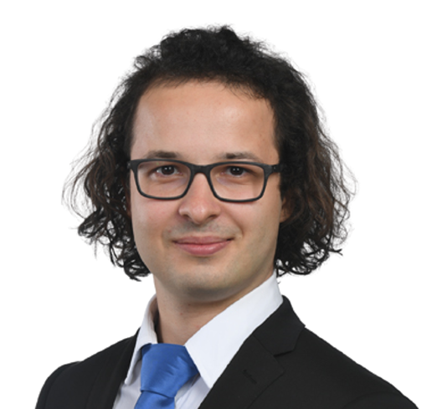
Intro
Who am I?
Dominik Buchegger, 25
I have a B.A. HSG in Law & Economics… …but didn’t enjoy the Law part that much.
Therefore, I did a B.A. HSG in Business Administration… …and realized I don’t want to do a business master.
Currently I am studying Banking and Finance while also pursuing courses for the MSc Statistics at ETH.
I enjoy academia & teaching (possibly doing a doctorate)
6th time tutoring for this course
And if you are scared by now from the overwhelming course content: I learned programming 3 years ago in this exact course.

Slide 3
The CS Exercises
Where are we?
We are here.
Thursday
Friday
weekend (yeah…)
Monday
Tuesday
Wednesday
Thursday
Lecture frontal with interaction
Lecture frontal with interaction
Quiz*
8.15-12.00
Guided Exercise frontal with interaction
Assignment
Exercise
in (smaller) groups
12.15-16.00
There is no presentation, but coaches will support you individually, with your relevant questions
16.15-18.00
optional
Coaching
* 08:17-08:37, (mostly) graded

Slide 4
What is the general idea of the exercises?
Computer science implementation competence cannot be achieved through frontal teaching only
Similar to learning an instrument, it is necessary that we actively practice
To guide practicing, we have weekly assignments (and their assessments, i.e., the quizzes)
In the weekly exercises we
Discuss the previous week’s assignment and respective quiz (in depth) → starting next week
Briefly summarize the current week’s lecture contents
Provide (some) time and support for the current week’s assignment
In our small(er) group we have sufficient time and opportunity for discussing your individual questions.

Slide 5
What are we doing in the exercises?
Discuss the previous week’s assignment (briefly) and respective quiz (in depth) → starting next week
Summarize the current week’s lecture contents (in more detail & including theory)
Provide additional material on Python Basics, Object Oriented Programming & Data Science → We will go through some of these material, but the idea behind them is self study / reference for questions.
Solve together additional, smaller exercises to prepare you for the current week’s assignment → I will upload them by Wednesday Noon. You benefit most if you already try to solve them on your own.
Additionally we have a virtual office hour (not to be confused with the official coaching session) → Exact time TBD, most likely Tuesday evening.
Slides, exercises/solutions, schedule/link for the office hour, … are uploaded to: https://dombbb.github.io/
Our group differs! In other groups you’ll have more time to work on the assignment & ask questions during the session. Of course you can also ask questions here, but there will be no timeslot dedicated to working on the assignment → Feel free to change groups if you would rather follow another structure.

Slide 6
The CS Exercises
Where are we?
We are here.
Thursday
Friday
weekend (yeah…)
Monday
Tuesday
Wednesday
Thursday
Lecture frontal with interaction
Lecture frontal with interaction
Quiz*
8.15-12.00
Guided Exercise frontal with interaction
Assignment
Exercise
in (smaller) groups
12.15-16.00
There is no presentation, but coaches will support you individually, with your relevant questions
Virtual Office Hour
16.15-18.00
optional
Coaching
* 08:17-08:37, (mostly) graded

Slide 7
The content corresponds to what I understand to be the core contents after reviewing the lecture slides and should only be understood as an overview.
This does not necessarily correspond to the opinion of the lecturer and does not claim to be complete, nor does it allow conclusions to be drawn about the quiz questions or the exam (which are both unknown to me).
Disclaimer

Slide 8
Today’s Menu
0. Setting you up (Python / Jupyter Notebook environment) & enabling you to find, download, (unzip) & load a .ipynb
Discuss previous week’s assignment & quiz
Summary of the current week’s lecture content
Additional material on coding (today incl. Python in 7 Slides)
Enable you to solve the assignment by solving together the smaller exercises
You solve the assignment
n+1. Virtual Office Hour

Slide 9
Python/Jupyter Notebooks

Slide 10
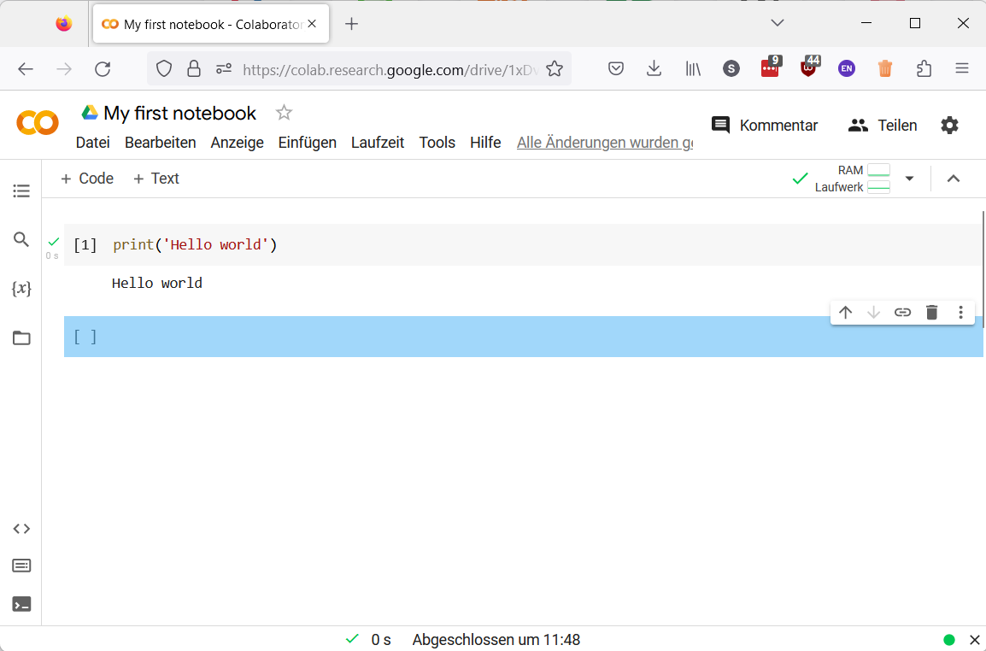
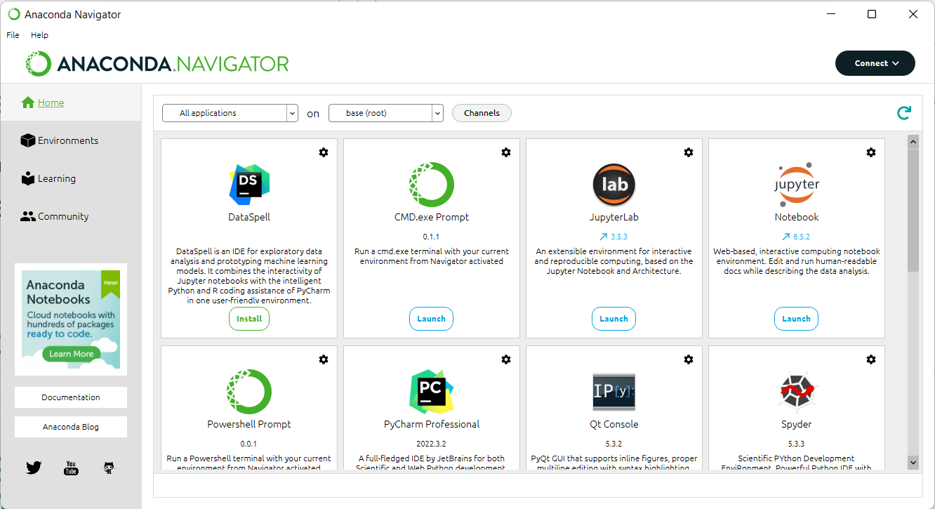
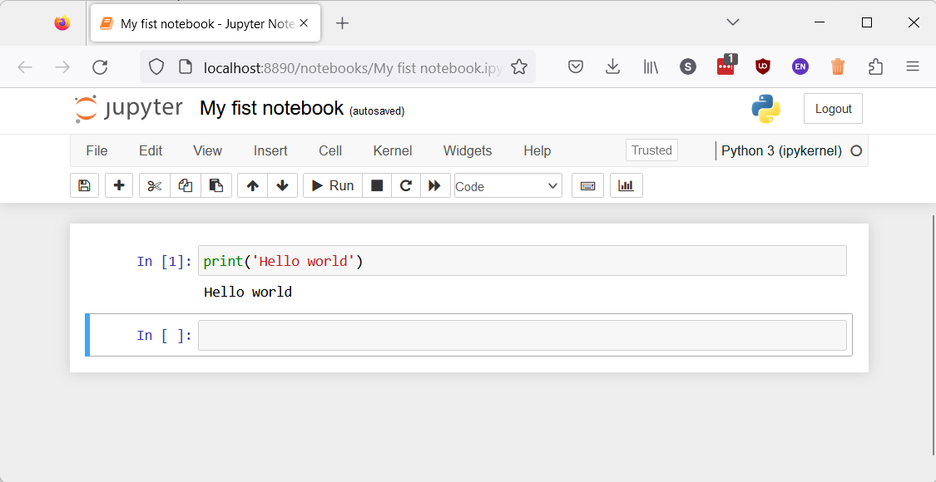
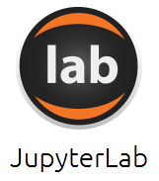

On your machine or in the cloud
While there are many more options, we support two ways of running Python/Jupyter Notebooks
On your machine: Anaconda
In the cloud: Google Colab
Anaconda is an easy to install and easy to use Python distribution that comes with everything we need.
Download https://www.anaconda.com/products/distribution
Install
https://web.microsoftstream.com/video/50227410-18db-452c-ae1a-6949b27bcfe1
Run
You typically need a Google account
Find https://colab.research.google.com/
Upload your Notebook
Run

Slide 11

Python / Jupyter Notebook
Having a running Python and Jupyter Notebook available is crucial, because …
All the assignments will need such an environment
All the lectures will provide their contents via notebooks
Let’s do it … now
If there is one thing you should have by today it is a running Python / Jupyter Notebook.

Slide 12
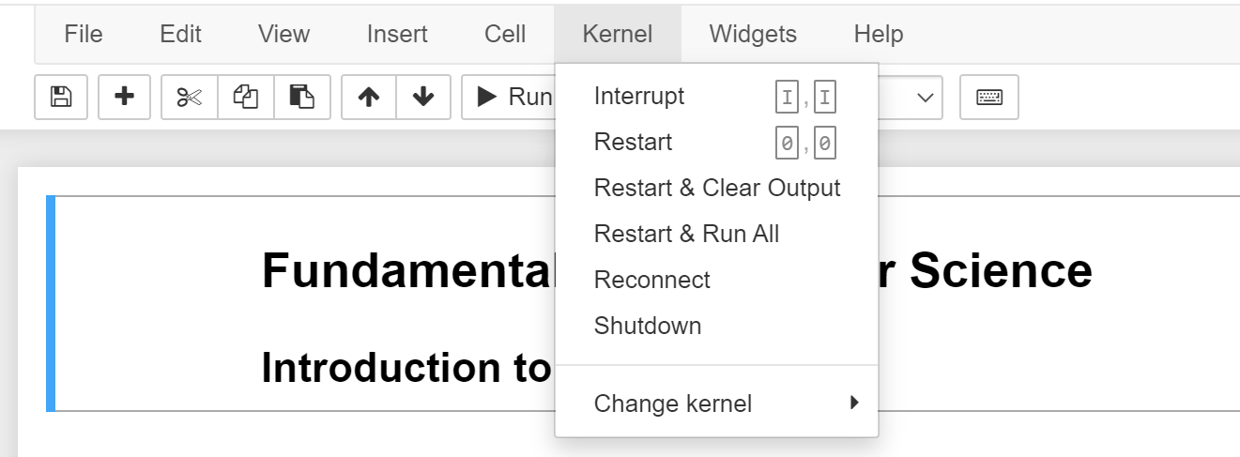
Troubleshooting in Jupyter
If your Jupyter Notebook:
does not run anymore, or
is taking more than a few (reasonable) seconds
Restart the Kernel!

Slide 13
Dominik Buchegger
dominik.buchegger@student.unisg.ch

