Slide 1
Fundamentals and Methods of Computer Science
Exercise week 10

Slide 2
Today’s Menu
Discussion of assignment 9 and the respective quiz
Introduction to Assignment 10: Data Visualization
3.1. Data Visualization in Python
3.2. Easy Example: Matplotlib
3.3. Easy Example: Seaborn
3.4. Insights on Assignment 10: Matplotlib
3.5. Insights on Assignment 10: Seaborn

Slide 3
1. Discussion of Assignment 9 and Quiz 9

Slide 4
Important concepts – merge()
Merging dataframes - on index (row)
Task 1-3: Merging Dataframes
Task 4: Count some json-encoded items with apply()
Task 5.1: Groupby
Task 5.2: Aggregation
Task 6: Flipping a DataFrame
Join type | Example command | Explanation
Outer join | pd.merge(df1, df2, how=“outer”, left_index=True, right_index=True) | The “outer” command returns the union of all rows and columns of both dataframes (df1, df2).
Inner join | pd.merge(df1, df2, how= “inner”, left_index=True, right_index=True) | The “inner” command returns the rows and columns that correspond to the intersection of the dataframes.
Left join | pd.merge(df1, df2, how= “left”, left_index=True, right_index=True) | “left” join returns all rows and columns of the left dataframe (df1) and the intersection with df2.
Right join | pd.merge(df1, df2, how= “right”, left_index=True, right_index=True) | “right” join returns all rows and columns of the right dataframe (df2) and the intersection with df1.
From last week’s exercise!
pd.merge(df1, df2, how=“outer”, left_on=‘column_name_df1’, right_on=‘column_name_df2’)
In this case, the left/right_index changes to left/right_on (left_on receives a column from the left dataframe, right_on receives a column from the right dataframe). We can also pass a list of column names for left/right_on, or combine left/right_on with right/left_index.
.merge documentation: https://pandas.pydata.org/docs/reference/api/pandas.DataFrame.merge.html

Slide 5
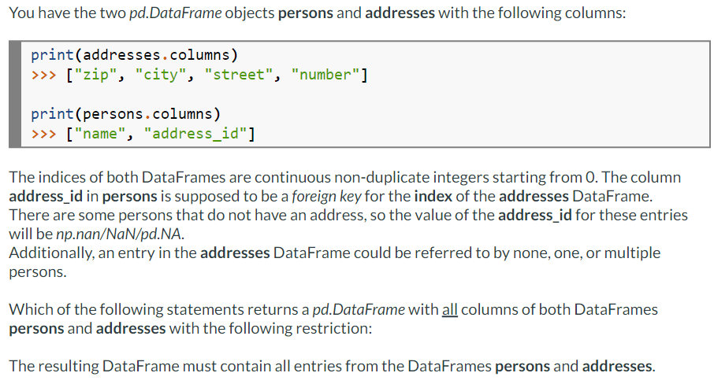
Important concepts – merge() – Quiz question 1

Slide 6
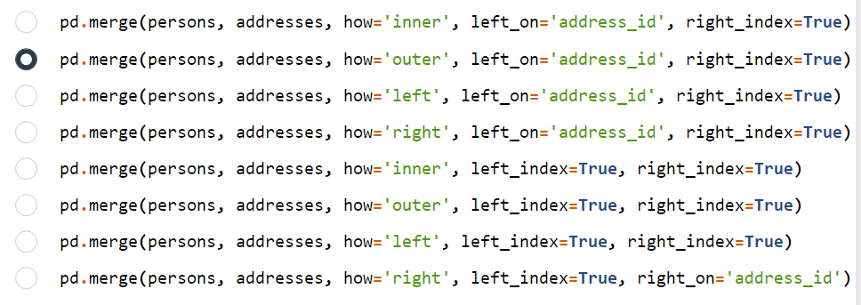
Important concepts – merge() – Quiz question 1
We want all entries of both dataframes:
The common column is the one containing the address: address_id in persons, the index in addresses. Persons is the dataframe on the left. Addresses is the dataframe on the right.

Slide 7
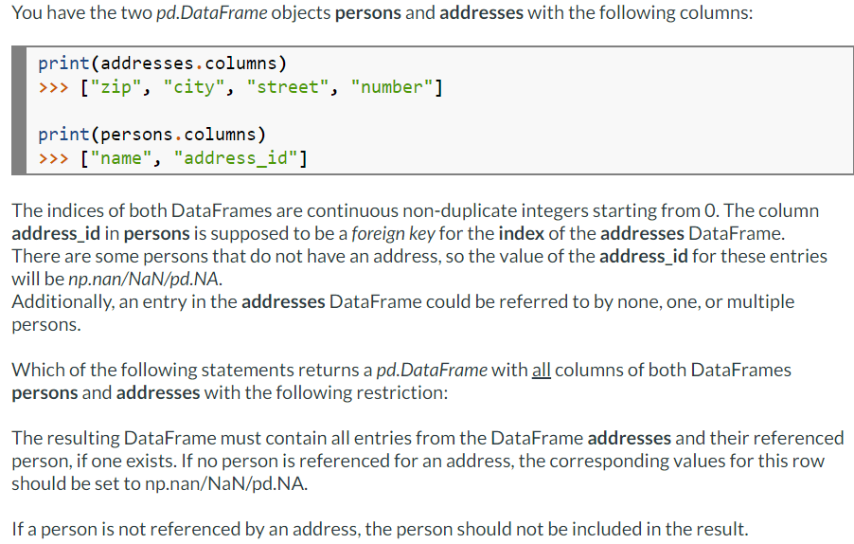
Important concepts – merge() – Quiz question 2

Slide 8
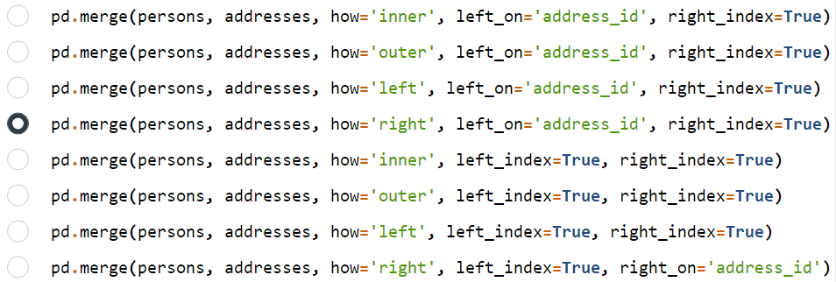
Important concepts – merge() – Quiz question 2
We want all entries of persons, with only their corresponding entry in addresses, if one exists. Persons is the dataframe on the left. Addresses is the dataframe on the right.
The common column is the one containing the address: address_id in persons, the index in addresses.

Slide 9
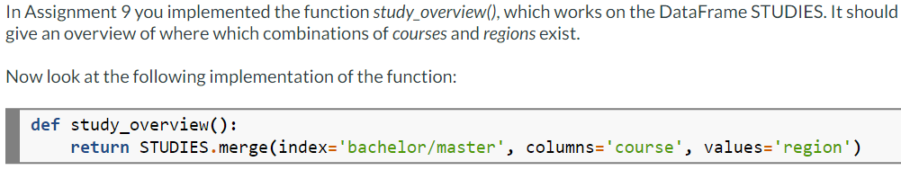
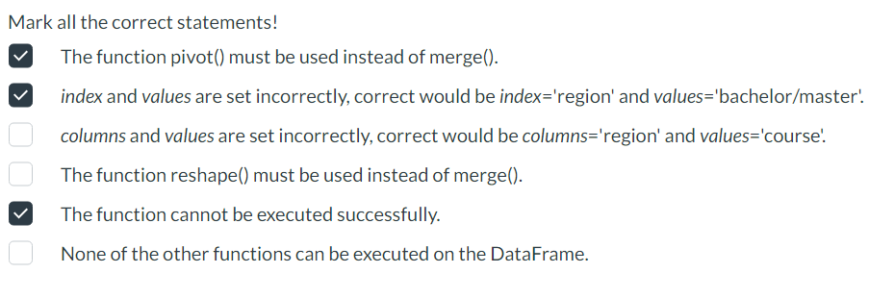
Important concepts – merge() & pivot() – Quiz question 4
We only have 1 dataframe, which we want to show in a different way.
We want to know what courses in what regions are available on a bachelor/master level.
We want to know what courses in what regions are available on a bachelor/master level.
reshape() is related with arrays, here we must use merge() because we are working on a dataframe
The given code snippet will not give the right output.
See choice number 1 =)

Slide 10
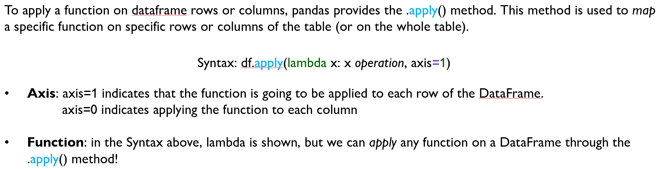
Important concepts – apply()
Task 1-3: Merging Dataframes
Task 4: Count some json-encoded items with apply()
Task 5.1: Dividing a DataFrame into groups: groupby()
Task 5.2: Aggregation
Task 6: Flipping a DataFrame
From last week’s exercise!

Slide 11
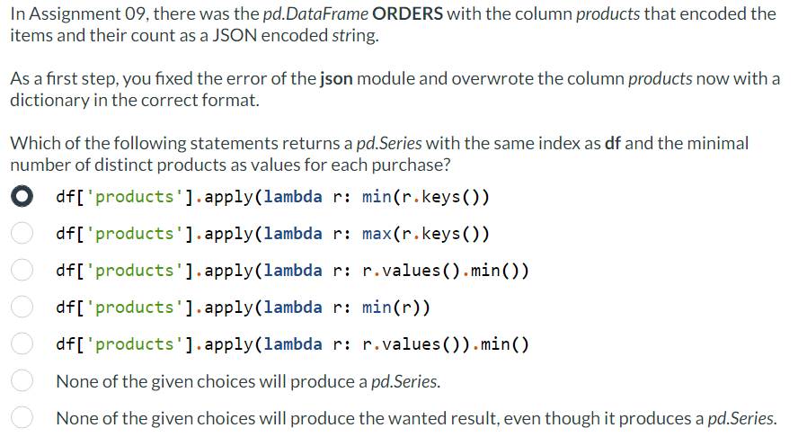

Important concepts – apply() – Question 5
Extract the numbers r.keys()
Take the minimum of these numbers min()
Put this in a function in the apply function apply(lambda r: min(r.keys())
On what to apply this function? On the column ‘products’
Querying several columns and several rows from a dataframe will return a pd.DataFrame.
Querying 1 column and several rows from a dataframe will return a pd.Series.
Querying 1 column and 1 row from a dataframe will return the content of 1 cell, which could be a string (e.g. ‘Avatar’).
Querying 1 column and 1 row from a dataframe will return the content of 1 cell, which could be a float (e.g. ‘2.0’).

Slide 12
Important concepts
Task 1-3: Merging Dataframes
Task 4: Count some json-encoded items with apply()
Task 5.1: Dividing a DataFrame into groups: groupby()
Task 5.2: Aggregation
Task 6: Flipping a DataFrame
From last week’s exercise!
Pandas comes with the .groupby() method, which allows to derive insights from data within the DataFrame. There are two aspects to consider: First, we need to select the column we want to group by (‘col_name’) and second, whether we want to use a function (e.g., mean()).
df.groupby(‘col_name’, as_index) .function_name()
The as_index parameter is a Boolean which is True by default. If we leave it as True, the column under ‘col_name’ will become the index of the dataframe that groupby() returns. If we set it to false, default indexes (0,1,2…) are going to be used instead.
.groupby() documentation: https://pandas.pydata.org/docs/reference/api/pandas.DataFrame.groupby.html

Slide 13
Important concepts
Task 1-3: Merging Dataframes
Task 4: Count some json-encoded items with apply()
Task 5.1: Dividing a DataFrame into groups: groupby()
Task 5.2: Aggregation
Task 6: Flipping a DataFrame
From last week’s exercise!
The power of the .groupby() method is that we split data into groups that interest us and then apply different functions on them to gain useful insights. Instead of using .min() or other functions as shown in the slide above, we can also use the .agg() method. It takes the function name as an argument (e.g., df.groupby('author').agg('max') to get the maximum value per column for each distinct entry in the ‘author’ column).
df.groupby(‘col_name’, as_index).agg(‘function_name’, axis)
If axis = 0 or axis = ‘index’: apply function to each column. If axis = 1 or axis = ‘columns’: apply function to each row.

Slide 14
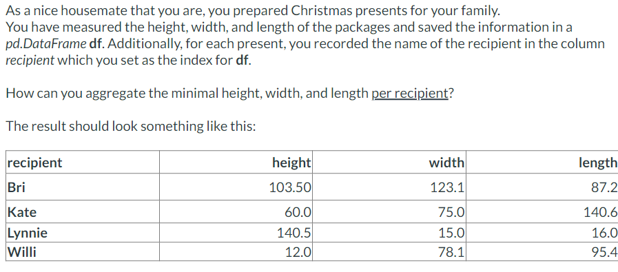
Important concepts – groupby() & agg() – Quiz question 6

Slide 15
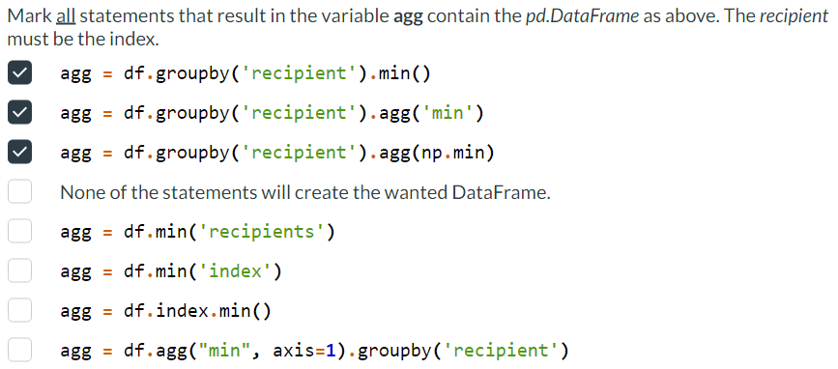
Important concepts – groupby() & agg() – Quiz question 6
Main idea: a same person can have several presents (so several rows for a same person). We want 1 row per person, with the minimum of each height, width and length of the present.
We use the groupby() function!
We want 1 row per person.
groupby(‘recipient’) !
We want the minimum for each column.
groupby().min() will compute the minimum for each column
groupby().agg(‘min’) also works: with agg(), just write the name of the function in a string
groupby().agg(np.min) also works: the min() function comes from the numpy library, so np.min

Slide 16
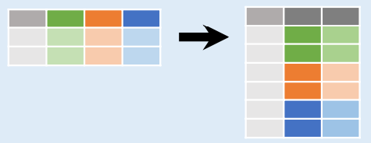
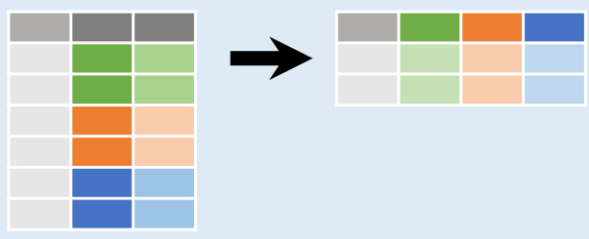
Important concepts
Reshaping a dataframe - Melt
Is used to create narrow dataframes out of wider ones.
Syntax:
pd.melt(id_vars=[‘col_name’], var_name=‘name’, value_name=‘name1’)
var_name and value_name are optional.
(More information on lecture notebook, section 3)
Documentation: https://pandas.pydata.org/docs/reference/api/pandas.melt.html
Task 1-4: Merging Dataframes
Task 5.1: Dividing a DataFrame into groups: groupby()
Task 5.2: Aggregation
Task 6: Flipping a DataFrame
Reshaping a dataframe - Pivot
Is used to create a wider dataframe out of a narrow one.
Syntax:
pd.pivot(index=‘col_name’, columns=‘col_name1’, values=‘col_name2’)
Index and columns are required parameters.
(More information on lecture notebook, section 3)
Documentation: https://pandas.pydata.org/docs/reference/api/pandas.DataFrame.pivot.html

Slide 17
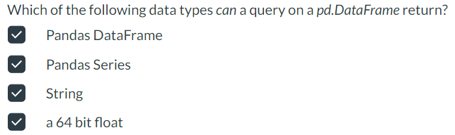
Other quiz questions – Question 3
Querying several columns and several rows from a dataframe will return a pd.DataFrame.
Querying 1 column and several rows from a dataframe will return a pd.Series.
Querying 1 column and 1 row from a dataframe will return the content of 1 cell, which could be a string (e.g. ‘Avatar’).
Querying 1 column and 1 row from a dataframe will return the content of 1 cell, which could be a float (e.g. ‘2.0’).

Slide 18
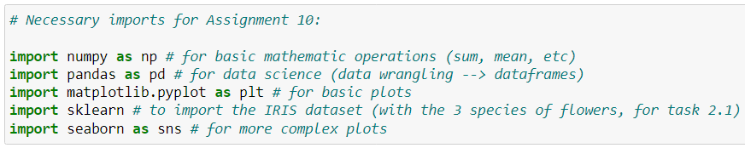
3. Introduction to Assignment 10: Data Visualization

Slide 19
3.1 Data Visualization in Python
Data Visualization
Visualizing data is essential to help those studying the data and those to whom it’s presented to better understand what the data say.
In Python third-party libraries are used in order to present data visually.
Matplotlib is the most widely-used data visualization library. It is used for basic plotting, is highly customizable and works with NumPy as well as pandas.
Seaborn is a high-level visualization library which is more widely used for statistical data visualization. It uses fewer syntax due to its more complex default themes. Making it easy to use but very powerful at the same time. Seaborn is built on top of Matplotlib.
In summary: Matplotlib is a general-purpose plotting library with extensive customization options, while Seaborn is a specialized library for statistical data visualization with a more concise and focused API. Seaborn can be seen as an extension or enhancement of Matplotlib, providing higher-level functions and stylistic enhancements for creating attractive statistical plots.

Slide 20
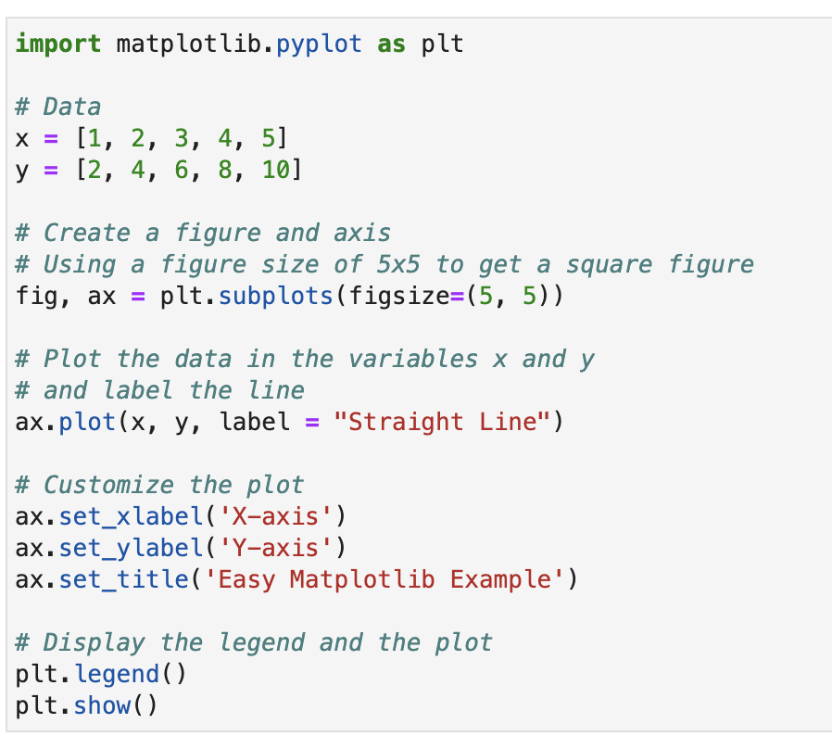
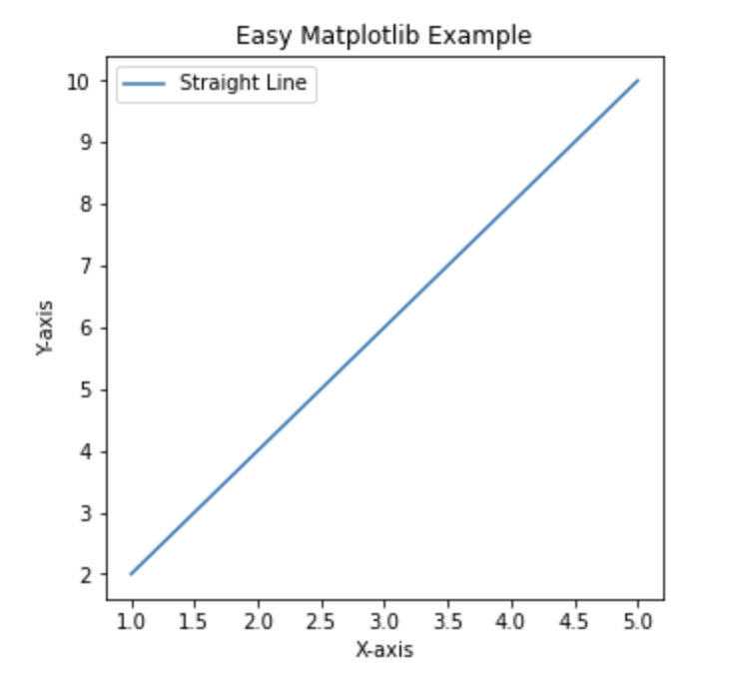
3.2 Easy Example: Matplotlib
Data Visualization

Slide 21
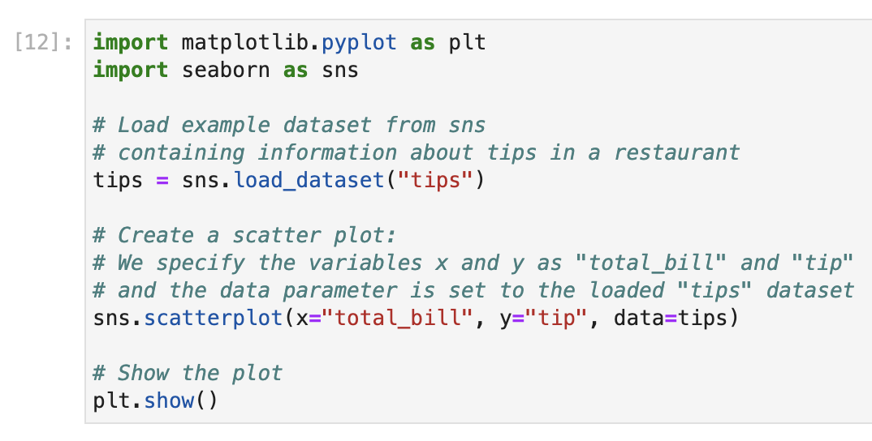
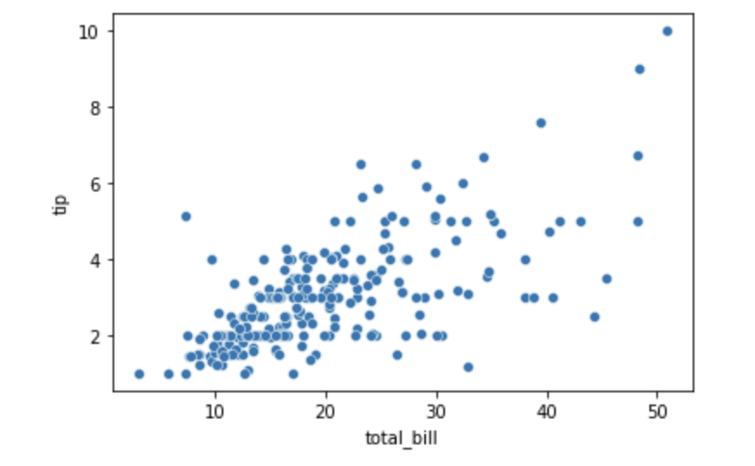
3.3 Easy Example: Seaborn
Data Visualization

Slide 22

3.4 Insights on Assignments 10: Matplotlib
Data Visualization
Color and label your lines in the .plot() function:
Create a bar plot with the .bar() function and set a specific width for each bar:
Create multiple plots in one figure with the plt.subplots() function with shared x and y axis:
Check out the Matplotlib documentation for more: https://matplotlib.org/stable/api/matplotlib_configuration_api.html

Slide 23

3.5 Insights on Assignments 10: Seaborn
Data Visualization
Create boxplots with sns.boxplot():
Create a regression plot with sns.regplot() with a cubic regression setting the parameter order = 3:
Check out the Seaborn documentation for more: https://seaborn.pydata.org/api.html

Slide 24
<Your Name>
lirst.last@<student.>unisg.ch

