Slide 1
Grundlagen und Methoden der Informatik
Exercise week 12
< Fname Lname >
< Exercise Group >

Slide 2
Today’s Menu
Discussion of Quiz 11 & Assignment 11
Lecture Content
Exam Preparation

Slide 3
1. Discussion of Quiz 11 & Assignment 11

Slide 4
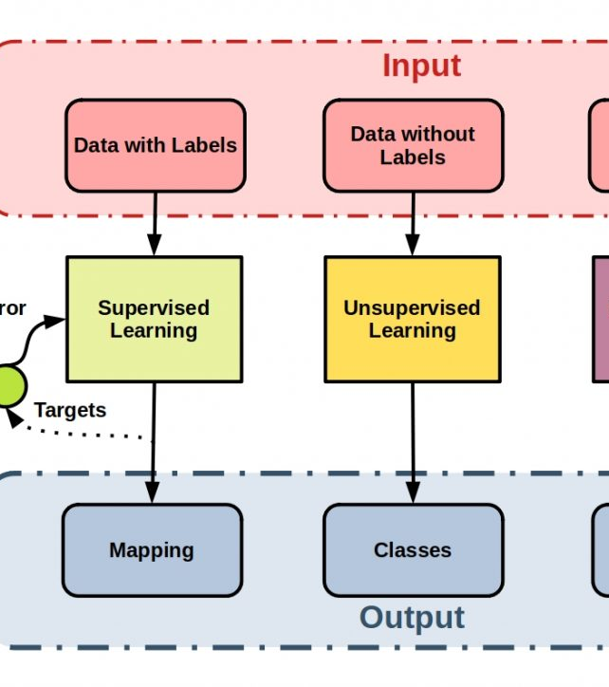

Supervised vs. Unsupervised learning
Assignment and Quiz
Basic steps to create a traditional machine learning model:
Explore the data – Visualize it!
Split the data – Get a training and a testing dataset!
Create and train the model – Get a model and fit it!
Test the model – Do some predictions!
Evaluate the model – Calculate some metrics!
Is the model good? Yes – Keep it and enjoy! No – Redo the previous steps!
Notes:
There is no such statement as unsupervised learning being better than supervised learning!
Which method to use depends on the problem to solve, on the dataset (especially on whether labels are available or not), as shown in the picture.

Slide 5
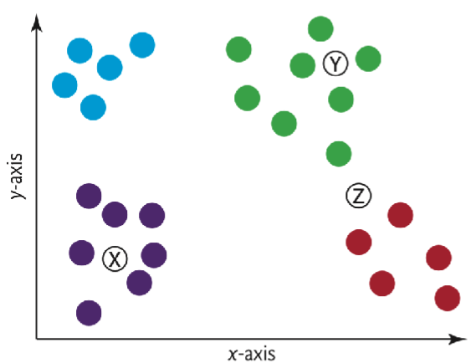
Supervised learning - kNN
Assignment and Quiz
K-Nearest Neighbors (kNN) – A supervised machine learning model
Find the k nearest neighbors of a data point (through Euclidean distance)
Decide what class the data point belongs to (from the neighbors, keep the predominant class)
Repeat for all data points
What color will the points X and Y be assigned?
k = 1
k = 3
X
X
Y
Y

Slide 6
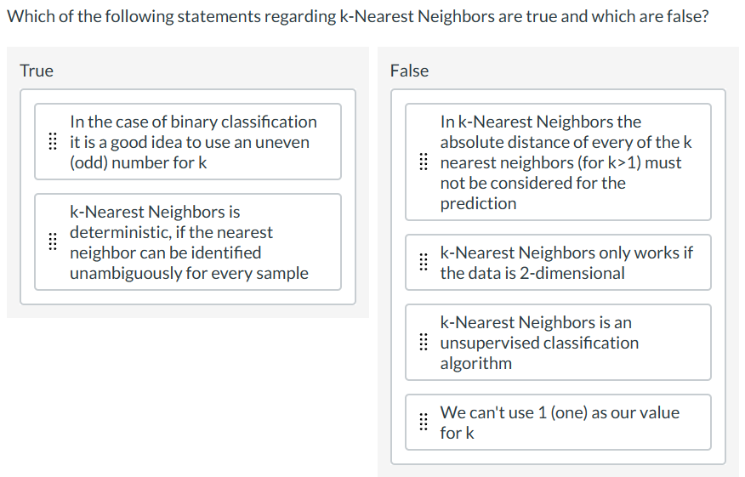
Supervised learning - kNN
Assignment and Quiz

Slide 7
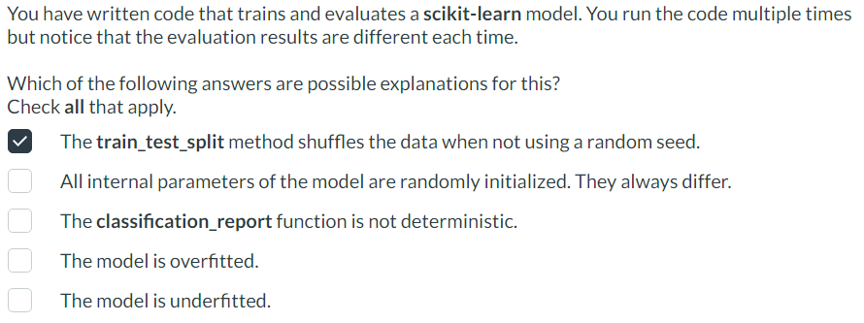
Training and Testing a model
Assignment and quiz
When one creates a model, one needs data to make the model (to train it), and then data that the model does not know yet to see how well the trained model perform with new data; i.e. calculate metrics.
The usual function for defining the training and testing datasets is train_test_split() (per default, 75% of data are for training the model, 25% for testing it).
Check the documentation!

Slide 8
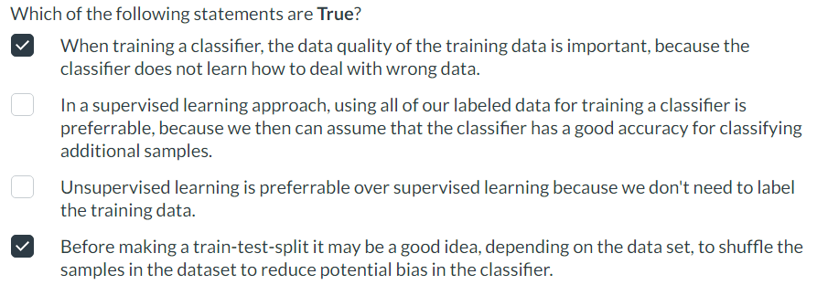
Training and Testing a model
Assignment and quiz
When one creates a model, one needs data to make the model (to train it), and then data that the model does not know yet to see how well the trained model perform with new data; i.e. calculate metrics.
The usual function for defining the training and testing datasets is train_test_split() (per default, 75% of data are for training the model, 25% for testing it).
Quiz explanations:
e.g. if the labels are wrong for some data, the model will learn incorrectly.
We need some data to test the model and see how good it is.
Depending on the problem, a method might be better.
Shuffled data is always better to use, because we are sure that no specific pattern exists in the data.

Slide 9
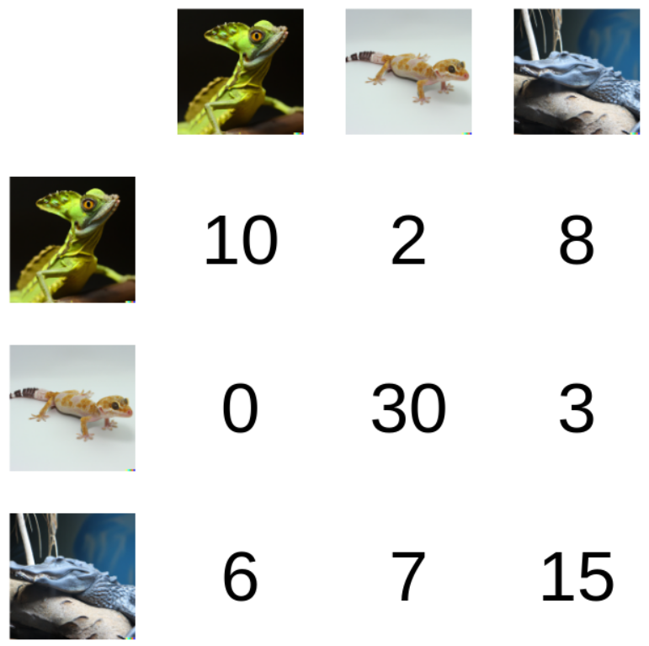
Metrics
Assignment and quiz
When the model is trained, it is tested – i.e. some values are predicted.
The predictions are compared with the actual sample values to derive some metrics of the model’s performance
Functions: accuracy_score, precision_recall_fscore_support, classification_report, … And confusion matrix!
We’re given the following confusion matrix, where the meaning of the rows and columns is the same as in the sklearn confusion matrix. → i.e. rows represent the actual classes, the columns the predictions!
For which of the 3 classes does the predictor work best?
“Green lizard predicted 16 times, but in reality was 10 times indeed green lizard” → Ratio 10/16, so predictions were correct around 62.5% of the time.
“Yellow lizard predicted 39 times, but in reality was 30 times indeed yellow lizard” → Ratio 30/39, so predictions were correct around 76.2% of the time.
“Blue lizard predicted 26 times, but in reality was 15 times indeed yellow lizard” → Ratio 15/26, so predictions were correct around 56.7% of the time.
→ Yellow lizard wins!

Slide 10
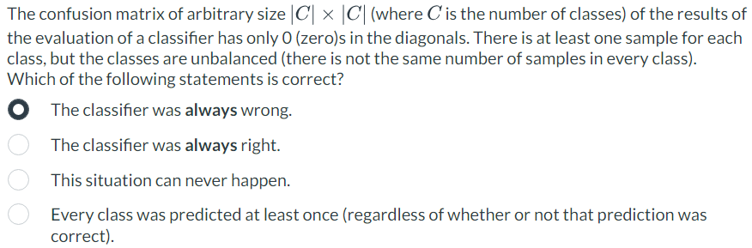
Metrics
Assignment and quiz
When the model is trained, it is tested – i.e. some values are predicted.
The predictions are compared with the actual sample values to derive some metrics of the model’s performance
Functions: accuracy_score, precision_recall_fscore_support, classification_report, … And confusion matrix!
0 | 4 | 4
0 | 0 | 6
0 | 7 | 0

Slide 11
Lecture Content

Slide 12
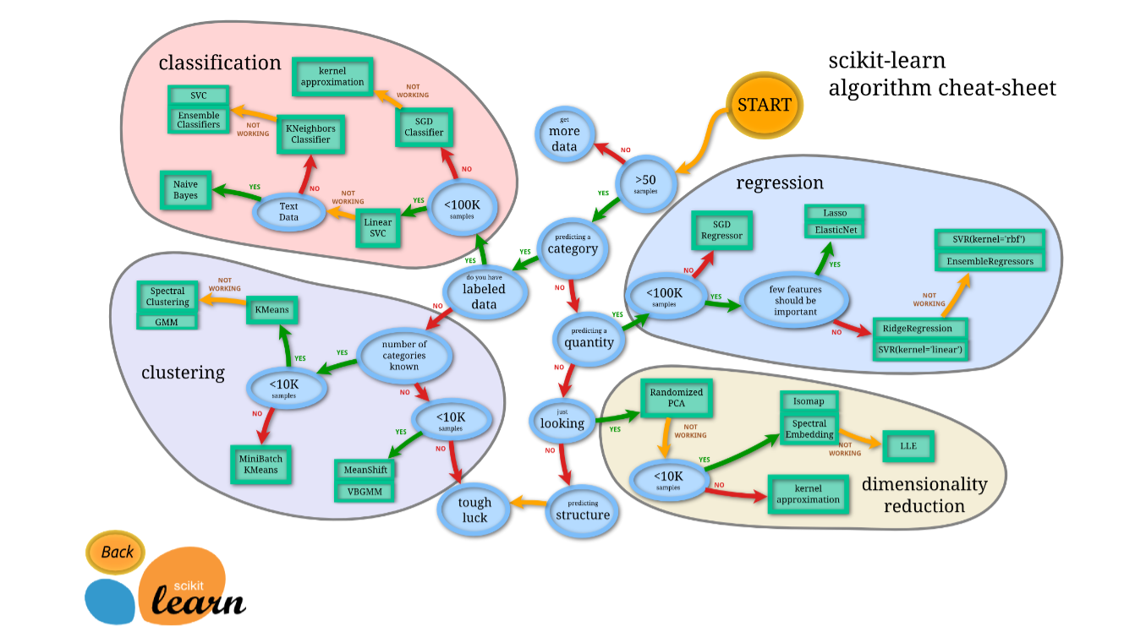
Which Algorithm should I use?

Slide 13
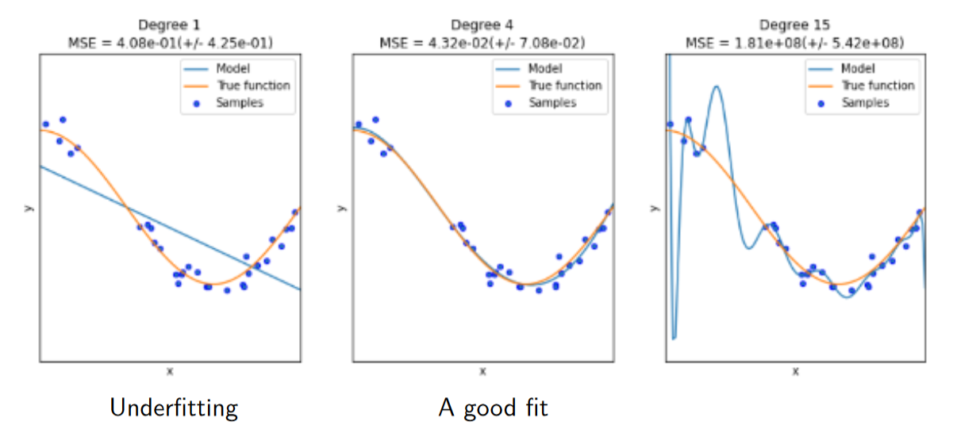
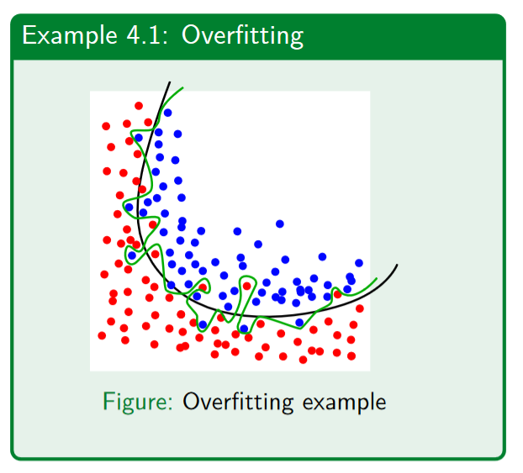
Overfitting / Underfitting
Goal: Our model should be able to generalise the learned rules onto new, unseen data.

Slide 14
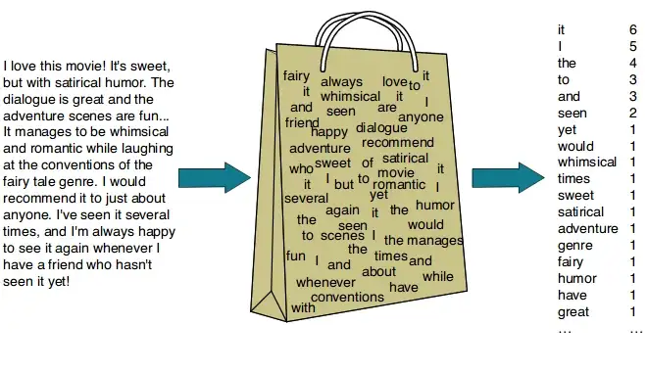
Classify text (bag of words)
https://dudeperf3ct.github.io/lstm/gru/nlp/2019/01/28/Force-of-LSTM-and-GRU/

Slide 15
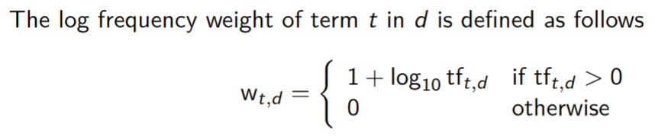
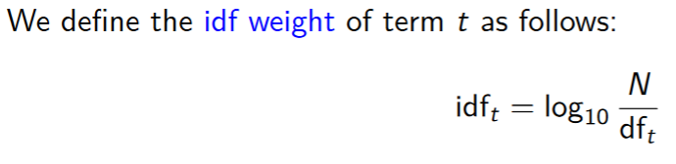
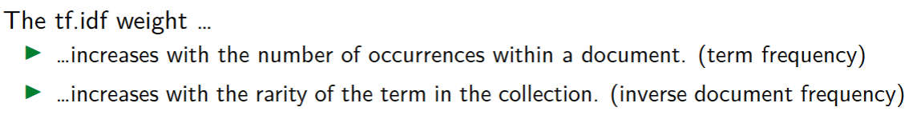
Classify text (tf.idf)
https://dudeperf3ct.github.io/lstm/gru/nlp/2019/01/28/Force-of-LSTM-and-GRU/
Term Frequency (TF) — (No. of repeated words) / (No. of documents)
Inverse Document Frequency (IDF) — log[ (No. of documents) / (No. of documents containing word)]
Calculate document vectors multiplying TF and IDF values. All of this can be achieved through TF-IDF vectorizer from sci-kit learn.

Slide 16
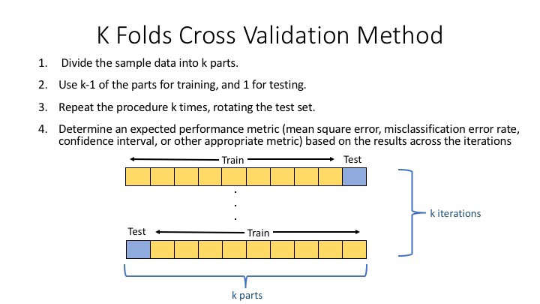
K-Fold split
https://deepnote.com/@djilax/4-Kfold-cross-validation-My-machine-learning-pipeline-2cb8b563-3b67-469e-8805-bb4d9341cf72

Slide 17
Exam Preparation

Slide 18



How to prepare for the exam…
Lecture Content
Review the content from the lectures: theory & coding
Assignments
Look at the assignments and try to solve them again
Quizzes
Look at the quizzes and try to solve them again
It is crucial to develop a genuine and comprehensive understanding. Rather than learning everything by hard, try to understand the concepts learned in class. This will make it a lot easier!
https://learning.unisg.ch/courses/18274/quizzes/28937 (HS22)
https://learning.unisg.ch/courses/18274/quizzes/28938 (FS23)
The practice exams serve as an indicator for the actual exam
Make sure to install the lockdown browser before the exam (you will also need it for the practice exam)

Slide 19
Good luck with the exam!

Slide 20
<Your Name>
<Function>
lirst.last@<student.>unisg.ch

