Slide 1
Fundamentals and Methods of Computer Science
Exercise week 11

Slide 2
Today’s Menu
Group project presentation
Discussion of the solutions of Assignment 10 & Quiz 10
Hints and relevant concepts for the tasks of Assignment 11

Slide 3
1. Group project presentation

Slide 4
Requirements
* Requirements relevant for evaluation/grading (mandatory)​
A problem that is solved by the application is clearly stated (e.g., business or consumer use case)​
The application uses some data that is loaded via some API and/or provided via some database​
The application visualizes some data that serves the use case​
The application allows for some user interaction, e.g., adding additional data, selecting certain data, running certain data analyses​
The source code is well documented by comments in the source code​
The contributions of each team member are documented (e.g., contribution matrix).​
The result is presented and demoed in a 5-minute video​
​
Extensions not relevant for evaluation but for the “beauty” of the result (optional)​
The application implements some machine learning​
The application is made publicly available to users, e.g., via the streamlit platform​
… anything you ever wanted to implement​

Slide 5
2. Discussion of Assignmnet 10 and Quiz 10

Slide 6
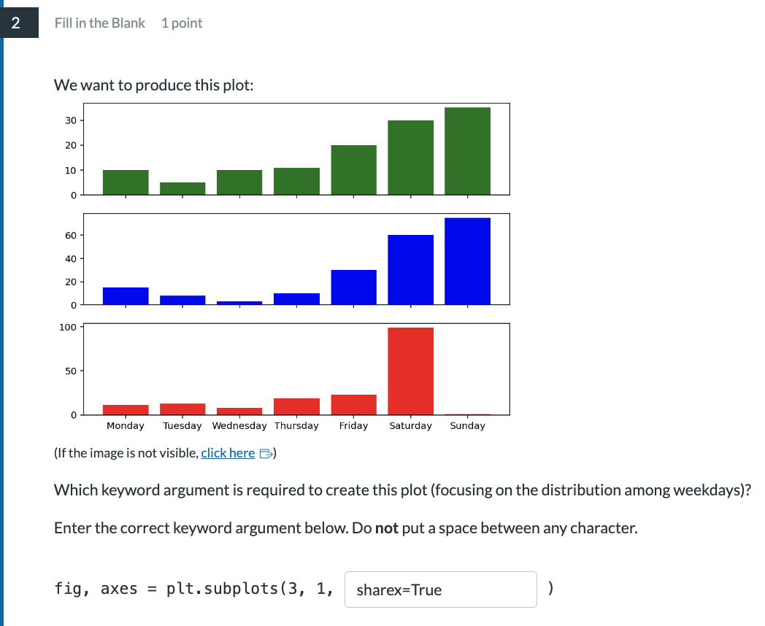
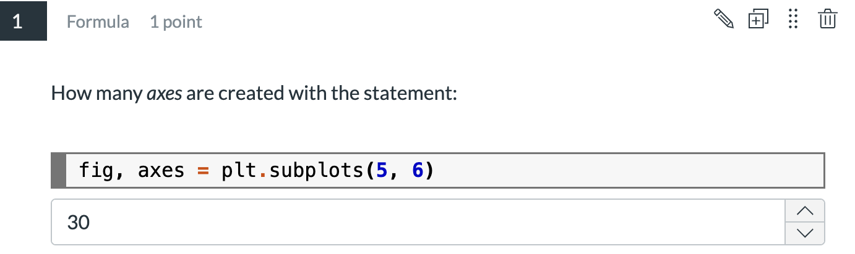
Q1 & Q2
2. Discussion of Quiz 10
See the documentation of plt.subplots()

Slide 7
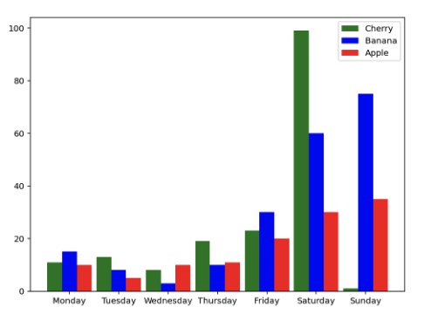
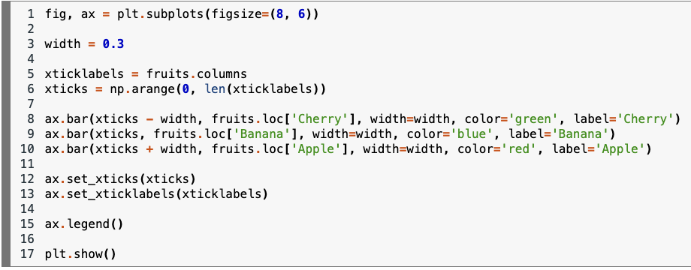
Q4
2. Discussion of Quiz 10
width
No overlap between the bars: width * 3 <= 1
1

Slide 8
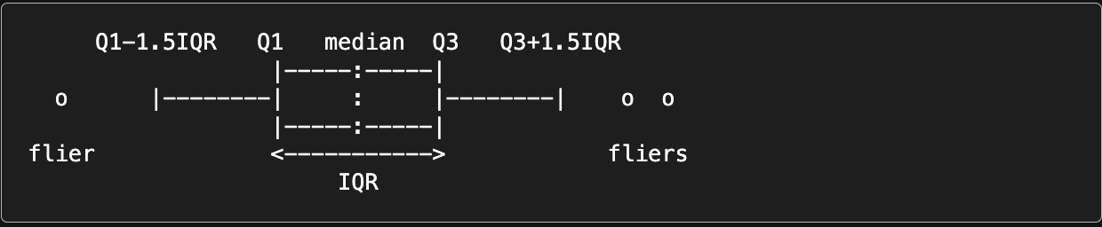
Q5
2. Discussion of Quiz 10
See the documentation of plt.boxplot()

Slide 9
3. Introduction to Assignment 11

Slide 10
What is Machine Learning?
Machine Learning
Computer programs (algorithms) that learn from (many) examples and can generalise from existing examples of a task.
High-level steps:
Program learns rules by understanding the training data.
Program applies rules to new, unseen data. This is called “generalise” and is what makes ML so powerful.
Many different steps like gathering and preprocessing data go into this – but in essence it is simply about “learning from data”.

Slide 11
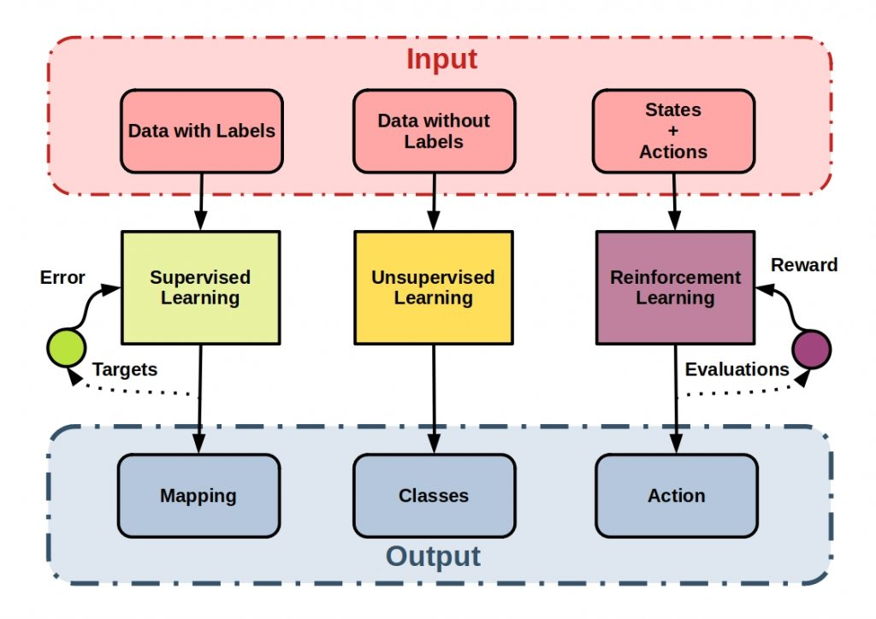
Machine Learning Types
https://starship-knowledge.com/wp-content/uploads/2021/01/unsupervised
_supervised_reinforcement-1024x724.jpeg
Machine Learning
Supervised Learning – Predictions:
classification for categorical values (discrete classes)
regression for continuous values
Self-Supervised Learning – GPT
Unsupervised Learning – Structuring:
clustering similar instances
outlier detection
Reinforcement Learning
Basic Machine Learning Workflow: Representation → Train → Evaluation → Optimisation (& repeat)

Slide 12
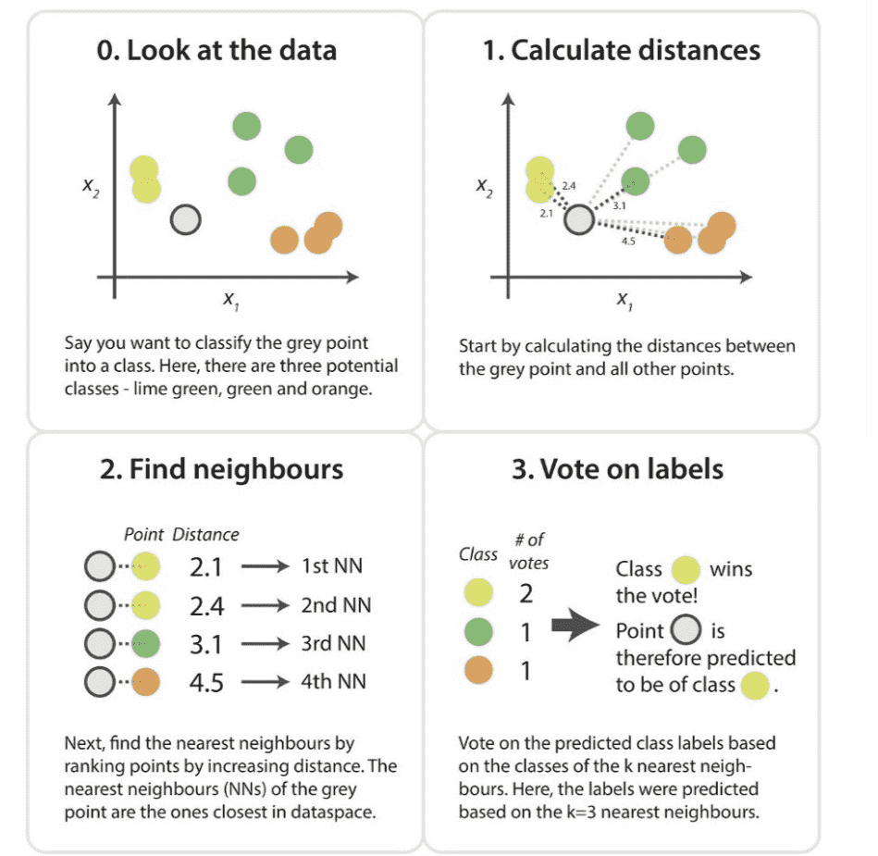
Supervised: k-Nearest Neighbour
Machine Learning
https://miro.medium.com/max/1400/0*34SajbTO2C5Lvigs.png, works in all dimensions, here in the picture shown for 2D
We need:
A distance metric (e.g. Euclidian)
How many nearest neighbours to look at (1 to n)
Optional weighting function on the neighbour points
Method for aggregating the classes of neighbour points (e.g. simple majority)
What can we predict?
binary: two classes (then use an odd k)
multiclass: three or more classes
multilabel: each item can have one or more classes*
*same idea but different implementation
Choose k so that bias and variance are balanced.

Slide 13
Machine Learning with scikit-learn (kNN example)
Machine Learning in Practice
See Machine Learning Notebook
in the main course room
# To do before you can train your model
“preprocess (clean your data, remove NaN, normalize, …)”
“define X & y (usually lists, series or dataframes containing the values for attributes [X] & labels [y])”
# To split the data in a training and a testing set
from sklearn.model_selection import train_test_split
# Shuffle and split data. Optional params: train_size or test_size (default 75%-25%); random_state (reproducibility)
X_train, X_test, y_train, y_test = train_test_split(X, y)
# Select and fit (train) the model to use if for predictions
from sklearn.neighbors import KNeighborsClassifier
clf = KNeighborsClassifier(n_neighbors = 5)
clf.fit(X_train, y_train)
y_pred = clf.predict(X_test)
Note, that only these things change, everything else stays the same for all sklearn algorithms!

Slide 14
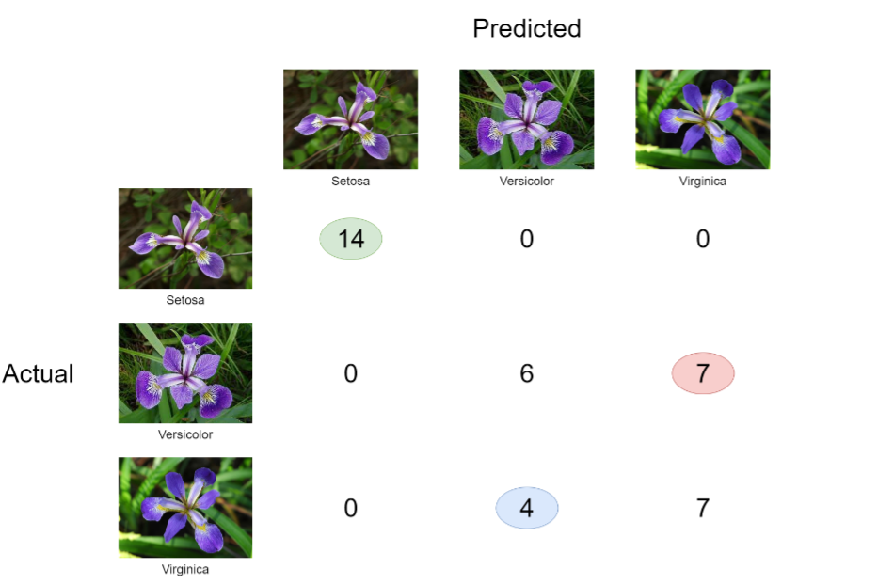
Evaluate results: Confusion Matrix

Slide 15
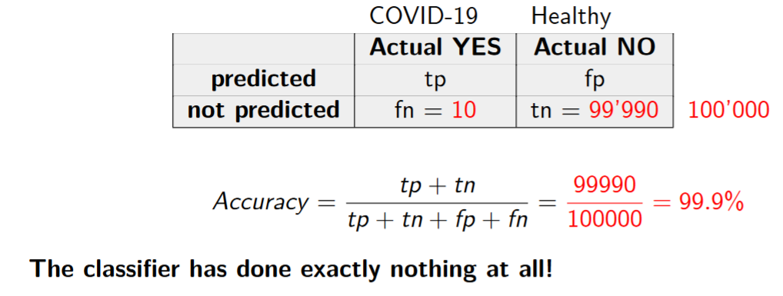
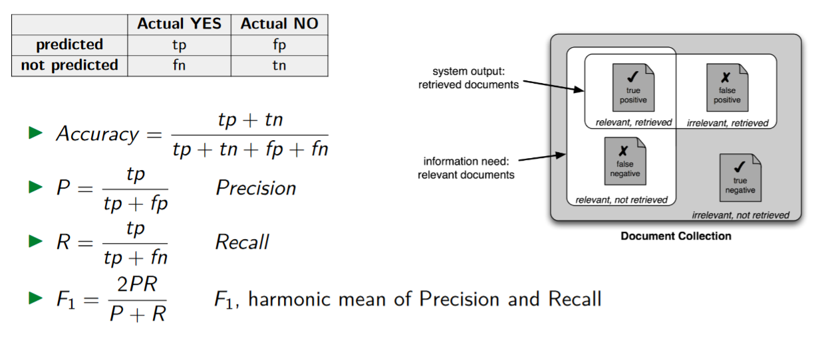
Evaluate results: Performance Metrics
Ratio: How many data points were correctly classified?
Ratio: How many of the data points assigned to a class actually belong to the class?
Ratio: How many of the data points belonging to a class were assigned that class.

Slide 16
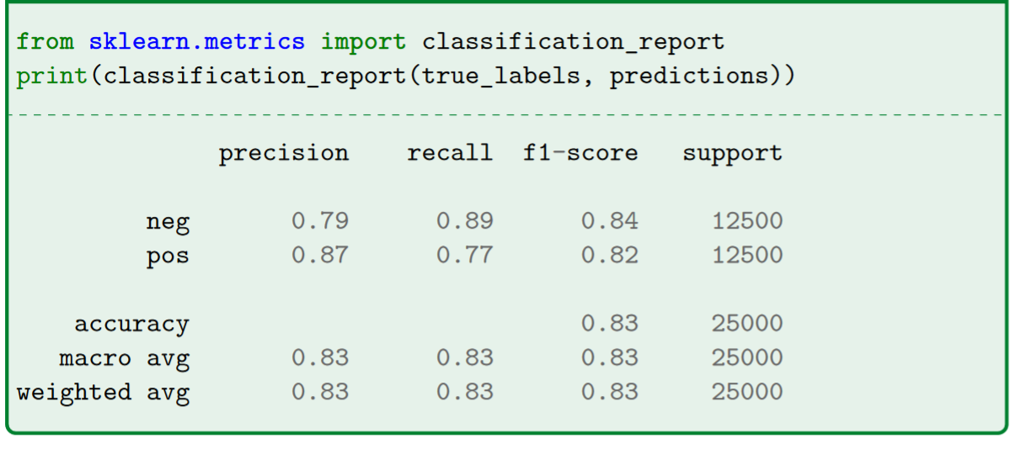
Performance Metrics in Python: Classification Report
The column support tells you how many data points are relevant for this line

Slide 17
<Your Name>
<Function>
lirst.last@<student.>unisg.ch

