Slide 1
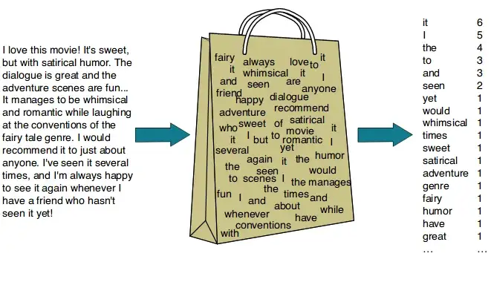
Classify text (bag of words)
https://dudeperf3ct.github.io/lstm/gru/nlp/2019/01/28/Force-of-LSTM-and-GRU/

Slide 2
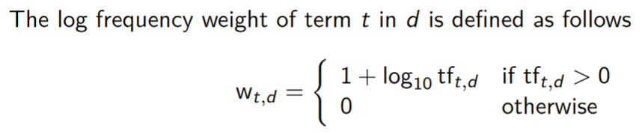
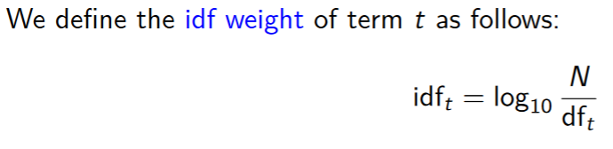
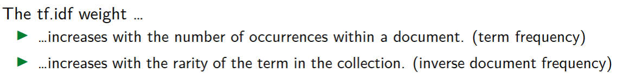
Classify text (tf.idf)
https://dudeperf3ct.github.io/lstm/gru/nlp/2019/01/28/Force-of-LSTM-and-GRU/
Term Frequency (TF) — (No. of repeated words) / (No. of documents)
Inverse Document Frequency (IDF) — log[ (No. of documents) / (No. of documents containing word)]
Calculate document vectors multiplying TF and IDF values. All of this can be achieved through TF-IDF vectorizer from sci-kit learn.

Slide 3
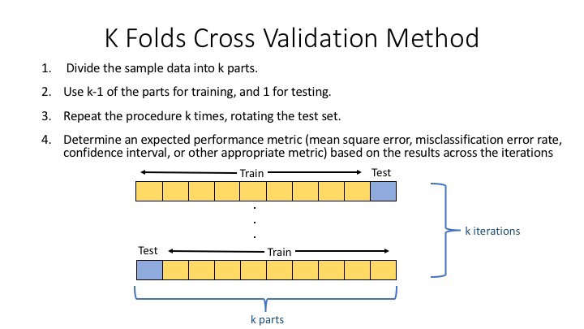
k-Fold split (avoid overfitting)
https://deepnote.com/@djilax/4-Kfold-cross-validation-My-machine-learning-pipeline-2cb8b563-3b67-469e-8805-bb4d9341cf72

