Slide 1
Grundlagen und Methoden der Informatik
Exercise week 12
< Fname Lname >
< Exercise Group >

Slide 2
Today’s Menu
Discussion of Quiz 11 & Assignment 11
Summary of the previous week’s Lecture content
Clarification of open questions

Slide 3
1. Discussion of Quiz 11 & Assignment 11

Slide 4
Full explanations on Google Colab
1. Discussion of Quiz 11
See the linked Google Colab for the full explanations for each question in Quiz 11

Slide 5
2. Lecture Content

Slide 6
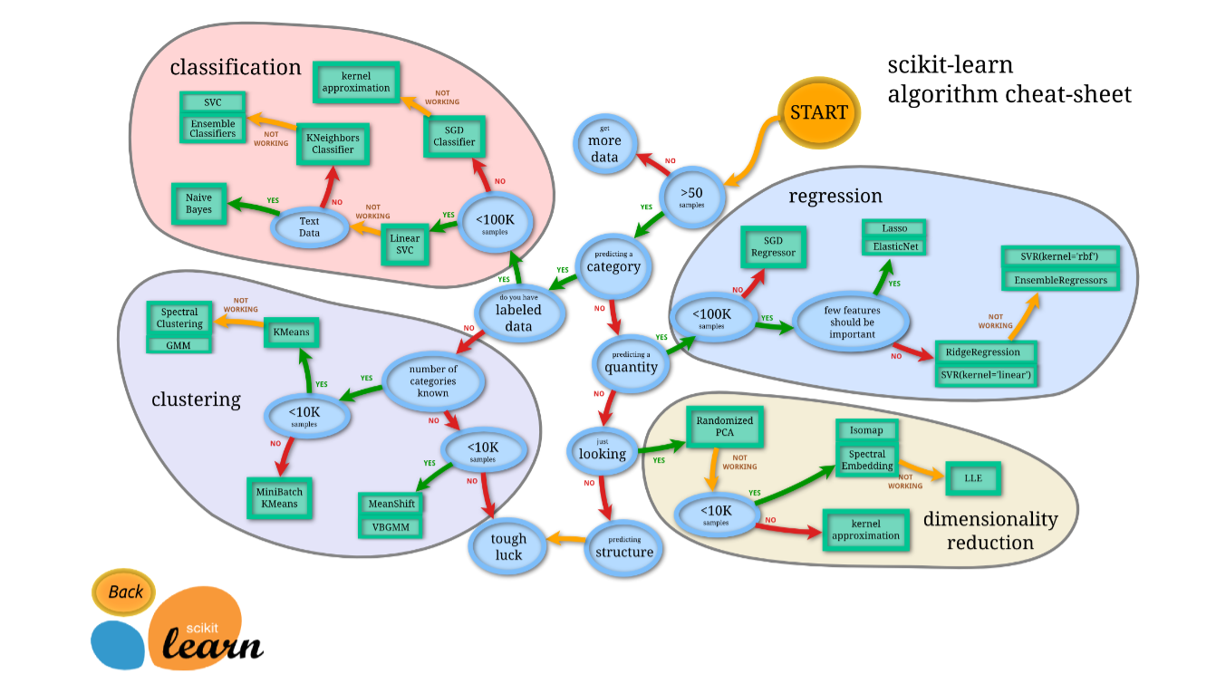
Which Algorithm should I use?
2. Lecture Content

Slide 7
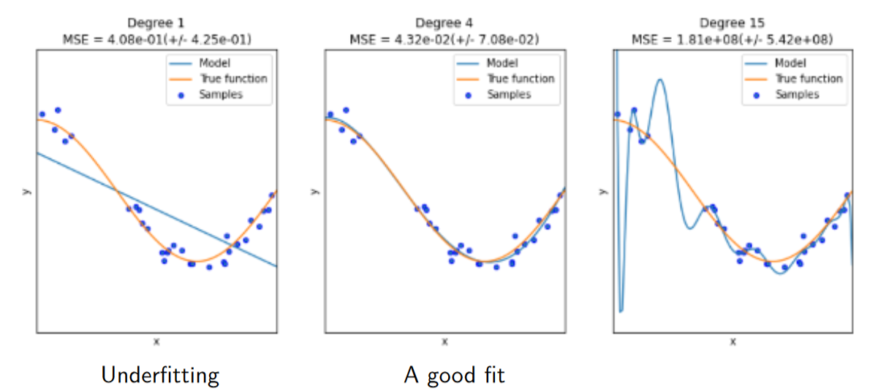
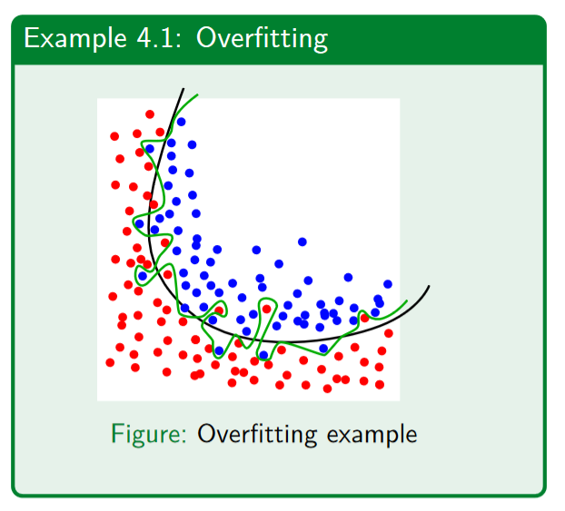
Overfitting / Underfitting
2. Lecture Content
Goal: Our model should be able to generalise the learned rules onto new, unseen data.

Slide 8
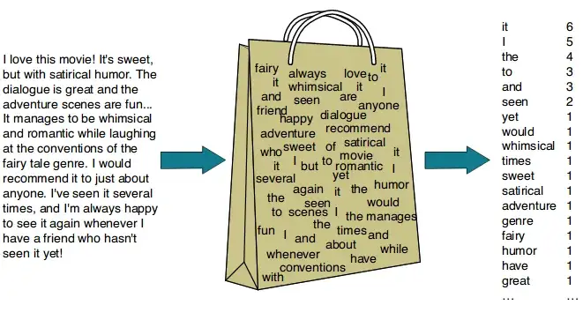
Classify text (bag of words)
https://dudeperf3ct.github.io/lstm/gru/nlp/2019/01/28/Force-of-LSTM-and-GRU/
2. Lecture Content

Slide 9
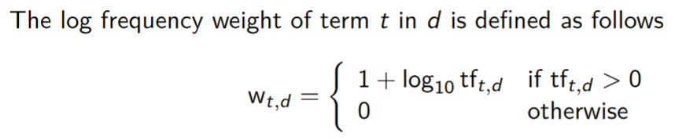
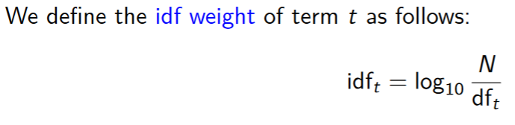
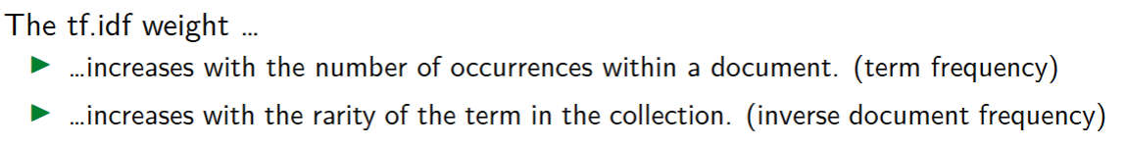
Classify text (tf.idf)
https://dudeperf3ct.github.io/lstm/gru/nlp/2019/01/28/Force-of-LSTM-and-GRU/
2. Lecture Content
Term Frequency (TF) — (No. of repeated words) / (No. of documents)
Inverse Document Frequency (IDF) — log[ (No. of documents) / (No. of documents containing word)]
Calculate document vectors multiplying TF and IDF values. All of this can be achieved through TF-IDF vectorizer from sci-kit learn.

Slide 10
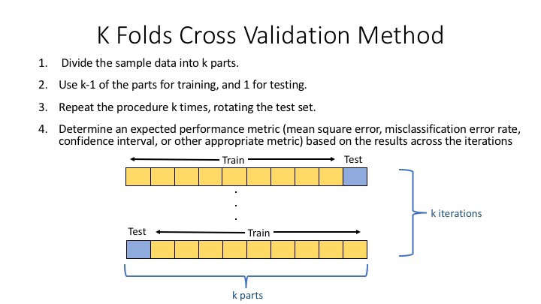
K-Fold split
https://deepnote.com/@djilax/4-Kfold-cross-validation-My-machine-learning-pipeline-2cb8b563-3b67-469e-8805-bb4d9341cf72
2. Lecture Content

Slide 11
3. Questions?

Slide 12



How to prepare for the exam…
Lecture Content
Review the content from the lectures: theory & coding
Assignments
Look at the assignments and try to solve them again
Quizzes
Look at the quizzes and try to solve them again
It is crucial to develop a genuine and comprehensive understanding. Rather than learning everything by hard, try to understand the concepts learned in class. This will make it a lot easier!
The practice exam serves as an indicator for the actual exam
Make sure to install the lockdown browser before the exam (you will also need it for the practice exam)

Slide 13
Good luck with the exam!

Slide 14
<Your Name>
<Function>
lirst.last@<student.>unisg.ch

