Slide 1
Lecture 11/12

Slide 2
What is Machine Learning?
Computer programs (algorithms) that learn from (many) examples and can generalise from existing examples of a task:
Program learns rules by understanding the training data.
Program applies rules to new, unseen data. This is called “generalise” and is what makes ML so powerful.
Many different steps like gathering and preprocessing data go into this – but in essence it is simply about “learning from data”.

Slide 3
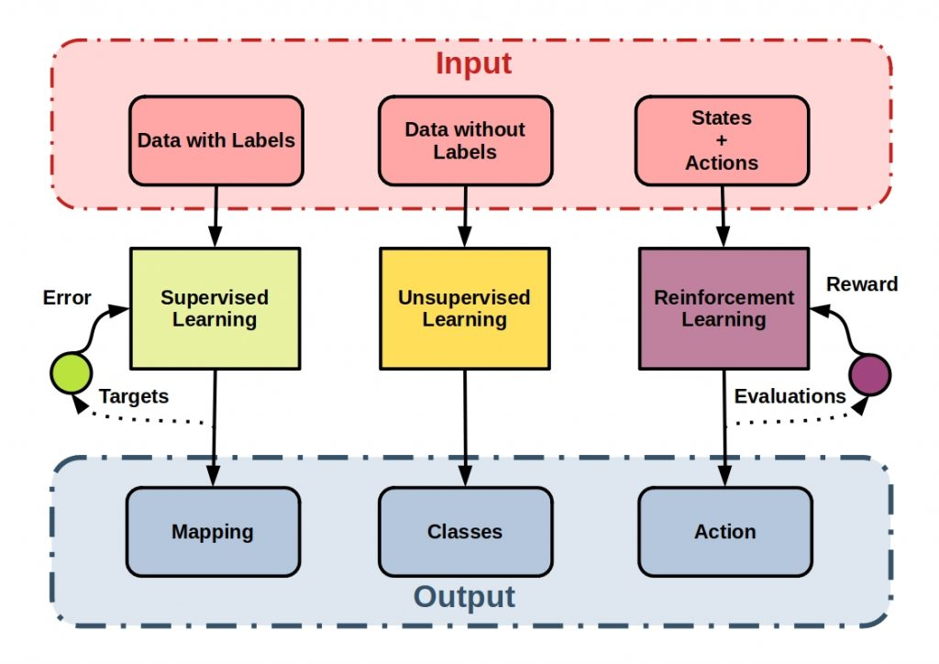
Machine Learning Types
https://starship-knowledge.com/wp-content/uploads/2021/01/unsupervised
_supervised_reinforcement-1024x724.jpeg
Supervised Learning: Predictions (classification for discrete classes, regression for continuous values)
Unsupervised Learning: Structuring (clustering similar instances, outlier detection)
Reinforcement Learning
Representation → Training → Evaluation → Optimisation (& repeat)

Slide 4
Machine Learning in Python: scikit-learn
Other libraries include: SciPy, NumPy, Pandas, matplotlib, …
# preprocess (clean your data, remove NaN, normalize, …)
# define X & y (usually lists, series or dataframes containing the values for attributes & labels)
from sklearn.model_selection import train_test_split # shuffles & splits our data
X_train, X_test, y_train, y_test = train_test_split(X, y) #use train_size or test_size if not 75%-25%
# use random_state to make reproducible
# select and fit your model, use it for predictions, and evaluate it

Slide 5
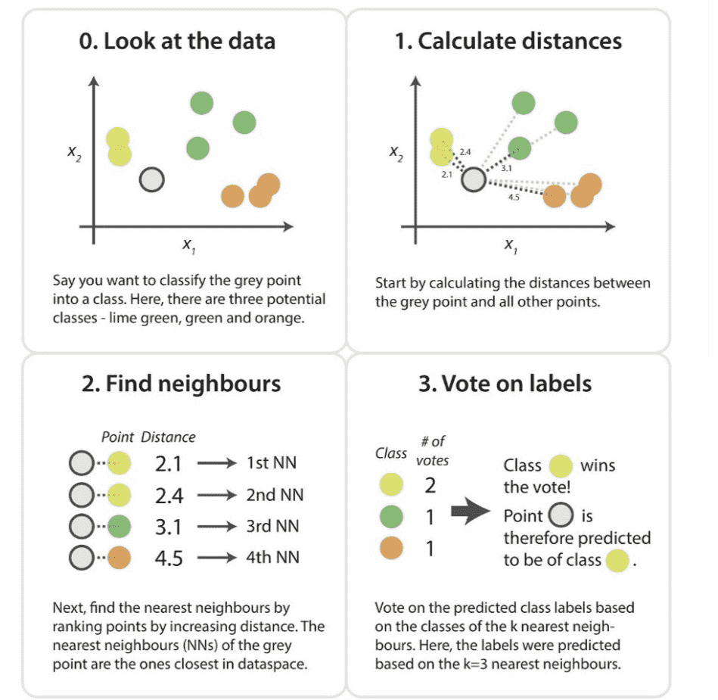
Supervised: k-Nearest Neighbour
Nearest neighbour averaging can be pretty good for small p (# of predictors/features), i.e. p ≤4 and large-ish N (# of observations)
https://miro.medium.com/max/1400/0*34SajbTO2C5Lvigs.png, works in all dimensions, here in the picture shown for 2D
We need:
A distance metric (e.g. Euclidian)
How many nearest neighbours to look at (your job to find out, 1-n possible)
Optional weighting function on the neighbour points
Method for aggregating the classes of neighbour points (e.g. simple majority)
I binary: Two classes (then use an odd k) I multiclass: Three or more classes I multilabel: Each item can have one or more classes.

Slide 6
k-NN in Python: scikit-learn
# preprocess (clean your data, remove NaN, normalize, …)
# define X & y (usually lists, series or dataframes containing the values for attributes & labels)
from sklearn.model_selection import train_test_split # shuffles & splits our data
X_train, X_test, y_train, y_test = train_test_split(X, y) #use train_size or test_size if not 75%-25%
#use random_state to make reproducible
from sklearn.neighbors import KNeighborsClassifier # import model
knn = KNeighborsClassifier(n_neighbors = 5) # select model
knn.fit(X_train, y_train) # fit model (train the model)
knn.predict([[20, 4.3, 5.5]]) # OR knn.predict(X_test) # predict (use the model)
knn.score(X_test, y_test)

Slide 7
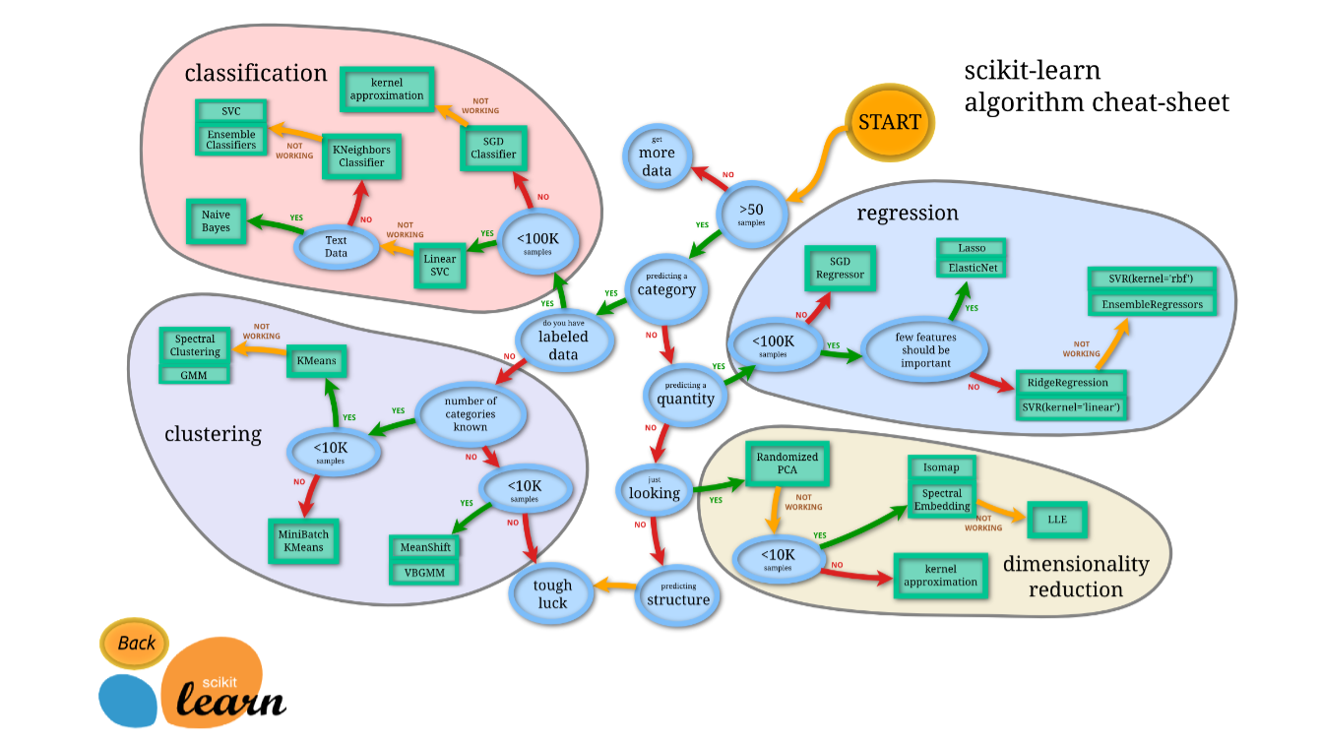
Which Algorithm should I use?

Slide 8
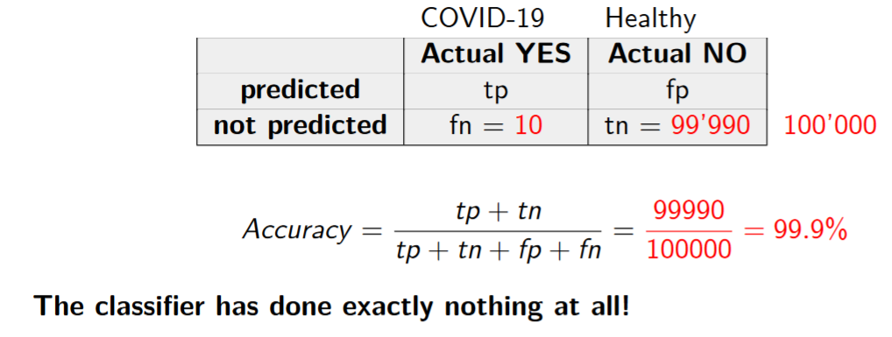
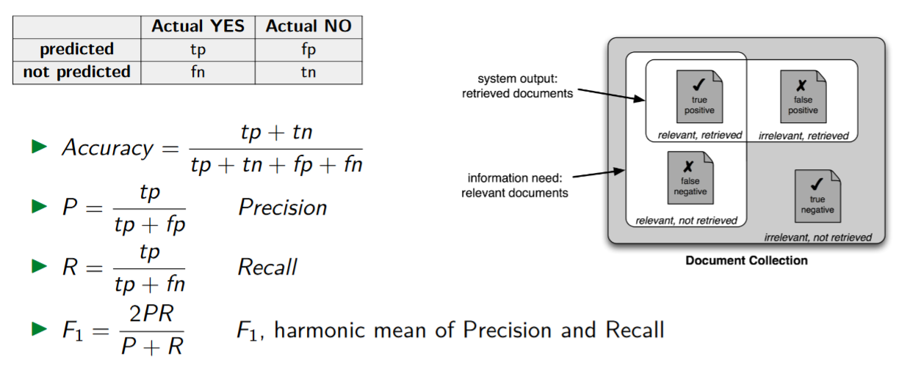
How to evaluate our results
Depending on the task you might focus on only one metric.
Generally we consider P & R → F1 might be a good idea.
Good within the ones we find, don’t care about FN.
Find as many as possible, don’t care about FP.
The Accuracy tells you the ratio of how many data points were correctly classified.
The Precision tells you the ratio of how many of the data points that were assigned a class actually belong to the class.
The Recall tells you the ratio of how many of the data points that belong to a class were assigned that class.

Slide 9
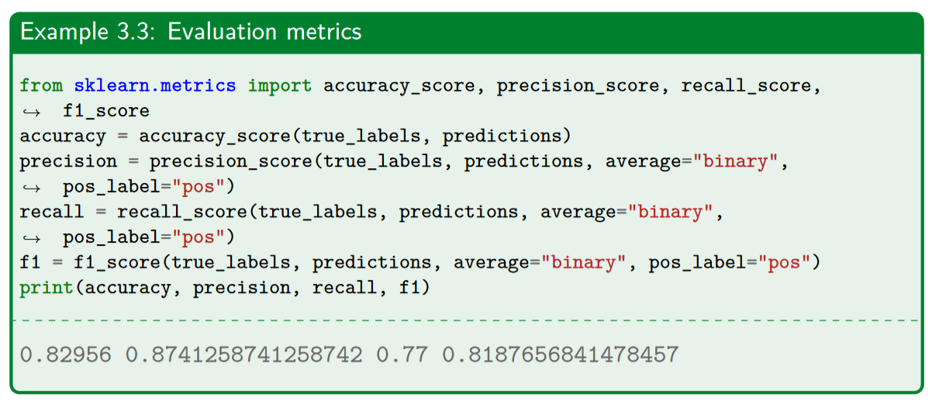
How to evaluate our results: in Python
Alternatively we can use the classification report (2 slides below).

Slide 10
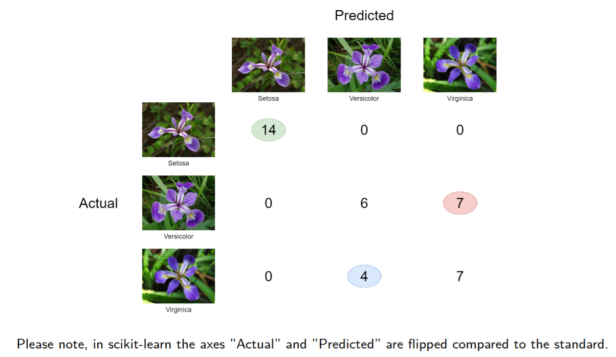
How to evaluate our results: Confusion Matrix

Slide 11
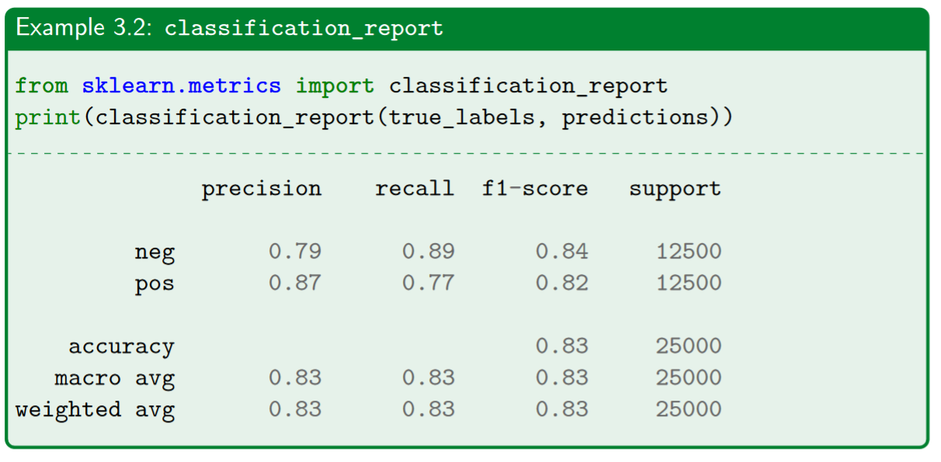
How to evaluate our results: Classification Report
The column support tells you how many data points are relevant for this line

Slide 12
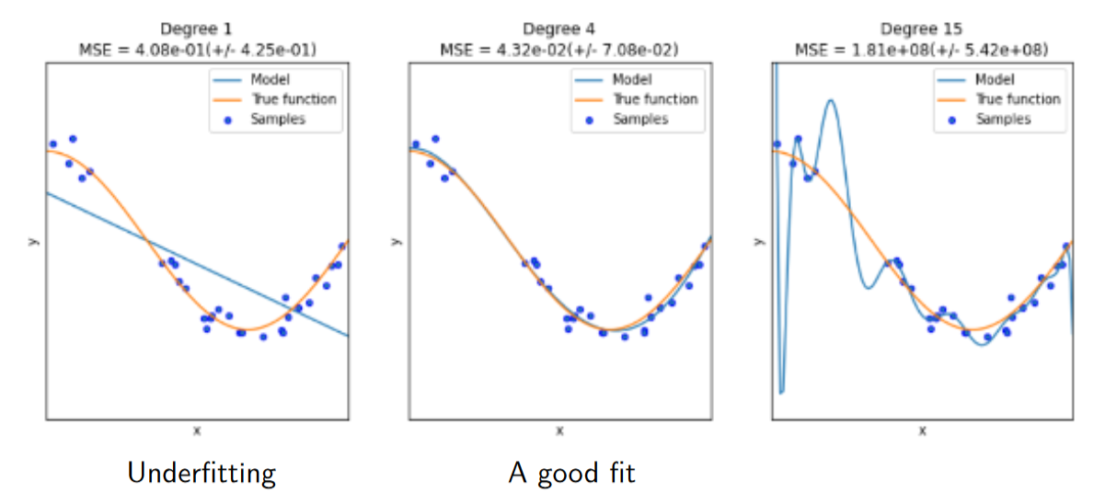
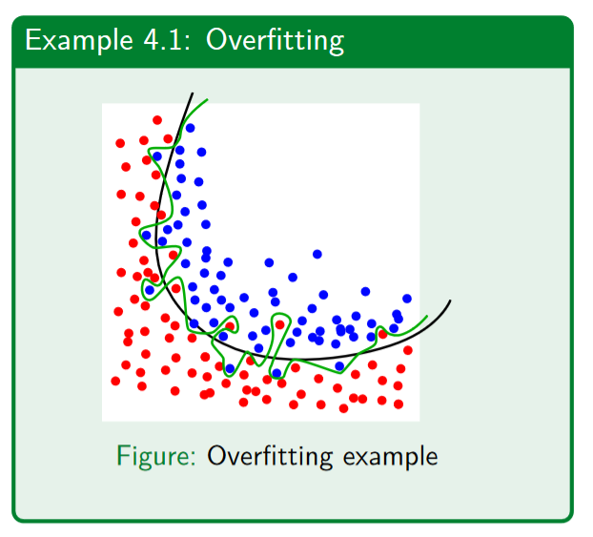
Overfitting / Underfitting
Goal: Our model should be able to generalise the learned rules onto new, unseen data.

Slide 13
Classify text (bag of words, tdf.idf)
Tbd

Slide 14
k-Fold split
Tbd

