Slide 1
Lecture 2

Slide 2

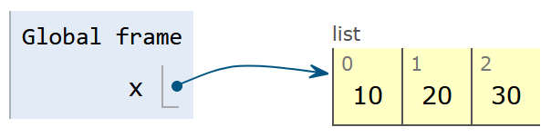

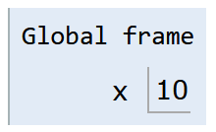

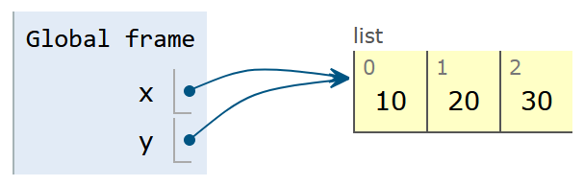

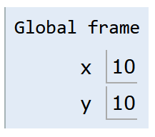


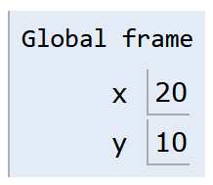
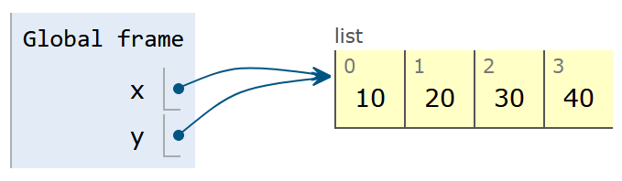
Pass by …
Reference
Value
All single values (numbers, text, boolean) follow this behaviour.
Collections usually follow this behaviour. Most important here are lists.

Slide 3

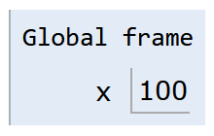
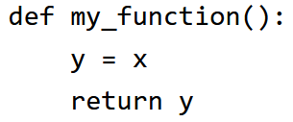
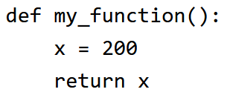
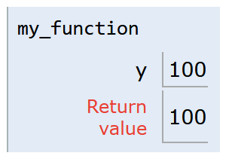
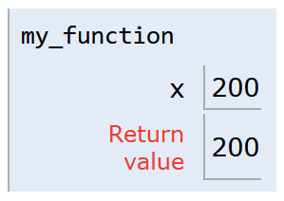
Scope / Namespace
Note: Not everything that is indented (e.g. if/else or loops) creates its own local scope.
For now it is sufficient to understand that each function creates its own local scope which is destroyed after executing the function.
This is the global scope.
Variables defined here can be accessed from everyhwere.
Variables defined in a lower scope (local) can not be accessed from here.
This is the local scope.
Variables defined here can only be accessed from within.
Variables defined in a higher scope (global) can also be accessed (but not changed) from here.

Slide 4
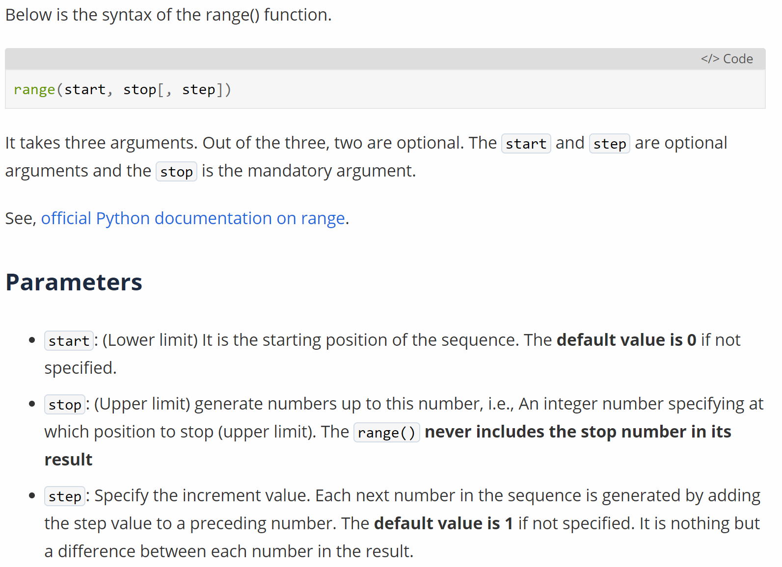
Read Documentation (1)

Slide 5

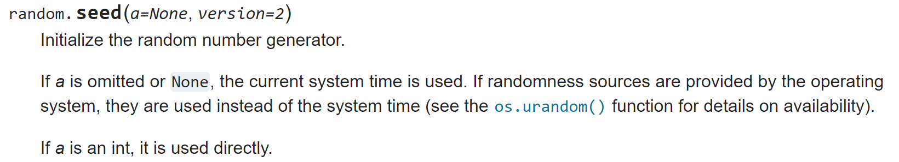
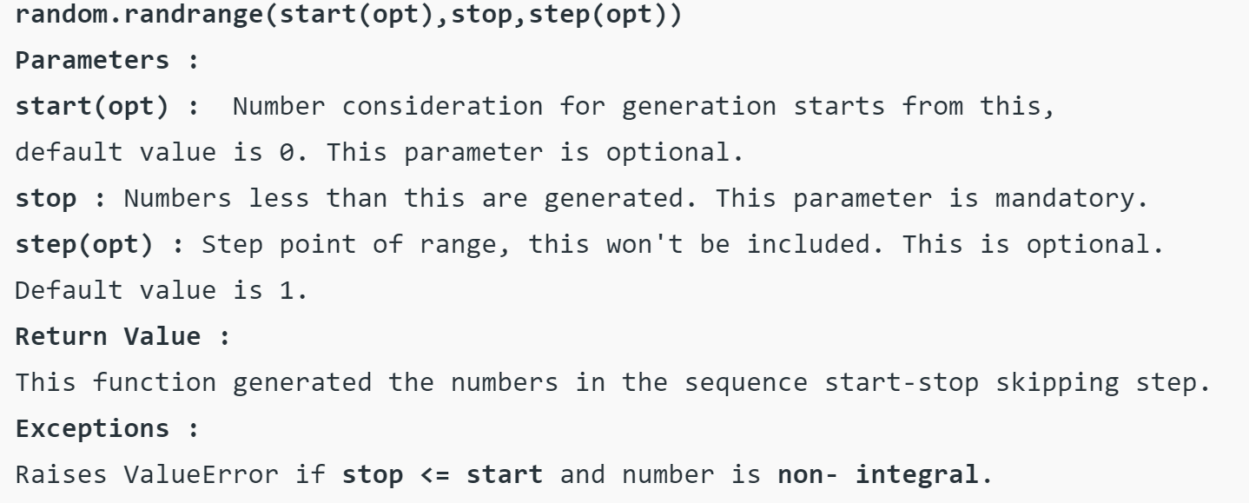
Read Documentation (2)

Slide 6
Introduction to Python (to read up)
1.5
1.8
2

