Slide 1
Lecture 7

Slide 2
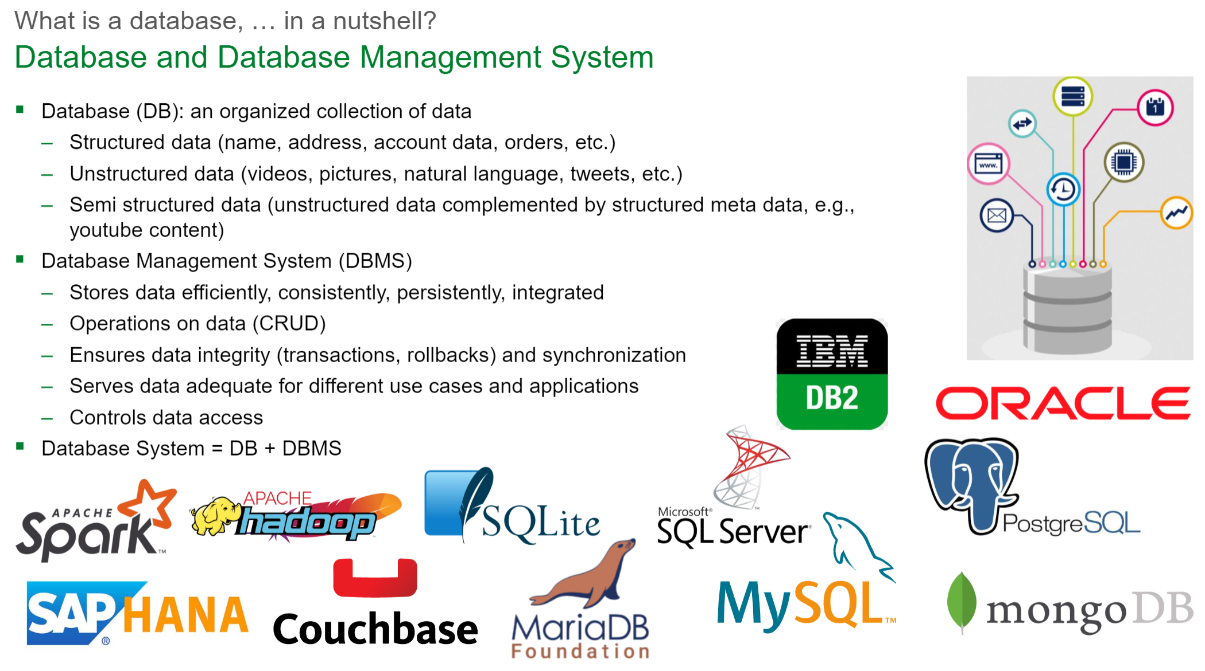

Slide 3
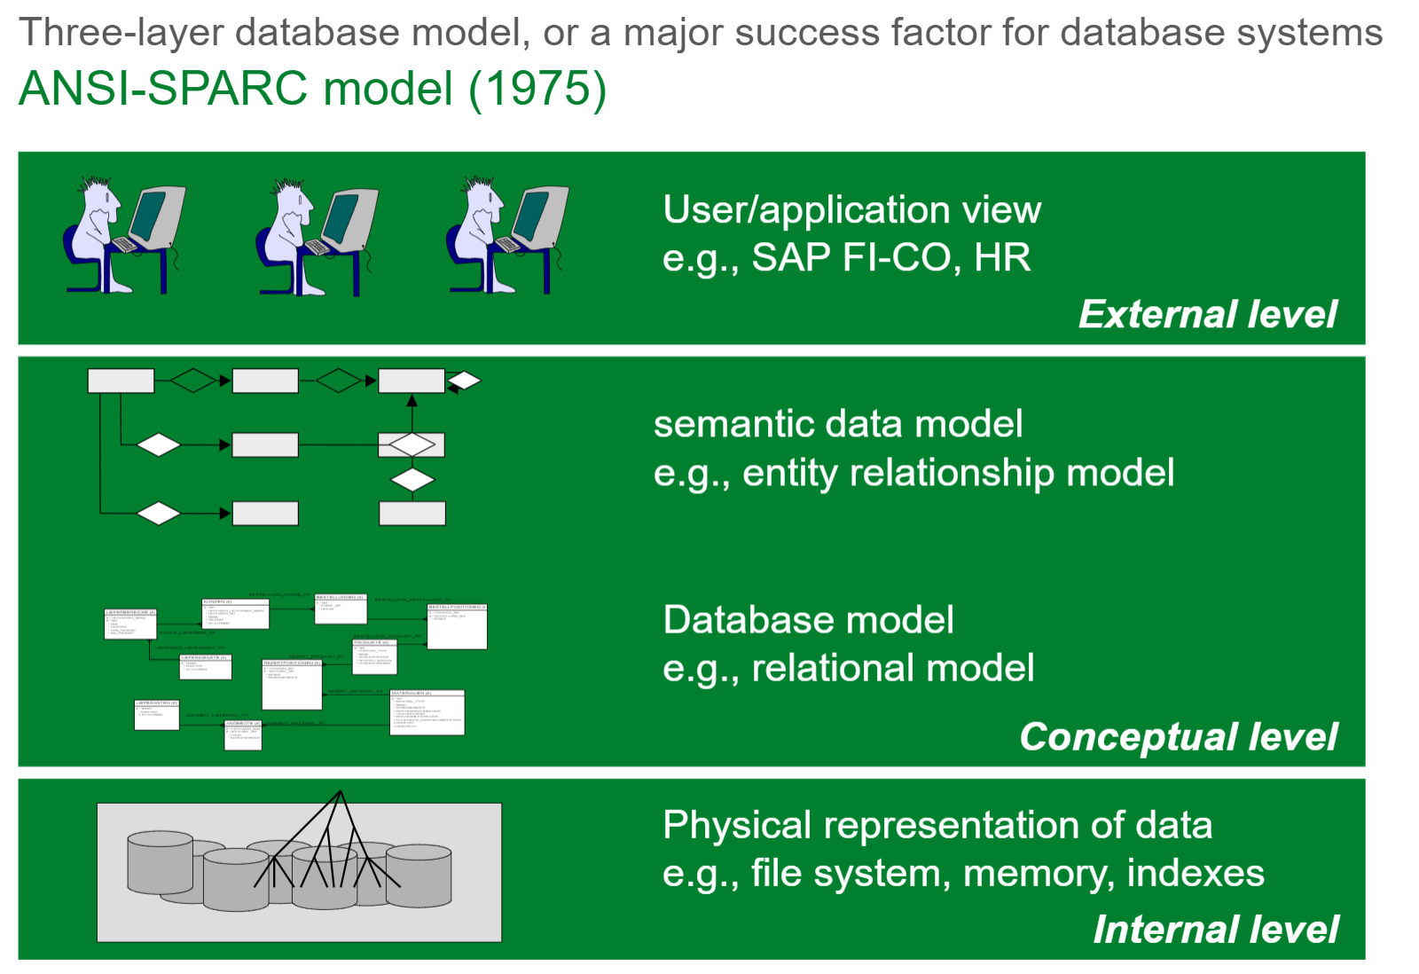

Slide 4
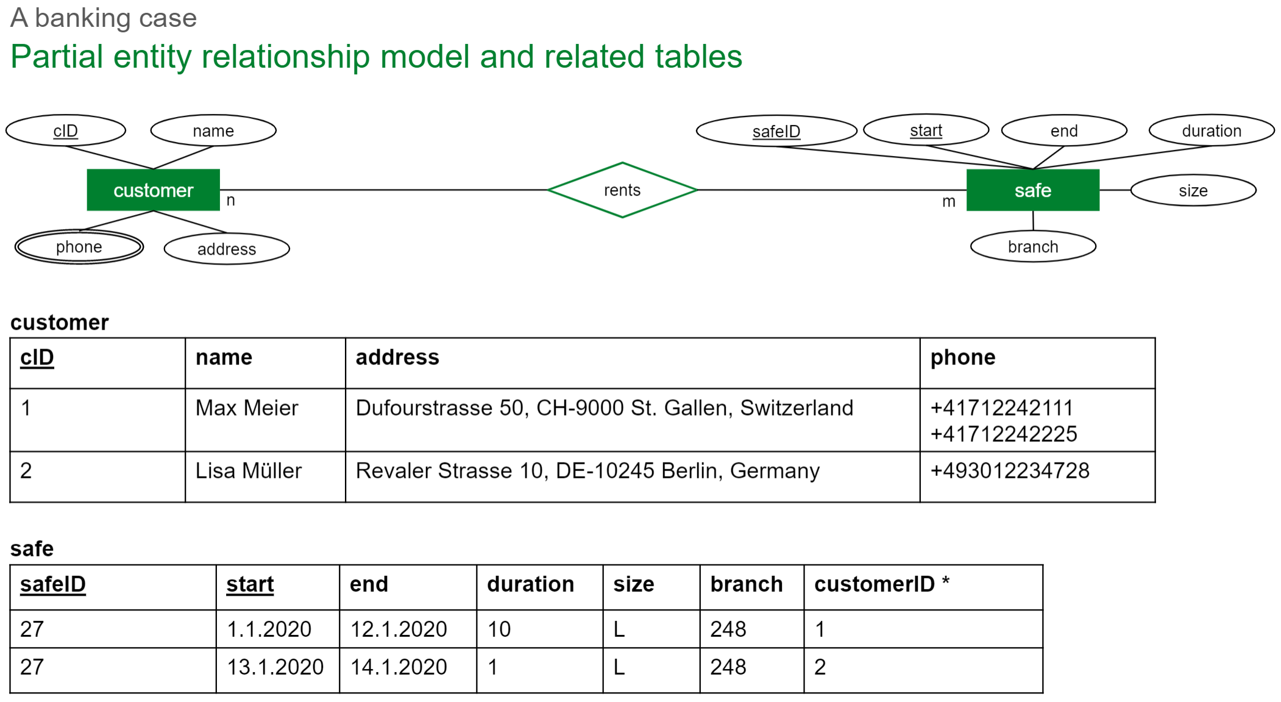
SQL (a relational database model created 1970)

Slide 5
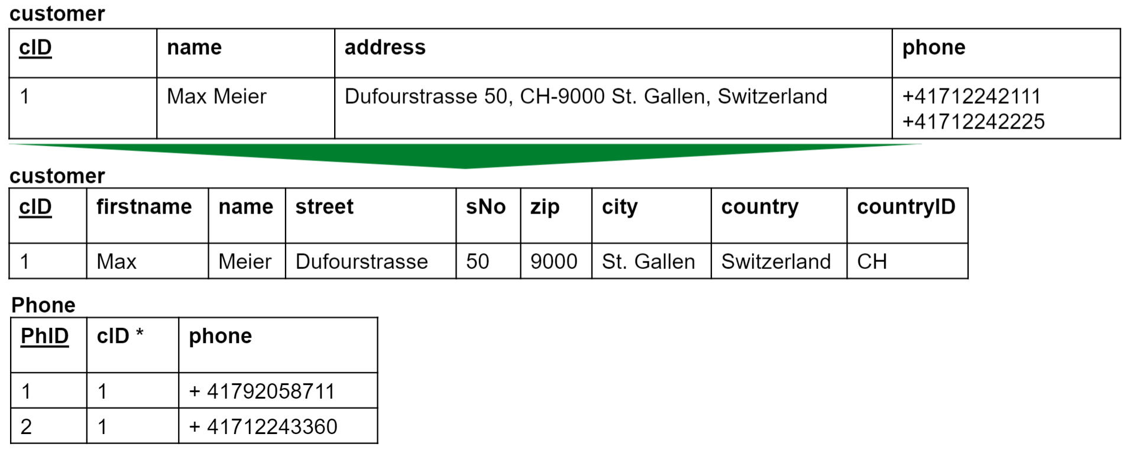
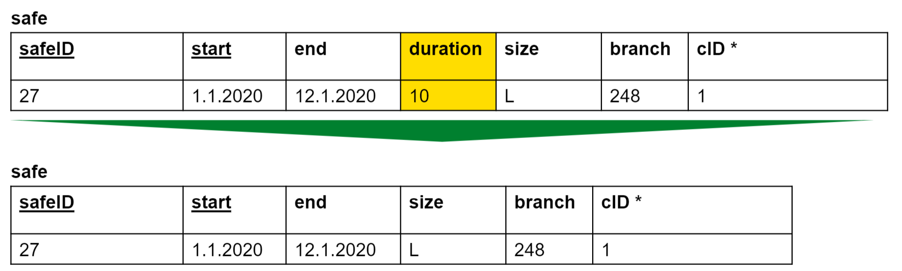
Normalization (First normal form – 1NF)
A relation is in first normal form, if
There are atomic attributes only
There are no repeated attributes
There are no derived attributes

Slide 6
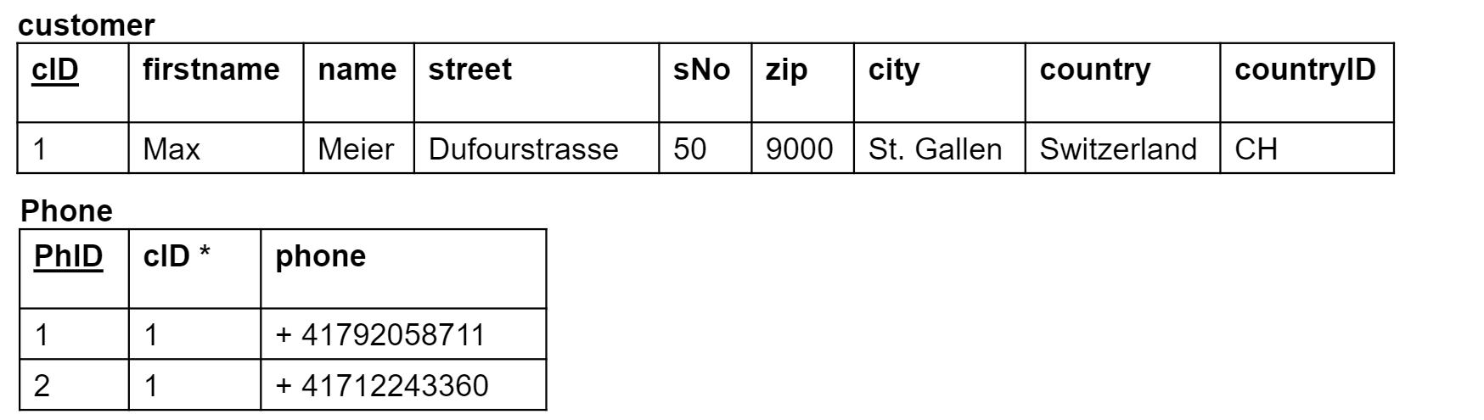
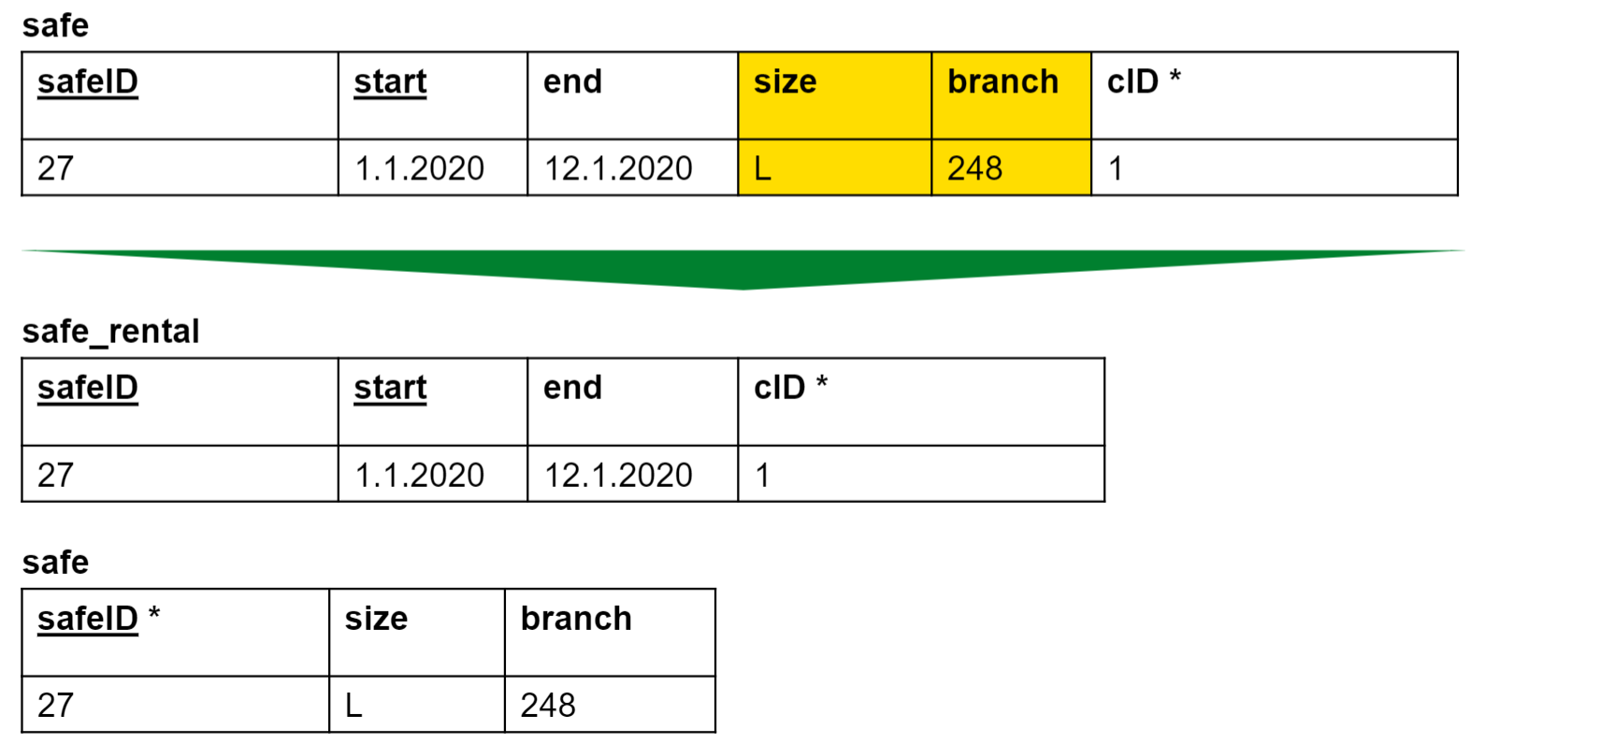
Normalization (Second normal form – 2NF)
A relation is in second normal form, if
It is in first normal form
every non-key attribute is fully functional dependent on the entire key – not on key components only

Slide 7
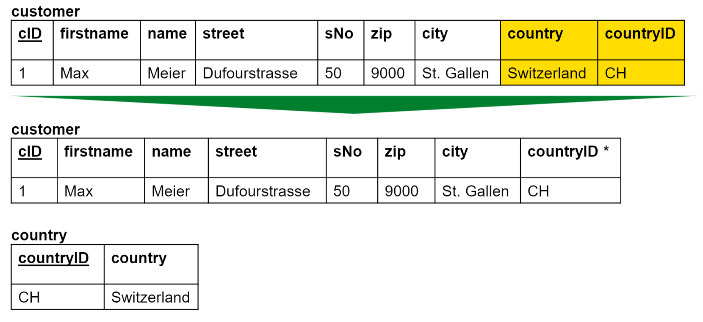
Normalization (Third normal form – 3NF)
A relation is in third normal form, if
It is in the second normal form
There are no dependencies between non-key attributes (transitive dependencies on the key)

Slide 8
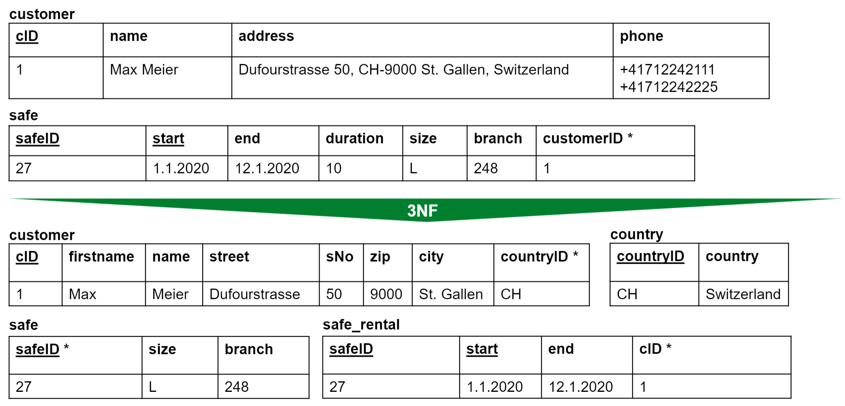
Normalization (Summary)
There are more than 3 normal forms, but 3NF is usually enough.

Slide 9
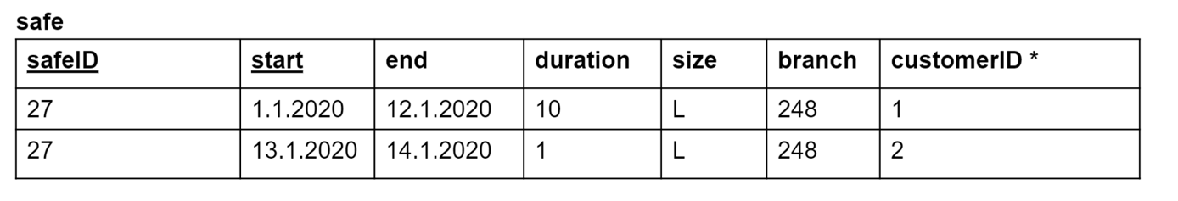
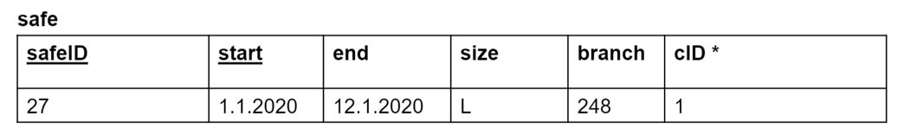
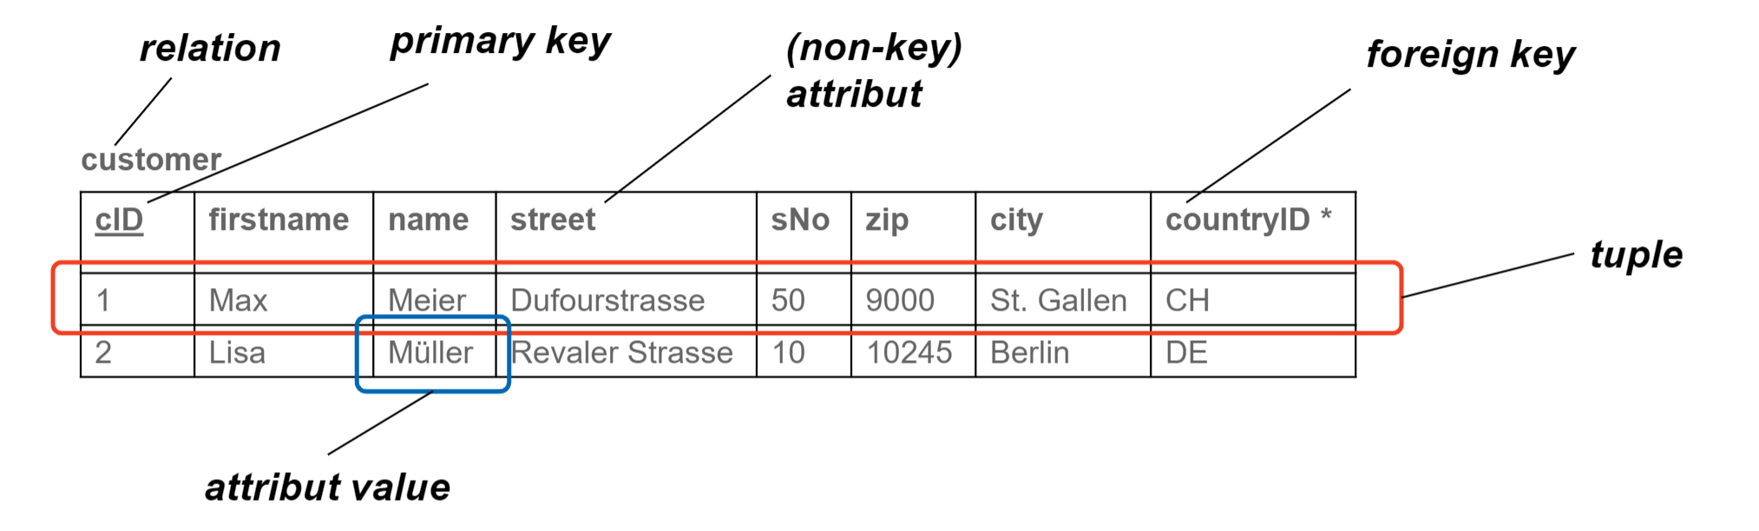
Mock Questions
What are the characteristics of the three normalization forms?
Consider this table:
What NF is this?
Fill in the
missing names

Slide 10
Key terms

Slide 11
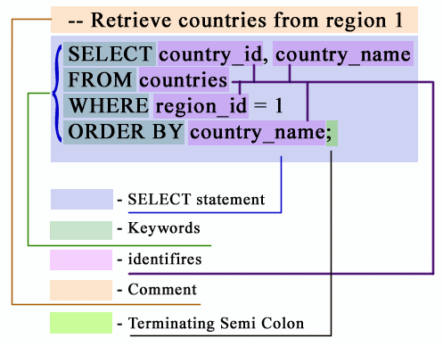
SQL Query Syntax in 1 Slide
https://www.w3resource.com/sql/sql-syntax.php

Slide 12
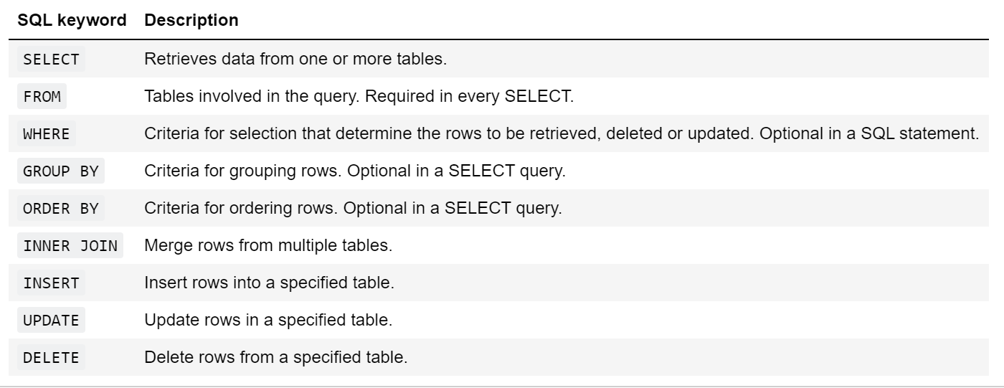
Important Keywords

Slide 13

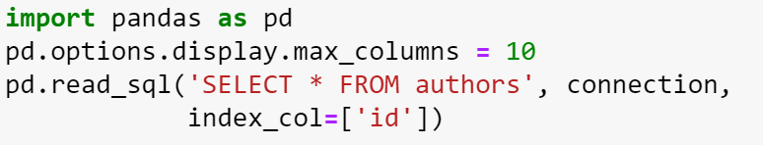
Using SQL in Python 1/2
Connecting to an existing database in Python
Using pandas («creates a cursor») to view a DataFrame for a table
It is common practice to use uppercase keywords, but it is not necessary!

Slide 14
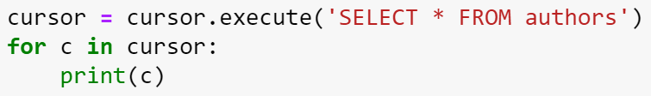

Using SQL in Python 2/2
Creating a Cursor to Insert / Delete data
Closing the database
DO THE SELF CHECK (Unit 7 Section 3)

