Slide 1
Lecture 3

Slide 2
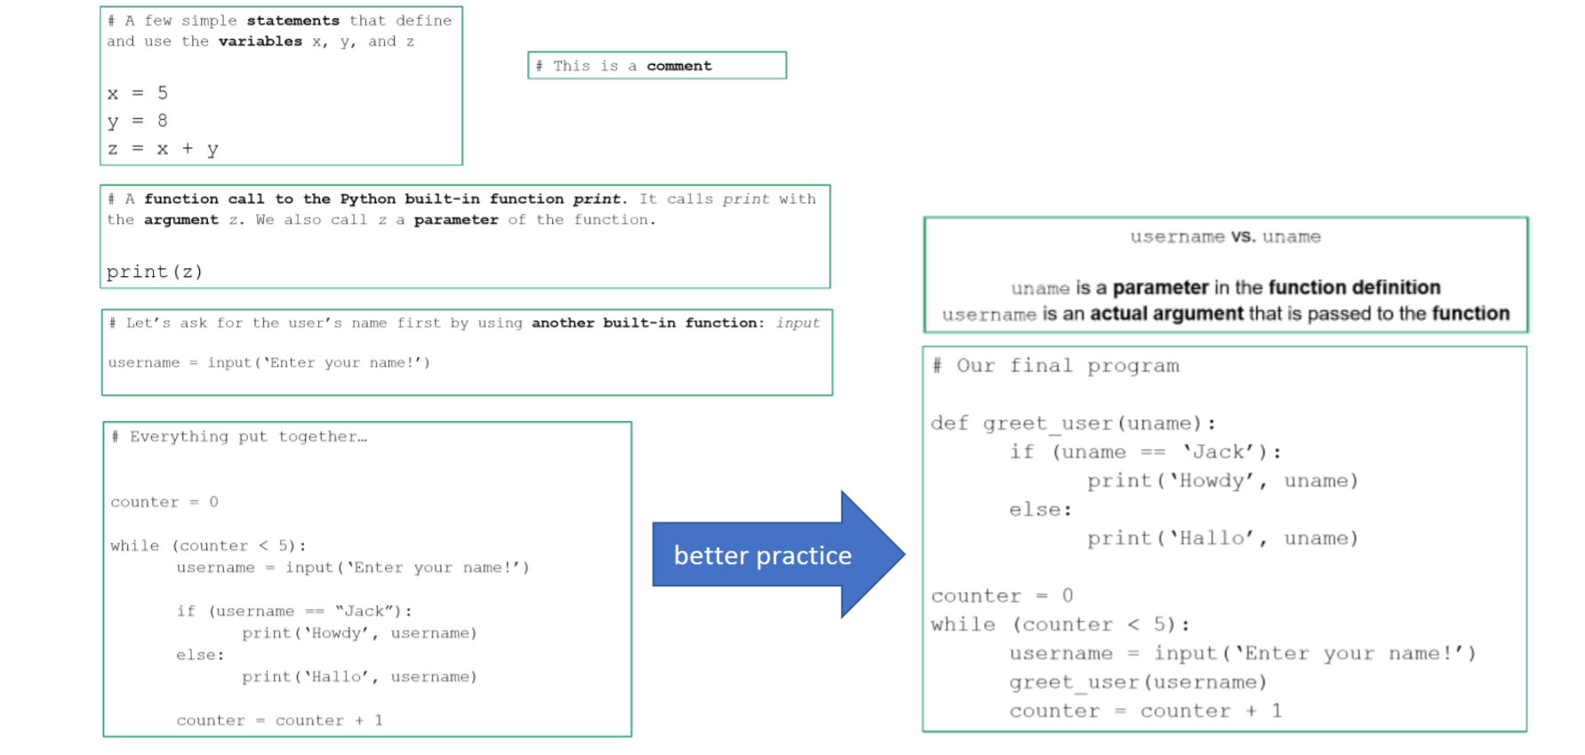
Programming in one Slide

Slide 3
Introduction to Python (to read up)
1.6
2.5

