Slide 1

Everything you ever wanted / needed to know about programming
Dominik Buchegger

Slide 2
Content / Disclaimer
Theory
Mock Up Questions
Programming
This content corresponds to what I understand to be the core contents after reviewing the lecture slides and should only be understood as an overview.
This does not necessarily correspond to the opinion of the lecturer and does not claim to be complete, nor does it allow conclusions to be drawn about the quiz questions or the exam (which are both unknown to me).

Slide 3

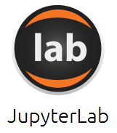
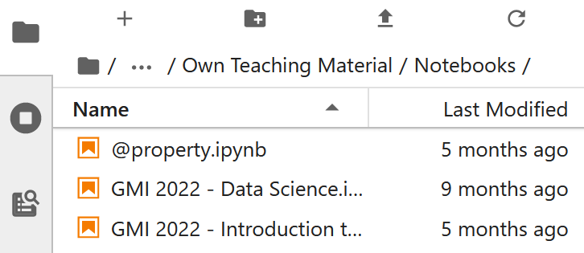
IDE
You can use an IDE of your choice as long as it supports Jupyter Notebooks (.ipynb).
We recommend: https://www.anaconda.com/products/distribution
Open: Launch:
Open Notebook from the folder you stored it in:

Slide 4
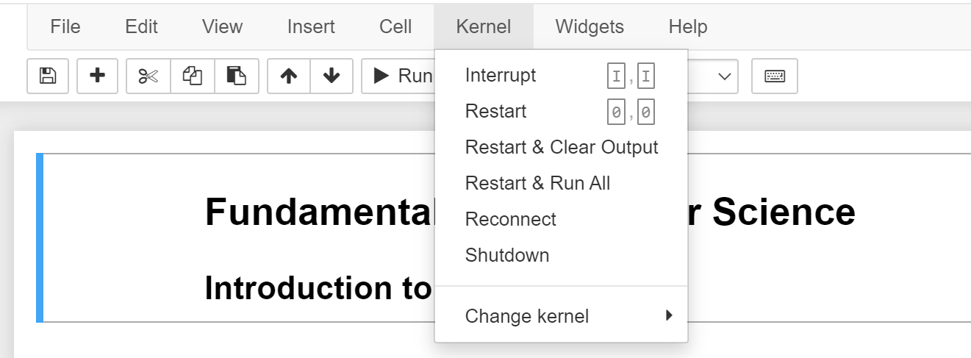
My Jupyter Notebook does not run anymore

Slide 5
Lecture 1

Slide 6

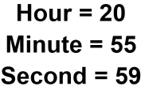
Bits (Binary Digits) & Bytes
Information = Contextualized Bits (0 / 1) with Encoding
For Data we talk about Bytes (normally 8 bits, numbers 0-255 [2^8])

Slide 7
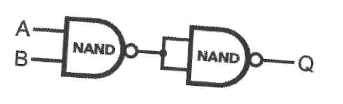
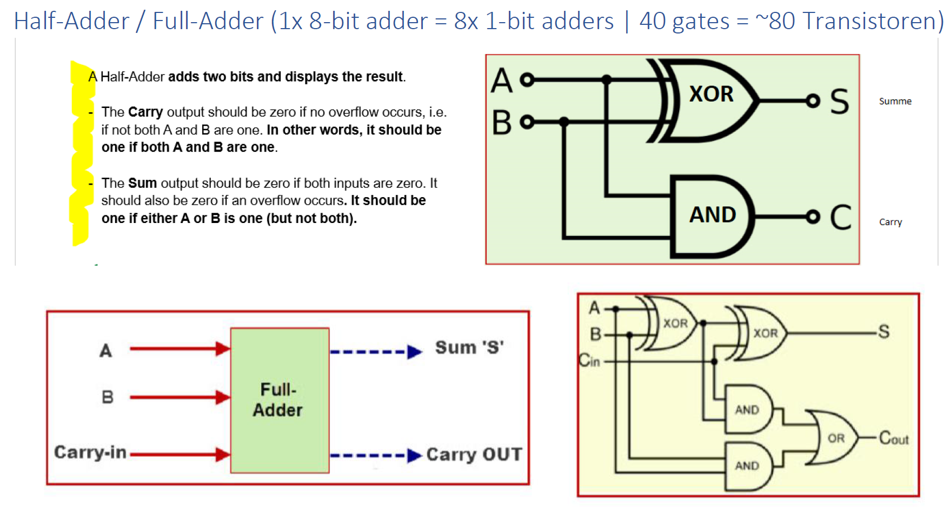
Boolean Algebra & NAND Gates
Boolean Algebra:
Bsp. X=True=1, y=False=0
NOT ~x = 0;
AND (x & y) = 0;
OR (x | y) = 1;
XOR (x ^ y) = 1;
Transistors (electronical switches) can represent 0 & 1 (True & False) → in combination we can build all logical symbols
Functional Completeness of NAND:
NOT: A NAND A
AND: (A NAND B) NAND (A NAND B)
OR: (A NAND A) NAND (B NAND B)
XOR: (A NAND (A NAND B)) NAND (B NAND (A NAND B))
NOR: NOT(A OR B)
XNOR: NOT(A XOR B)
Half-adder &
Full-adder

Slide 8
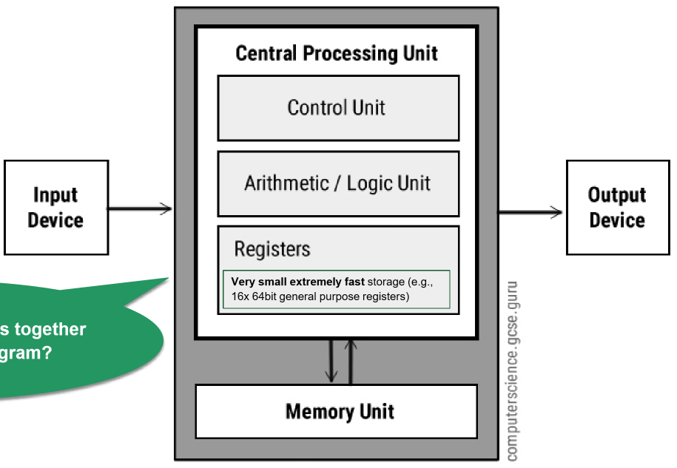
Arithmetic/Logic Unit (ALU) & Central Processing Unit (CPU)
CPU runs in a loop. In each cycle the CPU uses instructions to load data in the registers and computes the result to store in the memory unit.
Adding, Multiplier, Substractor & Divisor Circuits (4 Units) +
Memory for Input/Output +
Function select bits
Everything is a binary string interpreted as executable instructions.

Slide 9
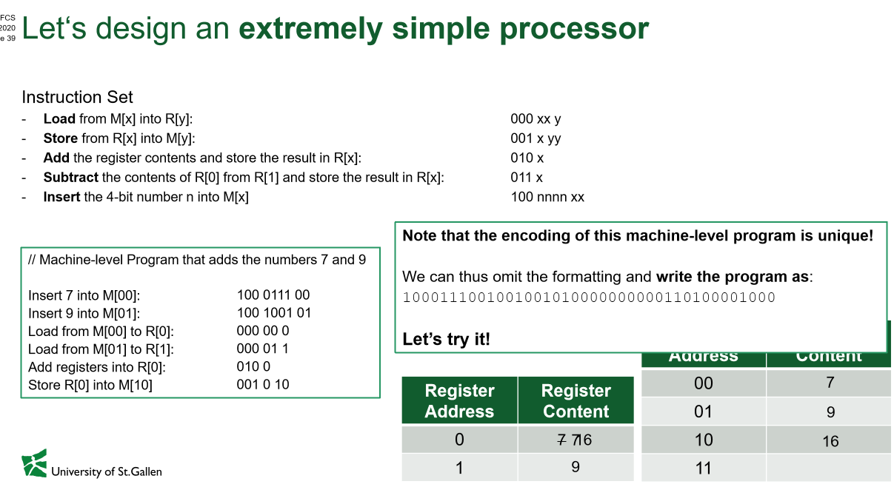
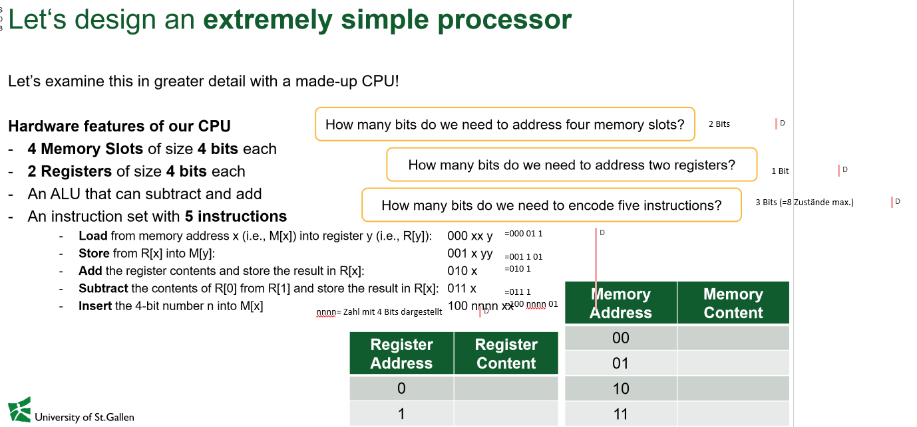
A simple processor
How many bits to address 4 memory slots?
How many bits to address 2 registers?
How many bits to encode 5 instructions?
4 Memory Slots of size 4 bits each 2 Registers of size 4 bits each An ALU that can subtract & add
Optimize the encoding by omitting prefix 0

Slide 10
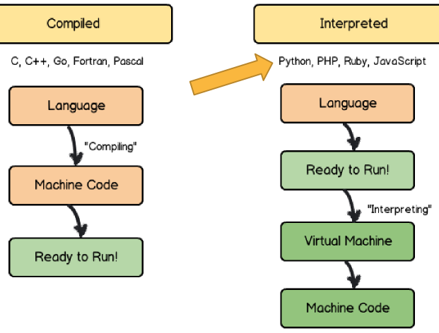
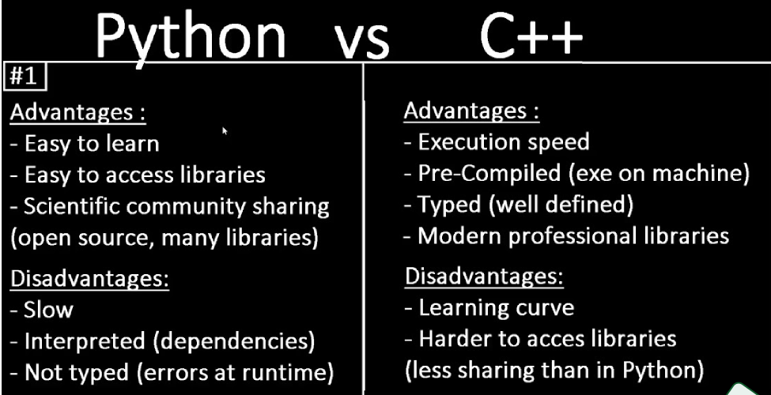
Compiled vs Interpreted Programming Languages
Compiled languages translate & validate the program before running, while interpreted languages are directly ready.

Slide 11
Mock Questions
Read the time: Complete the drawing Name the operator
(A NAND A) NAND
(B NAND B)
Name one advantage & What does this program do?
disadvantage of interpreted
languages (e.g. Python) (with given instructions)

