Slide 1
Lecture 4

Slide 2





Recursive Functions
BASE CASE / Stopping Condition

Slide 3
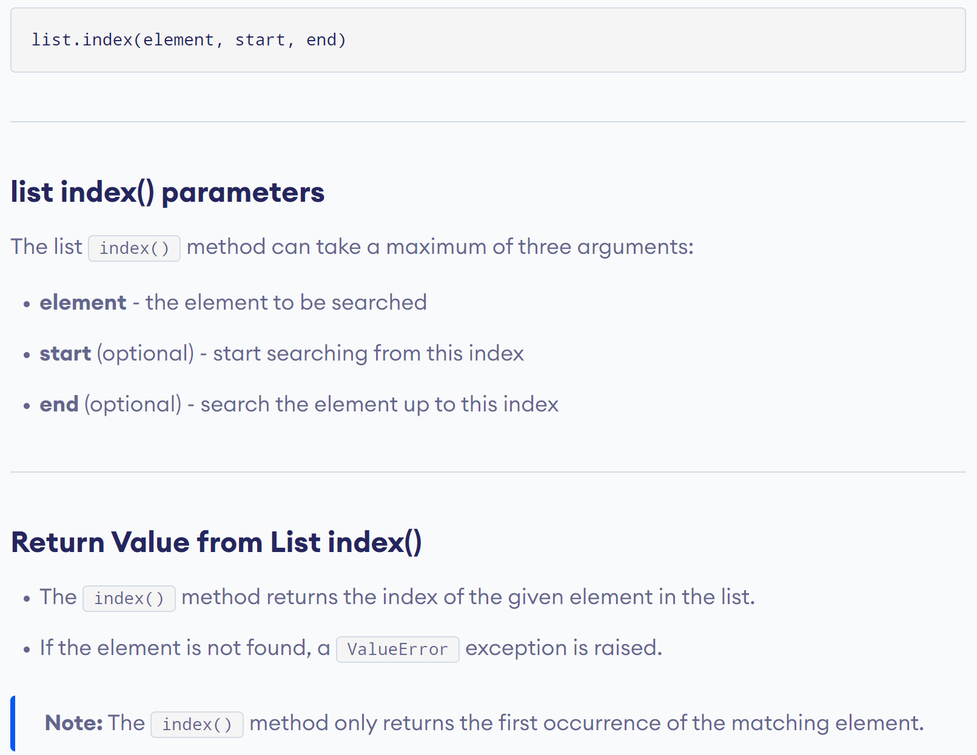
Python’s Built-In index() Function

Slide 4
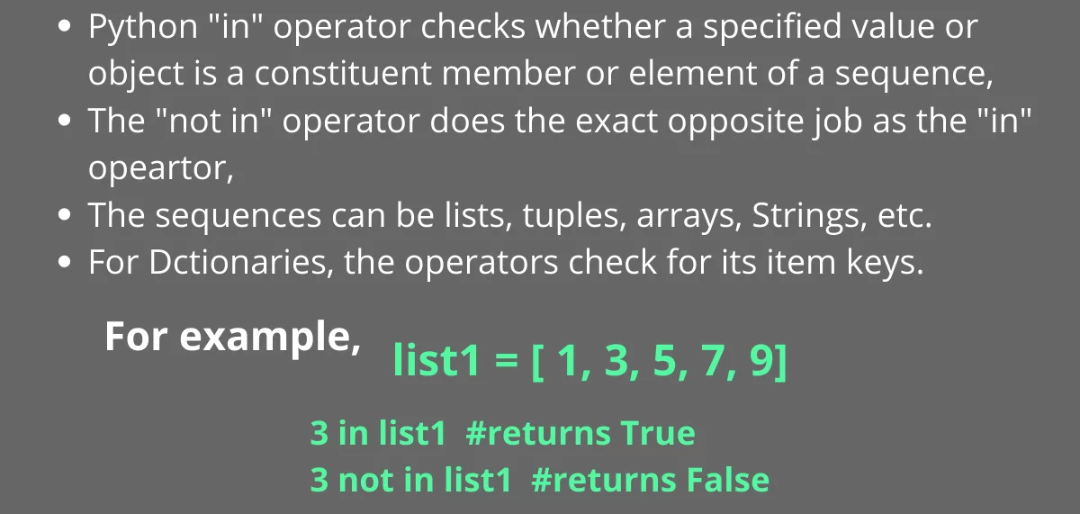
Python’s «in» / «not in» Operator

Slide 5
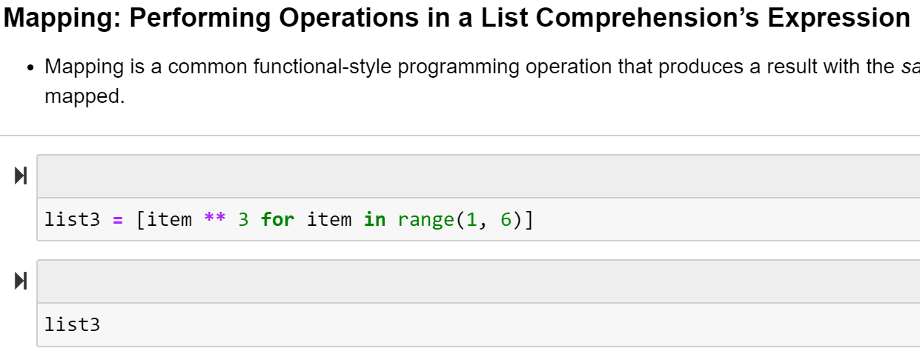
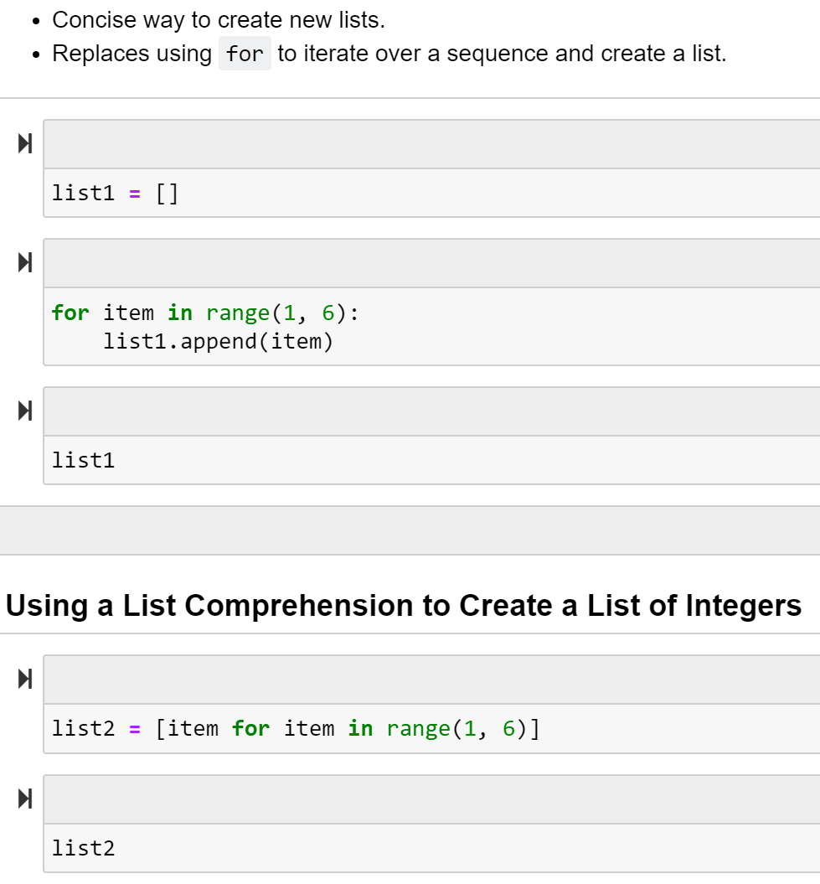
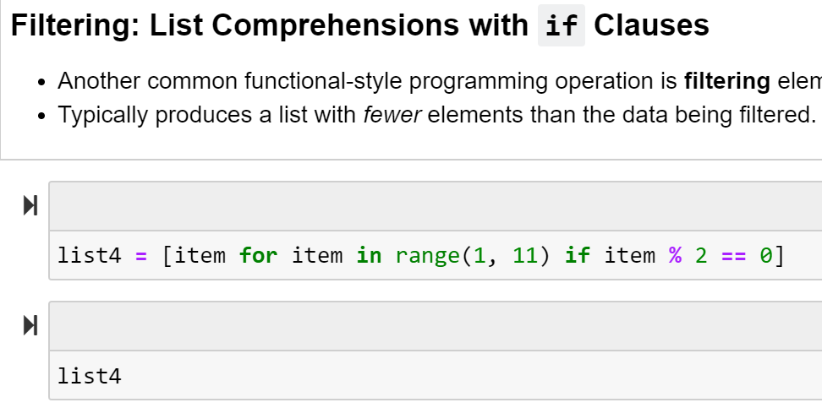
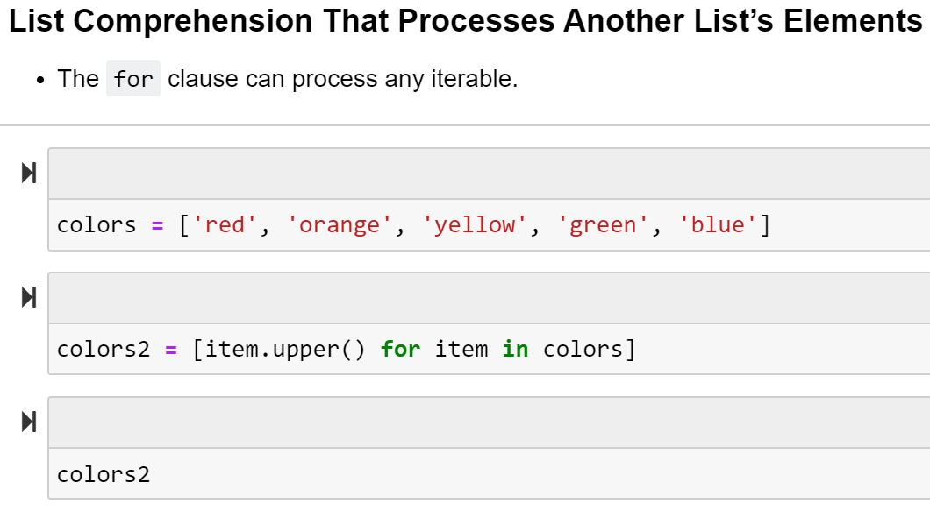
List comprehension

Slide 6
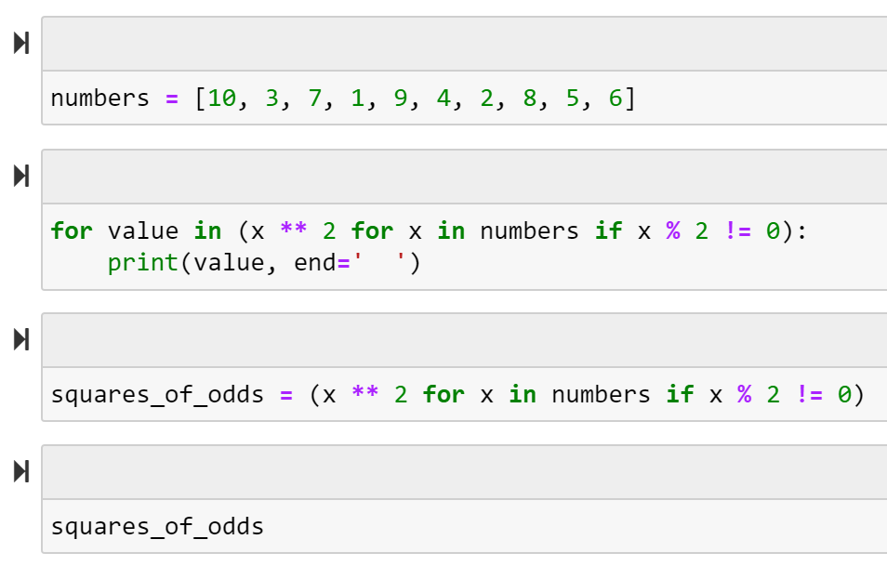
Generator Expression / Lazy Evaluation

Slide 7
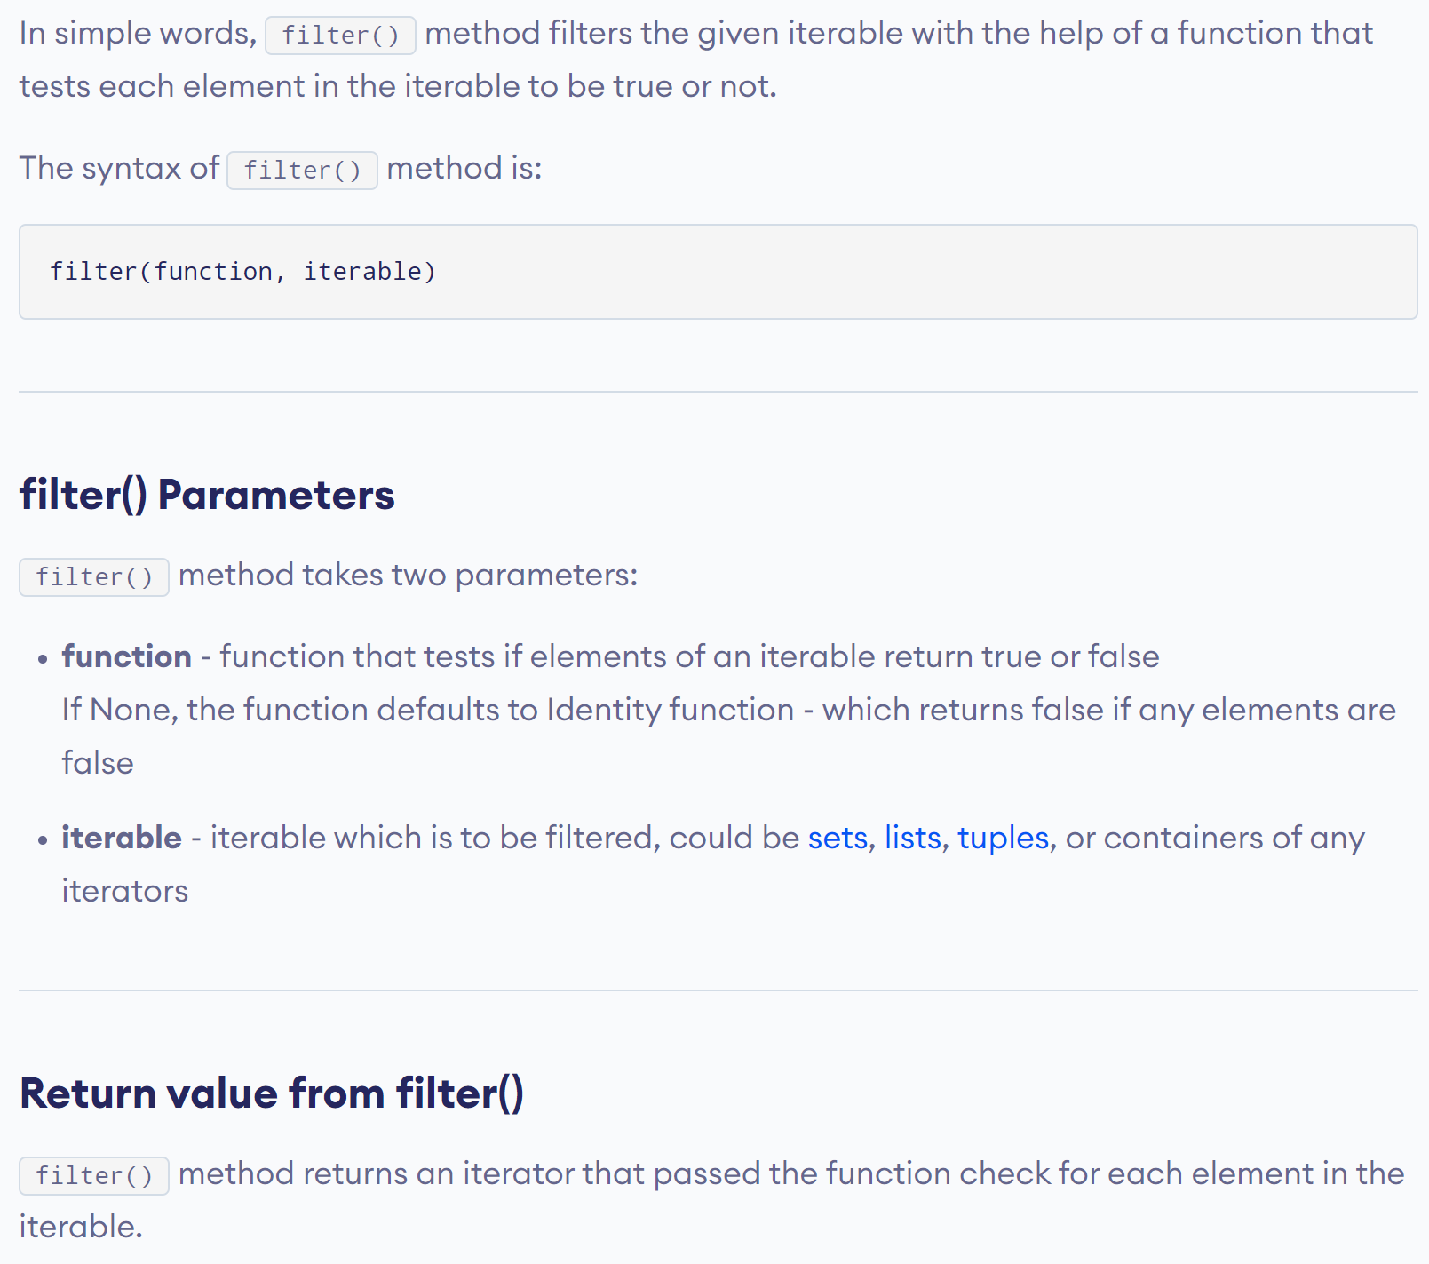
Python’s Built-in filter() Function

Slide 8
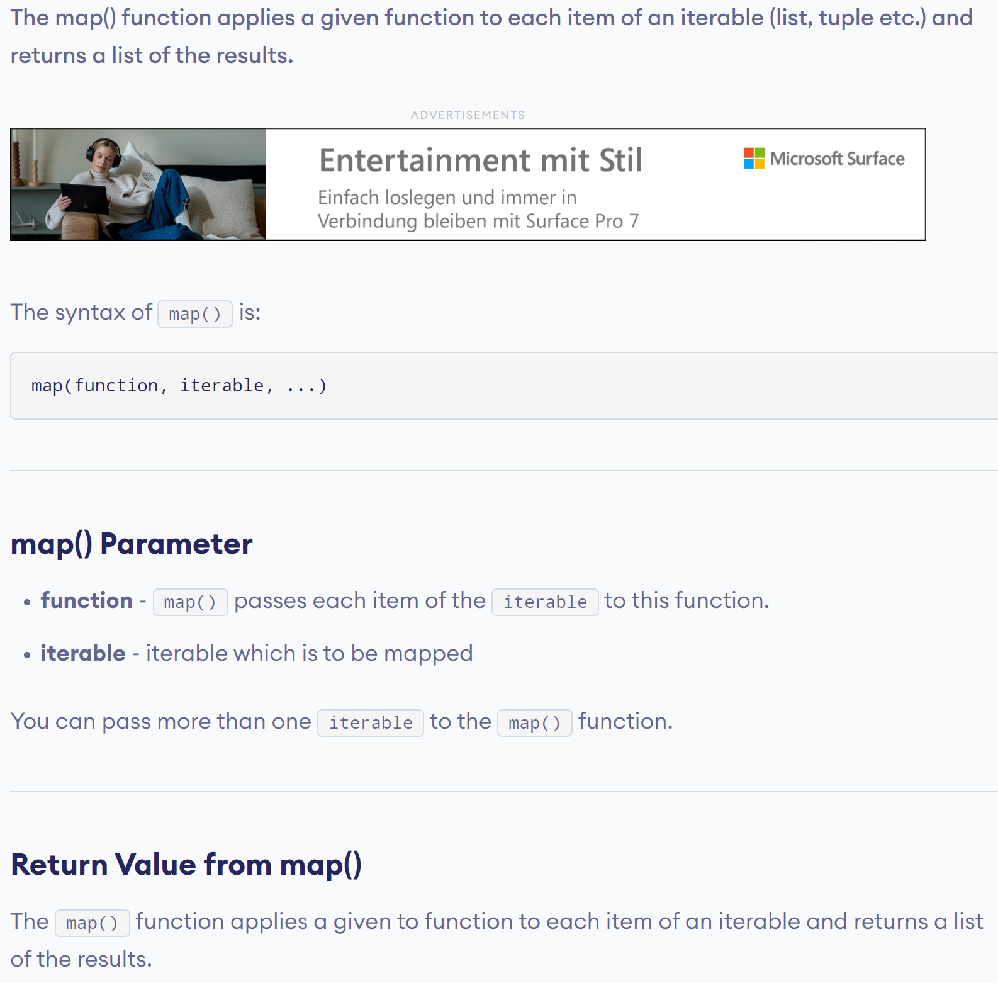
Python’s Built-in map() Function

Slide 9


Using a lambda function instead of a defined function

Slide 10
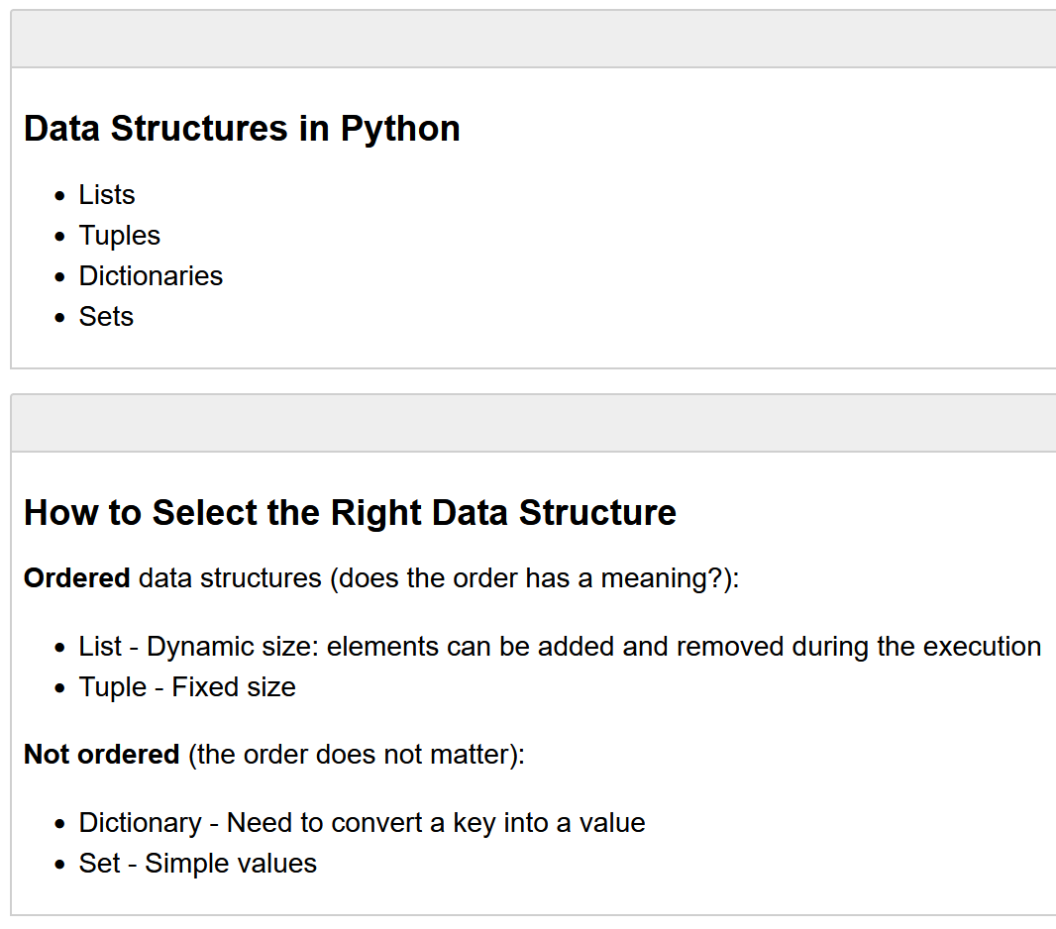
Introduction to Python (to read up)
1.6

