Slide 1
Grundlagen und Methoden der Informatik
Exercise week 10
< Fname Lname >
< Exercise Group >

Slide 2
Today’s Menu
Discussion of the solutions of Assignment 9
Discussion of Quiz 9
Introduction to Assignment 10: Data Visualization
3.1. Data Visualization in Python
3.2. Easy Example: Matplotlib
3.3. Easy Example: Seaborn
3.4. Insights on Assignment 10: Matplotlib
3.5. Insights on Assignment 10: Seaborn

Slide 3
1. Discussion of the solutions of Assignment 9

Slide 4
2. Discussion of Quiz 9

Slide 5
QUIZ 9 Full explanations on Google Colab
2. Discussion of Quiz 9
https://colab.research.google.com/drive/1aoM2Qi7zbBcjpi2xDXyiUp3FzbbrNWmv?usp=sharing

Slide 6
3. Introduction to Assignment 10: Data Visualization

Slide 7
3.1 Data Visualization in Python
Data Visualization
Visualizing data is essential to help those studying the data and those to whom it’s presented to better understand what the data say.
In Python third-party libraries are used in order to present data visually.
Matplotlib is the most widely-used data visualization library. It is used for basic plotting, is highly customizable and works with NumPy as well as pandas.
Seaborn is a high-level visualization library which is more widely used for statistical data visualization. It uses fewer syntax due to its more complex default themes. Making it easy to use but very powerful at the same time. Seaborn is built on top of Matplotlib.
In summary: Matplotlib is a general-purpose plotting library with extensive customization options, while Seaborn is a specialized library for statistical data visualization with a more concise and focused API. Seaborn can be seen as an extension or enhancement of Matplotlib, providing higher-level functions and stylistic enhancements for creating attractive statistical plots.

Slide 8
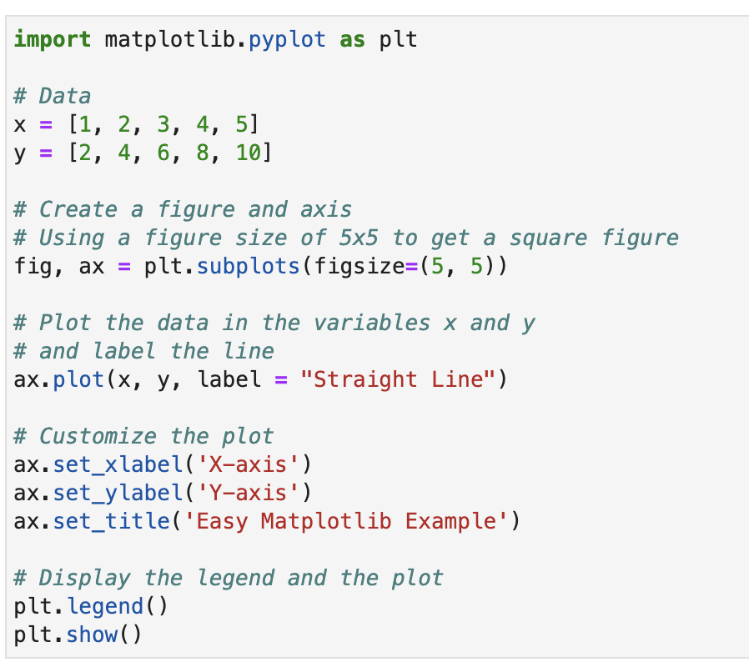
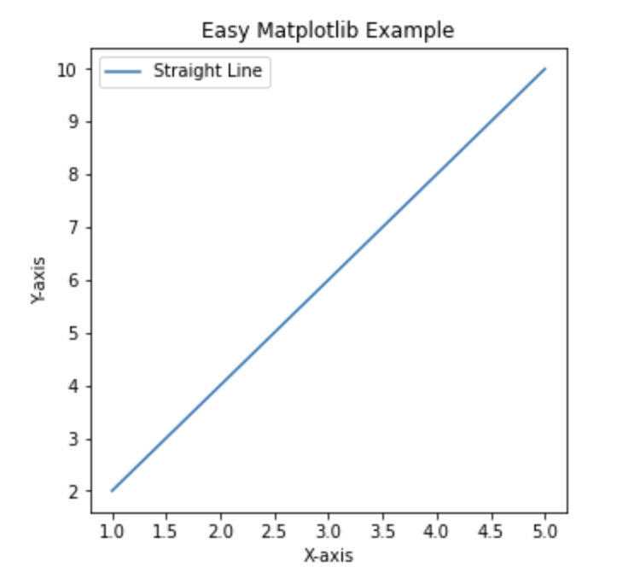
3.2 Easy Example: Matplotlib
Data Visualization

Slide 9
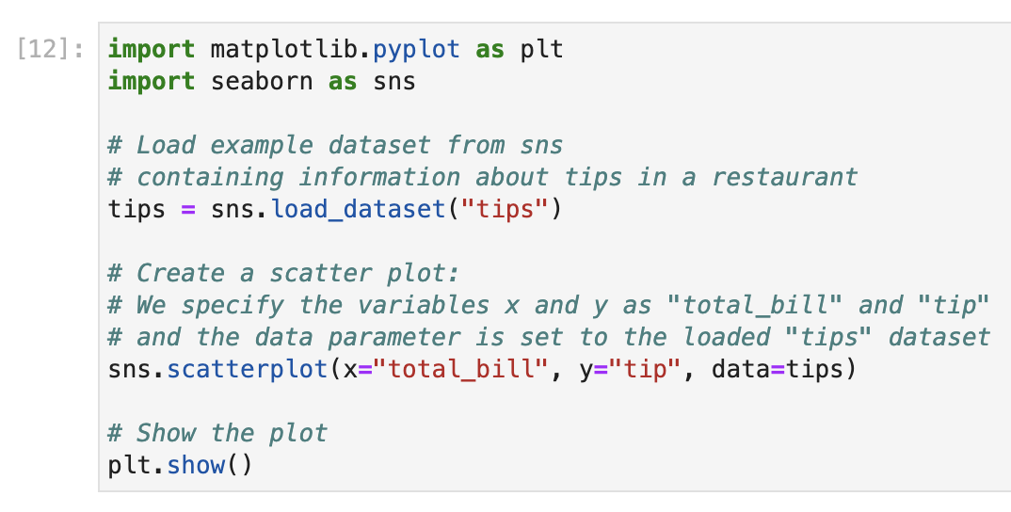
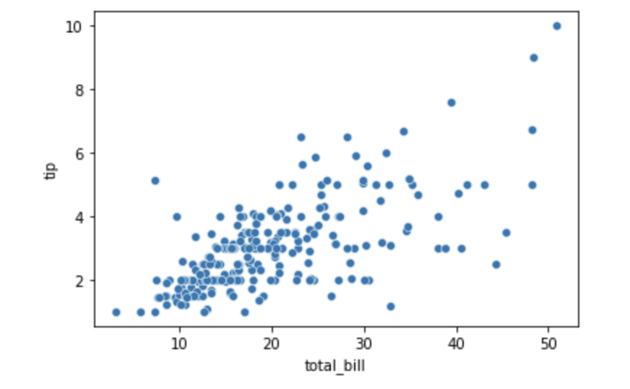
3.3 Easy Example: Seaborn
Data Visualization

Slide 10

3.4 Insights on Assignments 10: Matplotlib
Data Visualization
Color and label your lines in the .plot() function:
Create a bar plot with the .bar() function and set a specific width for each bar:
Create multiple plots in one figure with the plt.subplots() function with shared x and y axis:
Check out the Matplotlib documentation for more: https://matplotlib.org/stable/api/matplotlib_configuration_api.html

Slide 11

3.5 Insights on Assignments 10: Seaborn
Data Visualization
Create boxplots with sns.boxplot():
Create a regression plot with sns.regplot() with a cubic regression setting the parameter order = 3:
Check out the Seaborn documentation for more: https://seaborn.pydata.org/api.html

Slide 12
<Your Name>
<Function>
lirst.last@<student.>unisg.ch

