Slide 1
Lecture 5

Slide 2
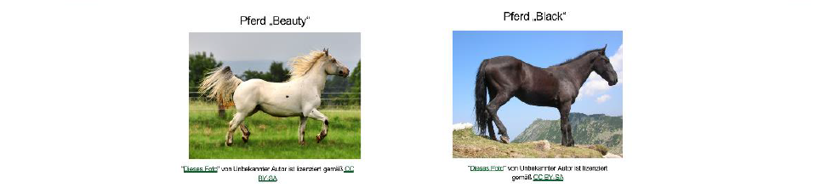
Object Orientation («Everything is an object»)
methods e.g. jump() or
walk(2)
class horse
attributes
with attribute
values
Abilities
jump
walk
Attributes
Height
Speed
methods
attributes
Objects are instances of classes (blueprint) with attribute values
Methods are executed on objects
Sub classes inherit attributes & methods from super (base) classes
Any time an object is created it is instantiated.
objects

Slide 3
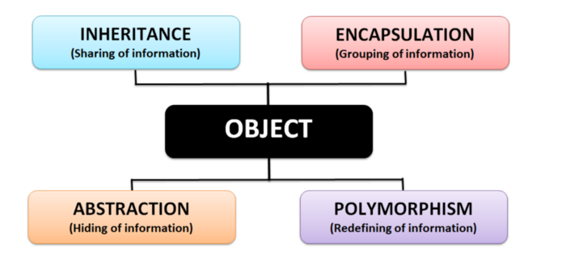
Four main pillars of OOP design
Source of the following 4 slides: https://javascript.plainenglish.io/object-oriented-programming-in-memes-e6964570e81a

Slide 4

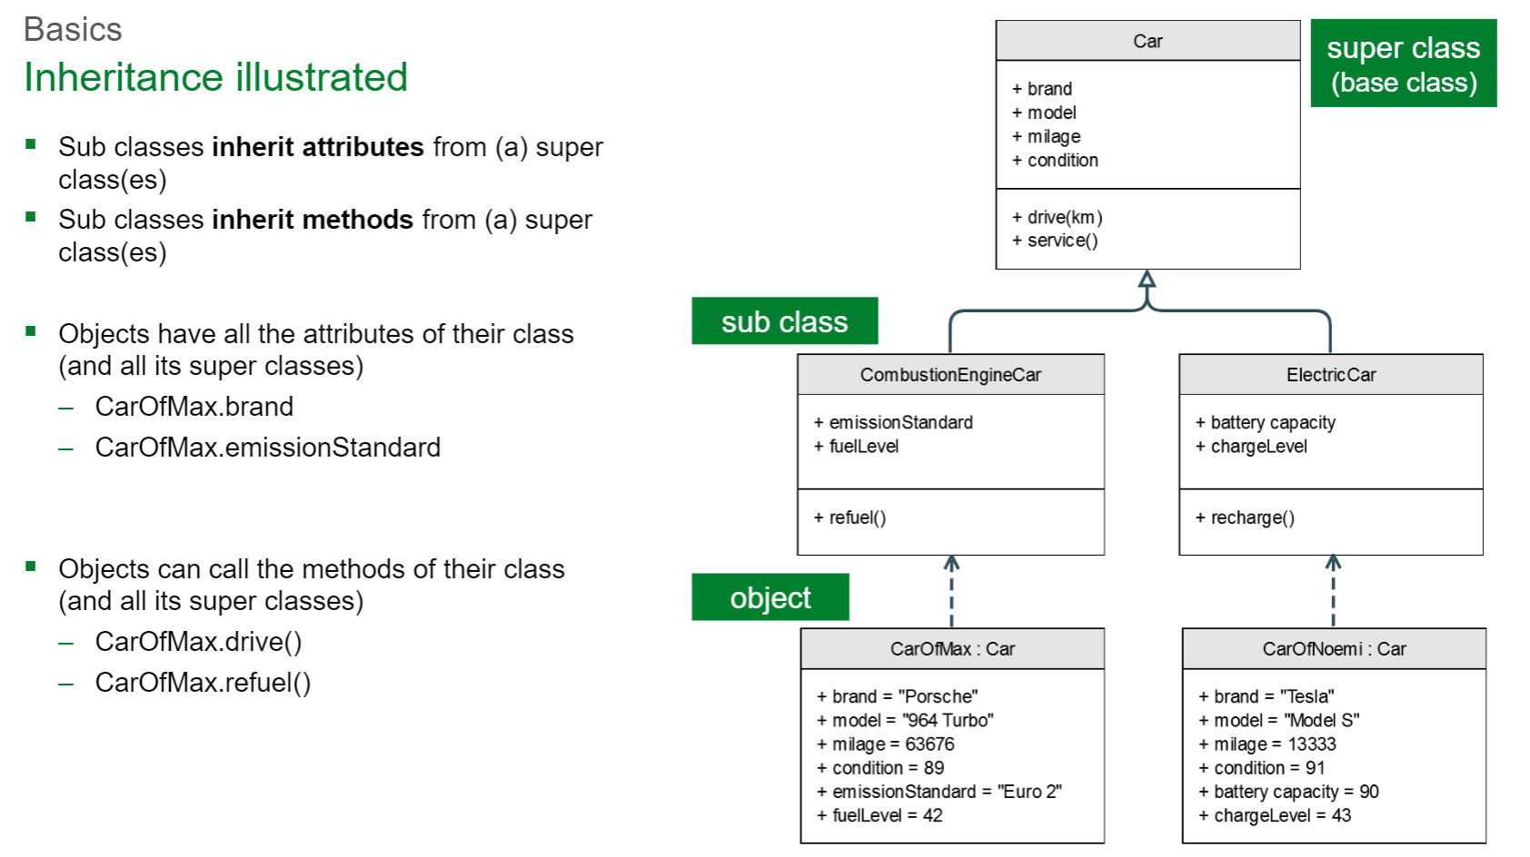
Four main pillars of OOP design
Inheritance:
Just like genetics — if a class was a dog and each object inheriting from the dog class was a puppy.
Objects made with a class inherit the information and methods of the super (or sub) class.
Python3: new-style
object

Slide 5
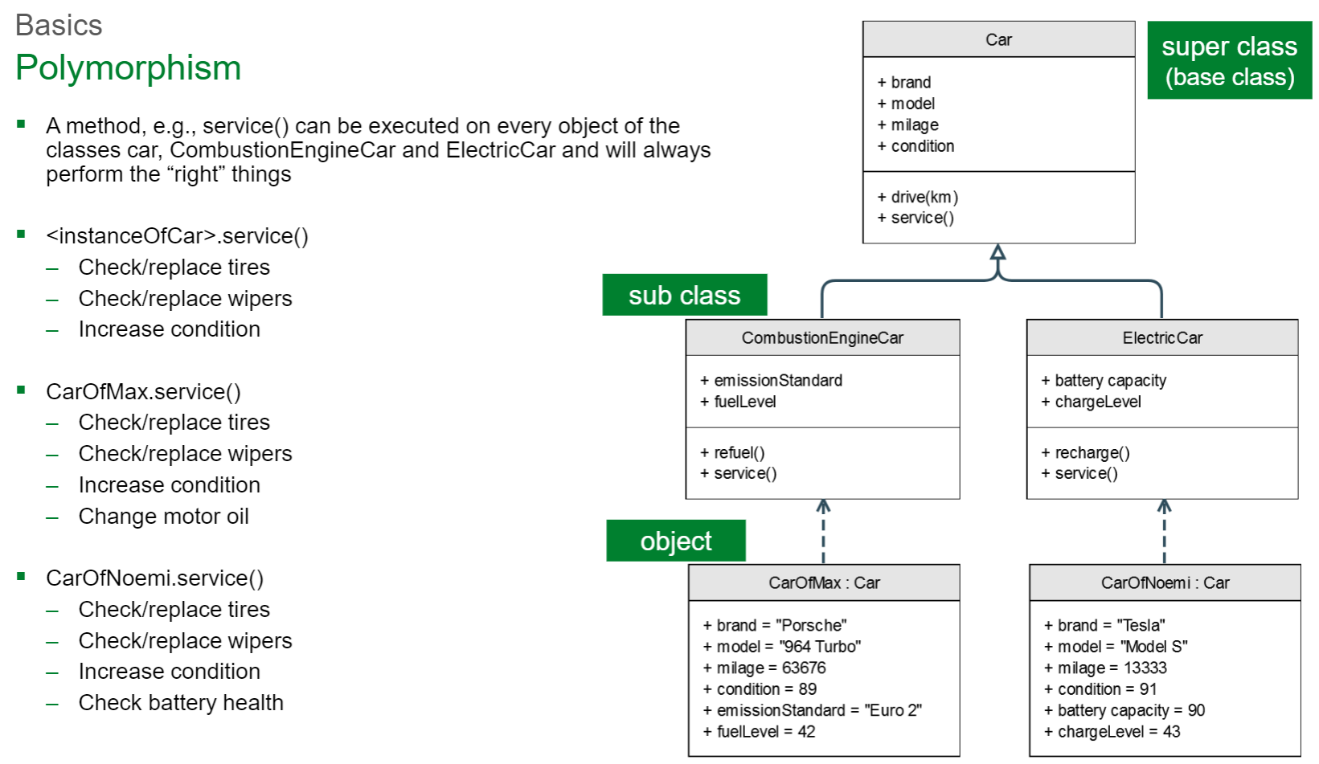

Four main pillars of OOP design
Polymorphism:
Fred and ghostFred both have a method called getDressed(). When getDressed() is called, Fred will put on his ascot, and ghostFred will put on his ghost costume.
The OOP language evaluates which getDressed() to use based on which object is being referenced when it is called.

Slide 6

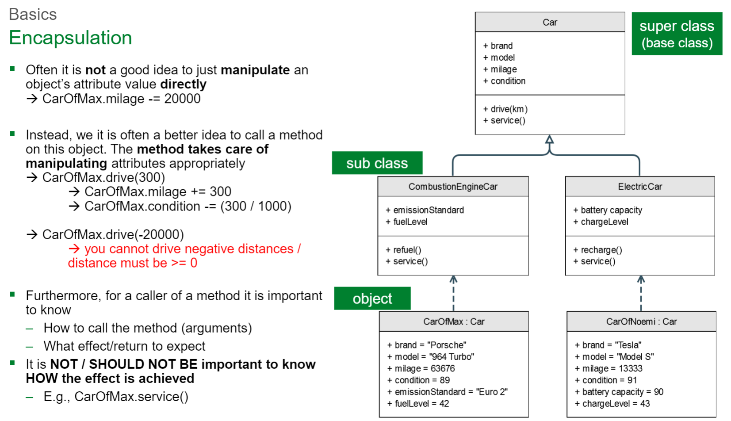
Four main pillars of OOP design
Encapsulation:
Encapsulation hides variables or some implementation that may be changed so often in a class to prevent outsiders access it directly. They must access it via getter and setter methods.

Slide 7
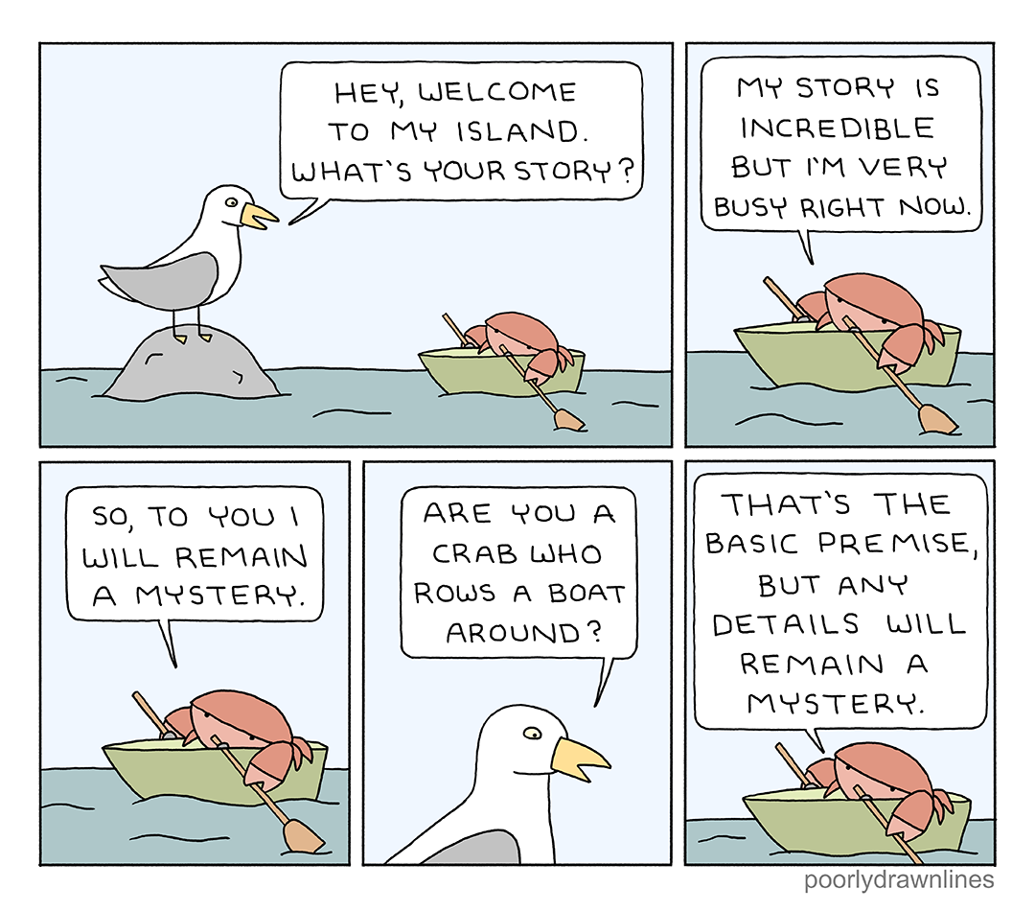
Four main pillars of OOP design
Abstraction:
Abstraction is used to hide something too, but in a higher degree (class, interface). Clients who use an abstract class (or interface) do not care about what it was, they just need to know what it can do.

Slide 8
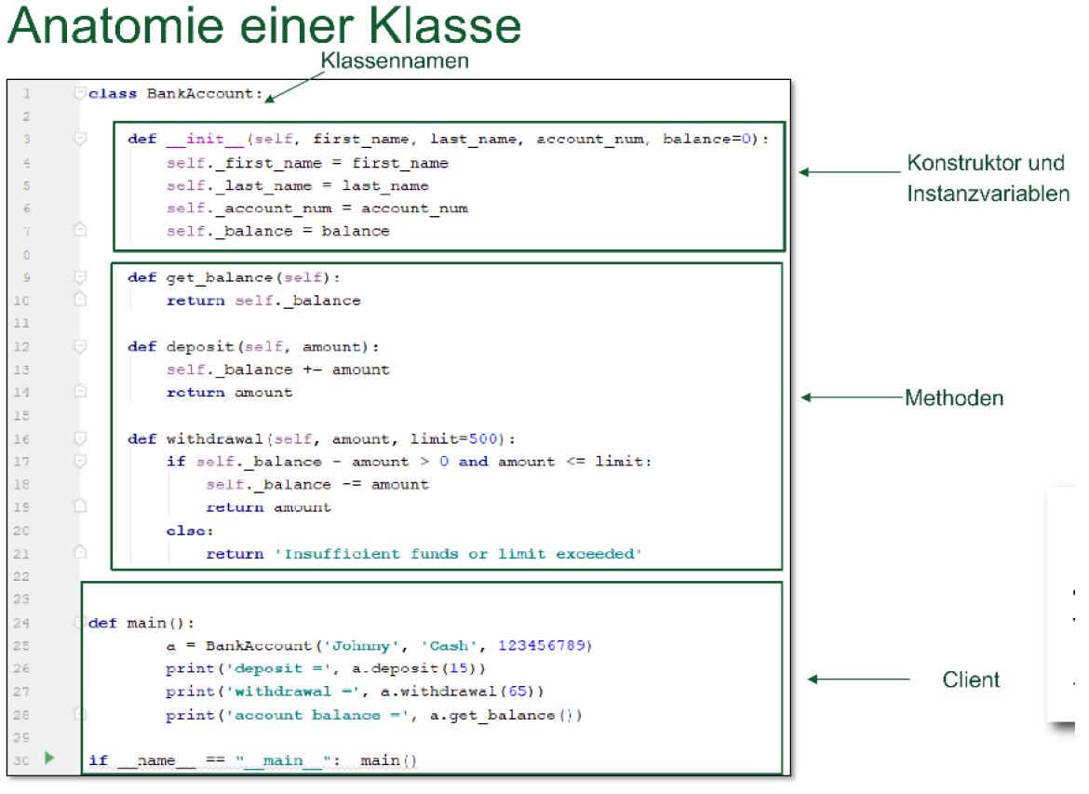
The class defines a new datatype.
All classes have a function called init(), which is always executed when the class is being initiated (constructor).
Use the init() function to assign values to object properties, or other operations that are necessary to do when the object is being created.
We can now create an object with a constructor expression.
Each object has datatype BankAccount and holds its own values for the fields.
To access and manipulate the attributes we should use a method (main pillar of OOP).
Class Attributes belong to class, not a specific object of that class.

Slide 9
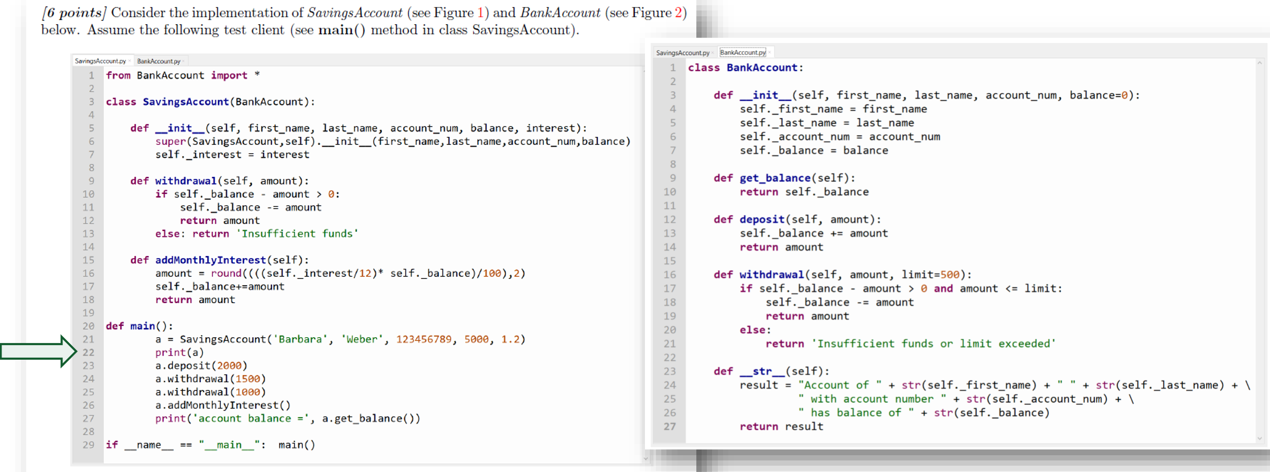
Mock Questions
What is the specific name of the function «get_balance« in this context? Method that returns the current balance of the instance object.
What is the specific name of elements such as "account_num" and "balance" in this case? Instance attributes.
What would be printed if line 22 was executed? "Account of Barbara Weber with account number 123456789 has balance of 5000"

Slide 10
class Vehicle:
def __init__(self, brand, model, type):
self.brand = brand
self.model = model
self.gas_tank_size = 14
self.fuel_level = 8
def fuel_up(self):
self.fuel_level = self.gas_tank_size
print("Gas tank is now full.")
def drive(self):
print(f"The {self.model} is now driving.")
Name the command needed to create a new instance «my_vehicle» of the class Vehicle (attributes freely chosen): my_vehicle = Vehicle("VW", "Golf", "Hybrid")
Name the code needed to call the method drive() on the newly created instance: my_vehicle.drive()

Slide 11
Name the 4 main pillars of OOP:

Slide 12
Jupyter Notebooks
oop.ipynb
@property.ipynb

