Slide 1
Grundlagen und Methoden der Informatik
Exercise week 2
Dominik Buchegger

Slide 2
Today’s Menu
Discuss previous week’s assignment & quiz
Summary of the current week’s lecture content
Additional material on coding (today incl. Python in 7 Slides)
Enable you to solve the assignment by solving together the smaller exercises
You solve the assignment
n+1. Virtual Office Hour

Slide 3
Previous week

Slide 4
Exercise
Questions?

Slide 5
Assignment
Questions?

Slide 6
What the questions were about
Recognize data types
type() and changing var type (int(), str(), float())
Create a calculator (no user input)
Computation with int and float vs. computation with string and int/float
Print() (variables, strings, int, float etc.)
If statements
While-Loop and increments
Understanding code/error messages (AssertionError)
Type | What? | Short | Example
Integer | Natural numbers | int | -42, 0, 1000
Float | Floating point value | float | -42.0, 0.7, 3.14
String | Concatenation of characters | str | ‚42‘ ‚Hello‘ ‚3.14‘
Boolean | Type with one of two possible values | bool | True, False

Slide 7
What the questions were about
Recognize data types
type() and changing var type (int(), str(), float())
Create a calculator (no user input)
Computation with int and float vs. computation with string and int/float
Print() (variables, strings, int, float etc.)
If statements
While-Loop and increments
Understanding code/error messages (AssertionError)
a = ‘Hello World’
type(a)
str
b = 5.5
type(b)
float
c = 5
type(c)
int
c = str(c)
type(c)
str

Slide 8
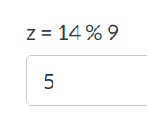
What the questions were about
Recognize data types
type() and changing var type (int(), str(), float())
Create a calculator (no user input)
Computation with int and float vs. computation with string and int/float
Print() (variables, strings, int, float etc.)
If statements
While-Loop and increments
Understanding code/error messages (AssertionError)
Examples of arithmetic operations in Python
Arithmetic rules apply: Parenthesis before power before multiplication/division before addition/subtraction
Python has built-in arithmetic operations. These include +, -, *, /, //, **, %
In computing, the modulo operation returns the remainder of a division, after one number is divided by another (called the modulus of the operation)
Other mathematical operations can be imported with libraries

Slide 9
What the questions were about
This is a comment
Recognize data types
type() and changing var type (int(), str(), float())
Create a calculator (no user input)
Computation with int and float vs. computation with string and int/float
Print() (variables, strings, int, float etc.)
If statements
While-Loop and increments
Understanding code/error messages (AssertionError)
x = 4
y = 5
# int and int operations yield int
print(x + y)
→ 9
x = 4
y = 5.0
# int and float operations yield float
print(x + y)
9.0
x = 45
y = 5
# divisions always yield float
print(x / y)
→ 9.0
x = 4
y = “5”
# cannot use arithmetic operations on number and strings. A string can be converted (e.g., int(“5”).
x = “4”
y = “5”
# adding strings is like attaching one string to another
print(x + y)
→ 45
(this is the string “45”)

Slide 10
What the questions were about
Recognize data types
type() and changing var type (int(), str(), float())
Create a calculator (no user input)
Computation with int and float vs. computation with string and int/float
Print() (variables, strings, int, float etc.)
If statements
While-Loop and increments
Understanding code/error messages (AssertionError)
print(‘Hello World’)
Hello World
print(‘Hello’, ‘World’)
Hello World
x = 5
y = 6
print(x + y)
11
print(‘The result of x + y is’, x + y)
→ The result of x + y is 11

Slide 11
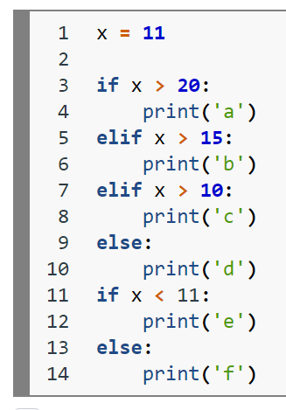
What the questions were about → today in detail
Recognize data types
type() and changing var type (int(), str(), float())
Create a calculator (no user input)
Computation with int and float vs. computation with string and int/float
Print() (variables, strings, int, float etc.)
If statements
While-Loop and increments
Understanding code/error messages (AssertionError)
Run this only if the initial
if-statement evaluates to True
Run this only if the elif-state-
ment is True AND all state-
ment above have been False.
Run this only if the statements
before this line have all been
False.
This if-statement will be tested
irrespective of the first if-statement

Slide 12
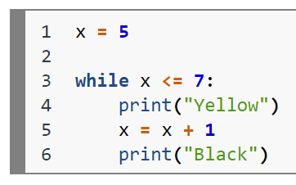
What the questions were about → today in detail
Recognize data types
type() and changing var type (int(), str(), float())
Create a calculator (no user input)
Computation with int and float vs. computation with string and int/float
Print() (variables, strings, int, float etc.)
If statements
While-Loop and increments
Understanding code/error messages (AssertionError)
„While this line is interpeted
as True, do whatever is indented
after the colon (:) and return to
this line“

Slide 13
What the questions were about
Recognize data types
type() and changing var type (int(), str(), float())
Create a calculator (no user input)
Computation with int and float vs. computation with string and int/float
Print() (variables, strings, int, float etc.)
If statements
While-Loop and increments
Understanding code/error messages (AssertionError)

Slide 14
Quiz
Questions?

Slide 15
Additional Material on Coding

Slide 16
What are augmented assignments and how do they work?
Augmented assignment | Sample expression | Explanation | Assigns
+= | c += 7 | c = c + 7 | 10 to c
-= | d -= 4 | d = d - 4 | 1 to d
*= | e *= 5 | e = e * 5 | 20 to e
**= | f **= 3 | f = f ** 3 | 8 to f
/= | g /= 2 | g = g / 2 | 4.5 to g
//= | g //= 2 | g = g // 2 | 4 to g
%= | h %= 9 | h = h % 9 | 3 to h

Slide 17


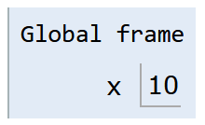
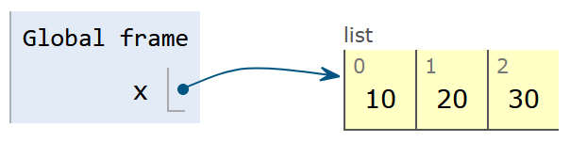

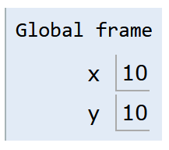

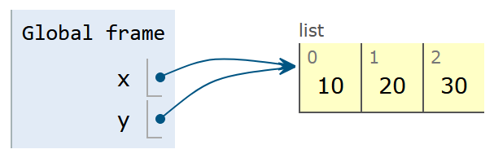

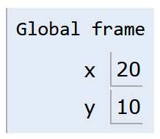

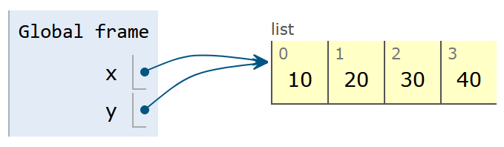
Pass by …
Value
Reference
All single values (numbers, text, boolean) follow this behaviour.
Collections usually follow this behaviour. Most important here are lists.
17

Slide 18

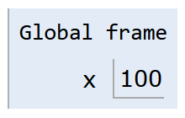
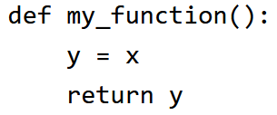
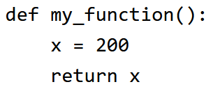
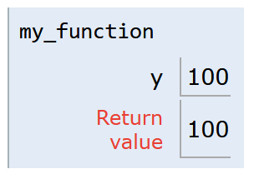
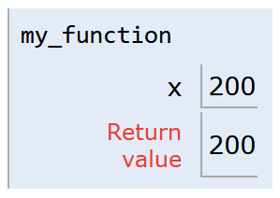
Scope / Namespace
Note: Not everything that is indented (e.g. if/else or loops) creates its own local scope.
For now it is sufficient to understand that each function creates its own local scope which is destroyed after executing the function.
This is the global scope.
Variables defined here can be accessed from everyhwere.
Variables defined in a lower scope (local) can not be accessed from here.
This is the local scope.
Variables defined here can only be accessed from within.
Variables defined in a higher scope (global) can also be accessed (but not changed) from here.
18

Slide 19
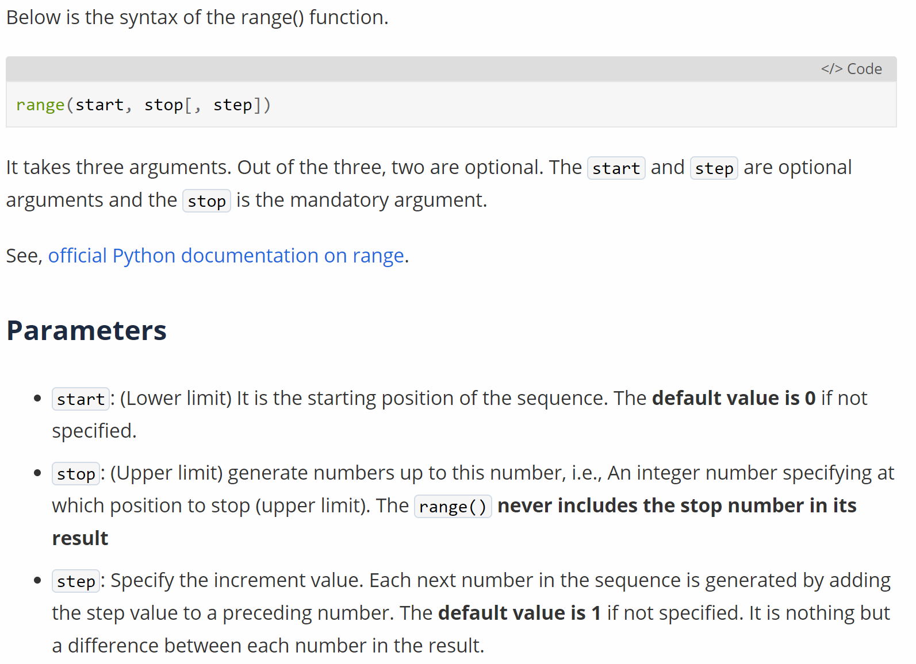
Read Documentation (1)
19

Slide 20

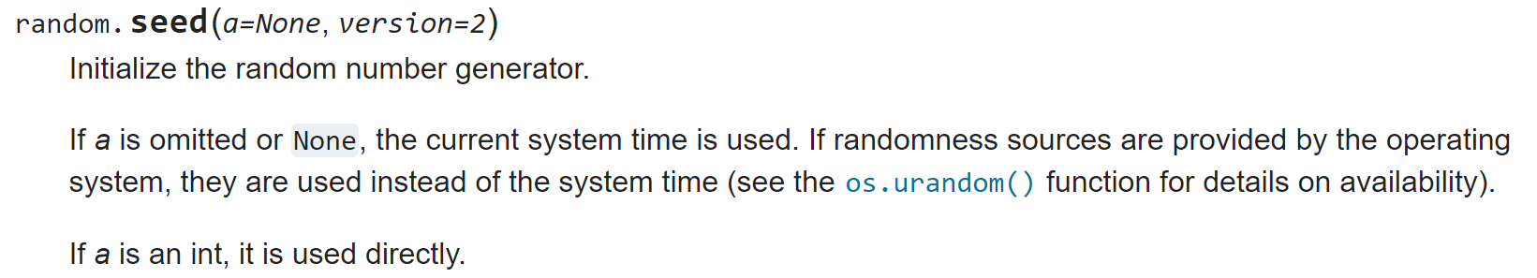
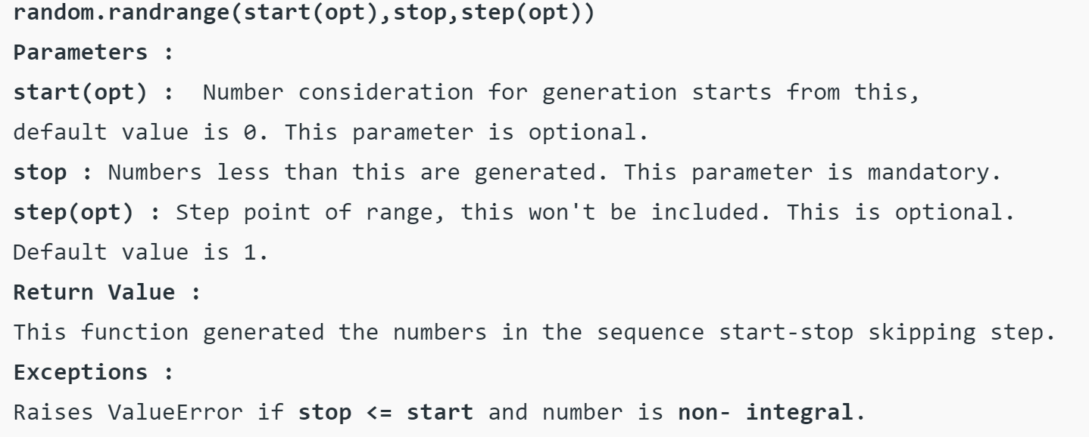
Read Documentation (2)
20

Slide 21
Introduction to Python:
1.5 & 1.8
2
To read up

Slide 22
Let’s solve the exercises together…
…to enable you to solve the assignment on your own

Slide 23
Demo
Exercise 1

Slide 24
How does the for loop work?
„For every element in a sequence of elements,
do whatever is indented after the colon (:) and
return to this line“
What is a sequence of elements?
Are digits in a number elements of that number?
Are characters in a string elements of that string?
How are ‚final_string‘ and ‚current_string‘ different?
elements = [ ‘H’, ‘a’, ‘l’, ‘l’, ‘o’ ]
final_string = “”
for element in elements:
current_string = element
# append element to final_string
final_string += current_string
print(final_string, current_string)
→ Hallo o

Slide 25
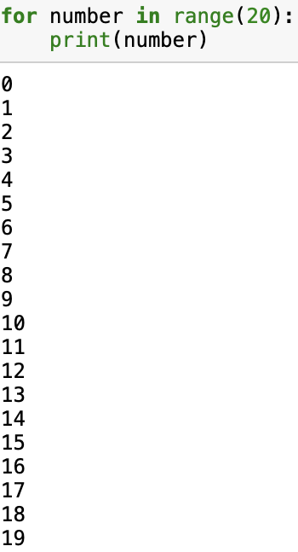
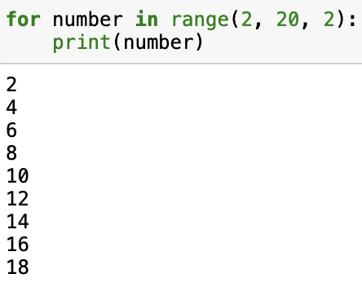
How does range() work?
The range function creates elements (similar to a list) from a starting number to an ending number. The parameters are:
range(start, stop, step)
including
excluding
How to use the function:
range(5) → start at 1, stop before 5, make steps of 1
range(1, 5) → start at 1, stop before 5, make steps of 1
range(1, 5, 2) → start at 1, stop before 5, make steps of 2
range(0, x, 1) → default parameters, if not specified otherwise

Slide 26
“Summary” of Coding Python in 7 Slides
Let’s take a look at the things still open from last week….
Do you know all of these things now?

Slide 27
Modulo and if-statements (1)
if num % 2 == 0:
even_number = True
else:
even_number = False

Slide 28
Modulo and if-statements (2)
num = 4
if num % 2 == 0:
even_number = True
else:
even_number = False
print(even_number)

Slide 29
Modulo and if-statements (3)
num = 5
if num % 2 == 0:
even_number = True
else:
even_number = False
print(even_number)

Slide 30
Functions → next week in detail
A function is a block of code that only runs when it is called by its function name
You can pass data, known as parameters, into a function.
A function can return data as a result.
def my_function(number):
x = 5
y = 3
z = x + y + number
return z
print(my_function(2)) # this is the function call

Slide 31
Now you have everything you need to start with assignment 2

Slide 32
Dominik Buchegger
dominik.buchegger@student.unisg.ch

