Slide 1
What is Julia?
And why is it different?

Slide 2
Outline
What is Julia / how does it work
Live demo
Ecosystem and tools

Slide 3



What is Julia
Compiled
Just-in-time
Interpreted
Two language problem
Dynamic, interactive
High performance
Easy parallelism
Built in package manager
Highly composable
Language interop
Two language problem

Slide 4
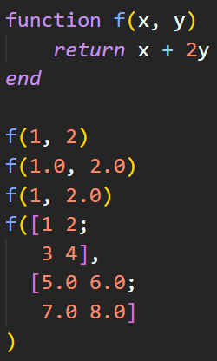
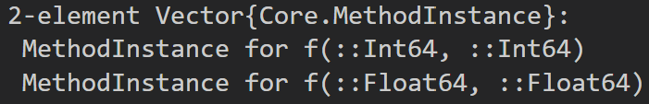
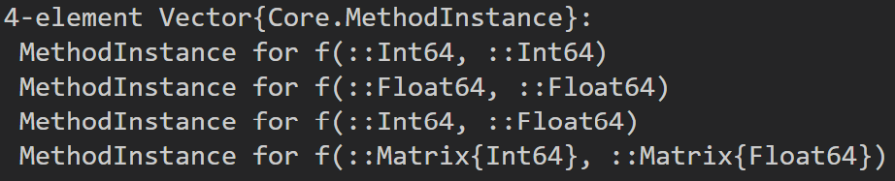

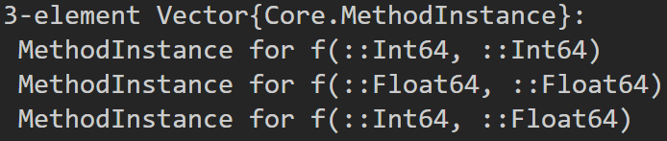
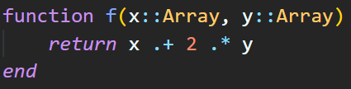
How?
Functions specialize on the type of all inputs (multiple dispatch)
Behaviour and data structure is separated: no classes!
Other: functional, powerful metaprogramming

Slide 5
Demo

Slide 6
Ecosystem

Slide 7
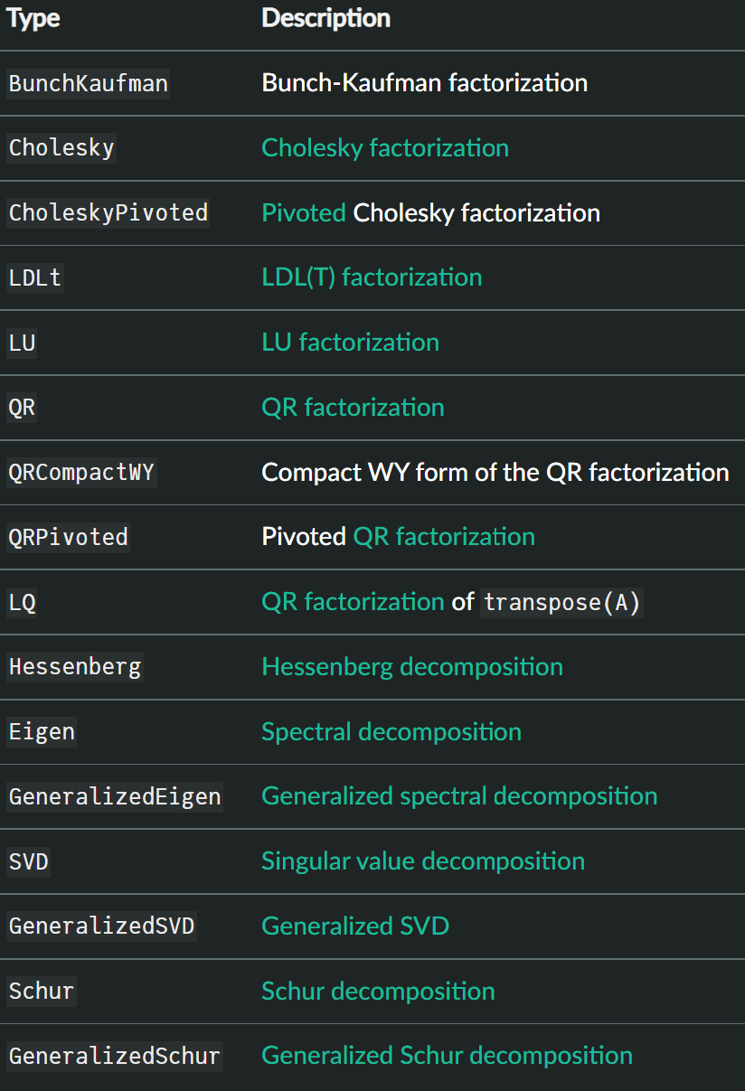
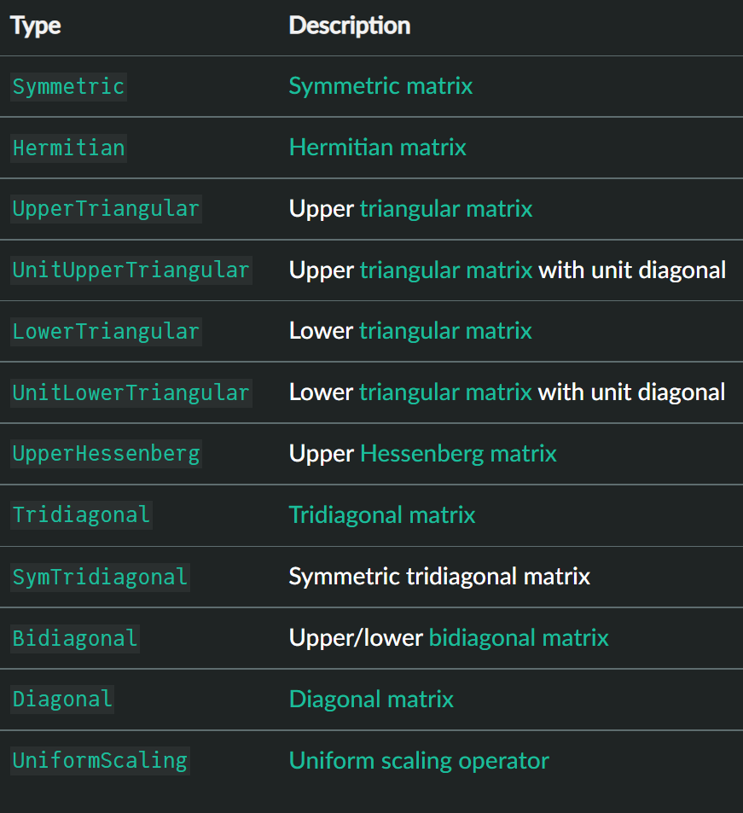
Linear algebra
Dense + sparse, built in
Many matrix types
Many matrix factorizations

Slide 8
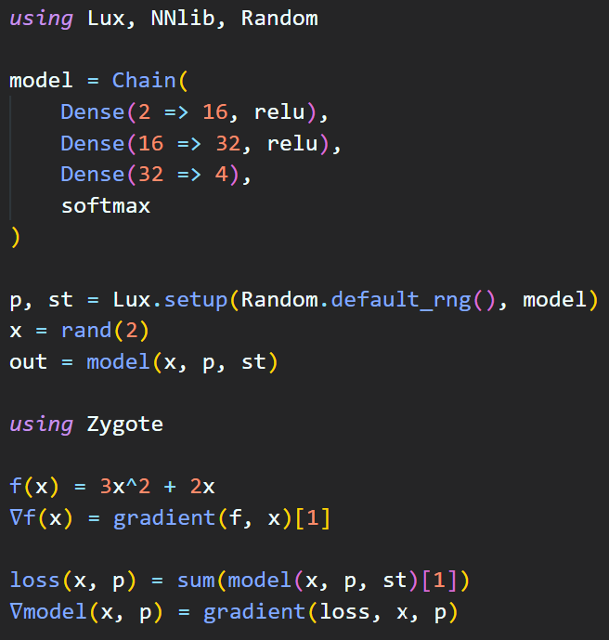
Machine learning and Automatic Differentiation
Multiple neural network frameworks
Flux, Lux, Knet…
Many supporting packages:
optimization, model manipulation
parameter scheduling, distributed training
data handling…
Multiple AD approaches: ForwardDiff, ReverseDiff, Zygote, Yota, Diffractor, Enzyme…
https://juliadiff.org/

Slide 9
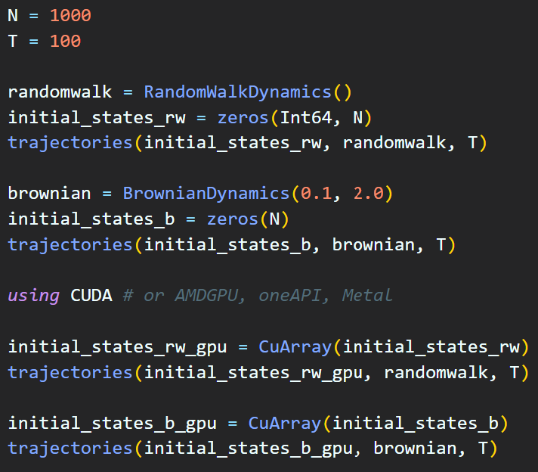
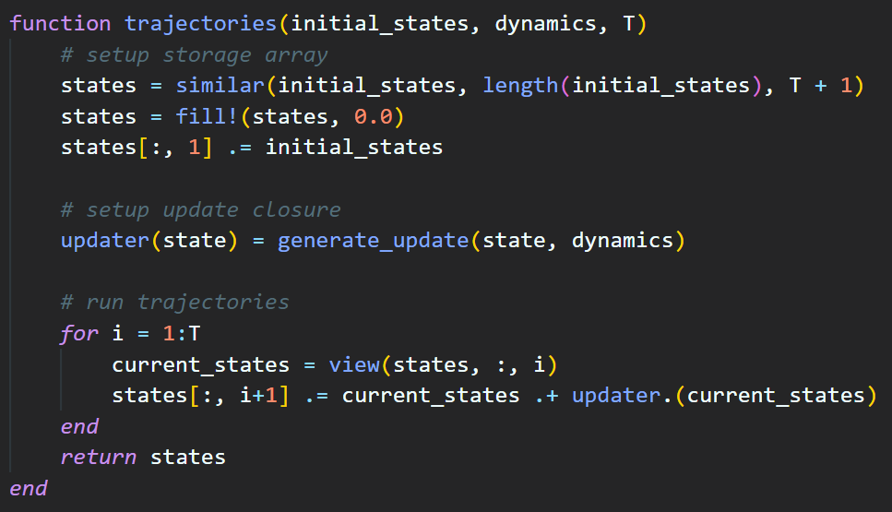
GPU
Supports all GPUs, best on Nvidia
Multiple dispatch: simply move data to GPU, run same code
https://juliagpu.org/

Slide 10
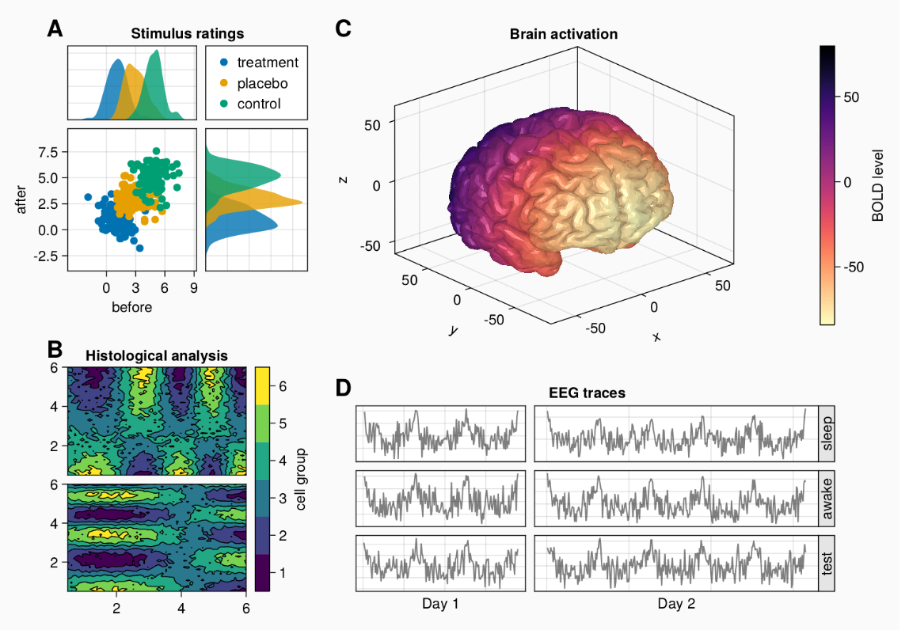
Plotting and GUIs
Plots.jl
Generic interface with multiple backends, e.g. matplotlib
Makie
Powerful plotting / layout interface
Utilizes GPUs, full 3D rendering
Slow start up, fast when compiled
Web/GUI: Genie, Franklin, …
https://docs.makie.org/v0.18.0/
https://genieframework.com/index.html

Slide 11
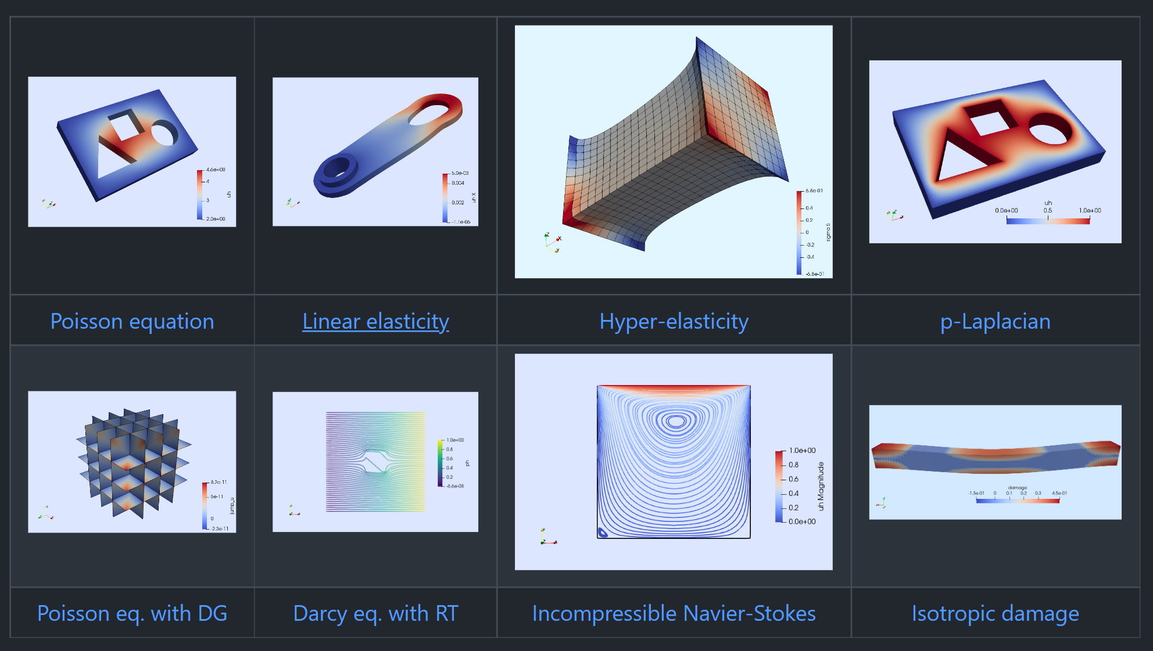
Differential equations and Finite element methods
State of the art DE support
Fast, flexible, supports GPU / parallelization, fully differentiable
Finite elements:
Ferrite, Gridap
Trixi, FEniCS…
Other PDE solvers:
NeuralPDE, NeuralOperators,
MethodOfLines…
https://docs.sciml.ai/Overview/stable/

Slide 12
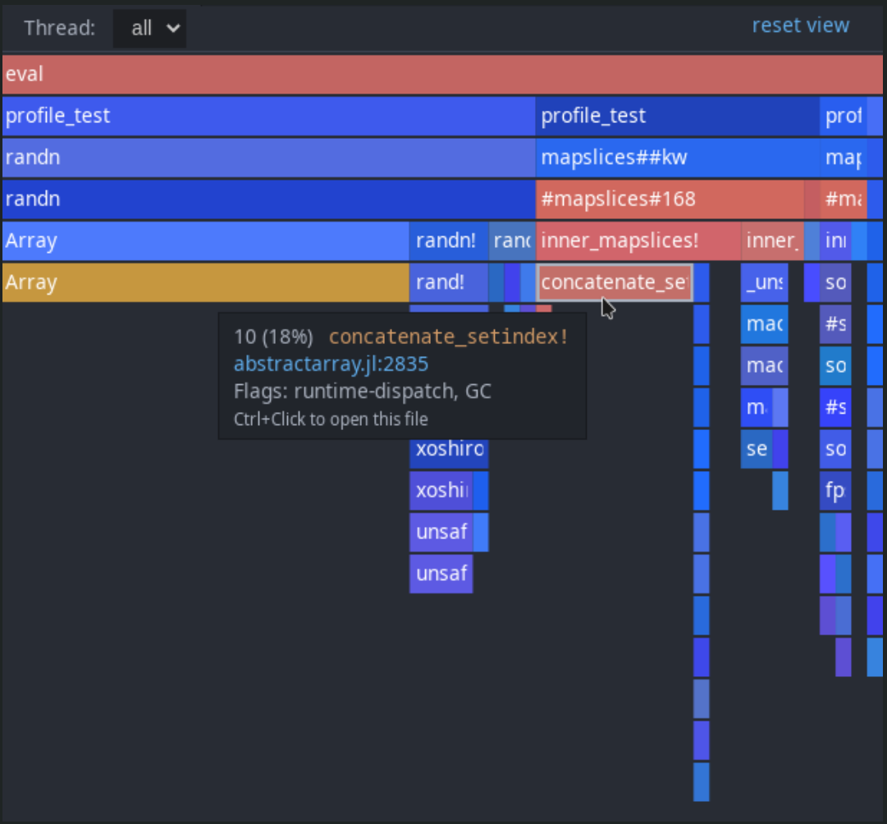
Dev / optimization tools
Built in testing, documentation, profiling (time / memory)
VS code extension
Highlighting / linting
Formatting
Code suggestions / completion
Debugging
Testing / profiling GUIs
Shortcuts to run code interactively
Powerful code introspection: @code macros, JET, Cthulhu
https://www.julia-vscode.org/docs/dev/

Slide 13
Alternative compilation
Limited support for producing (compact) executables
PackageCompiler.jl
Wraps up a “package” into a single executable
Doesn’t require Julia installation
Executables are very large, contains Julia runtime, ~300Mb
StaticCompiler.jl
Compiles Julia code down to small executables
Very experimental
Limited language support

