Slide 1
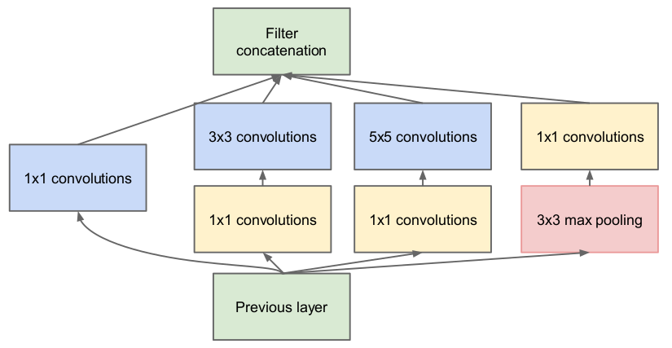
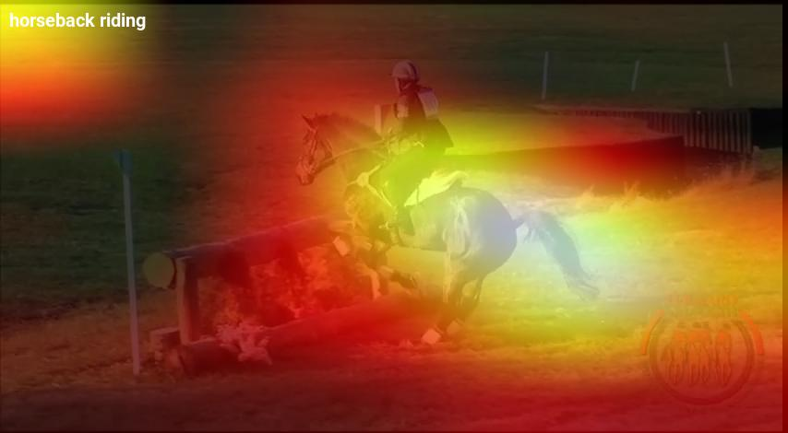

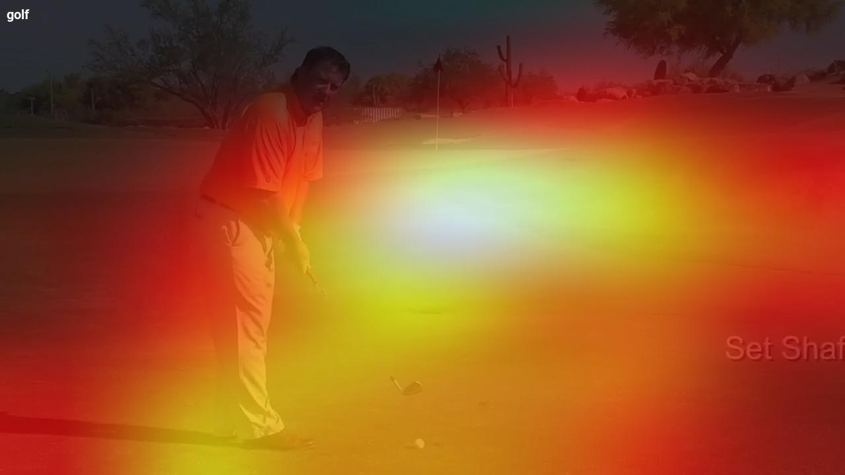
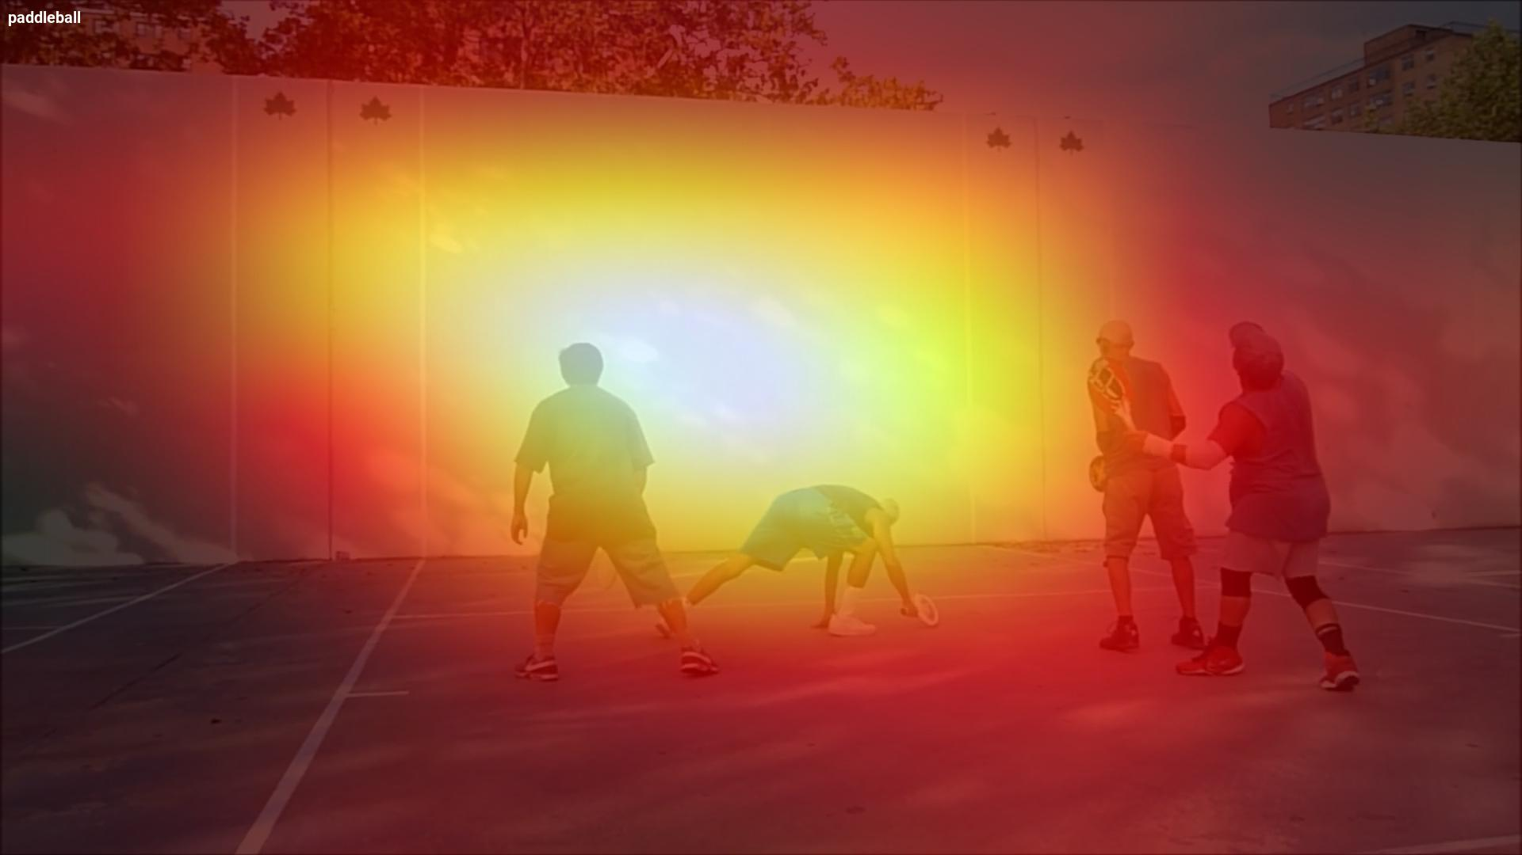
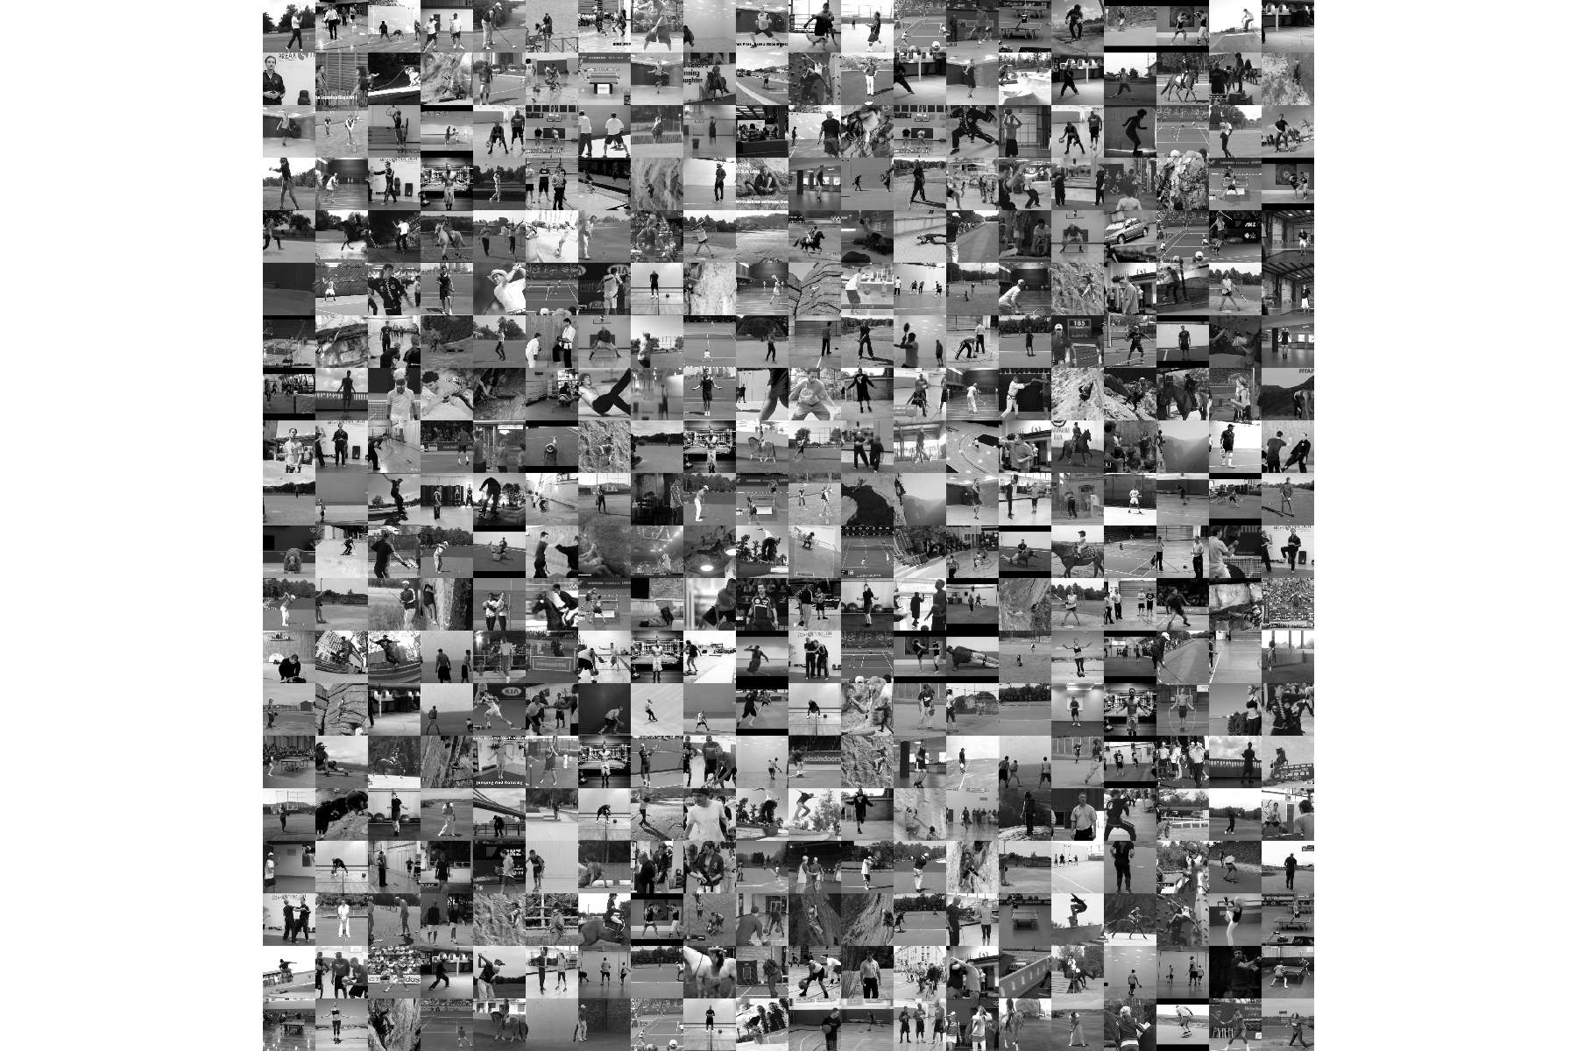
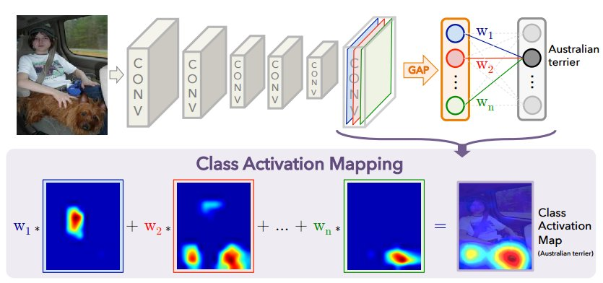
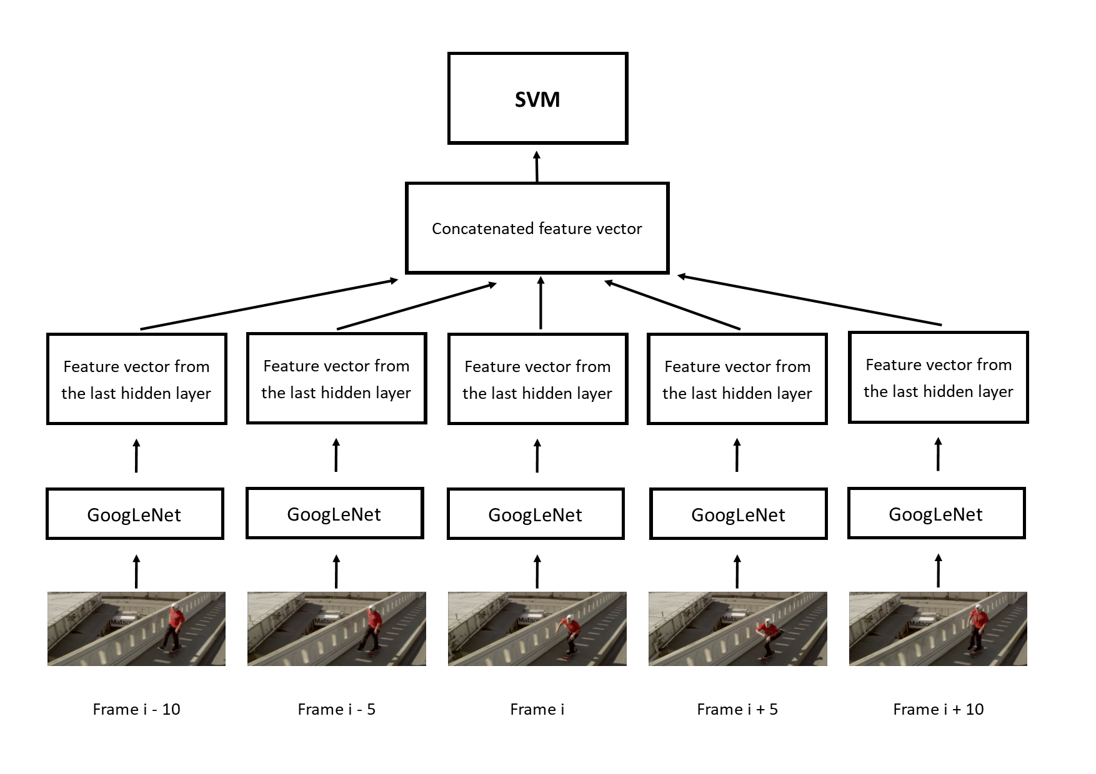
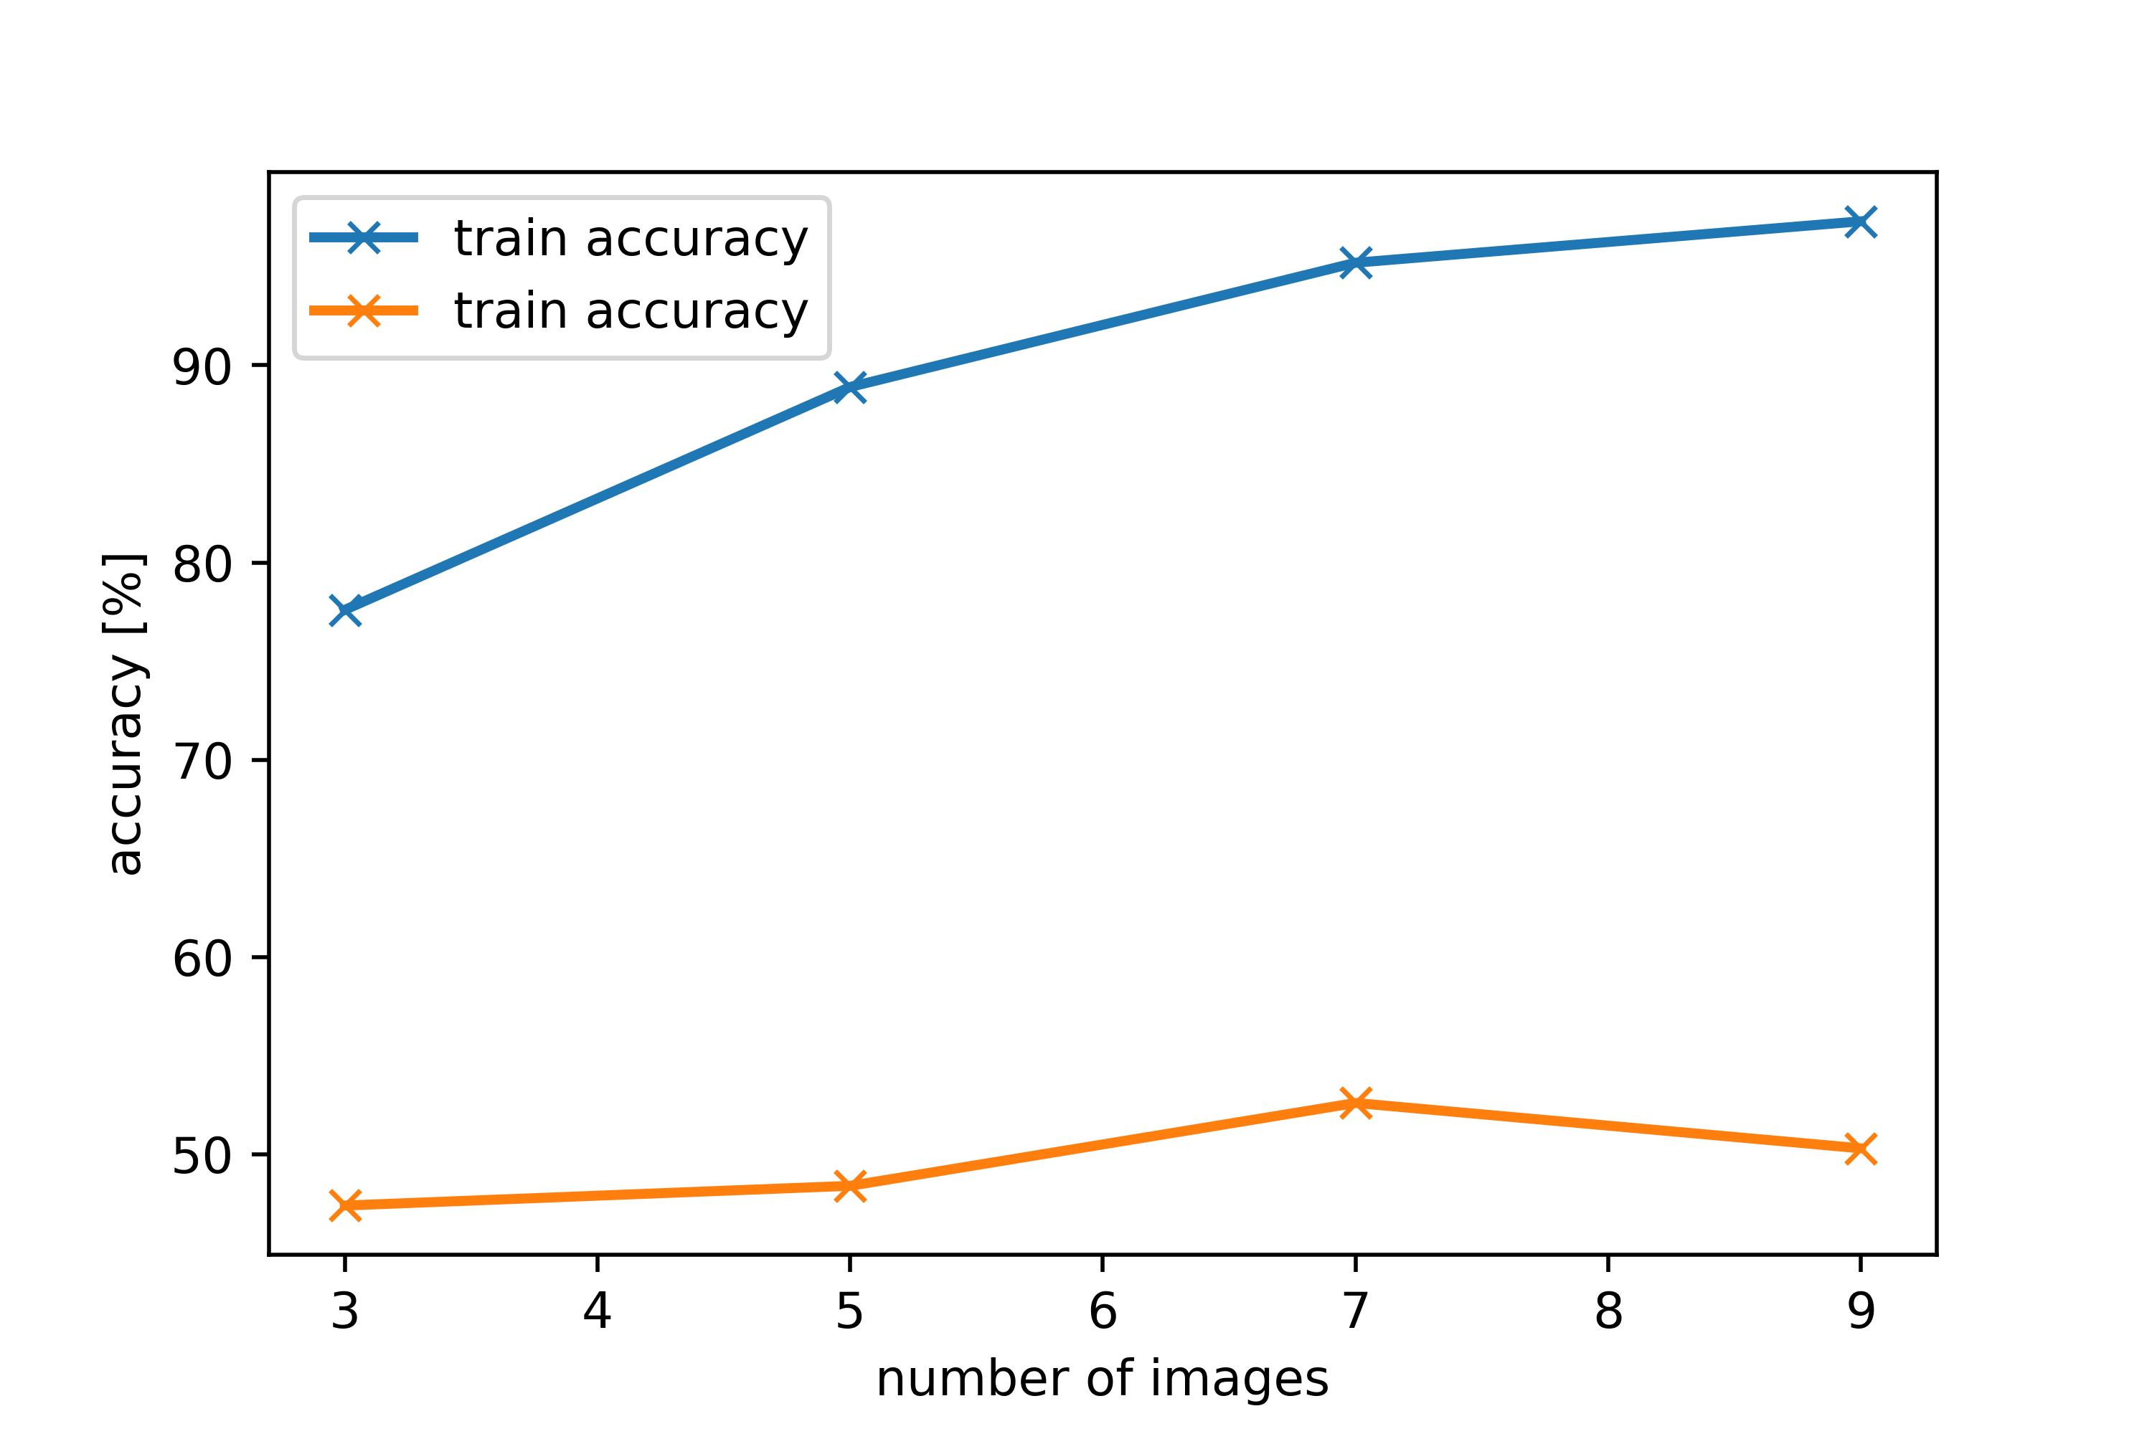
INSERT YOUR POSTER TITLE ON THIS LINE HERE
Dominique Cheray & Manuel Krämer
Motivation
Materials and Methods
Results
Due to the increasing amount of image and video data automatic classification is an important task in searching and summarization
Most classification tasks don’t include sports, therefore it will be interesting to see the performance of a common CNN on this challenge
Additionally investigate which image regions are important for the CNN’s prediction
Sport actions contain a lot of movement and for that reason the temporal information could be important in classification
One approach is to use adjacent frames of a video sequence as one single instance
GoogLeNet
27 layers deep network
9 Inception modules → reduce the number of
parameters, create a deeper and wider topology
Softmax Loss as the classifier
Trained for 200 Epochs using Stochastic Gradient
Descent with 0.9 Momentum, 0.001 Learning Rate and a fixed Learning Rate schedule (decrease Learning
Rate by 4% every 8 epochs)
Split training images into training and validation set
Performed data augmentation on the training images
Final testing was done on the test images
Class Activation Mapping
Indicates the discriminative image regions used by the CNN to identify that class
Perform Global average pooling on the convolutional feature maps
Use those features for a fully connected layer that produces the desired output
By projecting back the weights of the output layer onto the convolutional feature maps the importance of the image regions can be identified
Classification with GoogLeNet
TODO: Graph for Train and Validation accuracy
Class Activation Mapping
Four examples of the Class Activation Mapping results
Inception module
Data Set
Subset of MPII Human Pose Dataset → 10 sports: Basketball, Horseback riding, Martial Arts, Paddelball, Rock climbing, Rope skipping, Skateboarding, Softball, Tennis, Golf
1576 images total, 1266 training images, 310 test images
Class Activation Mapping
Temporal Analysis with SVM
 | Training Accuracy | Testing accuracy
3 frames with spacing 5 | 77.6% | 47.4%
5 frames with spacing 5 | 88.9% | 48.4%
7 frames with spacing 5 | 95.2% | 52.6%
9 frames with spacing 4 | 97.3% | 50.3%
References
Temporal Analysis with SVM
We use 3, 5, 7 or 9 frames with a distance of 5 frames (For 9 frames, 4 frames distance is used)
Every frame gets processed through the GoogLeNet until the last hidden layer
The output is a feature vector
All of them get concatenated and the final array is one instance for the SVM
Andriluka, M., Pishchulin, L., Gehler, P. and Schiele, B., 2014. 2d human pose estimation: New benchmark and state of the art analysis. In Proceedings of the IEEE Conference on computer Vision and Pattern Recognition (pp. 3686-3693).
Szegedy, C., Liu, W., Jia, Y., Sermanet, P., Reed, S., Anguelov, D., Erhan, D., Vanhoucke, V. and Rabinovich, A., 2015. Going deeper with convolutions. In Proceedings of the IEEE conference on computer vision and pattern recognition (pp. 1-9).
Zhou, B., Khosla, A., Lapedriza, A., Oliva, A. and Torralba, A., 2016. Learning deep features for discriminative localization. In Proceedings of the IEEE Conference on Computer Vision and Pattern Recognition (pp. 2921-2929).
The accuracy is increasing with more temporal information
Notes:
1

