Slide 1
Chinese translation Web app
Dominic Faustino
COSC412

Slide 2
What is the product?
Translation application website that allows users to input menu items to translate their menu to Mandarin Chinese
Enter a word in English, receive a translation in Mandarin Chinese

Slide 3
Why use this site?
Reach a wider audience on Grubhub and Doordash, which are especially prominent now due to Covid quarantine
Increasing number of Mandarin speakers in the US, nearly 3 million individuals use Mandarin Chinese at home, so this app can help your restaurant reach a wider audience¹
¹Bureau, U. (2015, August 17). Nearly 3 Million U.S. Residents Speak Chinese at Home. Retrieved July 24, 2020, from https://www.census.gov/newsroom/press-releases/2013/cb13-r90.html

Slide 4
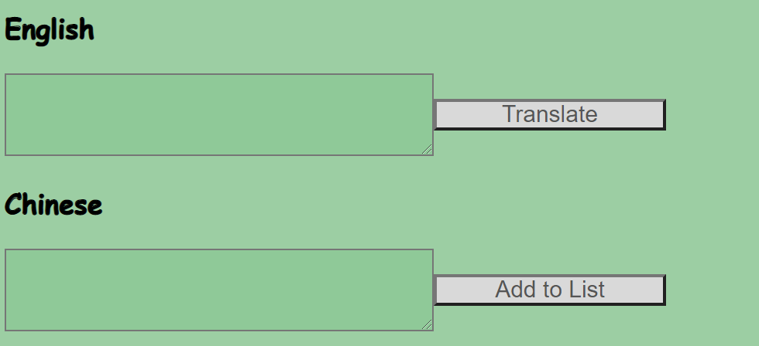
How the site works
Users enter menu item in English
Hit “Translate” button to translate it to Mandarin Chinese
“Add to List” button allows users to add it to their list of saved words

Slide 5
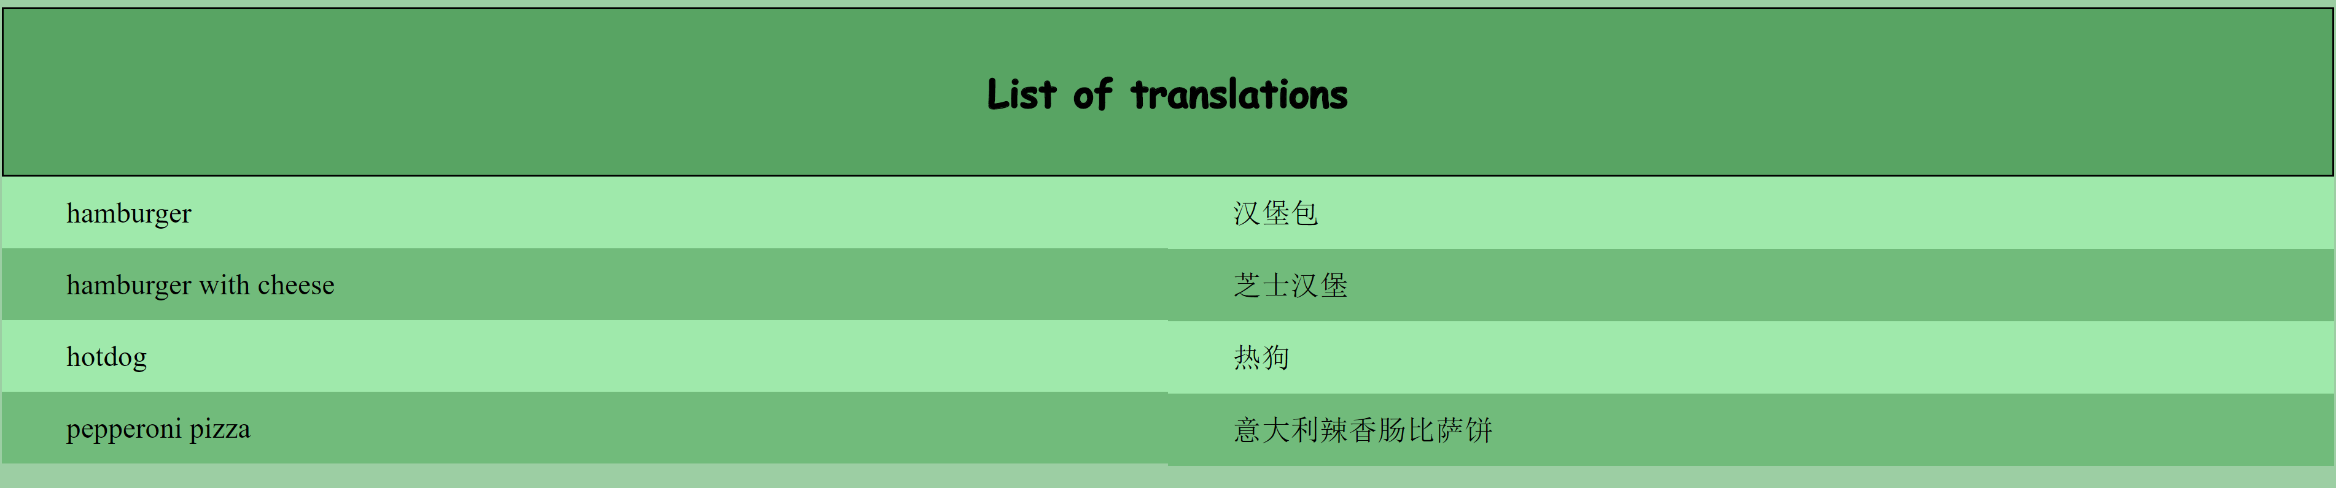
How the site works
Users can then copy the translation from the website and use it on Grubhub or other menu apps
Users can refresh the site to redo their list

Slide 6
Why use this app instead of another translation service?
This website features a very simple, user-friendly layout
Allows user to continuously append to a list of words
Can easily copy words from the website to your menu client

Slide 7
Behind the scenes
HTML
JavaScript
CSS
Google Translate API call
HostGator to host

Slide 8
Incomplete feature
Download function: allow the user to download the list of words as a text file or csv
Function not completed due to difficulties with downloading the list as an HTML collection object
In order to complete this feature
Another button for downloading list
Format data of words to be in format that can be put into text document
Open a download prompt and ask user to save the file

Slide 9
Live Demo
http://dominicfaustino.website/

Slide 10
Thank you for Listening + future
Product can be scaled into a subscription service for users
Incorporate other languages
AI to run menus through the site and automatically output a formatted document with translations

