Slide 1
A successful Git branching model
Presenter : harry le, JONATHAN

Slide 2
GIT GUIDE
Basic git command: Link
Workflow: Link

Slide 3

THE BRANCHING STRATEGY

Slide 4
CONTENTS
The main branches
The supporting branches.

Slide 5
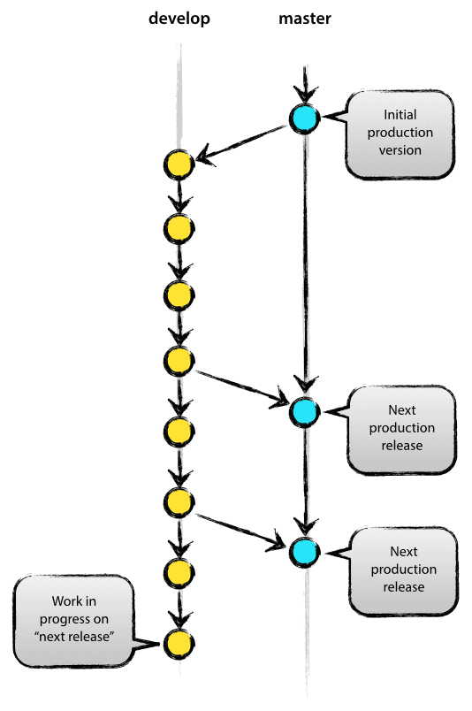
THE MAIN BRANCHES
Master
It reflects a production-ready state.
Develop
It reflects a state with the latest delivered development changes for the next release.
Notes:
When the source code in the develop branch reaches a stable point and is ready to be released, all of the changes should be merged back into master somehow and then tagged with a release number.
Therefore, each time when changes are merged back into master, this is a new production release by definition.

Slide 6
THE SUPPORTING BRANCHES
Feature branches
Release branches
Hotfix branches

Slide 7
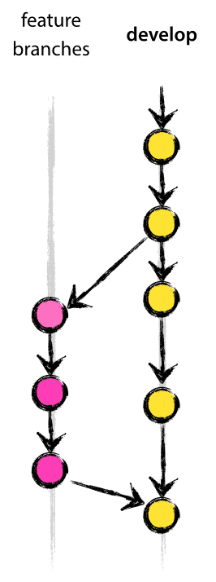
THE FEATURE BRANCHES
May branch off from : develop
Must merge back into : develop
Branch naming convention: anything except master, develop, release-*, or hotfix-*
Notes:
- But will eventually be merged back into develop (to definitely add the new feature to the upcoming release) or discarded (in case of a disappointing experiment).

Slide 8

THE FEATURE BRANCHES

Slide 9
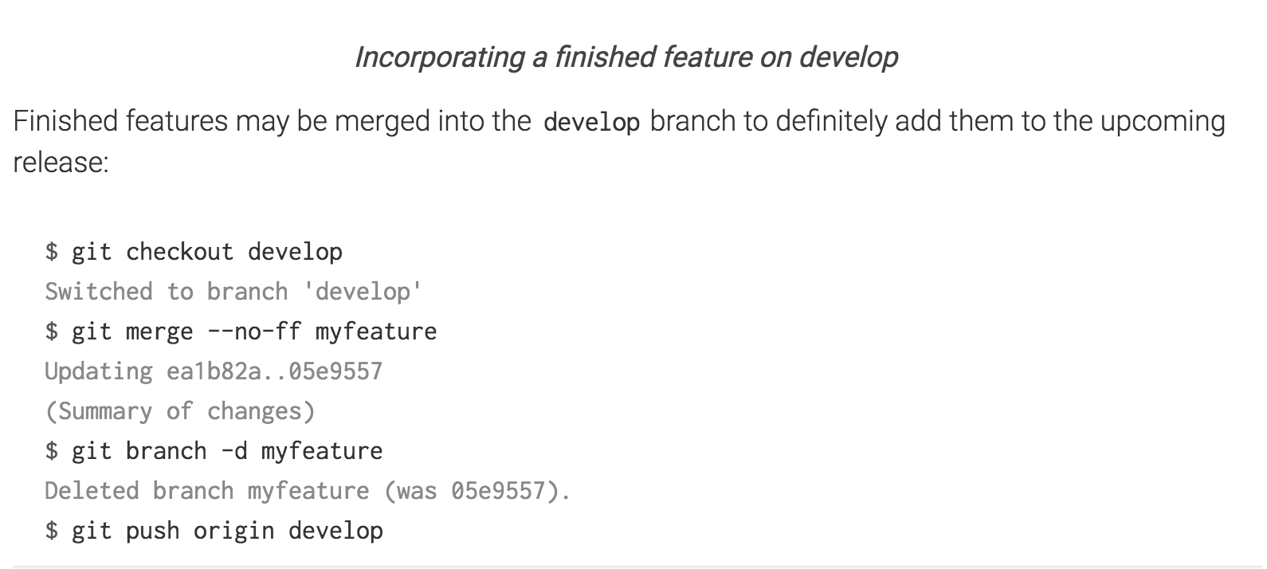
THE FEATURE BRANCHES
Notes:
The --no-ff flag causes the merge to always create a new commit object, even if the merge could be performed with a fast-forward. This avoids losing information about the historical existence of a feature branch and groups together all commits that together added the feature.

Slide 10
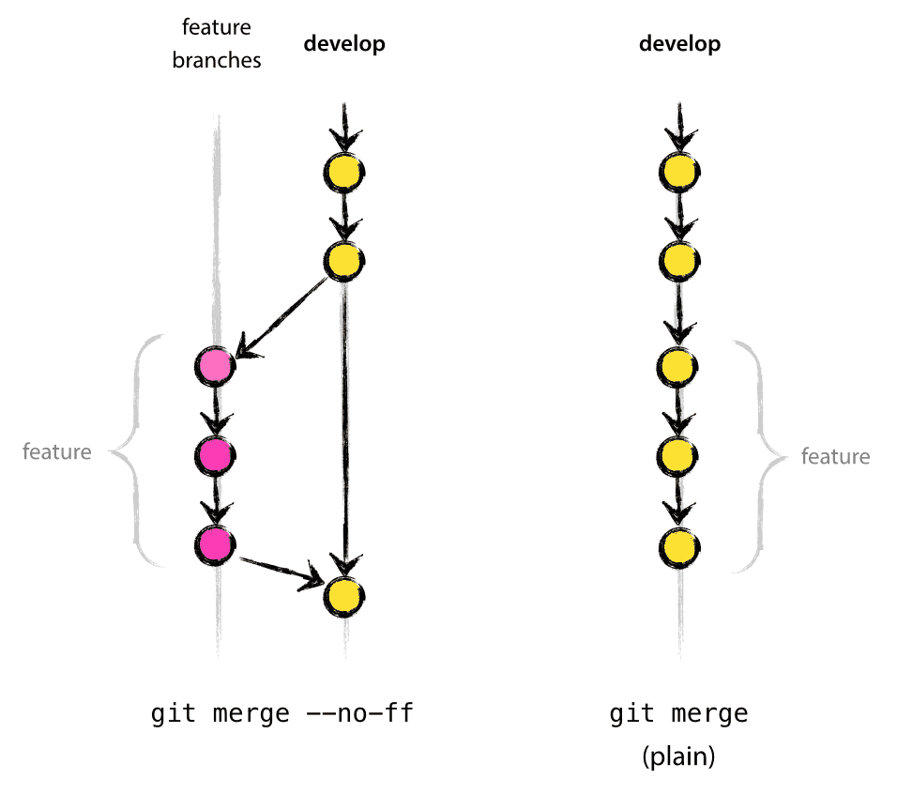
THE FEATURE BRANCHES
Notes:
- The --no-ff flag causes the merge to always create a new commit object, even if the merge could be performed with a fast-forward. This avoids losing information about the historical existence of a feature branch and groups together all commits that together added the feature.
- It will create a few more (empty) commit objects, but the gain is much bigger than the cost.

Slide 11
THE RELEASE BRANCHES
May branch off from : develop
Must merge back into : develop and master
Branch naming convention: release-*
It reflects the desired state of the new release.
Notes:
- Release branches support preparation of a new production release. They allow for last-minute dotting of i’s and crossing t’s. Furthermore, they allow for minor bug fixes and preparing meta-data for a release (version number, build dates, etc.). By doing all of this work on a release branch, the develop branch is cleared to receive features for the next big release.

Slide 12
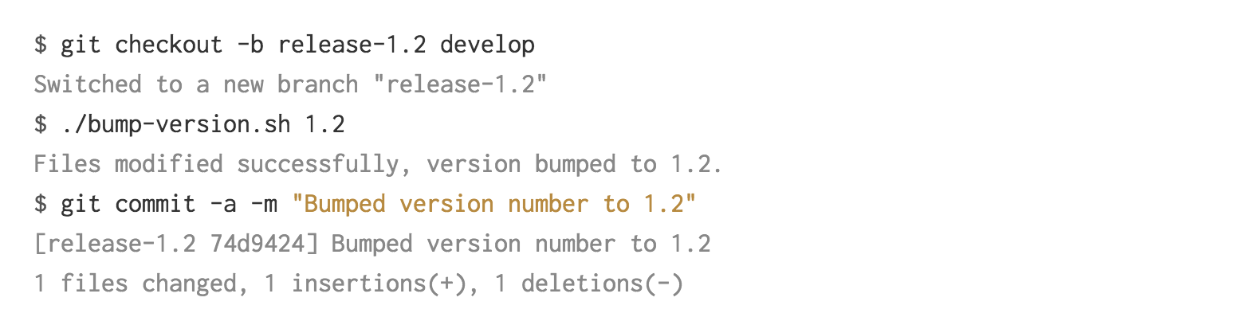
THE RELEASE BRANCHES
Notes:
Release branches support preparation of a new production release. They allow for last-minute dotting of i’s and crossing t’s. Furthermore, they allow for minor bug fixes and preparing meta-data for a release (version number, build dates, etc.). By doing all of this work on a release branch, the develop branch is cleared to receive features for the next big release.
This new branch may exist there for a while, until the release may be rolled out definitely. During that time, bug fixes may be applied in this branch (rather than on the develop branch). Adding large new features here is strictly prohibited. They must be merged into develop, and therefore, wait for the next big release.

Slide 13
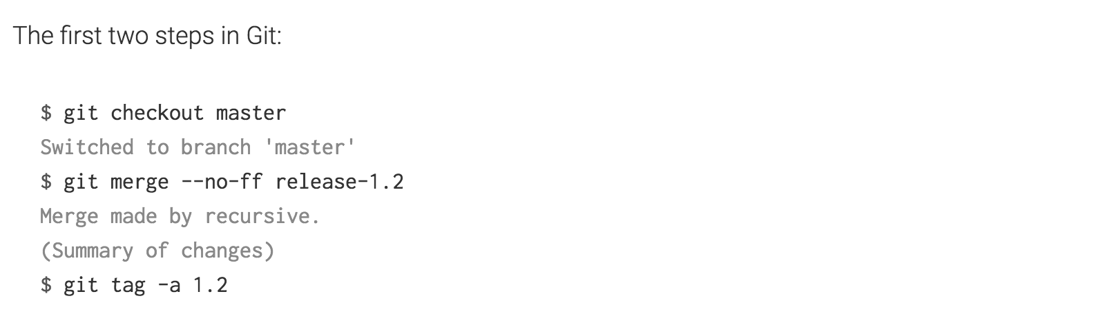
THE RELEASE BRANCHES
Notes:
Release branches support preparation of a new production release. They allow for last-minute dotting of i’s and crossing t’s. Furthermore, they allow for minor bug fixes and preparing meta-data for a release (version number, build dates, etc.). By doing all of this work on a release branch, the develop branch is cleared to receive features for the next big release.
This new branch may exist there for a while, until the release may be rolled out definitely. During that time, bug fixes may be applied in this branch (rather than on the develop branch). Adding large new features here is strictly prohibited. They must be merged into develop, and therefore, wait for the next big release.

Slide 14
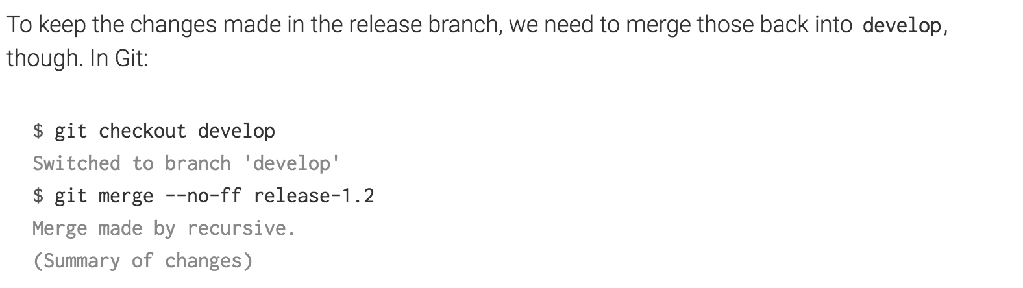

THE RELEASE BRANCHES
Notes:
Release branches support preparation of a new production release. They allow for last-minute dotting of i’s and crossing t’s. Furthermore, they allow for minor bug fixes and preparing meta-data for a release (version number, build dates, etc.). By doing all of this work on a release branch, the develop branch is cleared to receive features for the next big release.
This new branch may exist there for a while, until the release may be rolled out definitely. During that time, bug fixes may be applied in this branch (rather than on the develop branch). Adding large new features here is strictly prohibited. They must be merged into develop, and therefore, wait for the next big release.

Slide 15
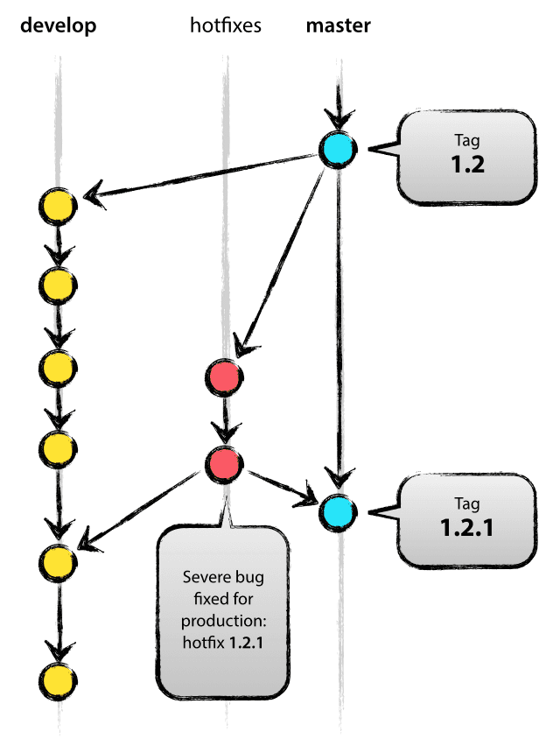
THE HOTFIX BRANCHES
May branch off from : master
May merge back into : master and develop
Branch naming convention: hotfix-*
When a critical bug in a production version must be resolved immediately.
When a release branch currently exists, the hotfix changes need to be merged into that release branch, instead of develop.
Notes:
when a release branch currently exists, the hotfix changes need to be merged into that release branch, instead of develop. Back-merging the bugfix into the release branch will eventually result in the bugfix being merged into develop too, when the release branch is finished.

Slide 16
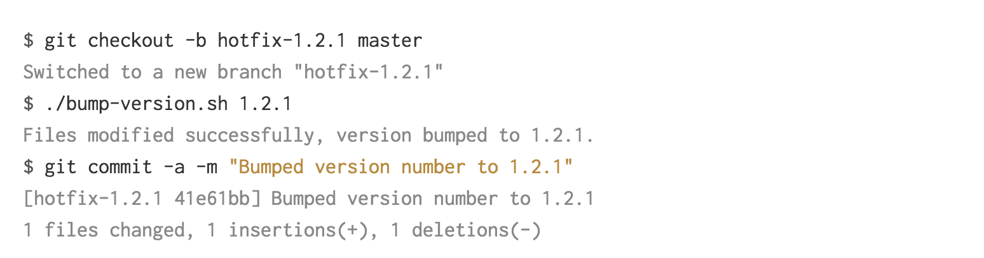
THE HOTFIX BRANCHES
Notes:
- When a critical bug in a production version must be resolved immediately, a hotfix branch may be branched off from the corresponding tag on the master branch that marks the production version.

Slide 17
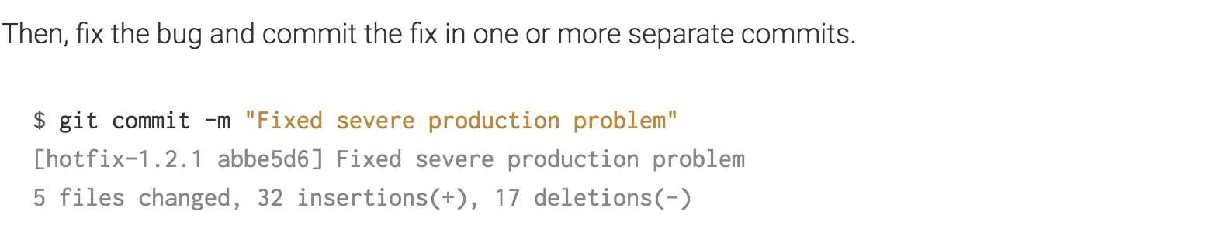
THE HOTFIX BRANCHES

Slide 18
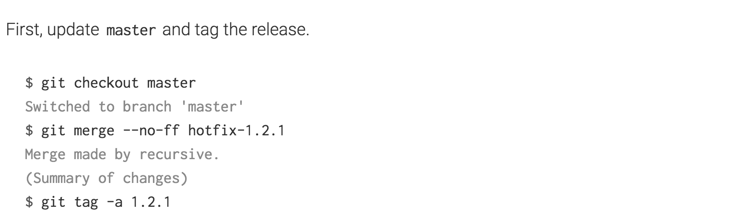
THE HOTFIX BRANCHES

Slide 19
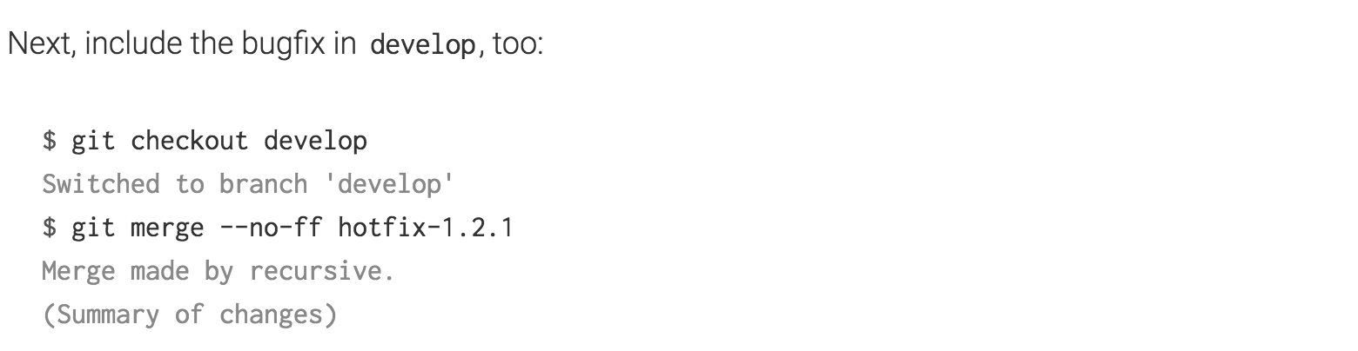

THE HOTFIX BRANCHES
Notes:
- When a critical bug in a production version must be resolved immediately, a hotfix branch may be branched off from the corresponding tag on the master branch that marks the production version.

Slide 20
SUMMARY
It forms an elegant mental model that is easy to comprehend and allows team members to develop a shared understanding of the branching and releasing processes.

Slide 21
Thanks for listening

