Slide 1
We need a Magintervention

Slide 2
74 Product Categories
A customer rating of four stars for their tech products
Present along the Brazilian east coast, into the central country
Source: Magist Database

Slide 3
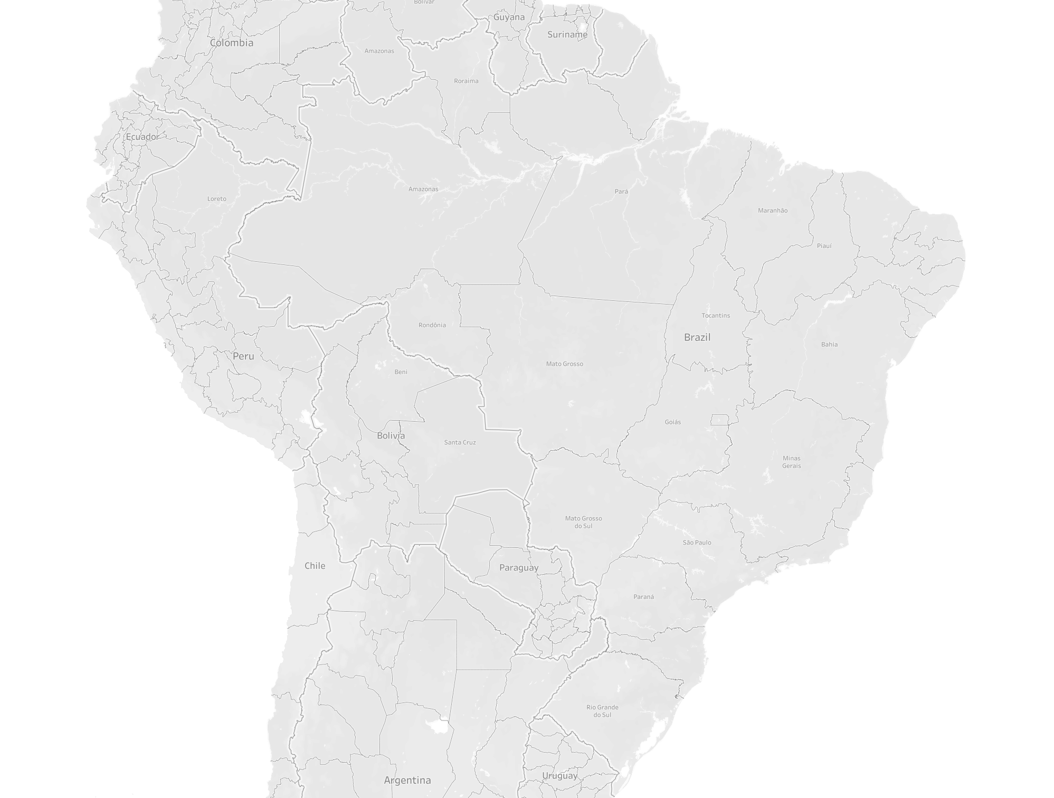
Big Players of E-Commerce:
The largest Retailer Magazine Luiza
The largest E-Commerce seller Mercado Livre
The Apple Reseller iPlace
The High End Reseller Fast Shop
7 - 15 days
3 - 10 days
iPlace does it in 2!
Source: Magist Database, Statista.com, Brazilian Post “Correios”
Notes:
What do brazilian customers look after in online shopping?
Top delivery criteria for online shoppers in Brazil 2023 (Publ. by Lynn Beyrouthy, Feb 5, 2024): 84 percent of online shoppers surveyed in Brazil cited free shipping as the most important delivery-related criteria for their e-commerce purchases.
As of March 2020, an online order in Brazil would take, on average, 21 days to be delivered to the shopper.

Slide 4
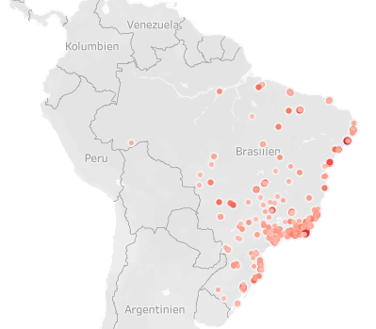
With an average of 12 shipping days, Magist offers standard service,
but has difficulties with its punctuality:
São Paolo region is a waiting hotspot: more than 10% of the shipments arrive delayed
Source: Magist Database
Notes:
The average of delayed packages is at 6.74%

Slide 5
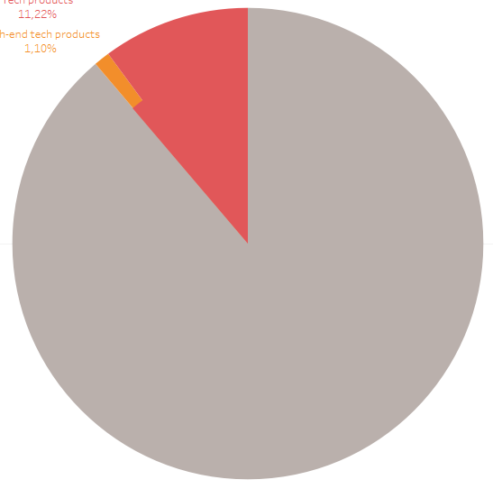
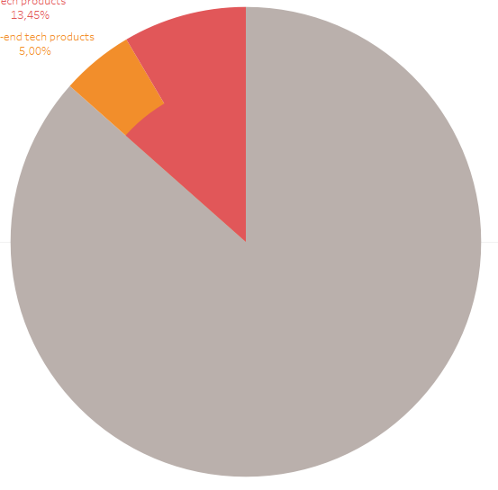
Does Eniac want to establish its products into a non-tech palette?
11,2%
13,5%
1,1%
5%
Magists share of Tech and High-End Tech Products in their Portfolio
Sales Volume of Tech and High-End Tech Products
Source: Magist Database
Notes:
define which categories we included in tech

Slide 6
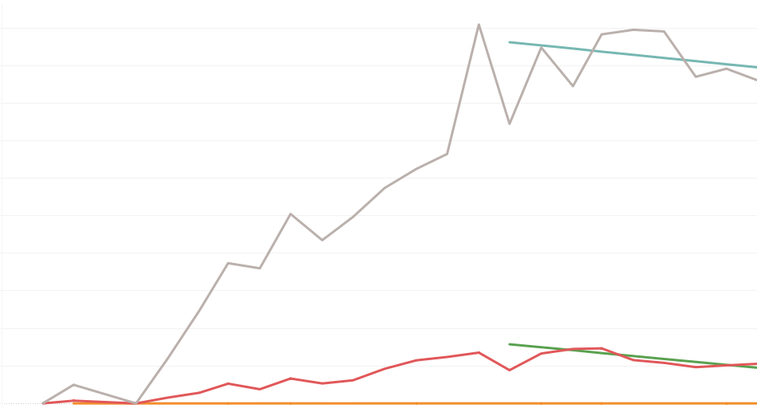
The future of Magist is uncertain
1M€
500K€
0€
Jan 2017
Jul 2017
Jan 2018
Jul 2018
Source: Magist Database

Slide 7
Magist is not the partner we need to get a foot into the market
Keeps the Brazilian shipping standard but lacks punctuality
Competition offers much faster deliveries
Magist does not focus on tech products
Their sales development falters in 2018

Slide 8
7 - 15 days
3 - 10 days
iPlace does it in 2!

Slide 9
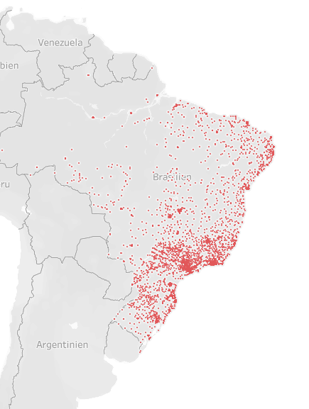
Geodata (cont.)
Tech customers distribution:
Source: Magist Database

Slide 10
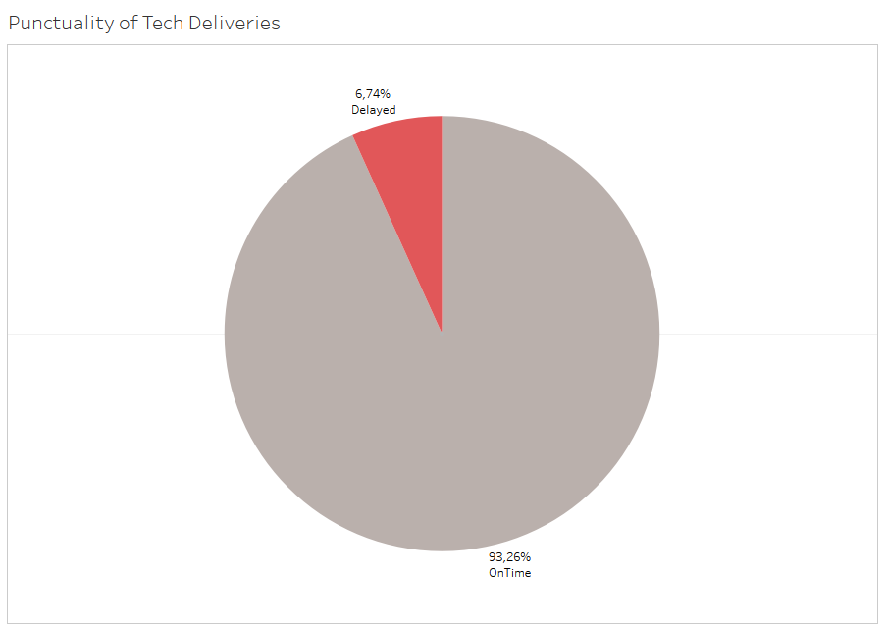
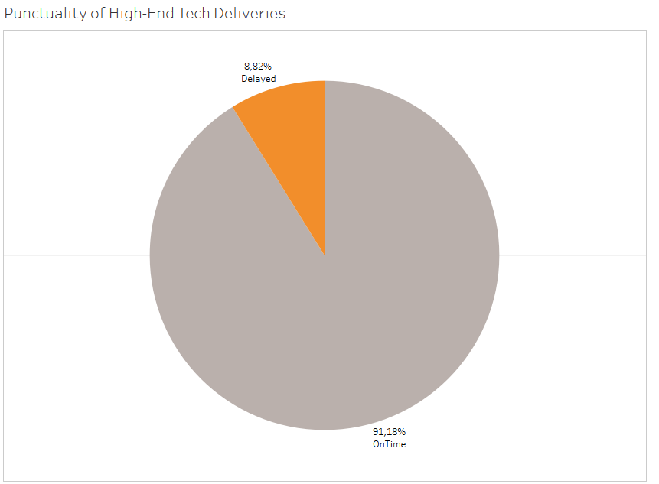
Magist has an average delivery span of 12 days
* Tech Products include the categories Audio, Gaming, Electronics and Telephones
** High-End Tech Products are Tech Products with an item price of 300 € or more
Source: Magist Database

