Slide 1
ViTAl-Hardware
HARDWARE-SOFTWARE CO-DESIGN · SPRINT 1
Vision Transformer Acceleration Hardware: ViT attention on edge FPGAs for autonomous robotics
Dominic Murphy · Boston University ECE · EC601 (Solo Project)

Slide 2
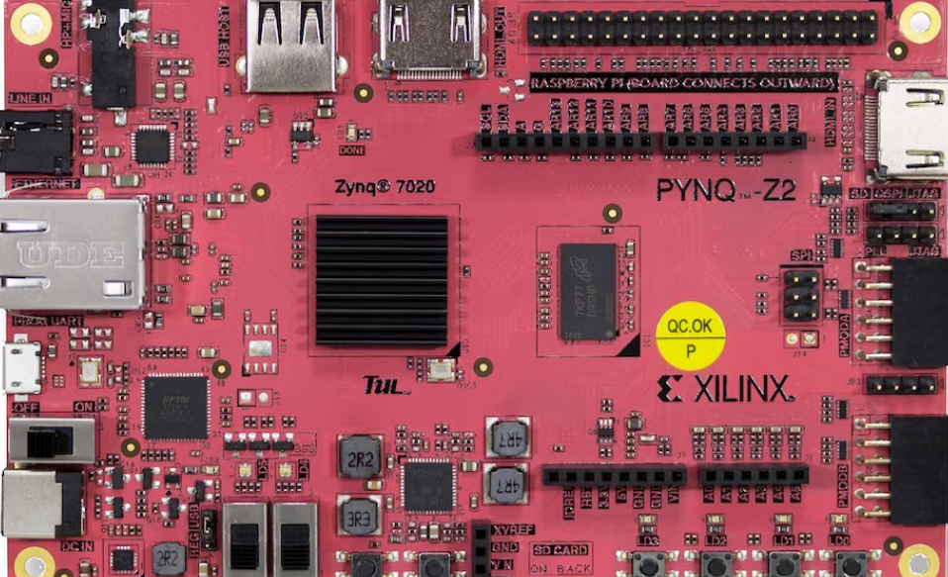
Mission
Build a heterogeneous, sub-byte quantized streaming attention accelerator on an AMD Zynq SoC that processes ViT patch blocks within a deterministic sub-33 ms deadline under a 5 W thermal envelope.
Iteration:
Scoped down from a full multi-layer transformer: resource modeling showed non-linear layers plus GEMMs would exceed logic and BRAM limits on the XC7Z020. The focus is the memory-choked Multi-Head Self-Attention score pipeline.

Slide 3
User Stories & Sprint 1 Scope
#1
Toolchain setup & PYNQ-Z2 board bring-up
5 tasks
In Procurement
#2
Isolate ViT attention block & FP32 baseline
4 tasks
In Progress
#3
Implement & verify W4A8 asymmetric quantization
4 tasks
In Progress
#4
Bit-accurate Base-2 streaming softmax model
4 tasks
In Testing
#5
Binary golden test vectors for RTL verification
5 tasks
To do
#6
Workflow, knowledge management & AI tooling setup
3 tasks
Complete
#7
Project definition, feasibility & baseline docs
4 tasks
Complete
2 of 7 issues complete

Slide 4
Toolchain & Environment
Tool | Primary reason
AMD Vivado ML Standard 2023.2 | Free tier supports XC7Z020; timing closure and ILA debugging
PyTorch | Golden model, float-to-fixed conversion, outlier profiling
TUL PYNQ-Z2 | Zynq-7000 SoC with ARM-to-PL AXI interconnect
Obsidian | Paper synthesis and prompt logging
GitHub | Issue tracking and version control

Slide 5
Sprint 1 Progress
Literature
Setup
What runs today
5 foundational papers, including FlashAttention and FlexViT. Key insight: edge FPGA bottlenecks come from memory I/O contention, not arithmetic capacity.
Reproducible Python environment, pending flash to PYNQ-Z2 hardware, configured Obsidian research vault.
bit-accurate NumPy/Python simulation of the online running-max and running-sum recurrence equations.
NumPy model vs. PyTorch Softmax
SOFTMAX PROBABILITIES
0.00229
MAX ABS ERROR · PASS allowed: 2% relative + 0.0002 absolute
STREAMING ATTENTION OUTPUTS
0.00116
MAX ABS ERROR · PASS allowed: 2.5% relative + 0.002 absolute
STREAMING / STORAGE CHECK
NO N × N SCORE MATRIX
TILE SIZES 13 AND 64 → IDENTICAL OUTPUT
196 keys · 32-d query · 16-d output

Slide 6
Engineering Reflection
Initial assumption
Empirical reality
Symmetric 4-bit quantization (W4A4) would suffice for both weights and activations.
Activation channels have massive magnitude spikes. 4-bit activations clipped low-intensity spatial features to zero, and hazard recall dropped sharply.
Fix: keep 8-bit activations (W4A8) and rely on 4-bit weight packing for the 50% bus reduction.
Created base2_softmax.py, implementing a Q15 exponential with a 64-entry fractional LUT, fixed-point score quantization, and the online max/sum recurrence. Its attention path processes key/value blocks and avoids materializing an N×N score matrix.
Validation passed: python3 base2_softmax.py --self-test verified the LUT, recurrence, normalization, and PyTorch Softmax comparisons; python3 -m py_compile base2_softmax.py and git diff --check also passed. PyTorch parity is numerical within the test tolerances—not bit-identical to floating-point Softmax, because the LUT and fixed-point arithmetic are approximations.

Slide 7
Sprint 2 Goals & Blockers
Demo goal
Where we are stuck
Write, simulate and verify synthesizable SystemVerilog RTL for the sub-byte unpacker and DSP48-mapped MAC array in Vivado xsim.
Have not yet procured the hardware to test out the FPGA SystemVerilog. Need more time capacity in Sprint 2 in order to meet Vivado simulation goals.
Plan Moving Forward
Redirect additional 7 hours weekly
Work with Osama to procure hardware
Prepare tests and firmware tooling for out of the box testing once procured
Big assumption here is that this softmax trick WILL be faster when implemented on RTL in the co-design architecture. This will need to be tested. From this simulation we know the algorithm will be accurate, but is it more time and power efficient vs the memory extensive attention score Softmax.

