Slide 1
Structure of Character’s move and Jump
PlayerInputManager
PlayerManager
Func
FixedUpdate
Func
TranslateBehaviour
Deal Character move
and jump
Character move
Func
Func
LateUpdate
JumpBehaviour
Collect input events to
Affect Character’s
behaviour
Character Jump
Param
PlayerManager
Jump up and down :
1 : get Jump command from LateUpdate of PlayerInputManager.
2 : if character is grounded and cur state is grounded.
3 : open kinematic, set behaviour to jump.
4 : calculate acceleration, duration, Initial Speed and Jump Height.
5 : when cur speed is zero, reset kinematic to false, and let character free falling.
PlayerMgr
Move :
1 : OnCollisionEnter is called before FixedUpdate
2 : when character hit brick or wall, system will call OnCollisionEnter
3 : Set m_bIsBlocked = true.
4 : when system calling FixedUpdate -> check m_bIsBlocked value, and
if(m_bIsBlocked) Play move animation, And ignore translate
command
.
DomTech
Learn ~ Create ~ Share

Slide 2
Behaviour Description
Character Behaviour
Character Normal Behaviour
eBehav_Normal
Grounded
eBehav_Hide
Small Jump
eBehav_JumpDown
Big Jump
DomTech
Learn ~ Create ~ Share

Slide 3
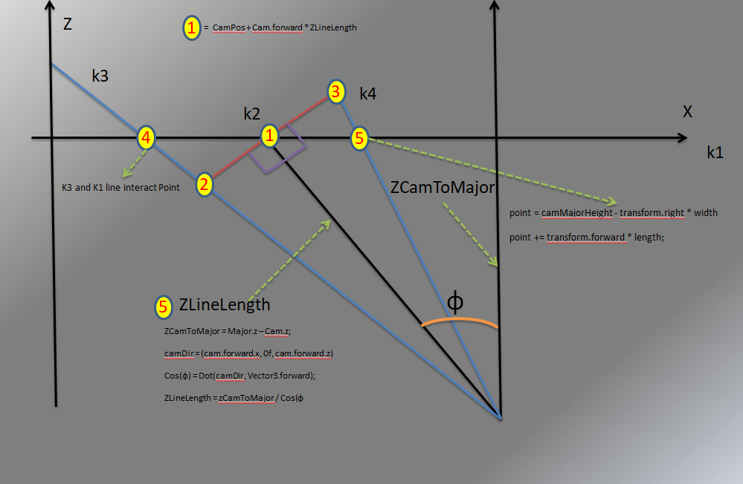
Rotate Around Y

Slide 4
Rotate Round X
Y
C
3
zeroPointY
Z
Ѳ
30f
1
0
2
DomTech
Learn ~ Create ~ Share

