Slide 1
Code Smells
Identifying and Addressing bad Code

Slide 2
Bloaters
Long Methods
Large Class
Long Parameter List

Slide 3
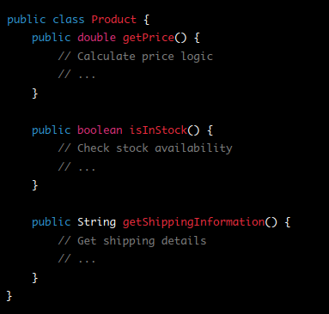
Bloaters
Long Methods
Large Class
Long Parameter List

Slide 4
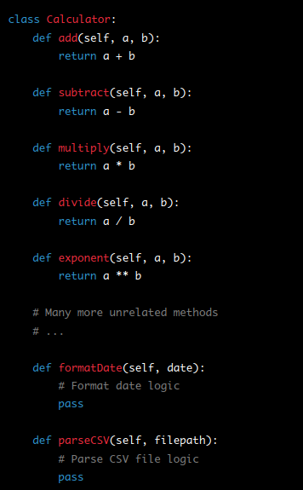
Bloaters
Long Methods
Large Class
Long Parameter List

Slide 5


Bloaters
Long Methods
Large Class
Long Parameter List

Slide 6
Object-Orientation Abusers
Alternative Classes with Different Interfaces
Temporary Field
Switch Statements

Slide 7
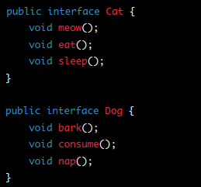
Object-Orientation Abusers
Alternative Classes with Different Interfaces
Temporary Field
Switch Statements

Slide 8
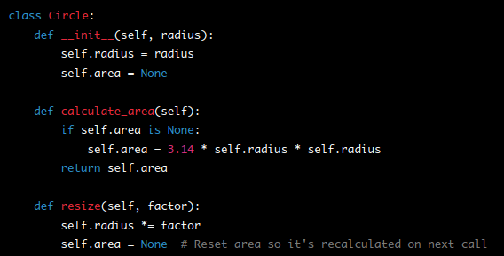
Object-Orientation Abusers
Alternative Classes with Different Interfaces
Temporary Field
Switch Statements

Slide 9
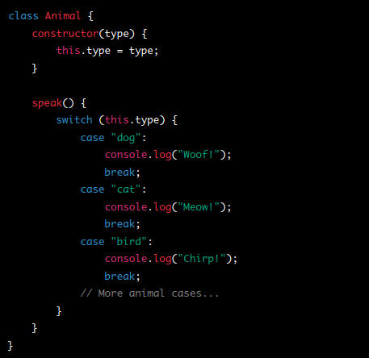
Object-Orientation Abusers
Alternative Classes with Different Interfaces
Temporary Field
Switch Statements

Slide 10
Change Preventers
Divergent Change
Parallel Inheritance Hierarchies
Shotgun Surgery

Slide 11

Change Preventers
Divergent Change
Parallel Inheritance Hierarchies
Shotgun Surgery

Slide 12
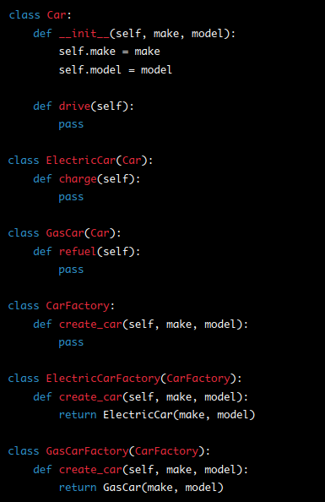
Change Preventers
Divergent Change
Parallel Inheritance Hierarchies
Shotgun Surgery

Slide 13
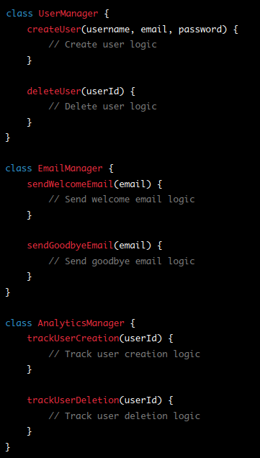
Change Preventers
Divergent Change
Parallel Inheritance Hierarchies
Shotgun Surgery

Slide 14
Dispensables
Comments
Duplicate Code
Speculative Generality

Slide 15
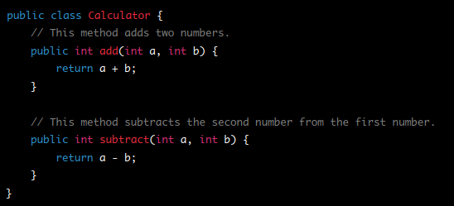
Dispensables
Comments
Duplicate Code
Speculative Generality

Slide 16
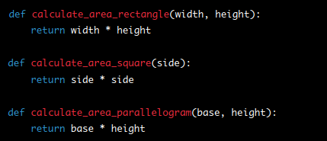
Dispensables
Comments
Duplicate Code
Speculative Generality

Slide 17
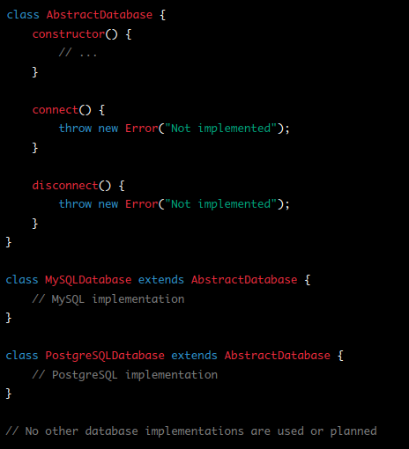
Dispensables
Comments
Duplicate Code
Speculative Generality

Slide 18
Couplers
Feature Envy
Middle Man
Message Chains

Slide 19
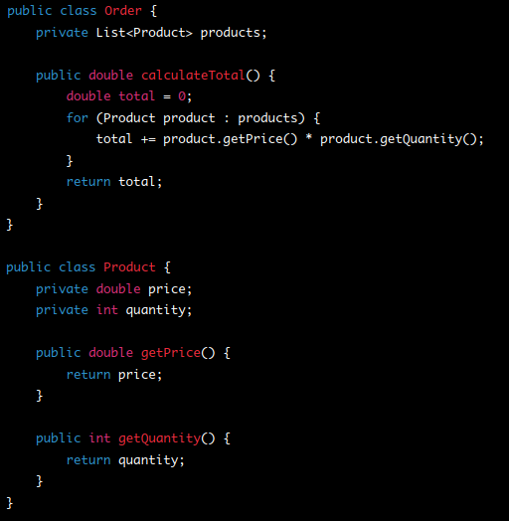
Couplers
Feature Envy
Middle Man
Message Chains

Slide 20
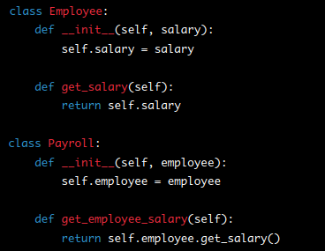
Couplers
Feature Envy
Middle Man
Message Chains

Slide 21
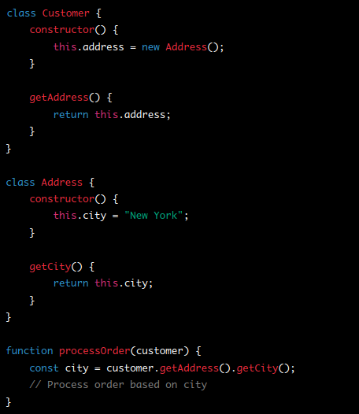
Couplers
Feature Envy
Middle Man
Message Chains

